Slide 1
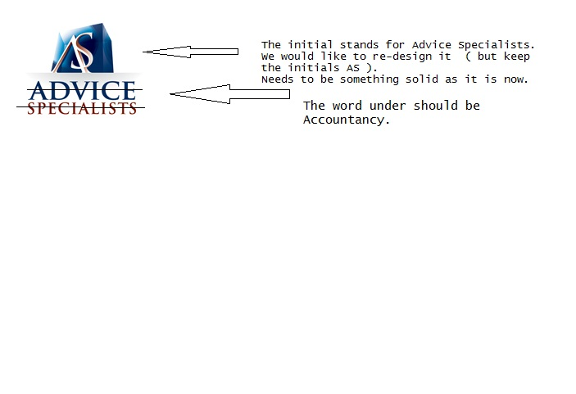
Logo

Slide 2

Logo will be in that place on this website. The background of the square can be changed.

