Slide 1
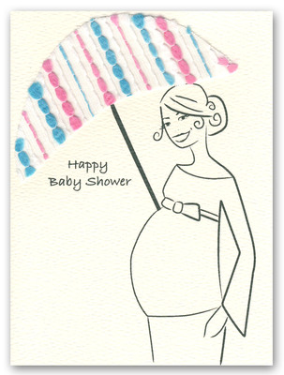





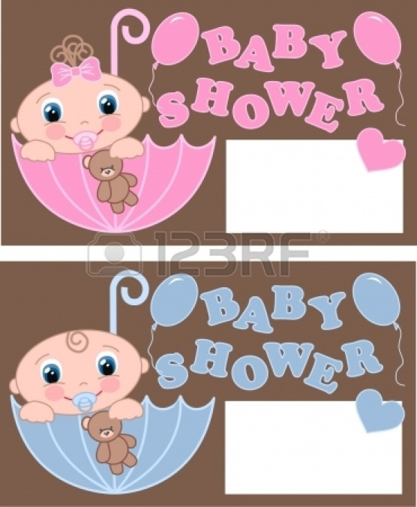

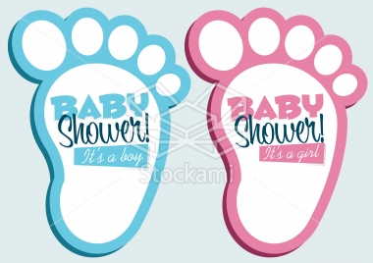

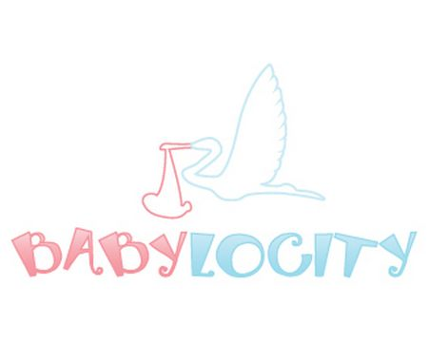


Ideas

Slide 2
Logo Ideas for text alignment
the
the
baby shower
baby shower
gifts company
gifts company
Memorable slogan/motto ideas
Creating happy memories (for mum-to-be)
Baby shower bliss
Baby shower gifts created with love

Slide 3
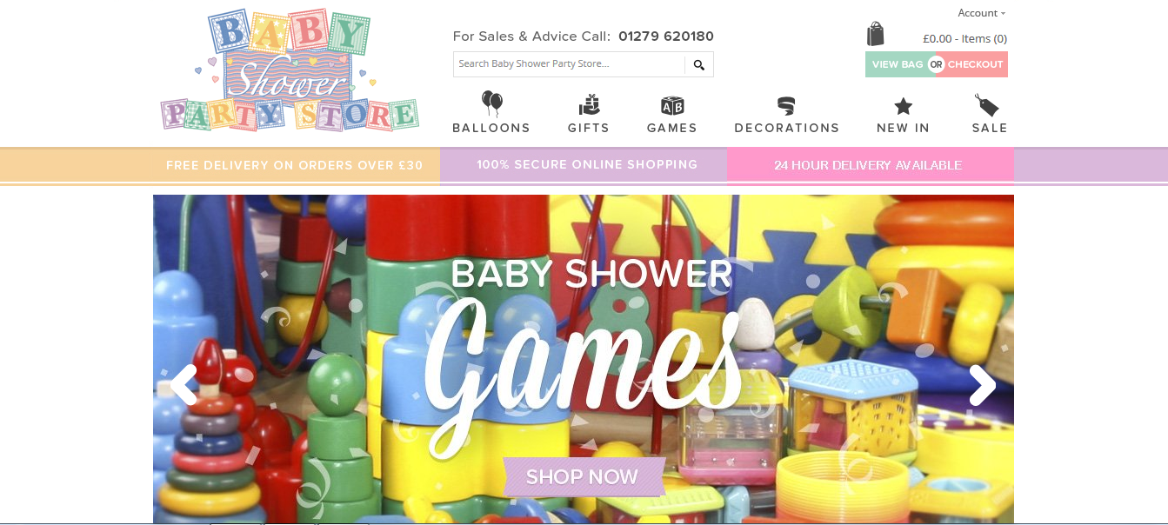
Competitors
http://www.babyshowerpartystore.co.uk

Slide 4
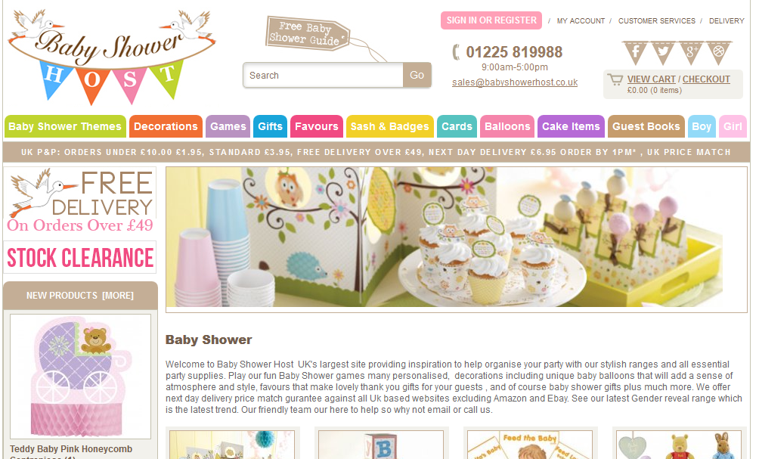
Competitors
http://www.babyshowerhost.co.uk

