Slide 1
Integrated Energy Services & Solutions LDA (IESSA)
Logo

Slide 2
IESSA
Angolan owned, focused and based, specialized Oil Services Company
Support from the local entity through the local content Law
Focused on niche markets:
Filtration
Cargo Basket Containers (CBM’s)
Drilling Services
Markets selected:
Technically simple
No competition from other local suppliers
Support from major oil companies and service providers

Slide 3
Technology & Services
Filtration Services
Inspections Services
DRT
Gyro Services
Productions Logging
Containers & Basket Rentals

Slide 4
Vision
“To be the local service provider of choice to the oil and gas industry in Angola”

Slide 5
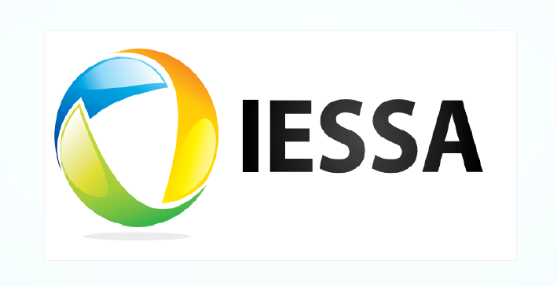
Current Logo
Colors: we would like to present more integrated color ideas, that express our business vision. We open for suggestions.
Logo Meaning: Integrated effort on the team – Team work and simple solutions delivered
Philosophy, Industry or culture: Team Work – Harmony – Master Mind.

Slide 6
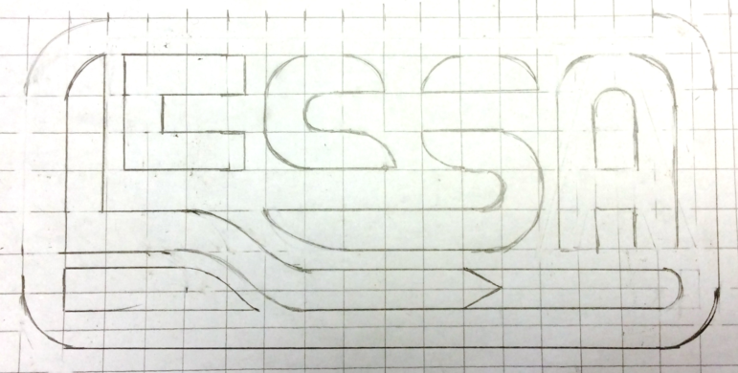
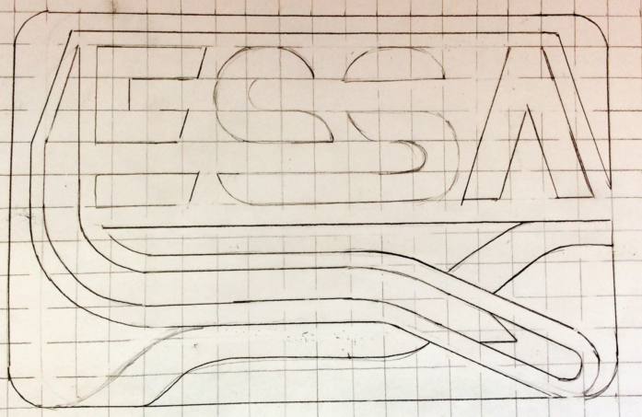
Concept #1
IESSA Logo with Directional Well in to Oil reservoir – with logging tool. Resembling the Mausoleum in the letter “I”, offshore shipping with the “S” and a drilling rig with the “A”. Offshore activities.
Resembles the Tools on a Oil Reservoir

Slide 7
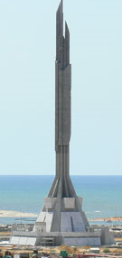
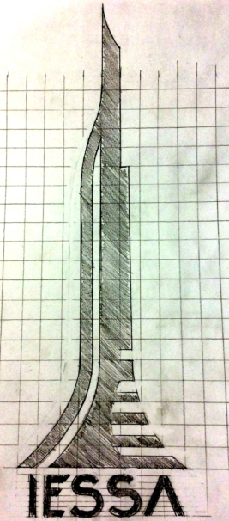
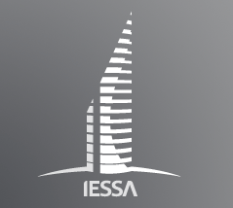
Concept #2
Logo resembling the Mausoleum (Angolan Monument)
Corporate feeling?
Found one similar on the web with same name

Slide 8





Concept #3
Logo that resembles the “Palanca Negra Gigante” Angolan National Symbol
Logo Examples

Slide 9




Other Concepts
Notes:
Integration/ Execution

Slide 10
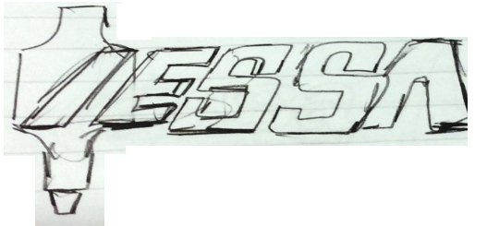

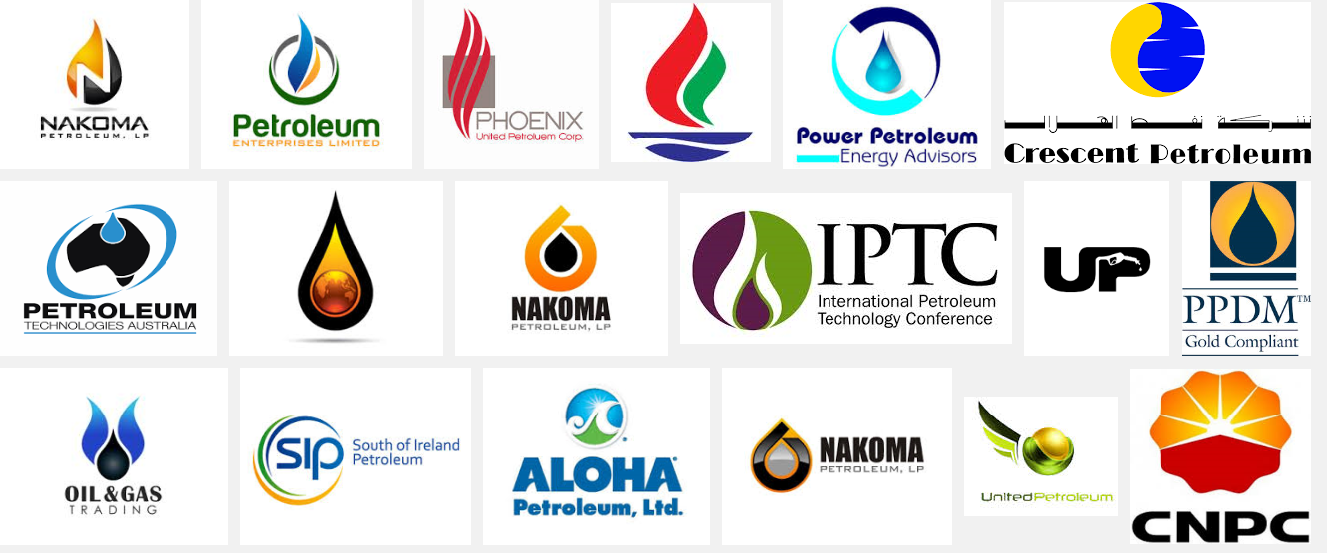

Other Concepts Ideas
Notes:
Drilling tools

Slide 11
Other similar companies websites
http://www.sps-eg.com/
http://scientificdrilling.com/
http://www.oegoffshore.com/

