Slide 1

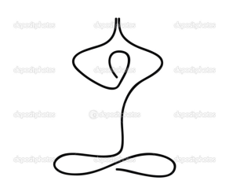

KCYoga Studio
KCYogaStudio

