Slide 1


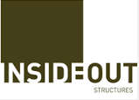


Logo concept ideas
Company name = Insight Out Research (« research » has only been added because
I am obliged because « Insight Out » on its own is already taken, so « research » should appear very small (if it has to be included at all)

Slide 2




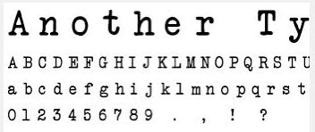
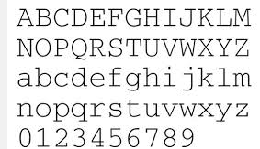

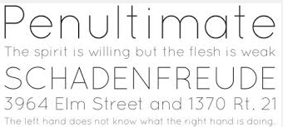
Colours and fonts that I like

Slide 3


Here’s what I came up with just using Powerpoint :
The font is « small typewriter » downloaded from Dafont.
I am open to suggestions for fonts

Slide 4


Additional idea : How about a magnifying glass for the « o » of « out »?
e.g. :
More suggestive of optimism, forward movement, dynamism with the handle pointing this way perhaps?... But not a conventional way to show a magnifying glass? Not sure…

