Slide 1

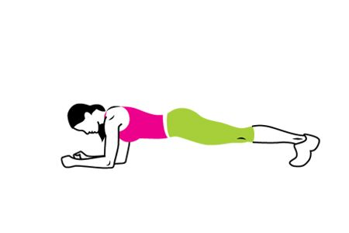
Or even coming though the F?
Across top of my name
Under the JF
Using same colours as logo?
Or underneath?
Could you try a couple of options with a
Person in the plank position as above?
Not sure what colours would work / stand out
Best.

