Slide 1
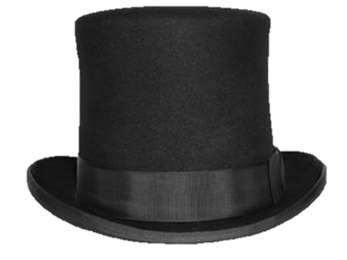

B
G

Slide 2
B ourbon
G ents

Slide 3
B ourbon
G ents

Slide 4
B
G

Slide 5
Bourbon
Gents

Slide 6
B ourbon
G ents

Slide 7
Bourbon
Gents

