Slide 1
Traveler’s diary
DATA FLOW & FISHBONE
DIAGRAM

Slide 2
OUTLINE
Data flow diagram of each subsystem
Fishbone diagram of each subsystem
Feasibility analysis
Tangible & intangible benefit

Slide 3
SUBSYSTEM
User profile
Agency profile
Board controlling
Information update
ACTORS
Anonymous user
Member user
Agency
Board

Slide 4
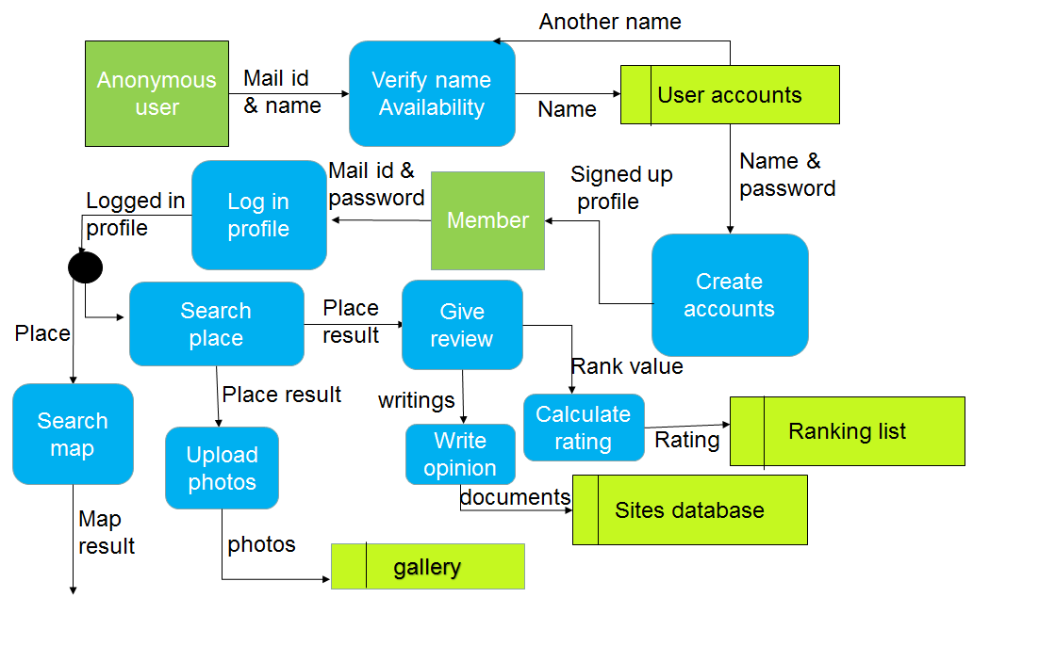
DATA FLOW DIAGRAM
User profile management:
Fig: data flow diagram for user profile

Slide 5
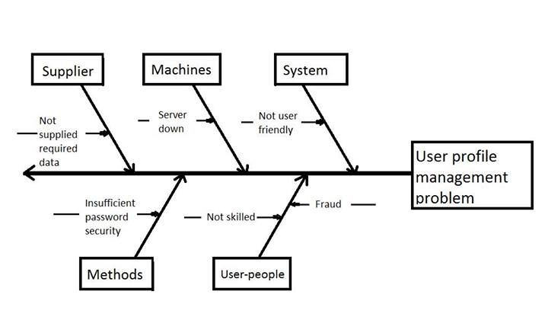
FISHBONE DIAGRAM
Fig: fish bone diagram for user profile system

Slide 6
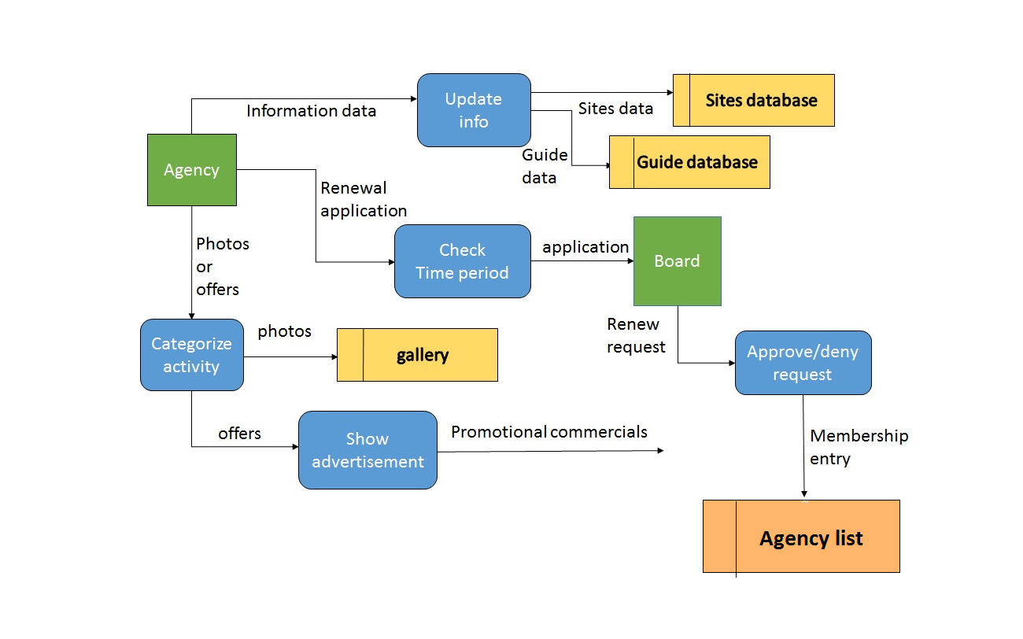
DATA FLOW DIAGRAM
Agency profile management:
Fig: data flow diagram for agency profile

Slide 7
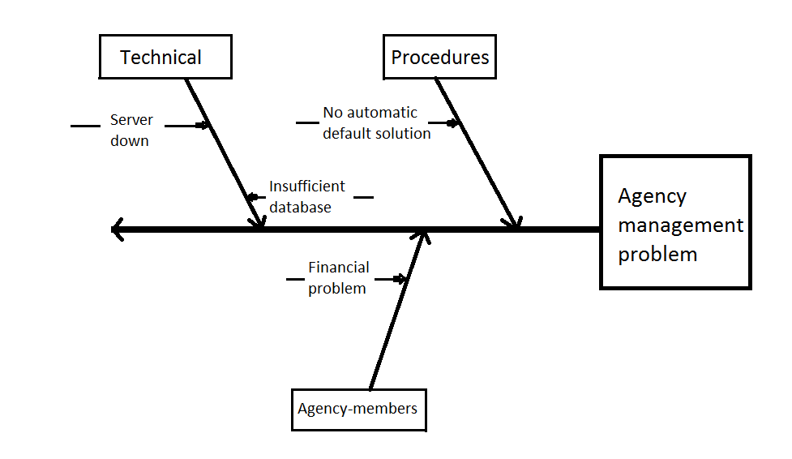
FISHBONE DIAGRAM
Fig: fish bone diagram for agency profile system

Slide 8
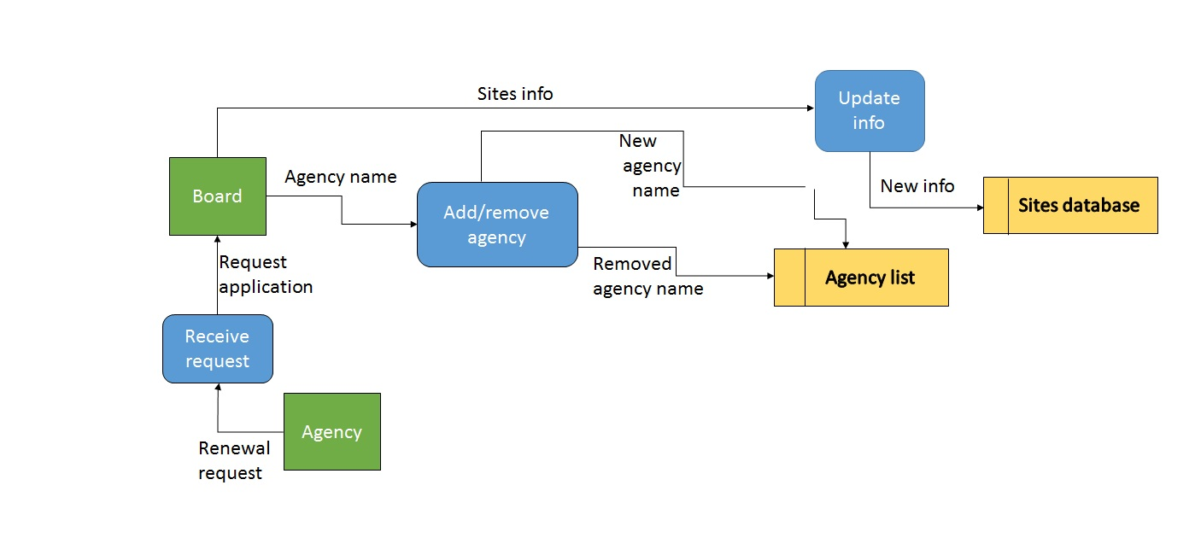
DATA FLOW DIAGRAM
Board controlling:
Board controlling:
Fig: data flow diagram for board controlling system

Slide 9
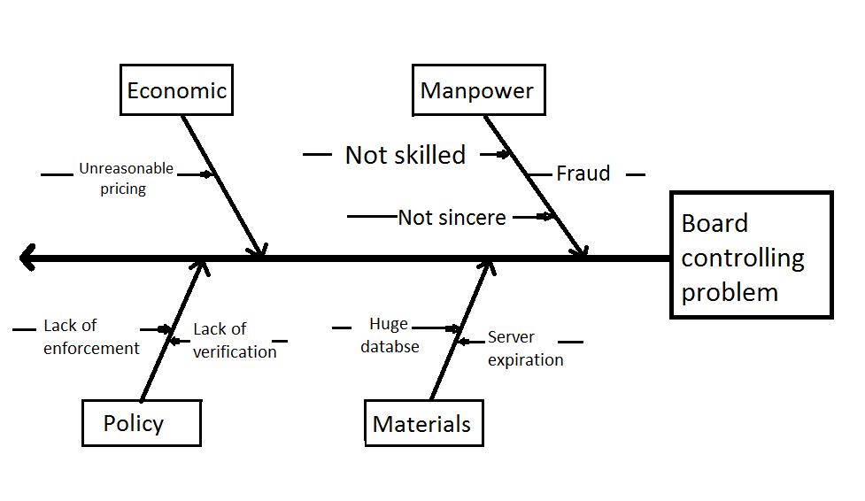
FISHBONE DIAGRAM
Fig: fish bone diagram for board controlling

Slide 10
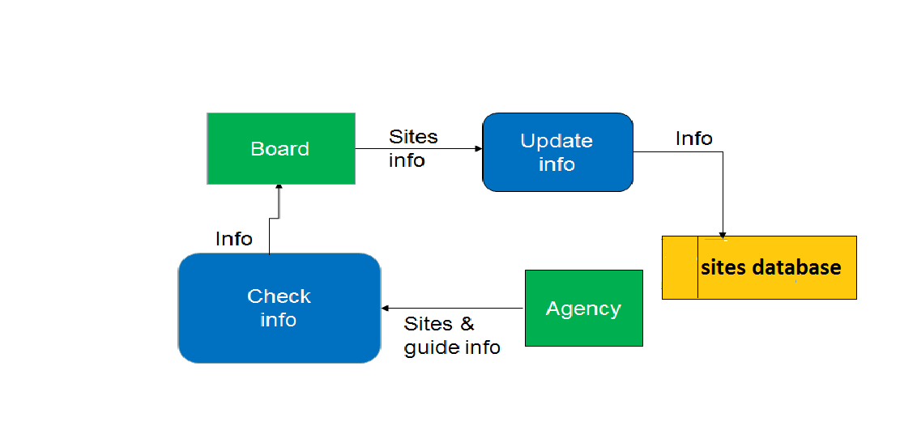
DATA FLOW DIAGRAM
Information update:
Fig: data flow diagram for information update
Fig: data flow diagram for information update

Slide 11
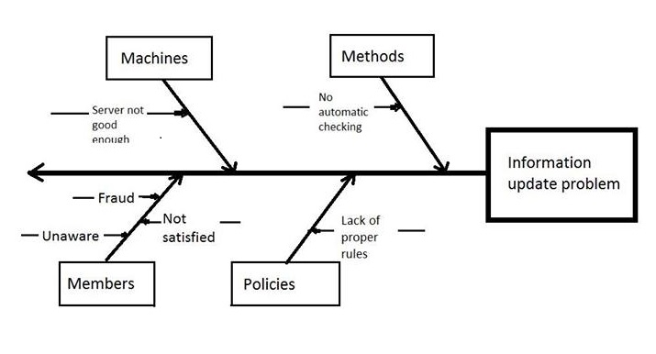
FISHBONE DIAGRAM
Fig: fish bone diagram for information update

Slide 12
FEASIBILITY ANALYSIS
Technical Feasibility:
The proposed technology is quite realistic as it is mature enough to easily apply to the problems.
For implementation of the system we will use
  PHP for server side scripting
  MySQL for Database management
  JavaScript for client side scripting
  Java for PC and mobile based software implementation
  HTML/CSS for web designing
  And expert engineers will deal with these

Slide 13
FEASIBILITY ANALYSIS
Operational analysis:
In the existing system following problem were found:
  Not user friendly
  Lack of information
  Lack of interaction
  No platform for sharing
  Our system successfully deals with this problems.

Slide 14
FEASIBILITY ANALYSIS
Cultural analysis:
Management supports because:
Increase end user number
Controlling the agencies will be easier
End user feeling about new system:
user friendly interface to meet their urges for information about tour spot
share their experience as they wish
user get privacy control

Slide 15
FEASIBILITY ANALYSIS
-With the present existing system, the end users find it hard to collect reliable and detailed information about their travelling spots and the tourism board has to manage agencies in a manual way. The agencies also find it hard to advertise their services as there is no common platform for travelers.
In this proposed system, getting information will be easier and they can also share their views. As the new system will be easier to use , advertise and manage , the end users and managers can easily adapt to the change.

Slide 16
Cost Benefit Analysis
PRELIMINARY EXPENSES
Software generation cost | 2.5 lacs
Advertisement cost | 10 lacs
Hardware purchase cost | 5 lacs
Internet cost | 1 lac
Server cost | 2 lacs
Total cost | 20.5 lacs

Slide 17
Cost Benefit Analysis
YEARLY EXPENSES
Cost | Amount
Software maintainance cost | 1.5 lacs
Advertisement cost | 5 lacs
Hosting cose | 1 lacs
Internet cost | 1 lac
Misc | 1 lac
Total cost | 9.5 lacs

Slide 18
Cost Benefit Analysis
REVENUE FROM REGISTRATION
Year | Income
1st | (15*30k)=4.5 lacs
2nd | (30*50k)=15 lacs
3rd | (70*50k)=35 lacs
4th | (100*50k)=50 lacs

Slide 19
Cost Benefit Analysis
Revenue from advertisement
Year | Income
1st | (200*5k)=10 lacs
2nd | (400*5k)=20 lacs
3rd | (500*10k)=50 lacs
4th | (700*10k)=70 lacs

Slide 20
Projected Cash Flow
 | 1st year | 2nd year | 3rd year | 4th year
Total expenses | 30 lacs | 9.5 lacs | 9.5 lacs | 9.5 lacs
Total revenue | 14.5 lacs | 35 lacs | 85 lacs | 1.2 crore
Profit | -15.5 lacs | 25.5 lacs | 75.5 lacs | 1.1 crore

Slide 21
Tangible & intangible benefit
Tangible benefit:
Increased revenue
Membership fee
Intangible benefit:
Highlighting the tourist spot
Representing cultural & tradition
Improvement in travel agency sector

Slide 22
Thank you
Group 5
CSE (B) 2
STUDENT NO.
1005101
1005102
1005103
1005104
1005119

