Slide 1


ITSU2006R — Project Management | Assessment Item 3
Project Plan Presentation
Development and Deployment of a Learning Management System (LMS) for Online Education
Prepared by
MD Sabid Hossen
Student ID: 66311
Yousuf Ali
Student ID: 68306
M Arnab bin Zaman
Student ID: 71963
Mahmudul Hassan Joy
Student ID: 68121
Riverbend Institute of Higher Education (RIHE) is a fictional organisation. Institutional figures, costs and targets are hypothetical planning assumptions.
Notes:
Welcome. We are presenting our project plan for developing and deploying a Learning Management System for Riverbend Institute of Higher Education, a fictional Melbourne-based private provider. Everything we show is a plan: institutional figures, dates and costs are hypothetical planning assumptions taken from our report.

Slide 2






Presentation overview
01
Problem and rationale
Why RIHE needs a centralised LMS, and what the literature says about adoption
02
Objectives, scope and platform
SMART objectives, charter, scope boundaries and the Moodle vs Canvas decision
03
Plan and schedule
WBS, milestones, Gantt chart, critical path, resources and budget
04
Control processes
Risk, issue, change, communication and quality management
05
Delivery and close
GitHub configuration management, pilot, go-live, hypercare and conclusion
Notes:
Our talk has five parts: the problem and why the project is needed; objectives, scope and platform choice; the plan and schedule; the control processes for risk, issues, change, communication and quality; and finally configuration management, deployment and our conclusion.

Slide 3




RIHE today: fragmented tools create real risk
2,800
140
4
1
students (approx.)
academic staff (approx.)
schools
ageing portal nearing end of vendor support
Current problem
Impact
Materials scattered across shared drives, email and an old portal
Students cannot find resources consistently
Submission and feedback are partly manual
Higher admin workload; risk of lost submissions
Course portal approaching end of vendor support
Security and continuity risk
Student data held in several places with inconsistent access controls
Weakens compliance with the Australian Privacy Principles [6]
Problem statement: RIHE has no single, secure and supported platform for online learning, and the deadline is set by the start of the next teaching trimester.
Notes:
RIHE has roughly 2,800 students, 140 academic staff and four schools. Learning materials sit in shared drives, email and an ageing portal that is near the end of vendor support. Submission and feedback are partly manual, and student data is spread across systems with inconsistent access control, which weakens privacy compliance. These figures are hypothetical planning assumptions.

Slide 4


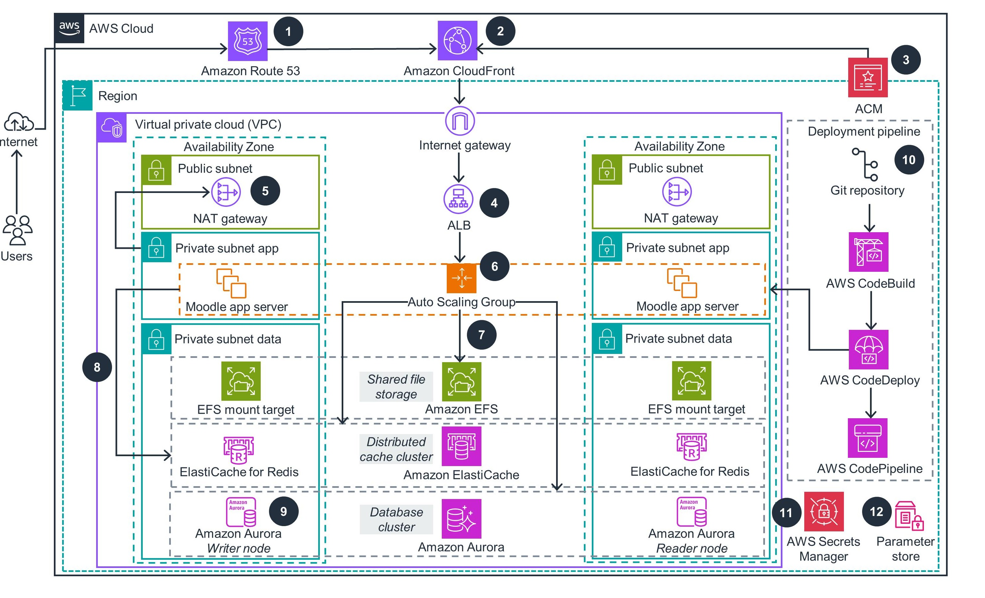

Proposed solution: one centralised Moodle LMS
Planned capabilities
Course delivery
Assignments and feedback
Quizzes and gradebook
Students
Lecturers
Progress tracking
Announcements
Role-based access
Moodle LMS
(planned)
Administrators
IT services
Moodle was selected after a weighted evaluation (slide 9). Implementation is phased: five-course pilot first, then institution-wide go-live.
Illustrative cloud hosting pattern for Moodle (AWS reference architecture, image supplied by the group). Not RIHE's approved design: the solution architecture is produced in WBS 4.1.
Notes:
We propose one centralised, web-based LMS, recommended to be Moodle. It will provide course delivery, assignment submission and feedback, quizzes and a gradebook, progress tracking, announcements, and role-based access to student information. These are planned capabilities, not delivered results. The image on the right is an AWS reference pattern for hosting Moodle, shown only to illustrate a typical cloud architecture; our actual design is a deliverable of work package 4.

Slide 5

SMART objectives define what acceptance means
ID | Objective | Measure (planning target) | Target
O1 | Formal acceptance of the configured LMS | 100% of must-have requirements pass UAT (incl. retest); sponsor signs acceptance | Week 24
O2 | Pilot and remediation completed | Zero open critical or high defects at the go/no-go review | Week 24
O3 | Current-trimester content migrated | 100% of agreed courses migrated, reconciled and approved by lecturers | Week 16
O4 | Lecturers trained before go-live | At least 90% of teaching staff complete core training | Week 21
O5 | Accessibility and security criteria met | No unresolved WCAG 2.2 A/AA failures in core workflows; no unresolved high-risk security findings | Week 17
O6 | Within budget and schedule | Final cost within approved budget incl. contingency; closure by Week 28 | Week 28
Expected benefits
Broader benefits, not formal acceptance criteria
One consistent place for all learning activity
Faster feedback for students
Less manual handling for lecturers
Centralised enrolment and reporting
Reduced compliance risk
Pilot satisfaction of at least 3.5 / 5 (tracked again in hypercare)
Notes:
Six SMART objectives define acceptance. O1 and O2 are measured at the go/no-go review in Week 24, so UAT defects can be fixed before go-live. O3 covers migration by Week 16, O4 the 90% training target by Week 21, O5 accessibility and security by Week 17, and O6 budget and closure by Week 28. On the right are the broader benefits we expect, which are not acceptance criteria.

Slide 6



What the literature tells us, and how it shapes the plan
Usefulness and ease of use drive adoption
Lecturer workload and resistance are the main barriers
TAM dominates LMS adoption research [8], [9]
Sweden and the Philippines report the same finding [1], [2]
Plan response: Usability testing, templates, visible early benefits
Plan response: Champions, training, workload recognition; R1 rated High
Pilot and support enable adoption; sudden introduction blocks it
System and information quality drive satisfaction
Oslo Canvas implementation case study [5]
DeLone and McLean model reviews [10], [11]
Plan response: Five-course pilot and phased rollout before go-live
Plan response: Quality matrix measures reliability, content and satisfaction
Learners sustain long-term LMS use, so students are represented in requirements, pilot and feedback [12].
IEEE references as in report: [1] Garrote Jurado 2013; [2] Delen 2026; [5] Sagvik 2018; [8] Al-Nuaimi & Al-Emran 2021; [9] Davis 1989; [10] DeLone & McLean 2003; [11] Otto et al. 2022; [12] Al-Busaidi 2012.
Notes:
Four findings shape our plan. First, perceived usefulness and ease of use drive adoption, so we test usability and use course templates. Second, lecturer workload and resistance are the most persistent barriers, seen in both Swedish and Philippine studies, so this is our only High risk. Third, the Oslo case shows that a pilot and support help, while sudden introduction hurts, so we pilot five courses first. Fourth, system and information quality drive satisfaction, so our quality plan measures them.

Slide 7
Project charter and governance: clear authority, one accountable owner
Dr Helen Carter
Project Sponsor (Academic Director)
Chairs steering committee and CCB
Authority set by the charter
Sponsor: approves charter, AUD 337,700 budget, platform and go/no-go; any change to scope, the critical path or above AUD 5,000
PM: minor changes up to AUD 5,000 from contingency with no scope or critical-path effect
Escalation: critical-path slip over 1 week or budget variance over 5% goes to the sponsor
Approval: charter to be signed at M1 (planned for 5 Feb 2027), not yet signed
Steering committee
Mark Thompson (Director of IT Services)
Head of School representative
Change Control Board
Sponsor (chair), PM, Technical Lead,
Lecturer Representative
Daniel Reyes
Project Manager
BA: Priya Nair
Tech Lead: Marcus Chen
LMS Admin / Config: Sarah O'Connell
Infrastructure: Tom Nguyen
QA: Aisha Rahman
Instr. Designer: James Walker
Lecturer reps: Dr E. Brooks, R. Patel
Student rep: SA nominee
All names are fictional and created for this hypothetical scenario.
Notes:
Governance gives every decision one accountable owner. Dr Helen Carter, the sponsor, chairs the steering committee and the Change Control Board, and holds go/no-go authority. Daniel Reyes, the project manager, runs day-to-day control and may approve only minor changes up to 5,000 dollars that do not touch scope or the critical path. The charter is planned for signature at milestone M1; nothing has been signed yet.

Slide 8

Scope boundaries: what the project will and will not deliver
In scope
Out of scope
Requirements analysis and platform evaluation
Four environments: development, test, staging, production
Install, harden and configure Moodle; branding theme and approved plugins
Migrate current-trimester course content
Functional, integration, security, accessibility, performance, backup and recovery testing; UAT
Staff training, student orientation, five-course pilot, institution-wide deployment
Two weeks of hypercare, handover and closure
Configuration management with GitHub
Live video conferencing (existing tools continue)
Online payment processing
Native mobile app (responsive web used)
Real-time student information system integration (CSV upload this phase)
Archived courses older than the current trimester
Curriculum redesign beyond LMS-related training
Notes:
Clear boundaries protect the baseline. In scope we have requirements and platform evaluation, four environments, installation and configuration, current-trimester migration, the full test programme and UAT, training, a five-course pilot, deployment, two weeks of hypercare, handover, and GitHub configuration management. Out of scope are video conferencing, payments, a native mobile app, real-time SIS integration, archived courses and curriculum redesign. Any change to this goes through change control.

Slide 9
Moodle vs Canvas: weighted evaluation favours Moodle, narrowly
Criterion | Weight | Moodle | Canvas | Moodle wtd | Canvas wtd
Licensing and total cost | 25% | 5 | 3 | 1.25 | 0.75
Customisation and control | 15% | 5 | 2 | 0.75 | 0.30
Usability for staff and students | 15% | 3 | 5 | 0.45 | 0.75
Security and data control | 15% | 4 | 4 | 0.60 | 0.60
Support availability | 10% | 3 | 5 | 0.30 | 0.50
Integration capability | 10% | 4 | 5 | 0.40 | 0.50
Skills required to administer | 10% | 3 | 4 | 0.30 | 0.40
Total | 100% |  |  | 4.05 | 3.80
4.05
Moodle / 5
3.80
Canvas / 5
Why Moodle: no per-seat licence, full control of hosting and data, high configurability [17]
Trade-offs: needs stronger in-house admin skills; weaker usability out of the box. Managed as risks R9 and R11
Sensitivity check: raising usability to 25% and lowering licensing to 15% gives Canvas 4.00 vs Moodle 3.85. The sponsor confirms the weights at milestone M3.
Scores are the team's informed assessment using official licence sources [17], [18] and commercial comparisons [20]–[22], not measured performance.
Notes:
We compared Moodle and Canvas on seven weighted criteria. Moodle scores 4.05 and Canvas 3.80, mainly because of cost and control. The margin is narrow: if usability were weighted 25% and licensing 15%, Canvas would win 4.00 to 3.85. So the decision reflects RIHE's budget and data-control priorities, and Moodle's weaknesses are treated as explicit risks.

Slide 10
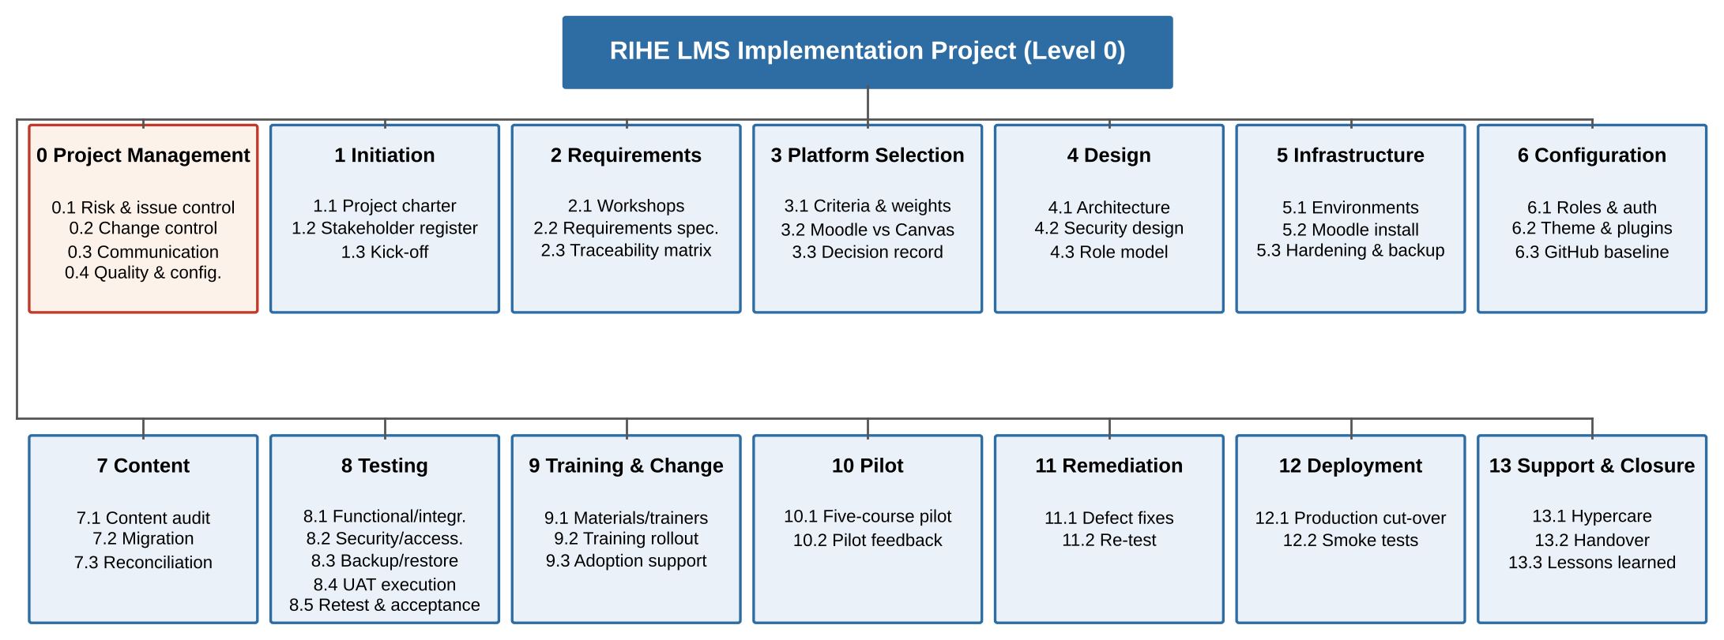



Work Breakdown Structure: 13 deliverable-oriented work packages
Deliverable-oriented
Every element is a tangible output covering 100% of scope [7]
Two levels
Level 1: 13 packages plus cross-cutting project management (0)
Linked to schedule
Level 2 deliverables roll up into 25 scheduled tasks
Notes:
Our WBS is deliverable-oriented, following the 100% rule. Level 1 has 13 work packages from initiation through support and closure, plus a cross-cutting project management package. Each Level 2 deliverable is mapped to one of the 25 scheduled tasks, so the WBS and schedule cover exactly the same scope.

Slide 11
Nine milestones gate the 28-week plan
M1 W1
Charter approved
5 Feb 2027
M3 W6
Platform approved
12 Mar 2027
M5 W20
Pilot completed
18 Jun 2027
M7 W24
Go-live approved
16 Jul 2027
M9 W28
Project closed
13 Aug 2027
W1
W7
W14
W28
M2 W5
Requirements baselined
5 Mar 2027
M4 W13
Configuration baselined (v1.0)
30 Apr 2027
M6 W21
Core training complete
25 Jun 2027
M8 W25
LMS live
23 Jul 2027
Initiate and define
Design and build
Prepare and prove
Accept and transition
Signed charter; requirements and traceability matrix; platform decision record
Architecture and security design; four environments; configured, branded LMS; GitHub baseline v1.0
Migrated, reconciled content; test reports; training materials; pilot evaluation report
UAT acceptance record; go-live approval; handover and lessons learned report
Dates are end-of-week planning dates from the assumed start of Monday 1 February 2027; they shift if charter approval moves.
Notes:
Nine zero-duration milestones gate the plan, from charter approval on 5 February to project closure on 13 August 2027. No phase starts until its approver signs off. Below the timeline are the major deliverables grouped by stage. These are planning dates from an assumed start date.

Slide 12
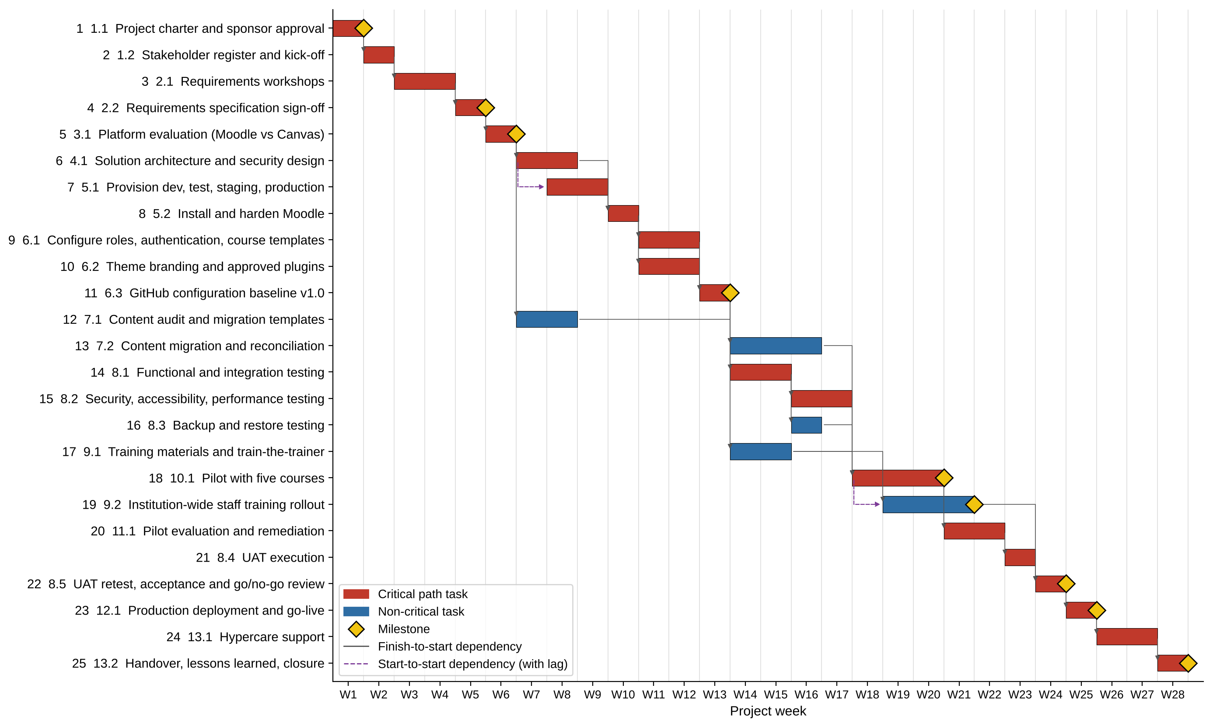
Project schedule: 25 tasks over 28 weeks
28
weeks in total
1 Feb 2027
assumed start (Week 1)
19–23 Jul
go-live (Week 25)
9–13 Aug
closure (Week 28)
Red bars = critical path; yellow diamonds = milestones; dashed arrows = start-to-start (+1 week) dependencies. Dates are planning dates.
Notes:
This is the Gantt chart from our report. The project runs 28 weeks from an assumed start of 1 February 2027. Go-live is in Week 25, 19 to 23 July, just before Trimester 2 teaching starts, and closure is in Week 28. Red bars are the critical path, diamonds are milestones and dashed arrows show the two start-to-start links.

Slide 13
Critical path: zero float from charter to closure
SS+1
1.1
W1
1.2
W2
2.1
W3–4
2.2
W5
3.1
W6
4.1
W7–8
5.1
W8–9
↵ continues
5.2
W10
6.1 / 6.2
W11–12
6.3
W13
8.1
W14–15
8.2
W16–17
10.1
W18–20
11.1
W21–22
↵ continues
8.4
W23
8.5
W24
12.1
W25
13.1
W26–27
13.2
W28
Key dependencies
Float on non-critical tasks
Configuration baseline (6.3) before testing, migration and training material
All readiness work (7.2, 8.2, 8.3, 9.1) before the pilot (10.1)
UAT (8.4) → retest and go/no-go (8.5) → deployment (12.1)
7.1 content audit: 6 weeks
9.1 training materials, 9.2 training rollout: 2 weeks each
7.2 migration, 8.3 backup test: 1 week each (7.2 watched; R4)
Notes:
A forward and backward pass gives 28 weeks. The critical path runs from the charter through requirements, design, environments, configuration, testing, the pilot, remediation, UAT, retest, deployment, hypercare and closure. Environment provisioning starts one week after design starts, a start-to-start link shown in purple. Any delay on these tasks delays go-live. Content migration has only one week of float, so it is monitored closely.

Slide 14
Resources and RACI: one Accountable role per deliverable
Deliverable | Spon. | PM | BA | Tech | LMS | Infra | QA | ID | Lect. | Stud.
Charter | A | R | C | I | I | I | I | I | I | I
Requirements spec | I | A | R | C | C | C | C | C | C | C
Platform decision | A | R | R | C | C | C | I | C | C | I
Architecture and security | I | A | C | R | C | R | I | I | I | I
Environments and install | I | A | I | C | R | R | I | I | I | I
Configuration and GitHub | I | A | C | R | R | C | C | C | I | I
Content migration | I | A | I | I | C | I | C | R | C | I
Testing and UAT | I | A | C | C | C | C | R | C | R | C
Training | I | A | I | I | C | I | I | R | C | I
Pilot and remediation | I | A | C | R | R | C | R | C | R | C
Go-live approval | A | R | I | C | C | C | C | I | C | I
Handover and closure | A | R | C | C | R | R | I | C | I | I
Core allocations
PM: 1.0 FTE, Weeks 1–28
LMS Admin: 1.0 FTE, Weeks 9–28
Instructional Designer: 1.0 FTE, Weeks 6–26
QA Tester: 0.8 FTE, Weeks 13–24
Security Specialist (contract): 0.3 FTE, Weeks 7–8, 16–17
Resource peaks
Weeks 14–16: migration and training material compete; use 9.1 float or a casual assistant
Weeks 19–21: rollout during pilot; lecturer champions co-train
R = Responsible, A = Accountable, C = Consulted, I = Informed. ID = Instructional Designer; Lect./Stud. = lecturer and student representatives.
Notes:
The RACI matrix gives every deliverable exactly one Accountable role, usually the project manager, with the sponsor accountable for the charter, platform decision, go-live and closure. Resource peaks occur in Weeks 14 to 16 and 19 to 21; we use float, a casual assistant funded from contingency, and lecturer champions as co-trainers.

Slide 15
Indicative budget: AUD 337,700 including contingency
AUD 337,700
total, 28 weeks + first year of hosting
Contingency AUD 30,700
Covers total residual risk EMV of AUD 29,750 (slide 17)
Open source is not free: hosting, administration, patching, backup and support make up most of the cost, so they are budgeted explicitly. Figures are illustrative, not vendor quotes.
Notes:
The indicative budget is 337,700 Australian dollars. Labour is the largest item at 248,000. Hosting, an optional Moodle Partner retainer, an external security and accessibility review and training make up the rest, plus a 10% contingency of 30,700. Moodle has no per-seat licence, but it is not free to run. These are illustrative planning estimates, not quotations or spending.

Slide 16
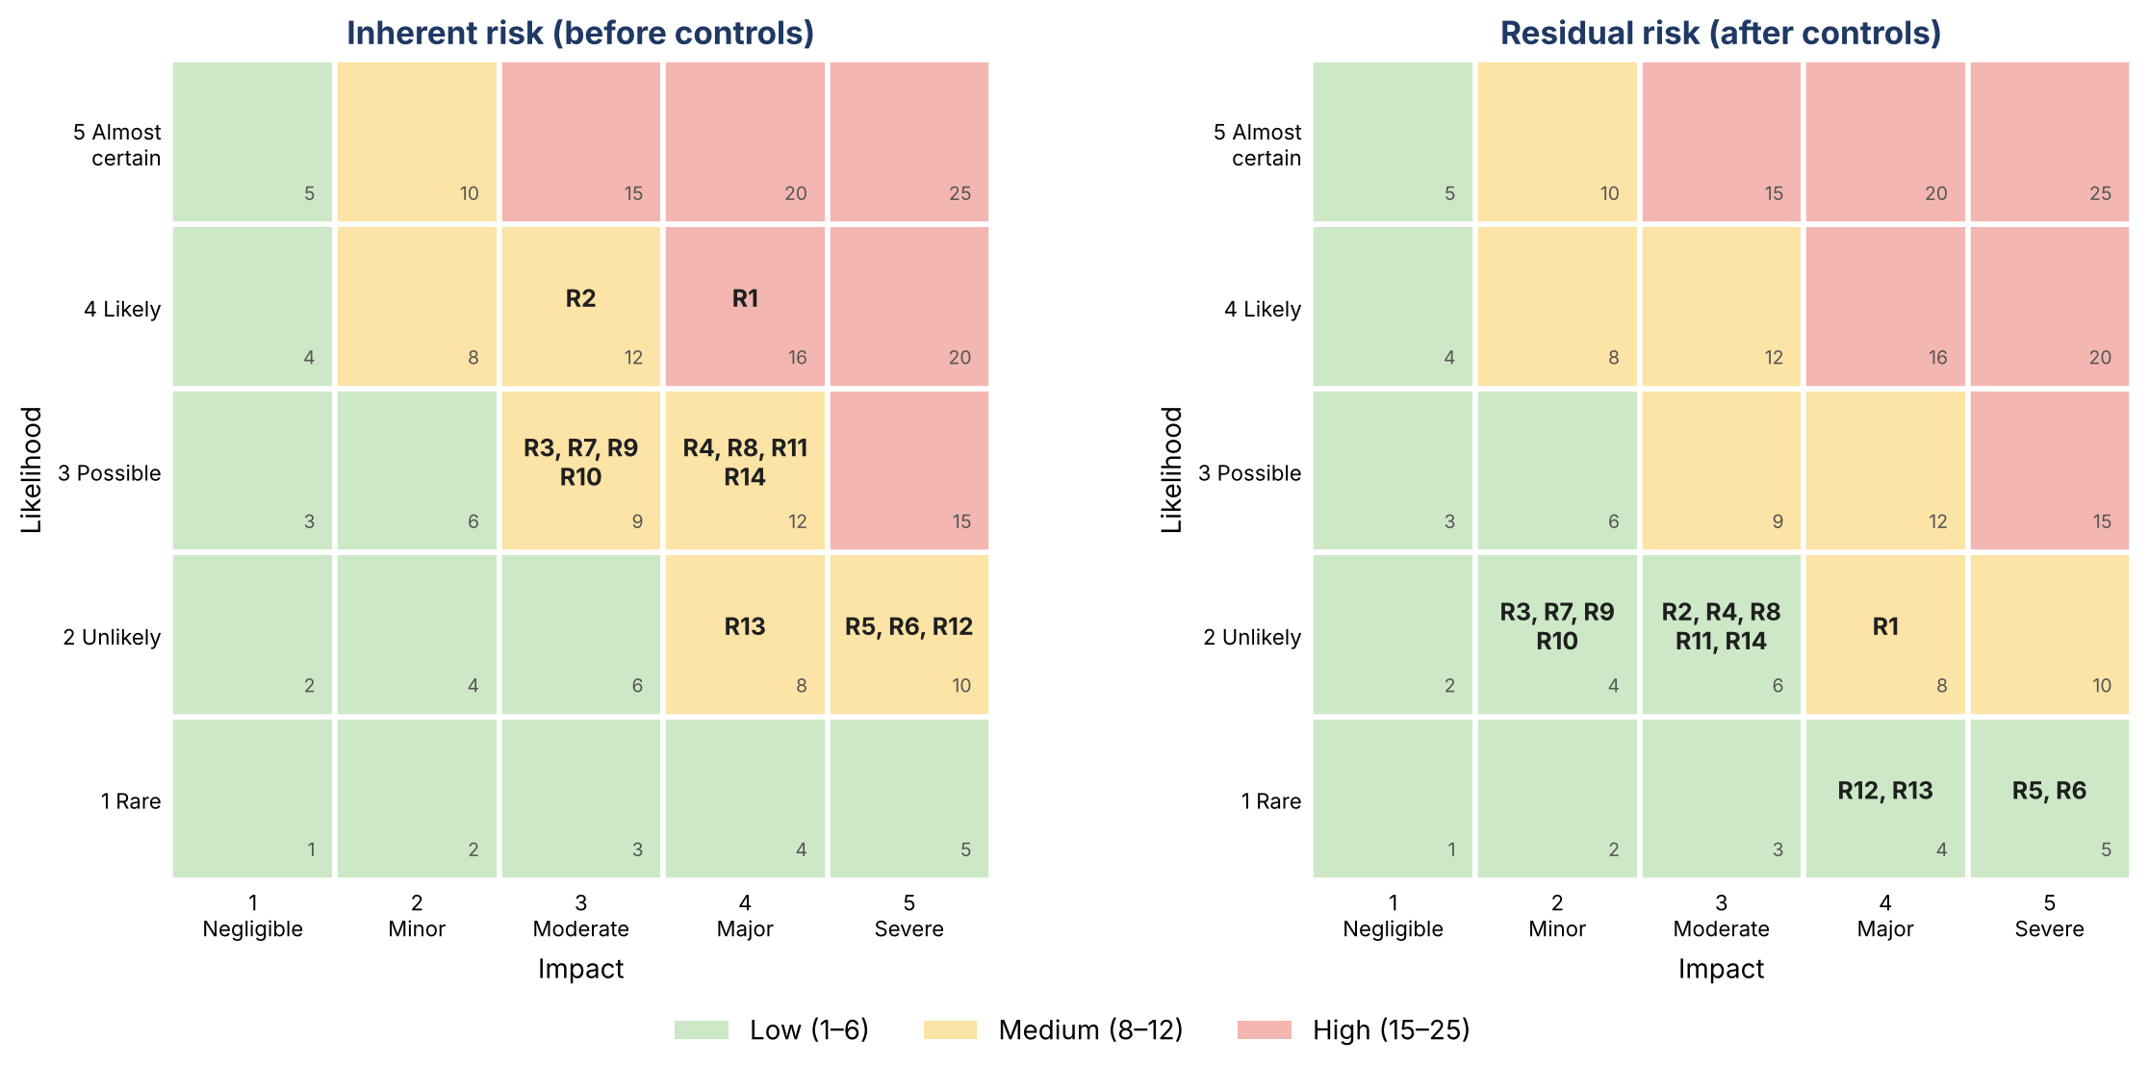
Risk framework: 14 risks scored on a 5 × 5 matrix
ID | Key documented risk | Inherent | Residual
R1 | Low lecturer adoption (workload fears) [1] | 16 High | 8 Med
R2 | Resistance; no time to redesign courses [2] | 12 Med | 6 Low
R4 | Content migration errors or delays | 12 Med | 6 Low
R5 | Data breach from misconfiguration or patching | 10 Med | 5 Low
R6 | Privacy non-compliance | 10 Med | 5 Low
R3 | Enrolment CSV integration problems [5] | 9 Med | 4 Low
R8 | Key resource shortage [5] | 12 Med | 6 Low
R14 | Overrun pushes go-live into teaching | 12 Med | 6 Low
Score = likelihood × impact (1–5 each)
Bands: Low 1–6, Medium 8–12, High 15–25
Residual risk assumes preventive controls work
Reviewed weekly by the PM, monthly by the steering committee
Notes:
We identified 14 risks from the literature, scope and schedule, scored on a five-by-five likelihood and impact matrix. The heat map shows each risk before and after controls. R1, low lecturer adoption, is the only High inherent risk. After controls everything except R1 falls into the Low band; R5 and R6 keep maximum impact because controls reduce likelihood, not consequence.

Slide 17
Mitigation vs contingency: responses mapped to key risks
Risk | Strategy | Preventive controls (reduce likelihood) | Contingency response (if it happens)
R1 adoption | Mitigate | Champions, course templates, workload recognition, early demos | Catch-up sessions Weeks 21–23; below 90% trained at go/no-go → sponsor defers go-live
R4 migration | Mitigate | Content inventory and templates, reconciliation checklist, lecturer sign-off | Prioritise pilot and first-trimester courses; casual assistant
R5 breach | Mitigate + Transfer | Least-privilege roles, admin MFA, patching, OWASP ASVS testing [14] | Incident response; disable accounts; restore from backup
R12 backup | Mitigate | Daily backups, off-site copies, restore test before pilot | Restore latest verified backup; invoke rollback plan
R14 schedule | Mitigate / Accept | Weekly tracking, float monitoring, early escalation | Fast-track or crash; defer go-live through the CCB
EMV = probability × cost impact
AUD 29,750
total residual EMV, 14 risks
≤ AUD 30,700 contingency (matches budget)
Probability = band midpoint: Rare 5%, Unlikely 20%
Drawdowns above AUD 5,000 need CCB approval
Severe R5/R6 events: cyber insurance and sponsor reserve
Example: R1 = 20% × AUD 25,000 = AUD 5,000 EMV. Strategy categories follow PMBOK [7]. Cost impacts are planning estimates.
Notes:
Each risk has preventive controls that reduce likelihood and a contingency response if it still occurs. We then priced residual risk as expected monetary value: probability times cost impact. For example, R1 is 20% times 25,000, or 5,000 dollars. The total across all 14 risks is 29,750 dollars, which the 30,700 dollar contingency covers. So the contingency is calculated from the risk register, not guessed.

Slide 18





Issue management: every issue logged, owned and closed
1. Identify and log
2. Assess
3. Assign owner
4. Set target date
GitHub Issue, unique number
Severity and priority
One owner per issue
By severity
5. Escalate
6. Track action
7. Verify and close
8. Learn
To sponsor; CR if baseline changes
Weekly team review
Requester or QA confirms
Root causes to lessons log
Severity | Target resolution
Critical | 1 working day
High | 3 days
Medium | 10 days
Low | Next planned release
Risk vs issue: a risk may happen; an issue already has. When a risk trigger fires, it moves from the risk register to the issue log.
Template example (ISS-007): CSV export date format differs from spec → conversion script; linked to R3; no CR needed. Illustrative only.
Notes:
Issues follow eight steps: log as a GitHub Issue, assess severity and priority, assign one owner, set a target date, escalate if overdue or if the baseline is affected, track corrective action, verify and close, and record lessons. Target resolution is one working day for Critical up to the next release for Low. The ISS-007 example is a template illustration, not a real resolved issue.

Slide 19
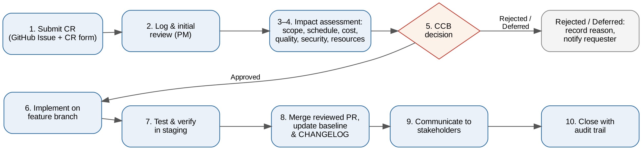
Change control: no change alters the baseline without a decision
Who decides
Worked example: CR-014 (illustrative)
Request: integrate live video conferencing into Moodle.
Impact: +3 weeks on task 8.2 (zero float) pushes go-live from Week 25 to Week 28, into teaching; AUD 18,500 (60% of contingency); new privacy data flow.
Decision: rejected for this phase in Week 16; added to the Phase 2 backlog.
CCB: sponsor (chair), PM, technical lead, lecturer representative
PM may approve minor changes: no scope or critical-path effect, up to AUD 5,000
Every decision is recorded and linked: issue → pull request → release
Notes:
Our change control has ten steps, from submitting a change request as a GitHub Issue through impact assessment, a CCB decision, implementation on a feature branch, testing, a reviewed merge, communication and closure. In our worked example, CR-014 asks for video conferencing. It would add three weeks to a critical task, push go-live into the teaching trimester and use 60% of contingency, so the CCB rejects it for this phase.

Slide 20

Communication plan: right message, right audience, right time
Stakeholder | Key information | Method | Frequency or trigger
Sponsor and steering committee | Progress, risks, issues, decisions | Status report; steering meeting | Fortnightly report; monthly meeting
Project team | Tasks, dependencies, blockers | Stand-up; GitHub project board | Twice weekly; continuous
Lecturers | Purpose, timeline, training, support | Bulletin; school meetings; training | Monthly; before training; at go-live
Pilot lecturers and students | Pilot schedule, how to report problems | Briefing; in-LMS announcements | Before pilot; weekly during pilot
Students | What changes, login, where to get help | Portal news; email; orientation video | 4 weeks and 1 week before go-live
IT Services | Architecture, operations, handover | Technical docs; handover sessions | During design; before handover
All users (incidents) | Outages and workarounds | LMS banner; email | On incident
Engagement by power and interest
Manage closely: sponsor, heads of school, IT Services. Keep satisfied: executive, Privacy Officer. Involve: lecturers. Monitor: suppliers.
Notes:
Communication supports adoption. The sponsor and steering committee get fortnightly reports and monthly meetings. Lecturers get monthly bulletins and training notices, pilot users get weekly updates, and students hear four weeks and one week before go-live. Engagement follows a power-interest grid: we manage the sponsor, heads of school and IT closely, and actively involve lecturers.

Slide 21
Quality management: planned gates before go-live
Quality assurance prevents defects through process: requirement and design reviews, pull-request peer review, change control. Quality control detects defects through testing [10], [11].
Traceability
8.1 Functional
8.2 Security
8.3 Backup
10.1 Pilot
8.4 UAT
8.5 Go/no-go
Each requirement → test case
and integration tests
ASVS [14], WCAG 2.2 [13], load
Full restore test
Five courses, exit criteria
Realistic user scenarios
Retest, acceptance, sponsor
Mandatory go-live gates (all must pass)
100% must-have requirements pass UAT, incl. retest
Zero open critical or high defects
No unresolved high-risk security findings
No unresolved WCAG 2.2 A/AA failures in core workflows
100% of agreed courses reconciled
Restore test passed; rollback rehearsed
Core pages within agreed load threshold
At least 90% of teaching staff trained; sponsor decision recorded
These are planned controls and thresholds. No tests have been executed and no compliance is claimed.
Notes:
Quality assurance prevents defects through reviews and controlled processes; quality control detects them through testing. Our gates run from requirements traceability through functional, security, accessibility, performance and backup testing, the pilot, UAT, and the go/no-go review. Every mandatory gate must pass before deployment. These are planned controls, not results.

Slide 22


Configuration management: GitHub keeps every change traceable
Issue / CR
Feature branch
Commits
Pull request
Protected main
Release tag
Labelled: issue, defect, change-request
e.g. feature/cr-012-quiz-settings
"config: add assignment plugin settings (#45)"
References issue; one reviewer approves
Merge only via reviewed PR [23]
Baseline with release notes
Planned release baselines
v0.1
Approved project plan
v0.2
Approved requirements
v1.0
Configuration baseline (M4)
v1.1
Post-pilot configuration
v2.0
Production go-live
Repository evidence
The GitHub workflow is planned; repository evidence has not yet been provided. Commits, pull requests, labelled issues and release tags will be shown once the repository is set up.
Versioned: plans, Moodle config template (no secrets), theme, plugin list, scripts, test plans, CHANGELOG.
Excluded: passwords and keys, student data, the database, uploaded course files.
Notes:
GitHub is our configuration management tool. Every change starts as a labelled issue, is made on a feature branch with conventional commit messages, goes through a pull request approved by another member, and merges into a protected main branch. Approved baselines are tagged from v0.1 to v2.0. Secrets, student data and the database are never committed. This slide shows the planned workflow; repository evidence will be added.

Slide 23





From pilot to handover, and our recommendation
Pilot
5 courses
W18–20
Evaluate and remediate
Fix defects
W21–22
UAT
Real scenarios
W23
Retest and go/no-go
Sponsor decides (M7)
W24
Go-live
Production cut-over
W25
Hypercare
2 weeks
W26–27
Handover and close
Lessons learned (M9)
W28
Pilot exit and rollback
Conclusion
All pilot assessments submitted and graded without data loss
No open critical defects; others logged for remediation
Pilot satisfaction of at least 3.5 / 5, or an approved remediation plan
Cut-over failure: restore last verified backup and previous release tag
A pilot-led, change-managed Moodle implementation, supported by formal governance, risk management, quality gates and structured training, is proposed as the lowest-risk way for RIHE to replace its fragmented tools within budget and before a teaching trimester.
This presentation describes a plan, not a completed implementation.
Notes:
Delivery is phased. A three-week, five-course pilot is followed by remediation, UAT, retest and the go/no-go decision in Week 24. Go-live is Week 25, followed by two weeks of hypercare and handover in Week 28. If cut-over fails, we restore the last verified backup. Our conclusion: a pilot-led, change-managed Moodle implementation is the lowest-risk way for RIHE to replace its fragmented tools. This is a plan, not a completed implementation.

Slide 24

Questions & Discussion
Thank You
We welcome your questions and feedback.
MD Sabid Hossen · Yousuf Ali · M Arnab bin Zaman · Mahmudul Hassan Joy
ITSU2006R Project Management | Victorian Institute of Technology
Notes:
Thank you for listening. We are happy to take questions about any part of the plan.

