Slide 1
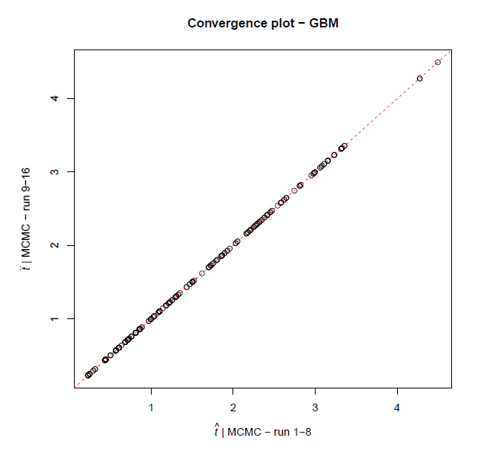
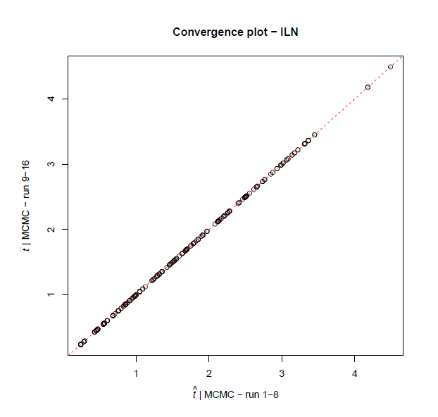
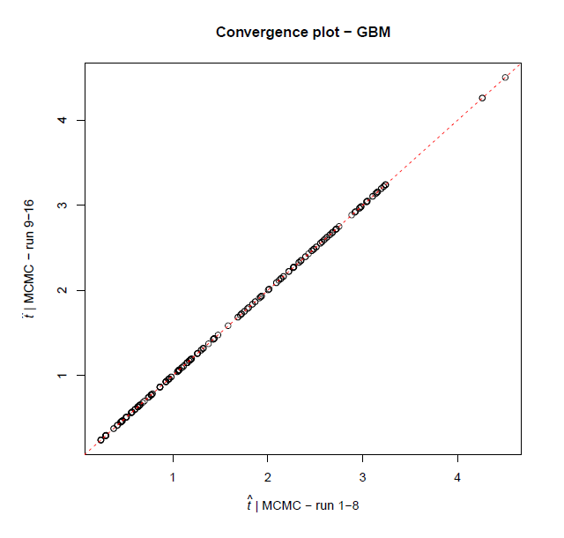
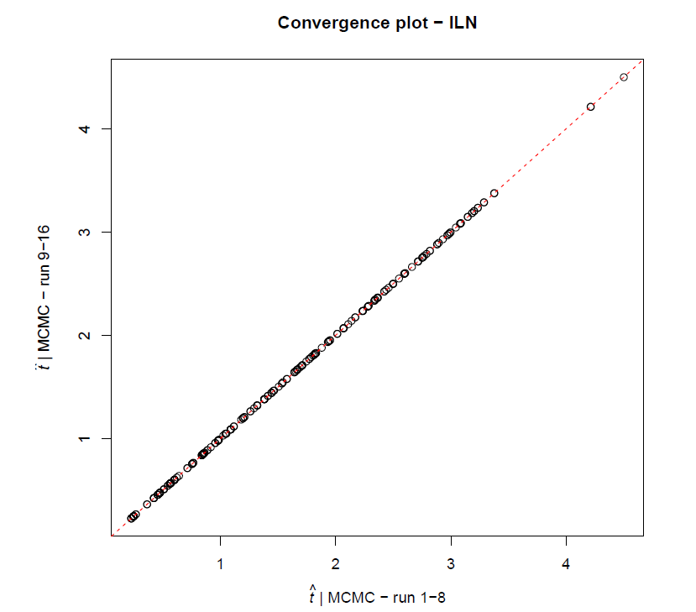
A) Concatenated + GBM
B) Concatenated + ILN
A) Concatenated + GBM
C) Partitioned + GBM
D) Partitioned + ILN

