Slide 1

PROJECT PROGRESS MONITORING
2022-Arid-4158 Raja Muhammad Taha
2022-Arid-4198 Simran Hafeez
2022-Arid-4118 M. Sabih Ul Hassan

Slide 2
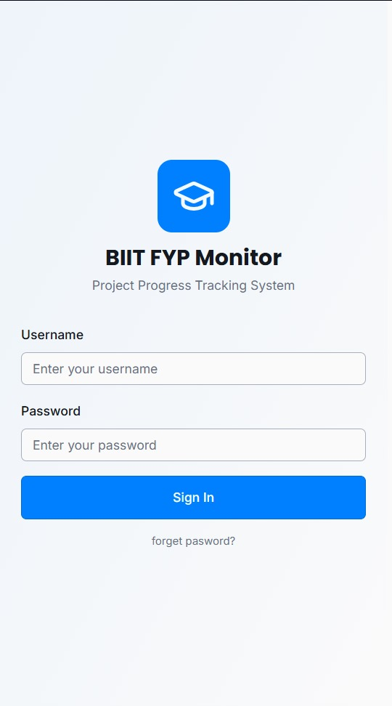
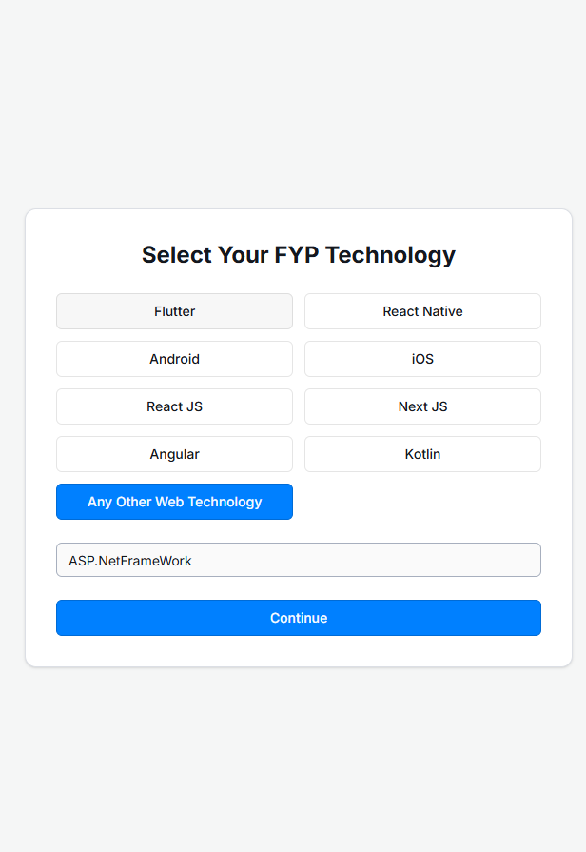
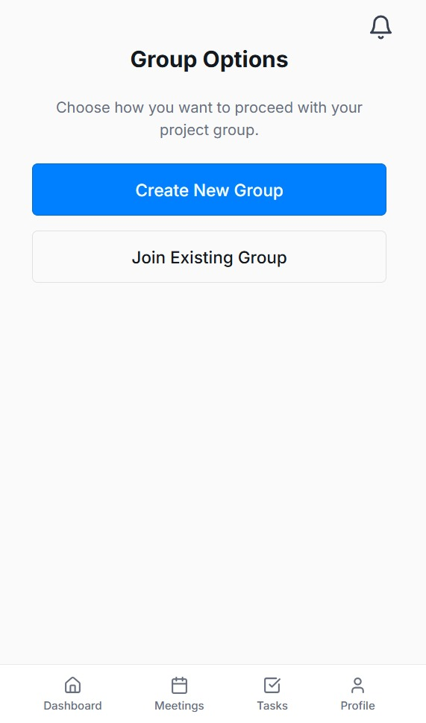
IMPLEMENTED + INTEGRATED

Slide 3
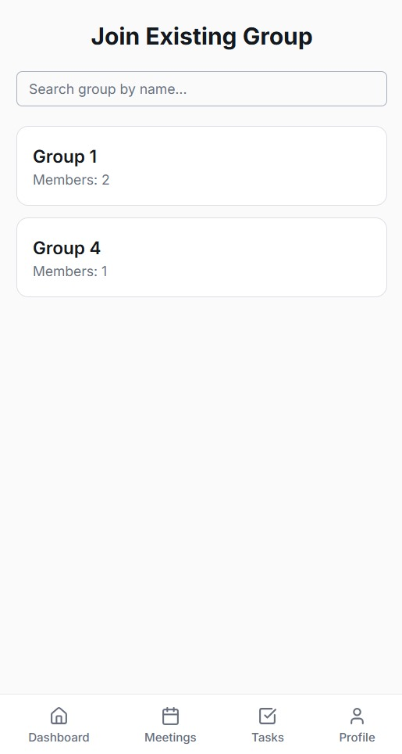
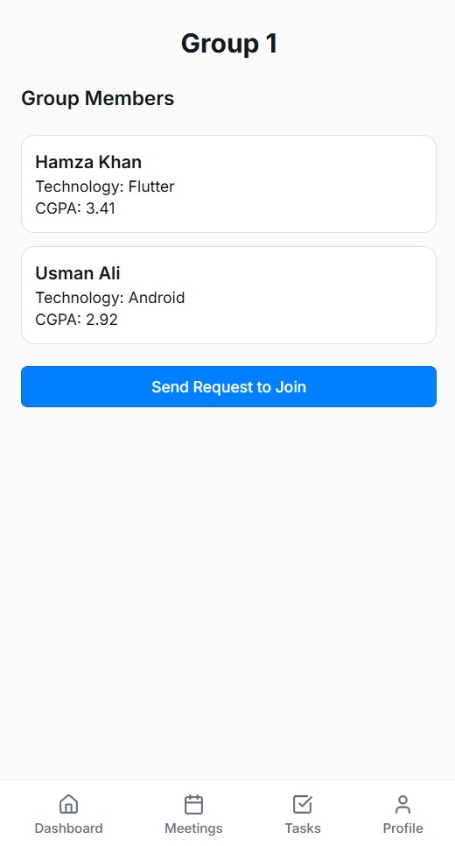
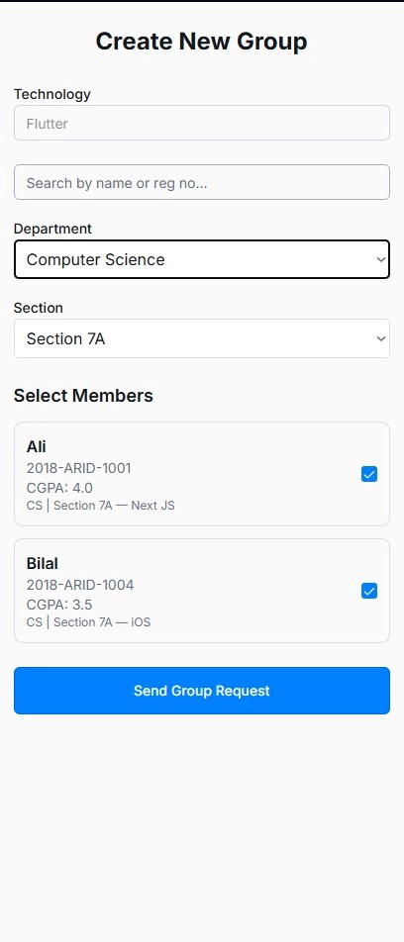
IMPLEMENTED + INTEGRATED

Slide 4
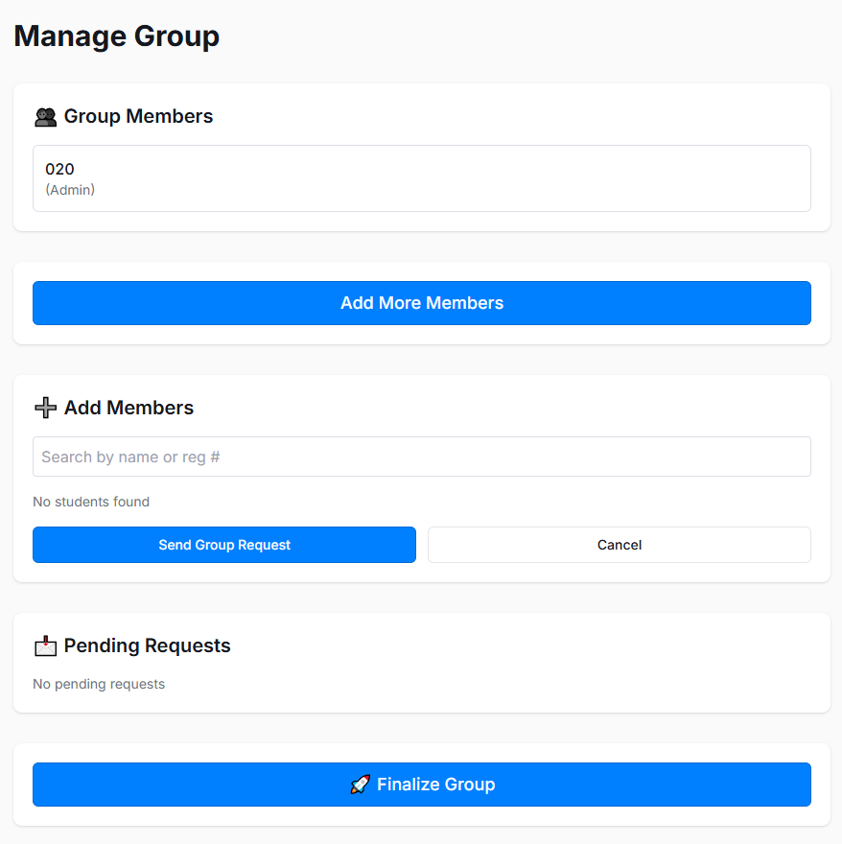
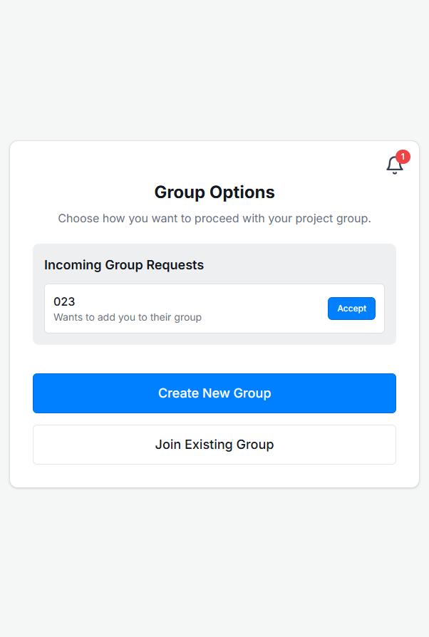
IMPLEMENTED + INTEGRATED

Slide 5
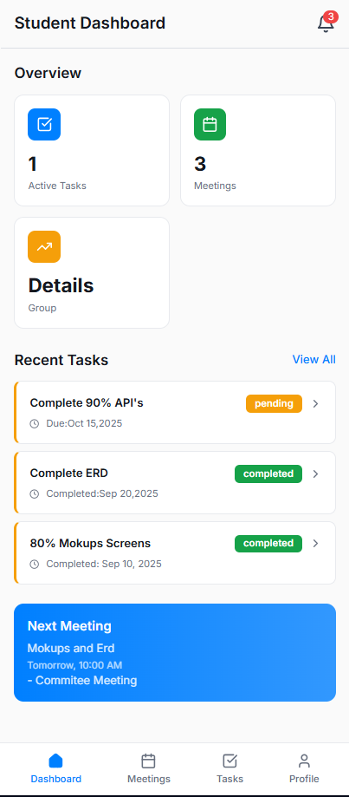
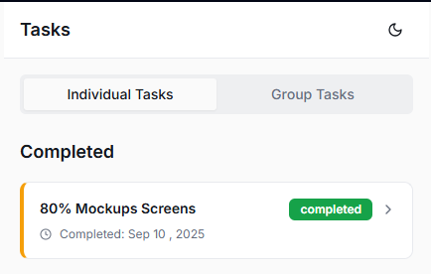
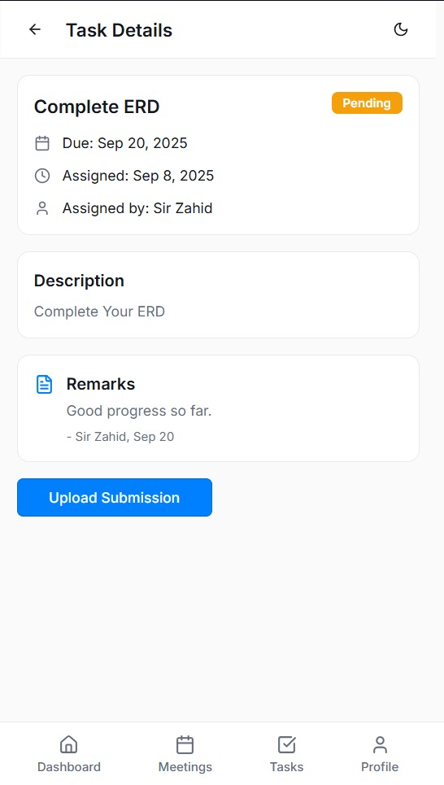
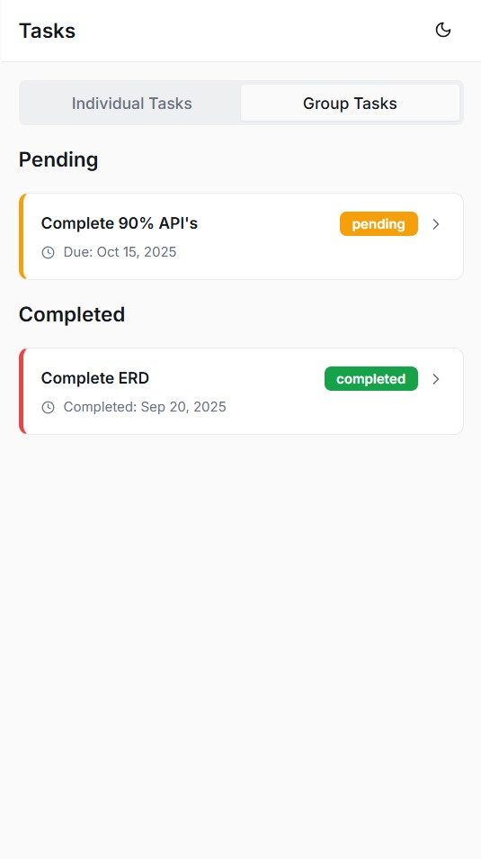
IMPLEMENTED + INTEGRATED
Student Dashboard

Slide 6
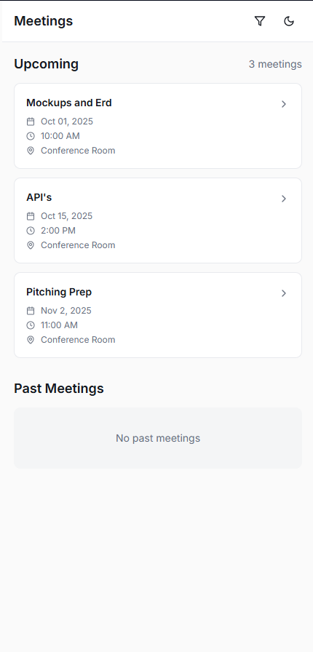
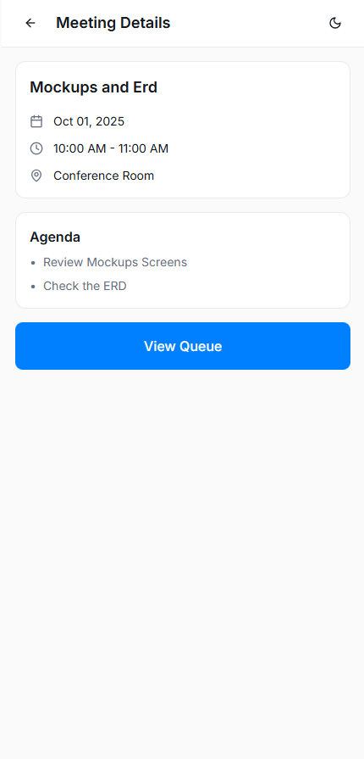
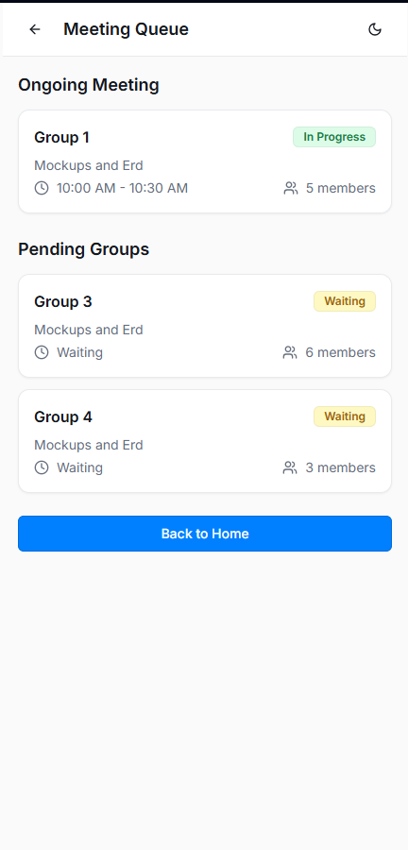
IMPLEMENTED + INTEGRATED

Slide 7
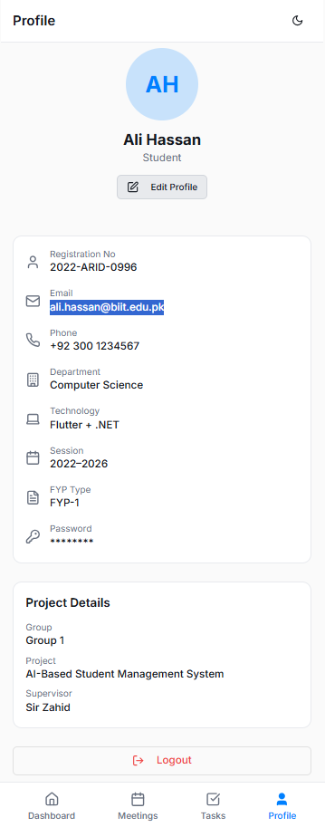
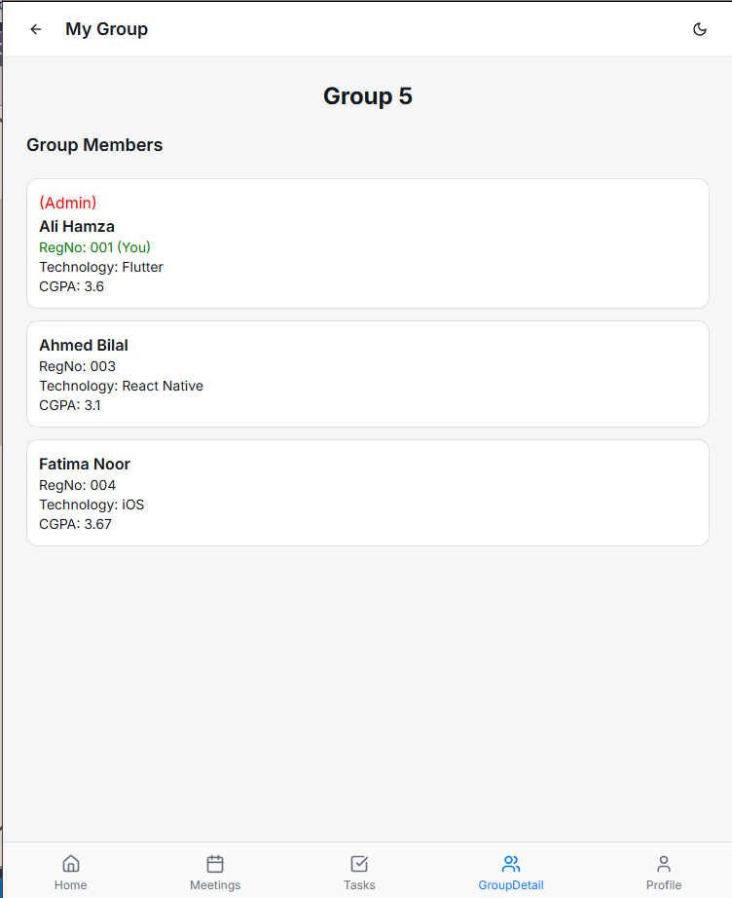
IMPLEMENTED + INTEGRATED

Slide 8
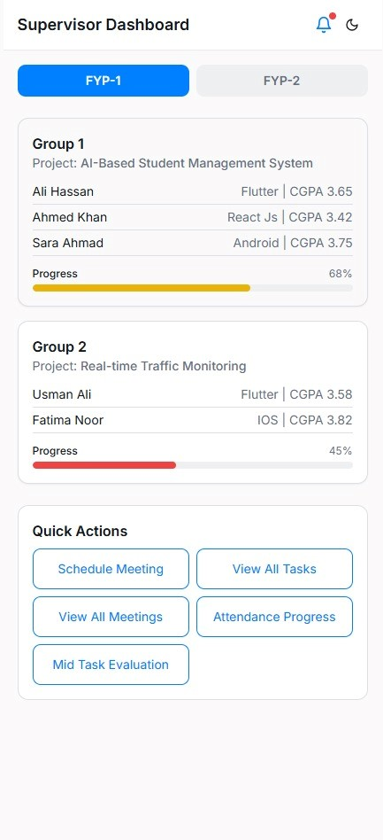
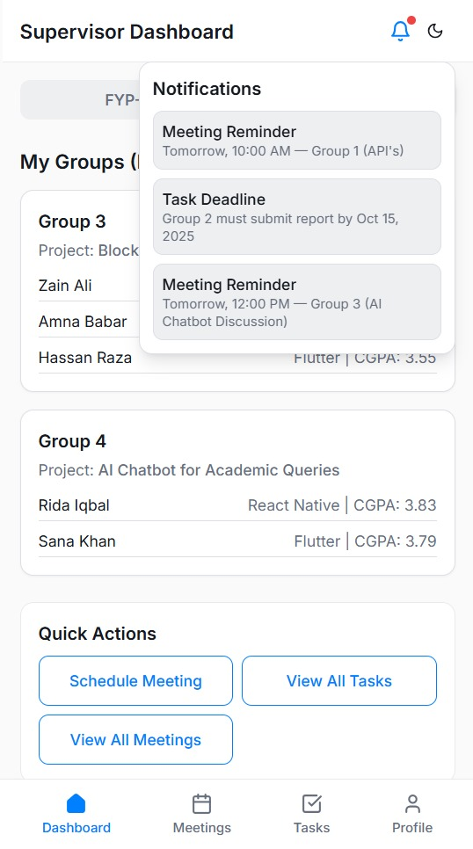
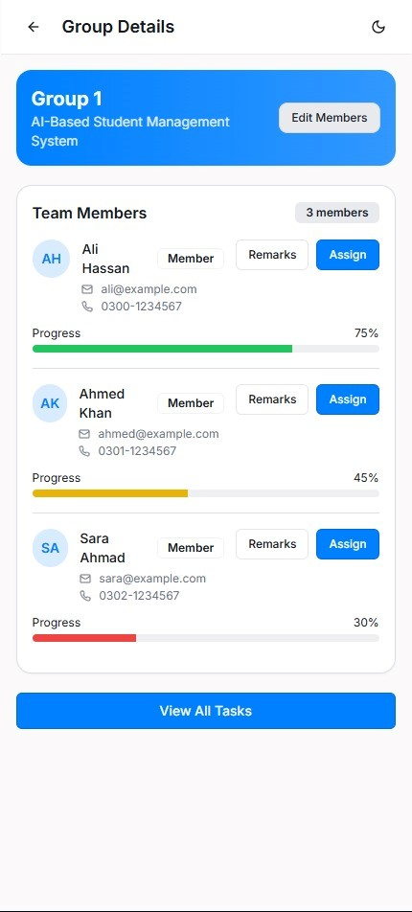
IMPLEMENTED + INTEGRATED
Supervisor Dashboard

Slide 9
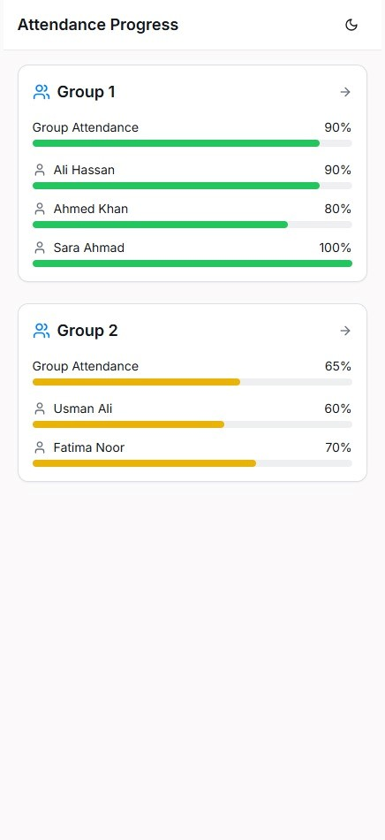
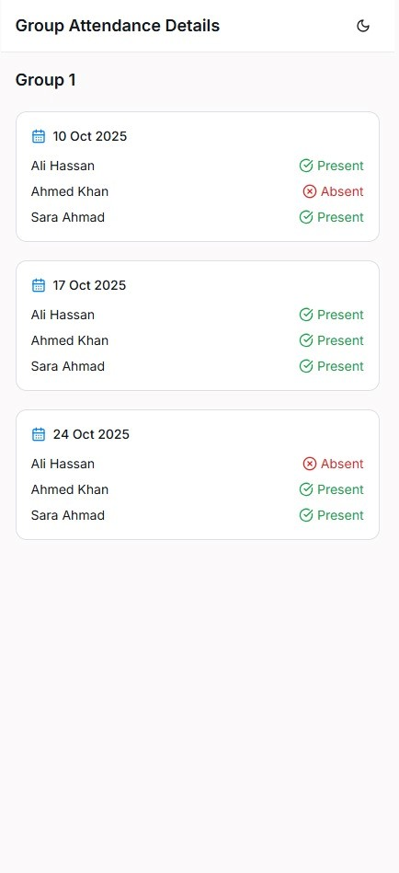
IMPLEMENTED + INTEGRATED

Slide 10
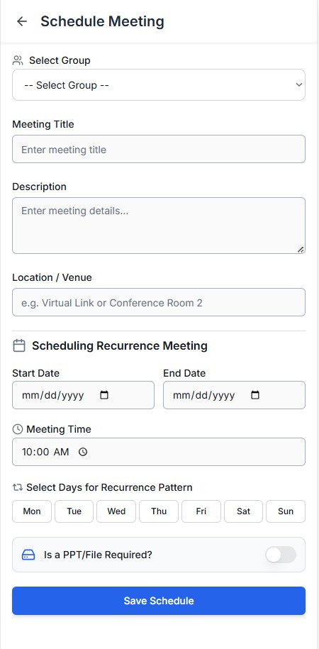
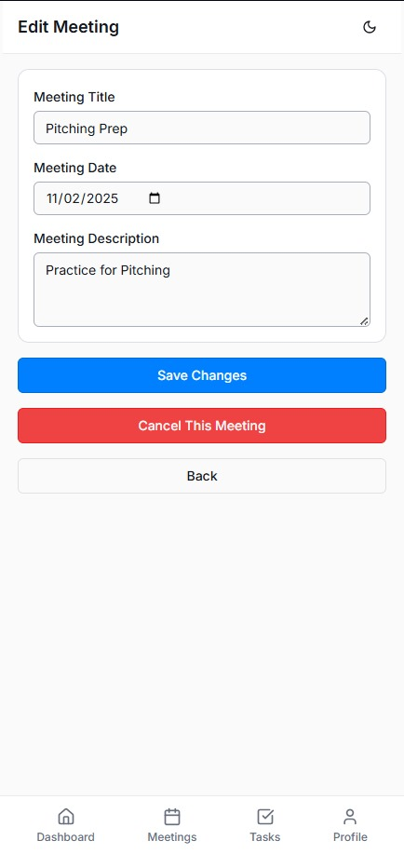
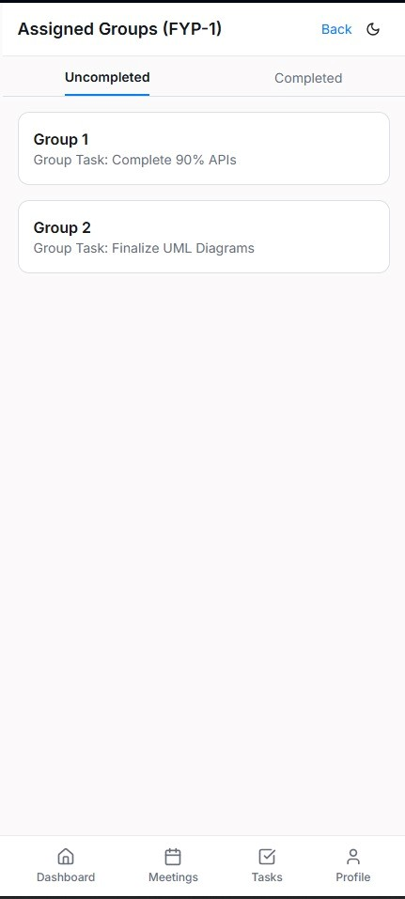
IMPLEMENTED + INTEGRATED

Slide 11
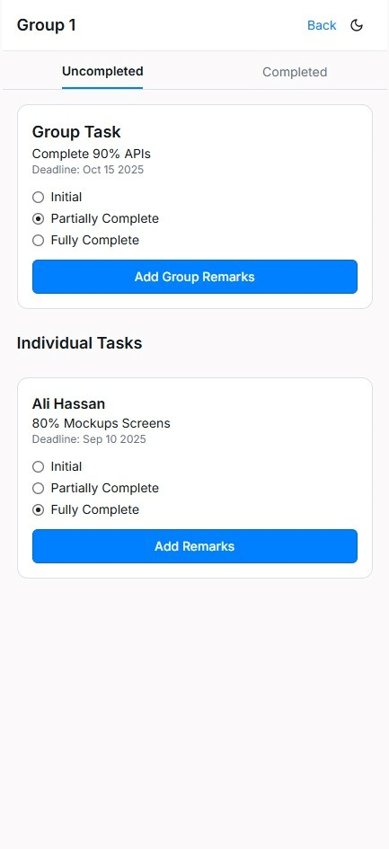
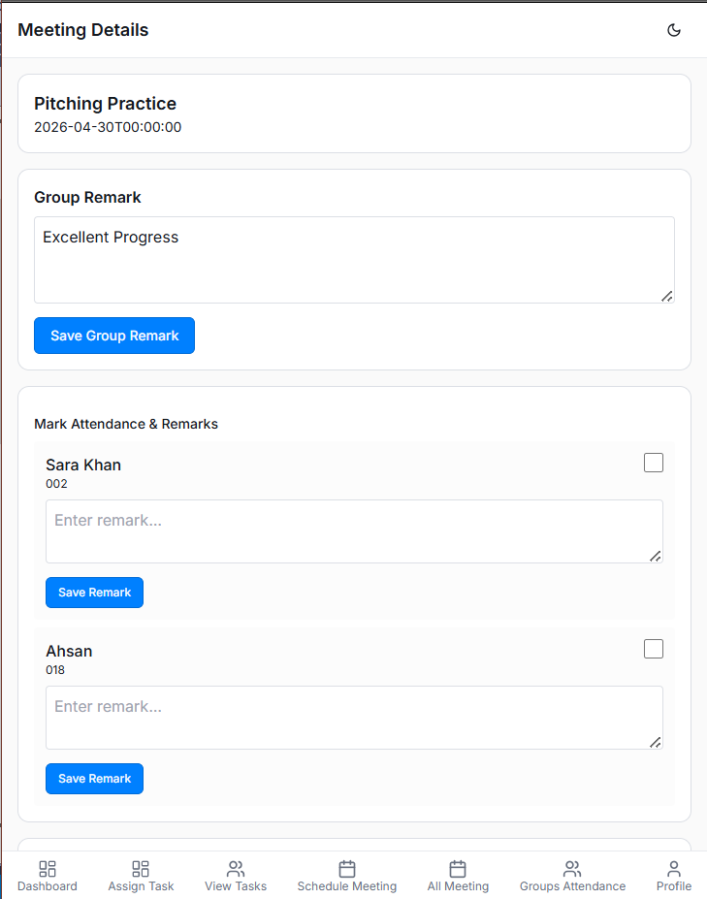
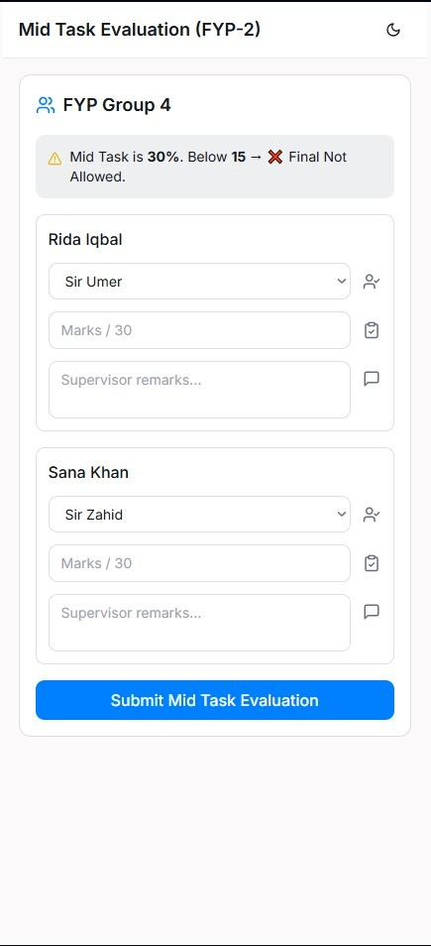
IMPLEMENTED + INTEGRATED

Slide 12
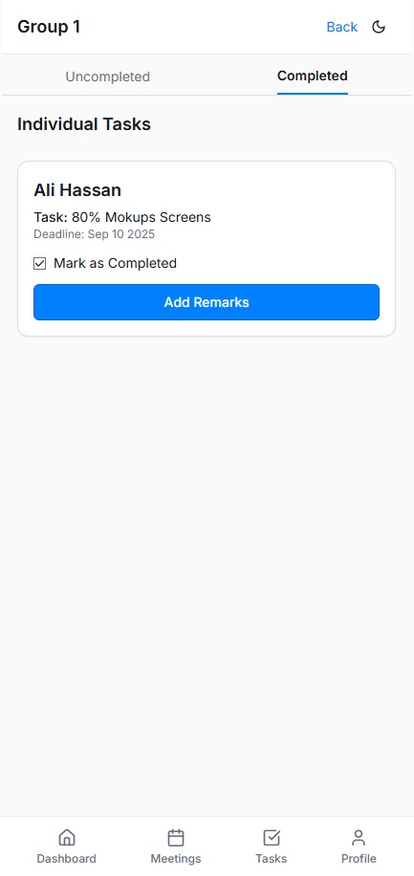
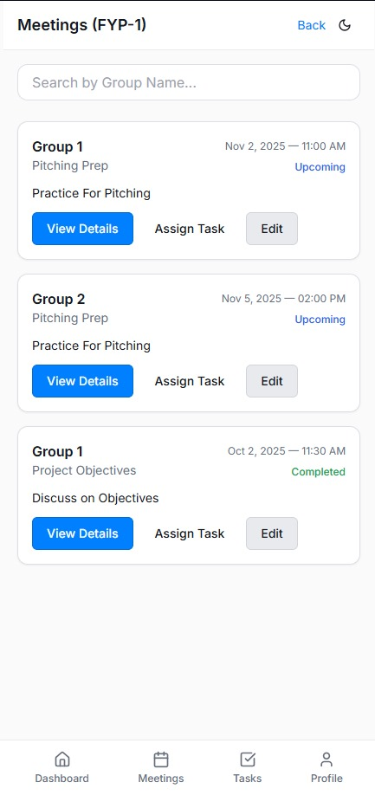
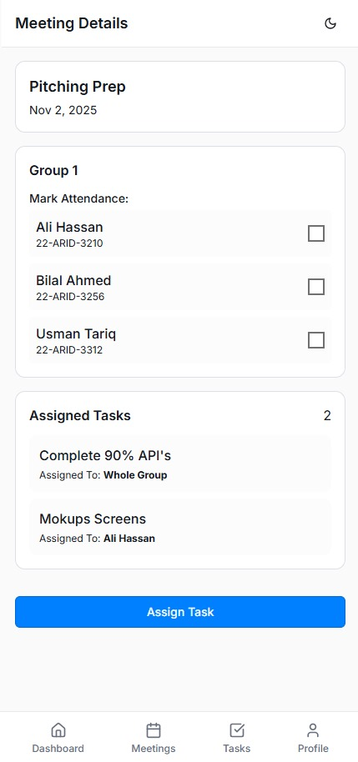
IMPLEMENTED + INTEGRATED

Slide 13
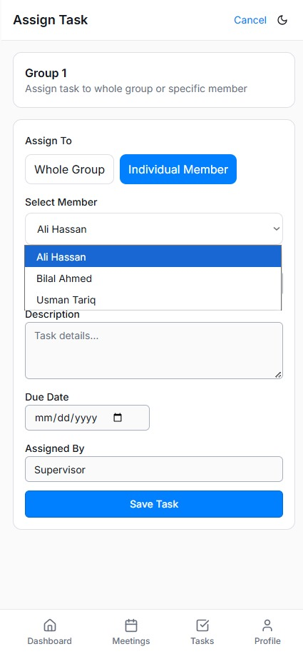
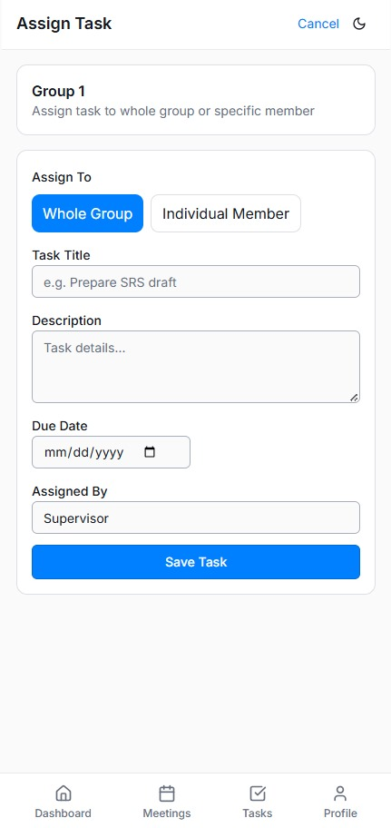
IMPLEMENTED + INTEGRATED

Slide 14
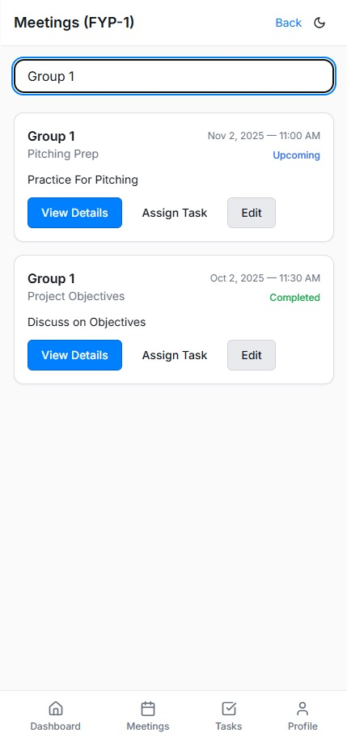
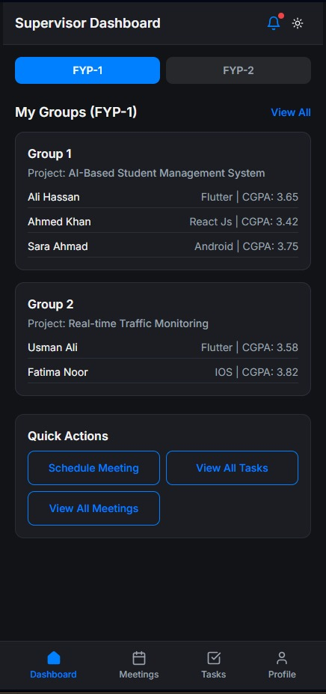
IMPLEMENTED + INTEGRATED

Slide 15
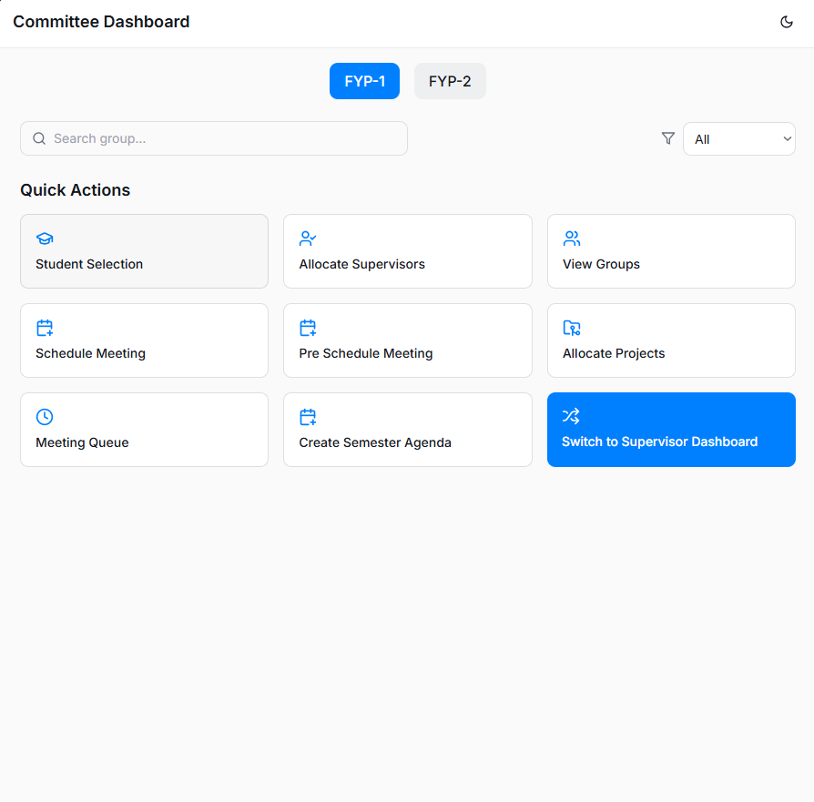
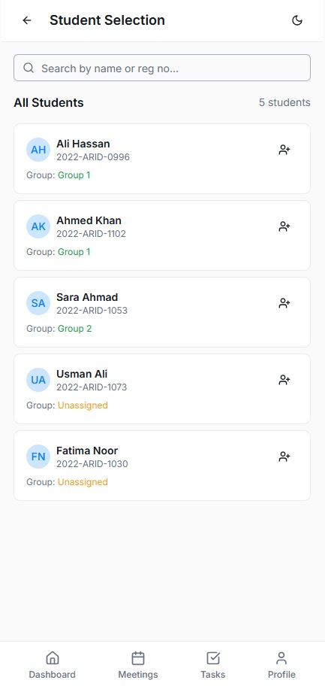
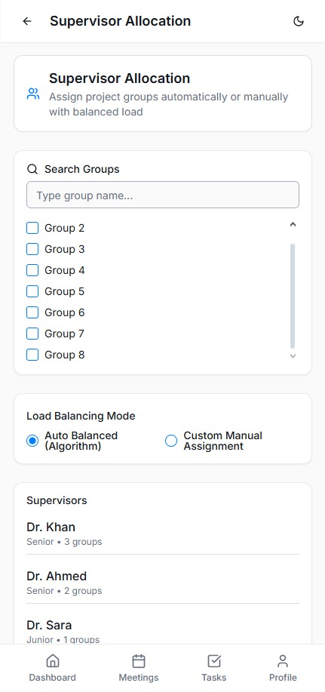
Committee Dashboard
IMPLEMENTED + INTEGRATED

Slide 16
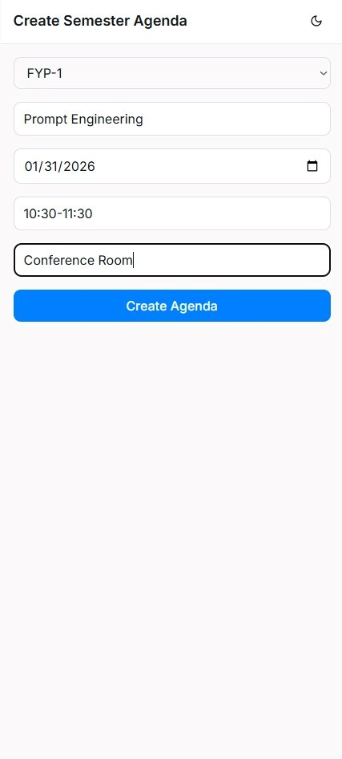
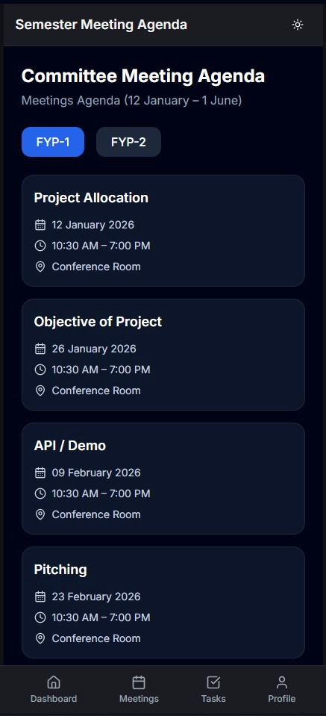
IMPLEMENTED + INTEGRATED

Slide 17
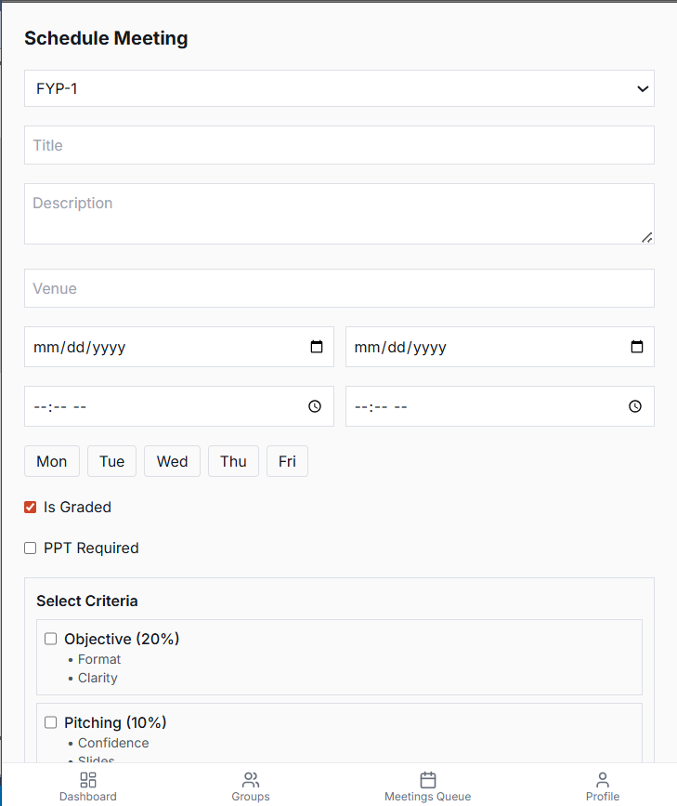
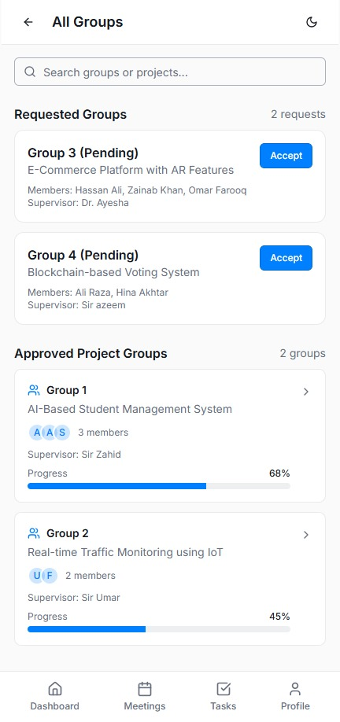
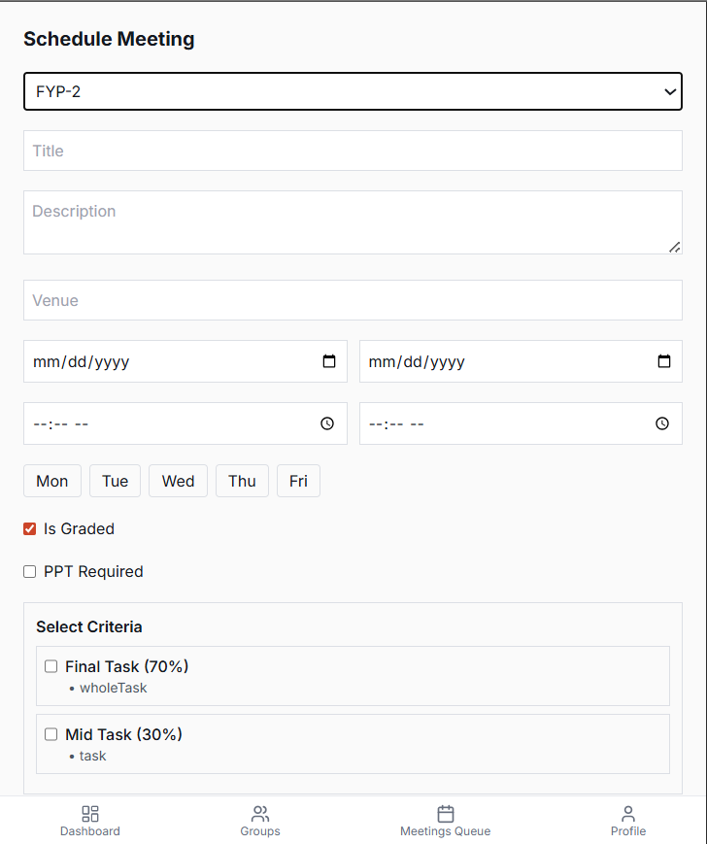
IMPLEMENTED + INTEGRATED

Slide 18
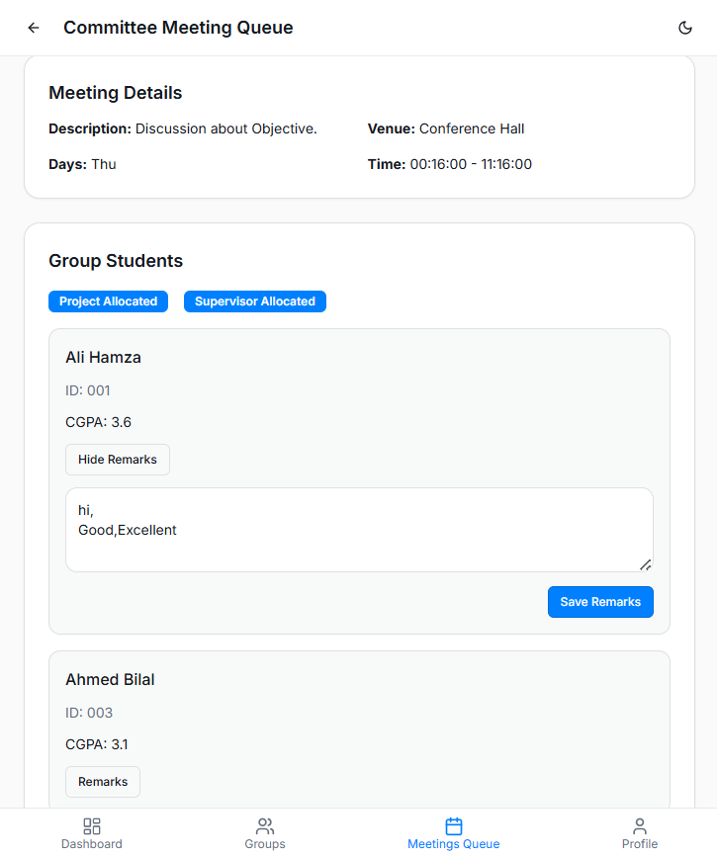
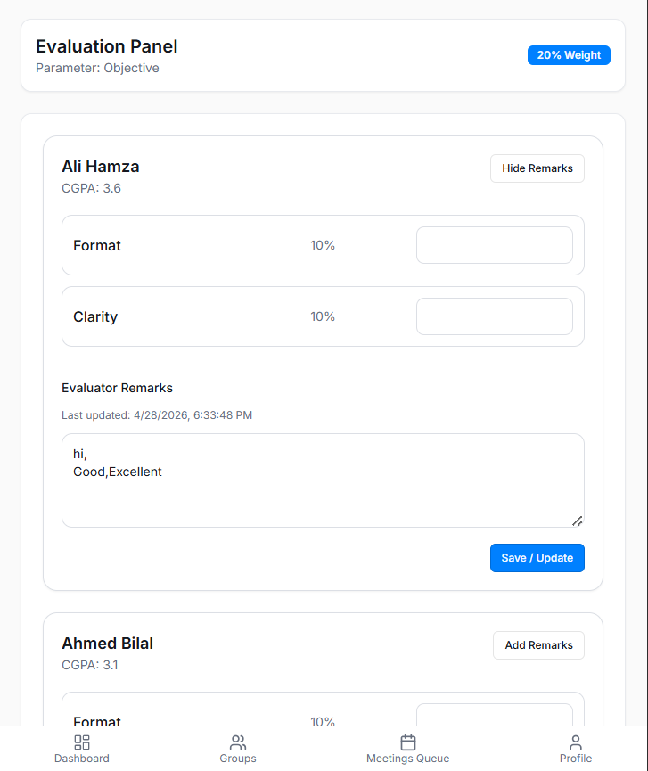
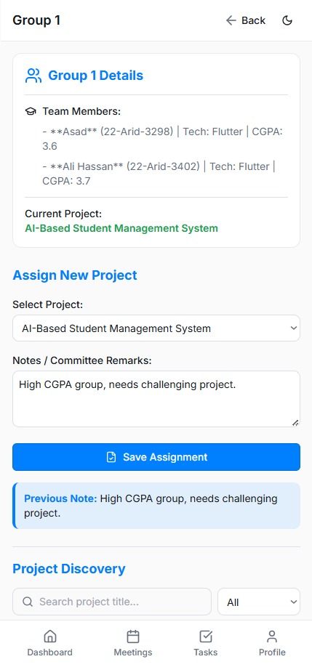
IMPLEMENTED + INTEGRATED

Slide 19
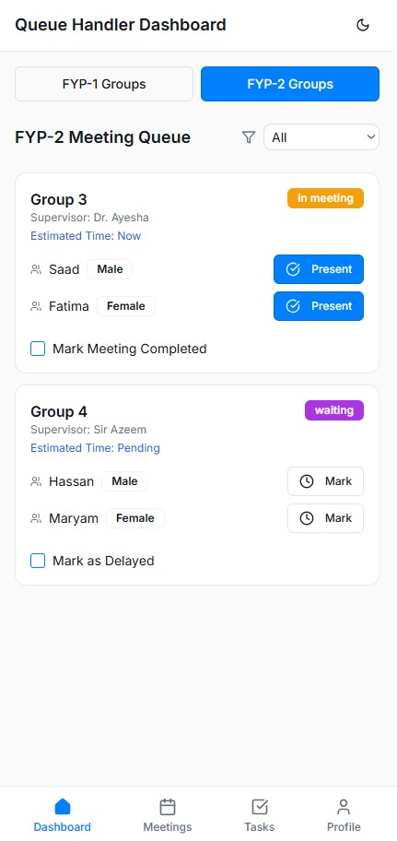
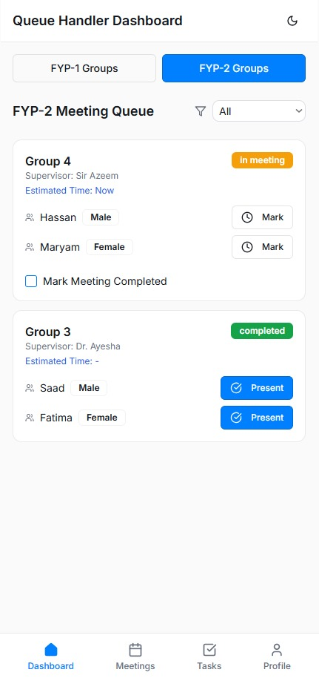
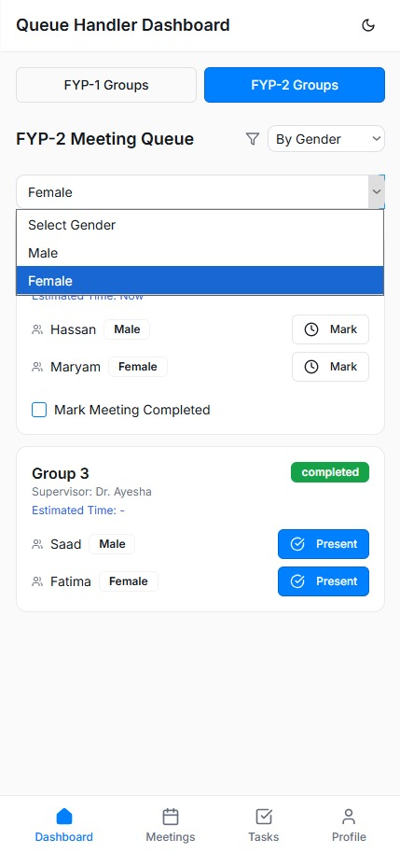
Queue Handler Dashboard
IMPLEMENTED + INTEGRATED

Slide 20
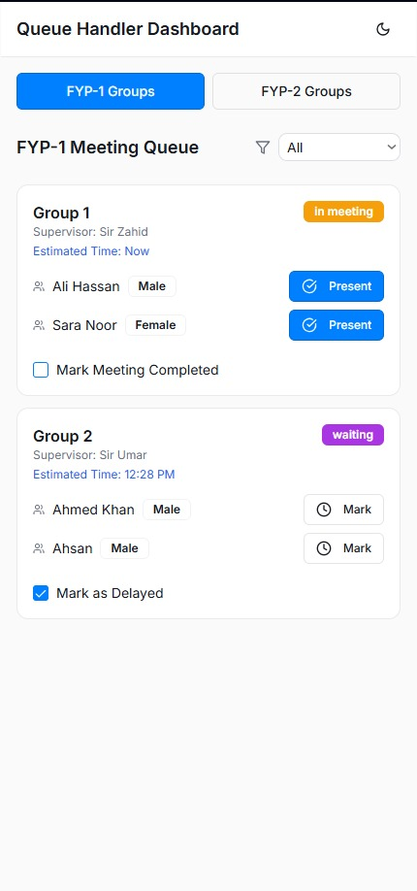


IMPLEMENTED + INTEGRATED
Alternative

Slide 21

IMPLEMENTED + INTEGRATED

Slide 22



Committee Head Dashboard
IMPLEMENTED + INTEGRATED

Slide 23




IMPLEMENTED + INTEGRATED

Slide 24



IMPLEMENTED + INTEGRATED

Slide 25
IMPLEMENTED + INTEGRATED

Slide 26
TAHA’S SCREENS (Flutter)

Slide 27



IMPLEMENTED + INTEGRATED

Slide 28



IMPLEMENTED + INTEGRATED

Slide 29



IMPLEMENTED + INTEGRATED

Slide 30


IMPLEMENTED + INTEGRATED

Slide 31
IMPLEMENTED
Supervisor Dashboard

Slide 32
IMPLEMENTED

Slide 33
IMPLEMENTED

Slide 34
IMPLEMENTED

Slide 35
IMPLEMENTED

Slide 36
IMPLEMENTED

Slide 37
IMPLEMENTED

Slide 38
Queue Handler Dashboard
IMPLEMENTED

Slide 39
IMPLEMENTED
Alternative

Slide 40
SIMRAN HAFEEZ’S SCREENS (REACT NATIVE)

Slide 41



IMPLEMENTED + INTEGRATED

Slide 42


IMPLEMENTED + INTEGRATED

Slide 43





Student Dashboard

Slide 44



Slide 45


Slide 46






Supervisor Dashboard

Slide 47






Slide 48




IMPLEMENTED + INTEGRATED

Slide 49




Slide 50


IMPLEMENTED + INTEGRATED

Slide 51





IMPLEMENTED + INTEGRATED

Slide 52





IMPLEMENTED + INTEGRATED

Slide 53




IMPLEMENTED + INTEGRATED

Slide 54


IMPLEMENTED + INTEGRATED

Slide 55


Queue Handler Dashboard

Slide 56


Slide 57







Committee Head

Slide 58



Slide 59





