Slide 1

PROJECT PROGRESS MONITORING
2022-Arid-4158 Raja Muhammad Taha
2022-Arid-4198 Simran Hafeez
2022-Arid-4118 M. Sabih Ul Hassan

Slide 2
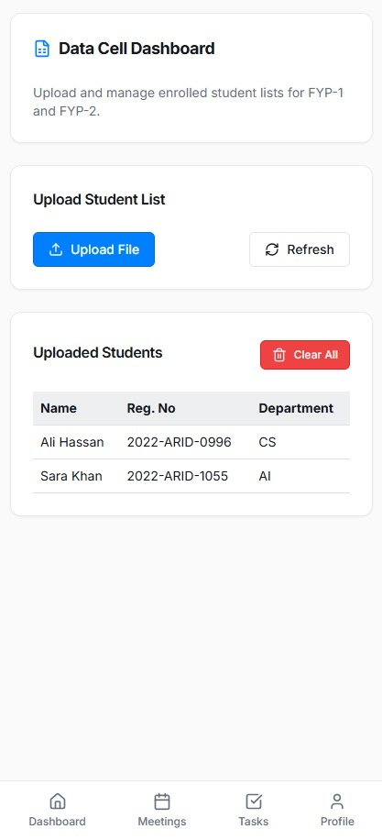

Slide 3
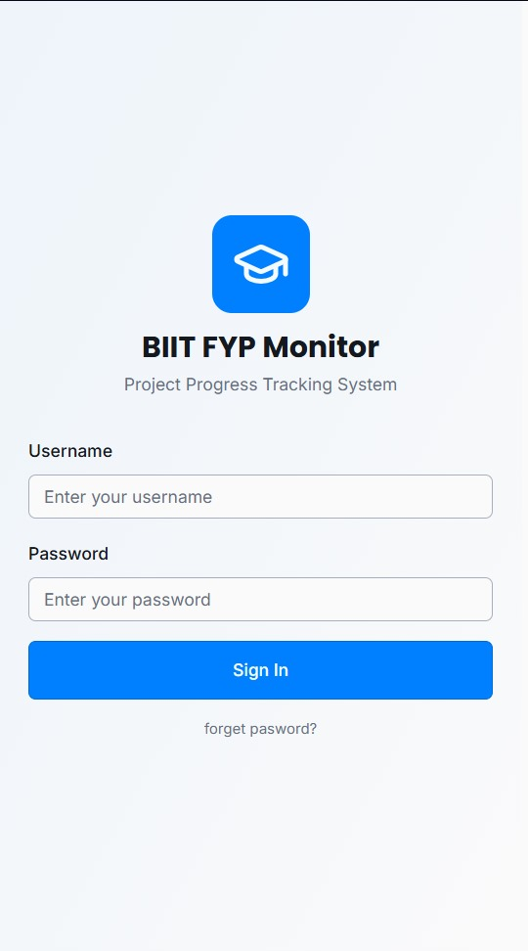
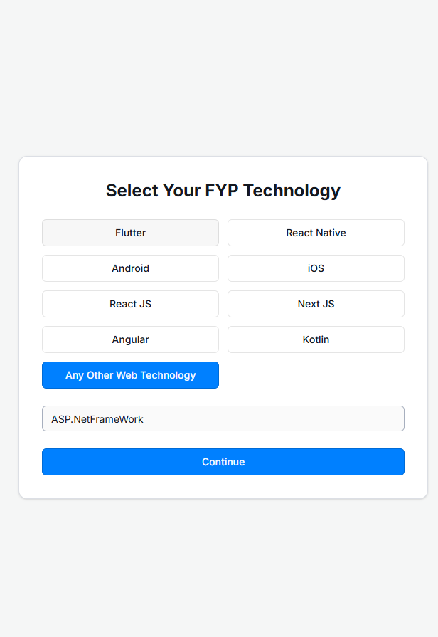

Slide 4
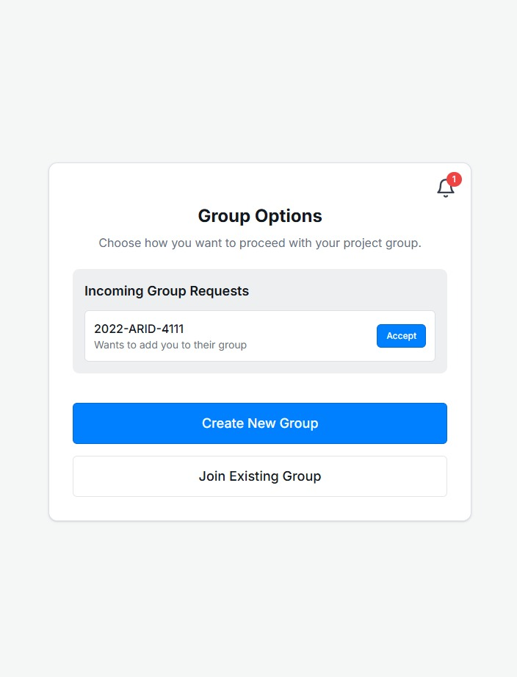
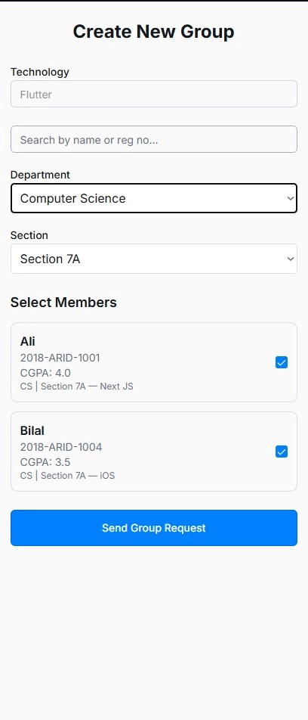

Slide 5
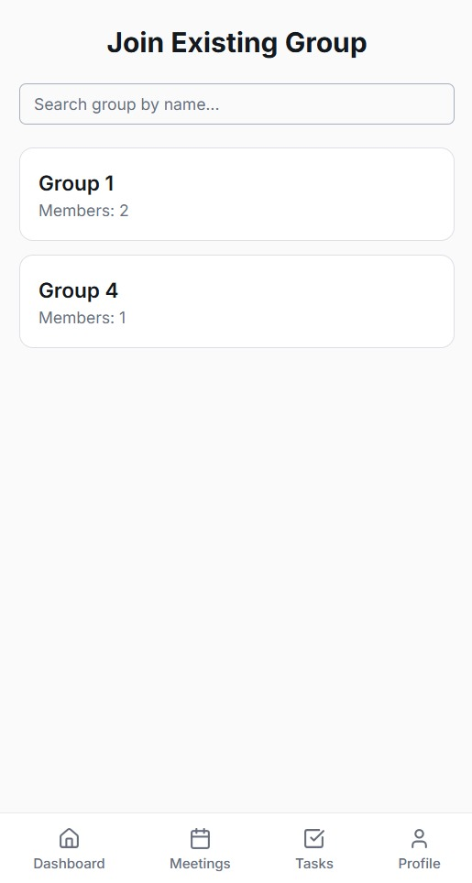
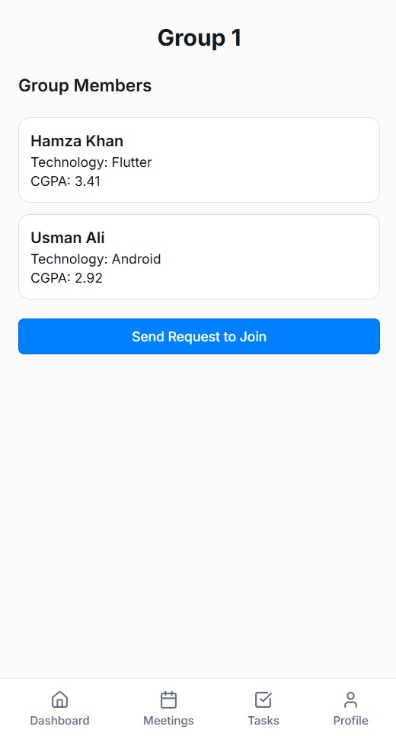

Slide 6
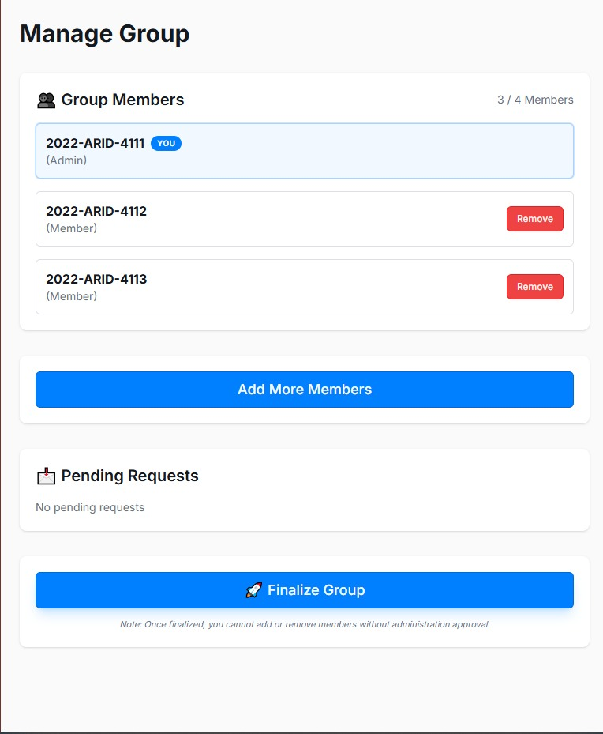
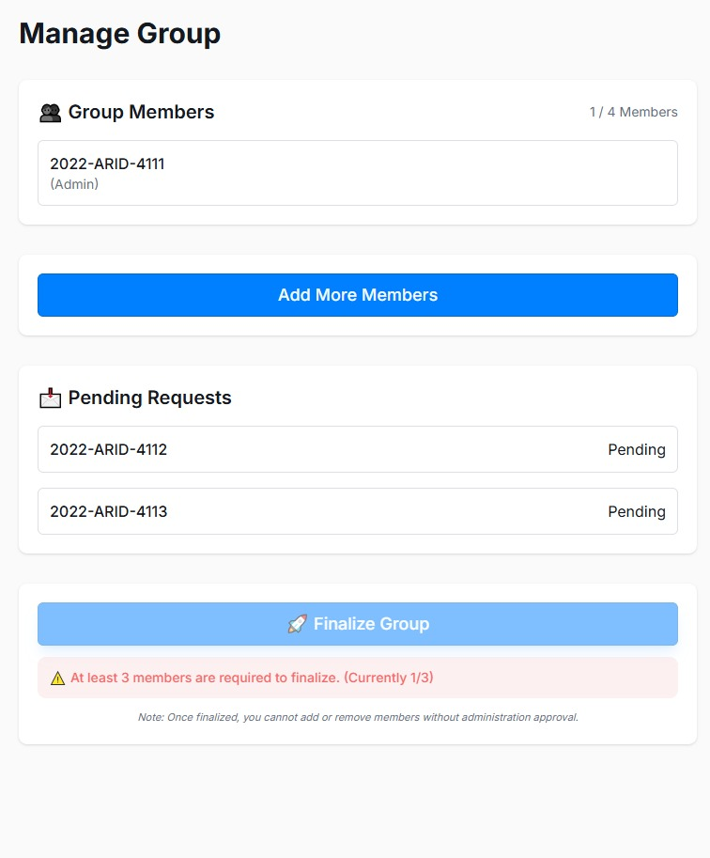

Slide 7
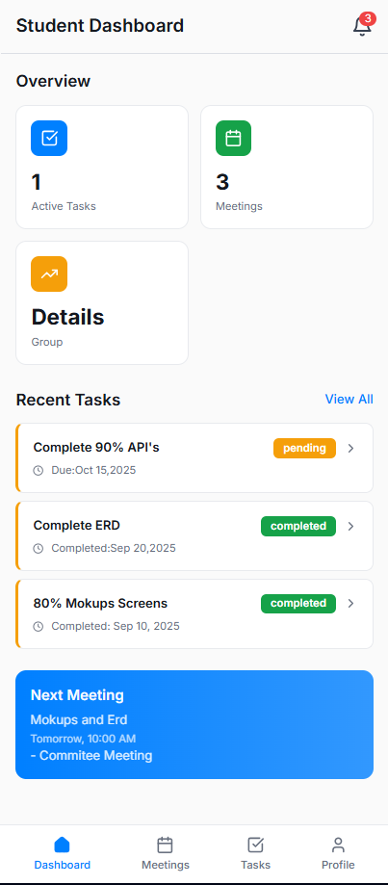
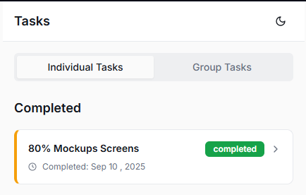
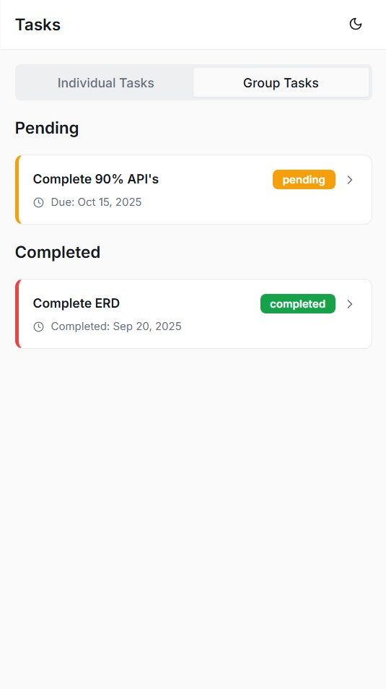

Slide 8
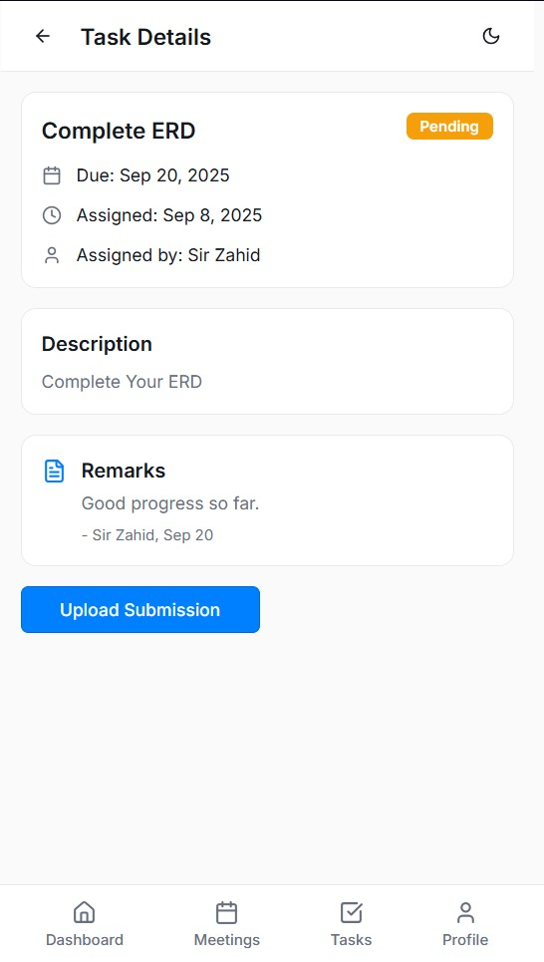
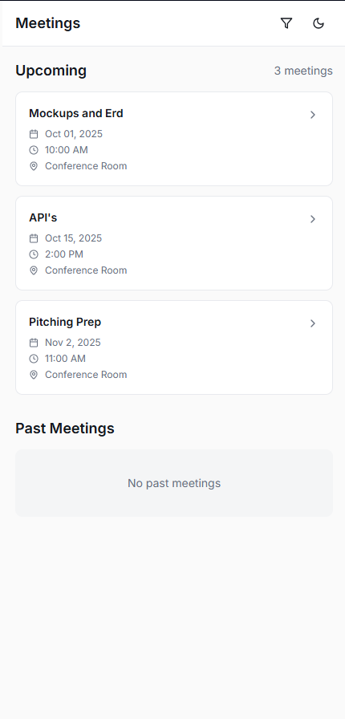

Slide 9
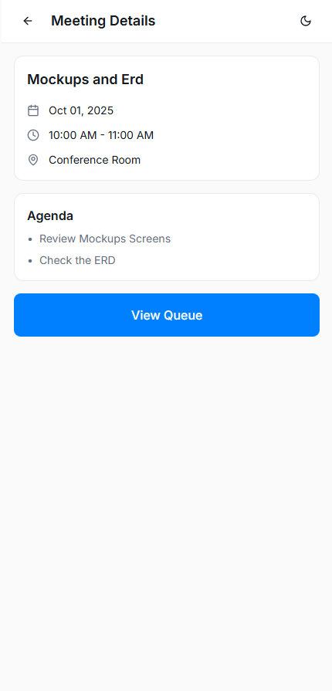
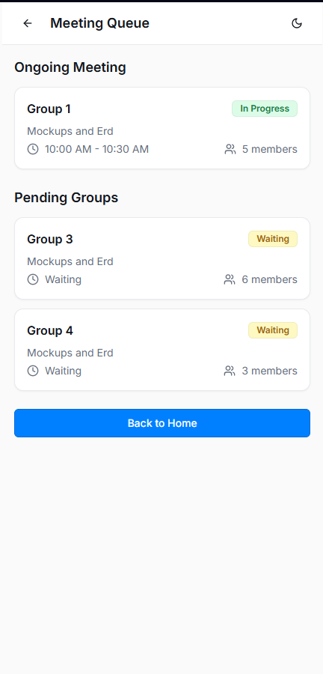

Slide 10
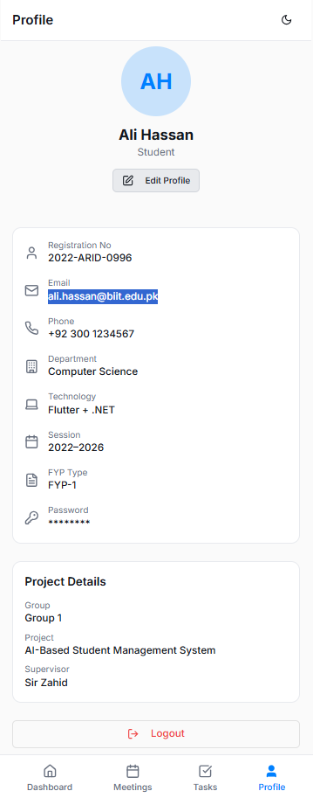
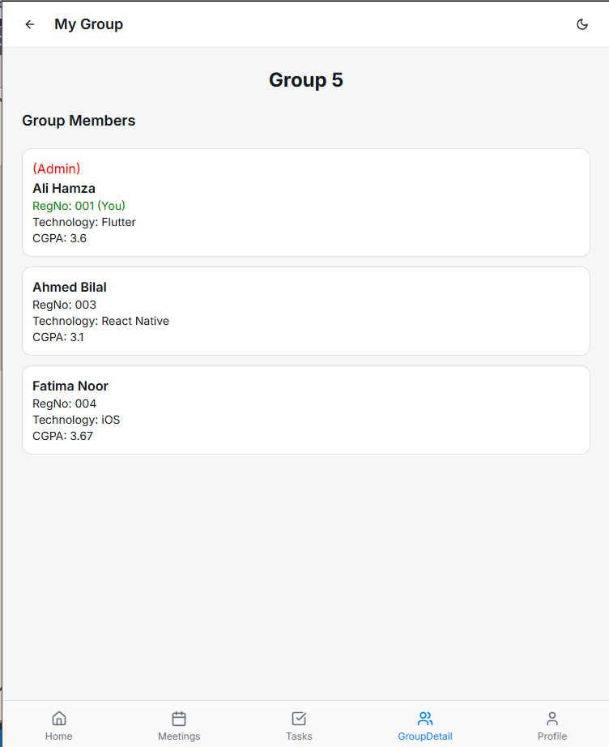

Slide 11
Committee

Slide 12
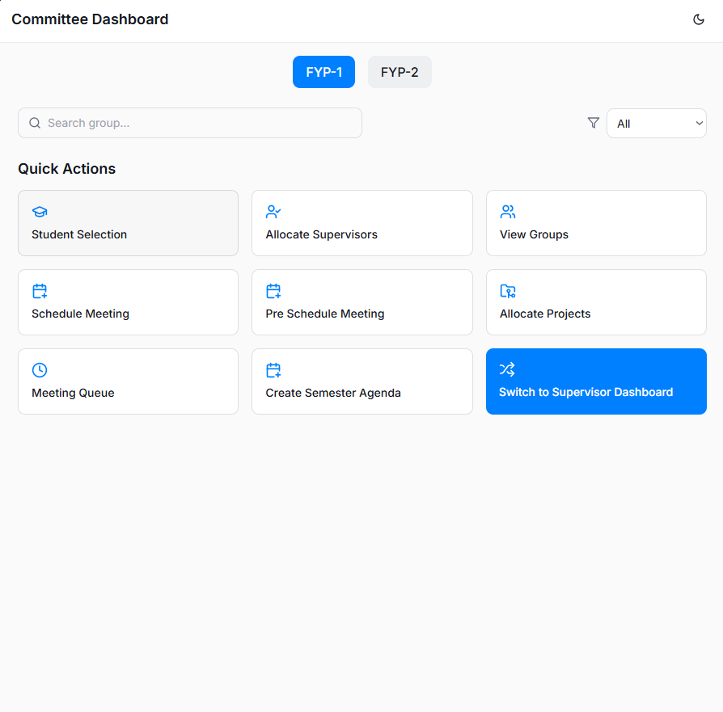
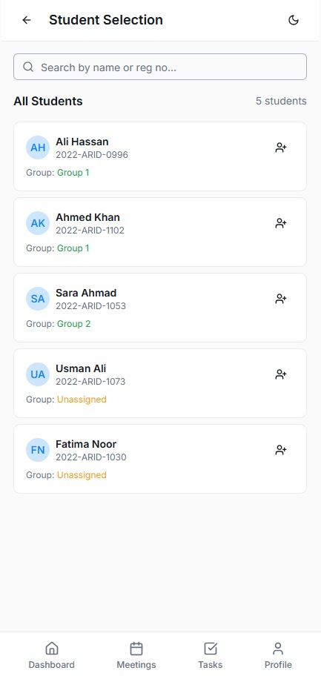

Slide 13
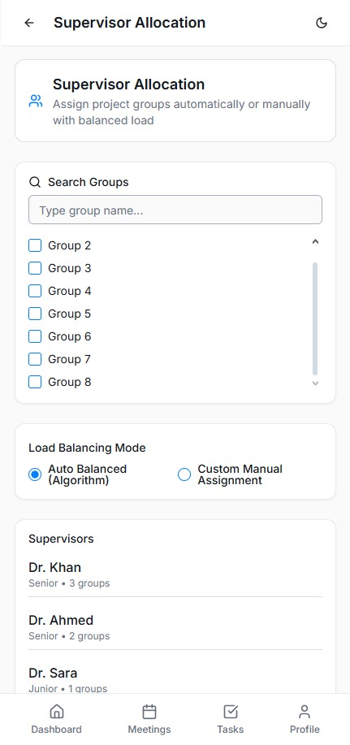
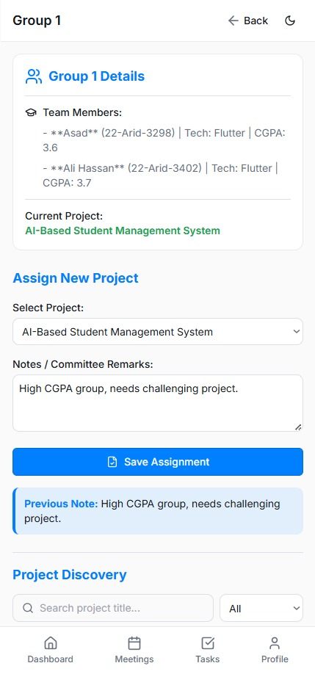

Slide 14
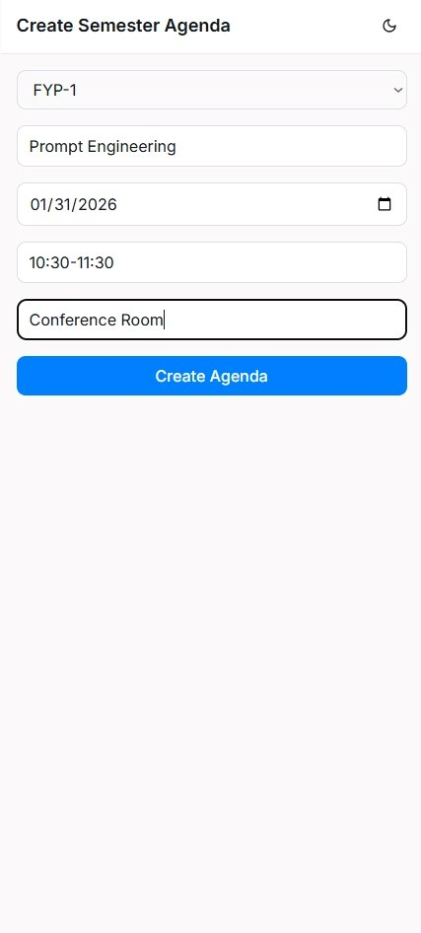
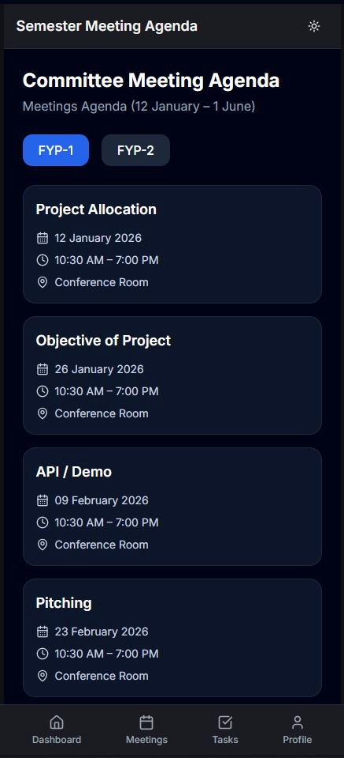

Slide 15
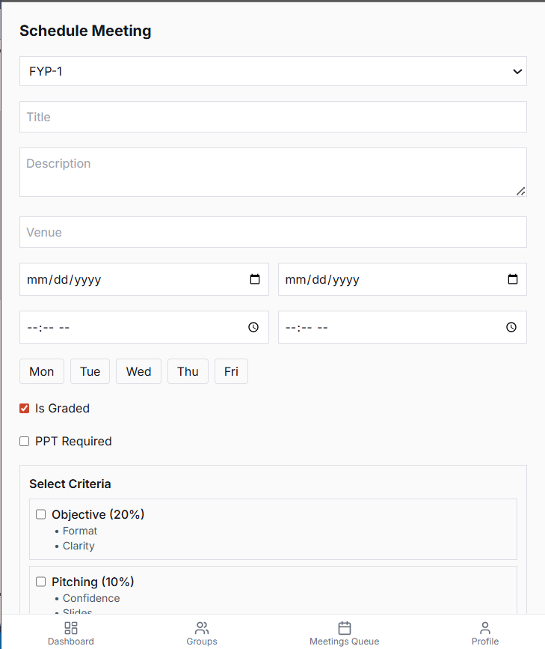
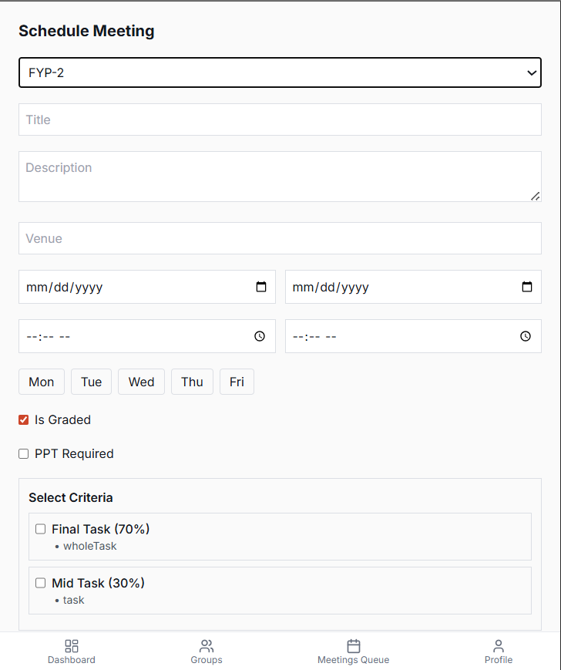

Slide 16
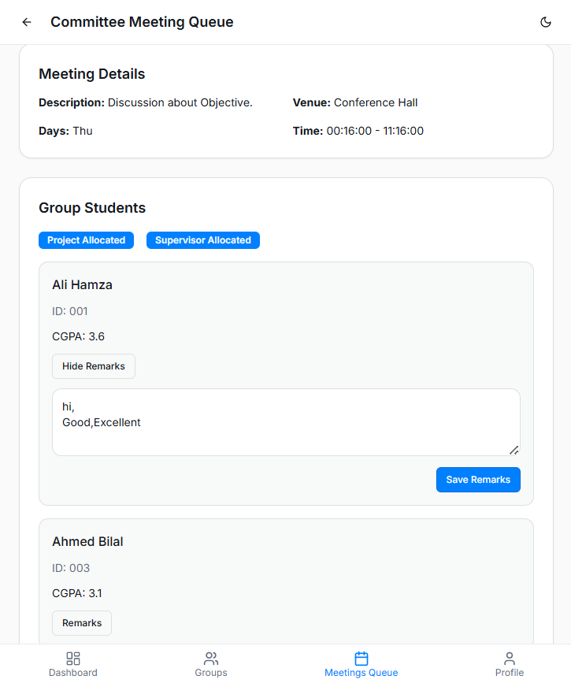
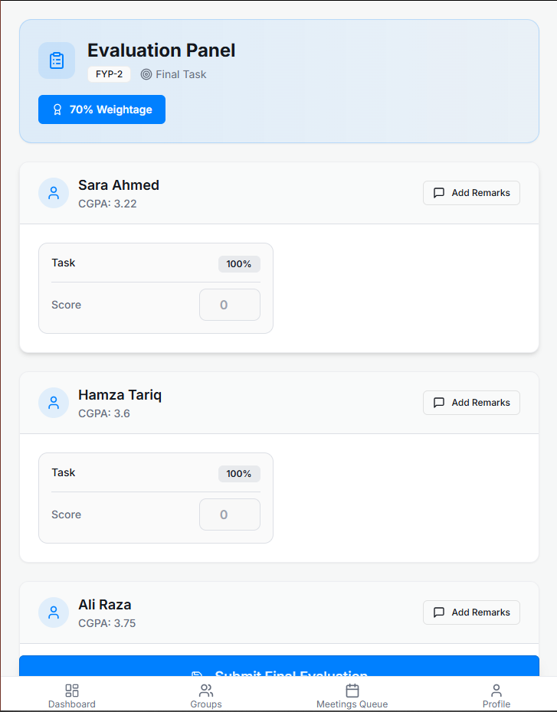
Committee Evaluation PAnel

Slide 17
Supervisor

Slide 18
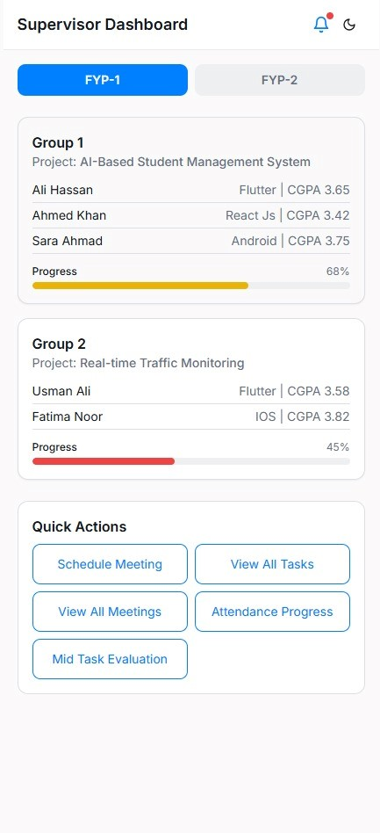
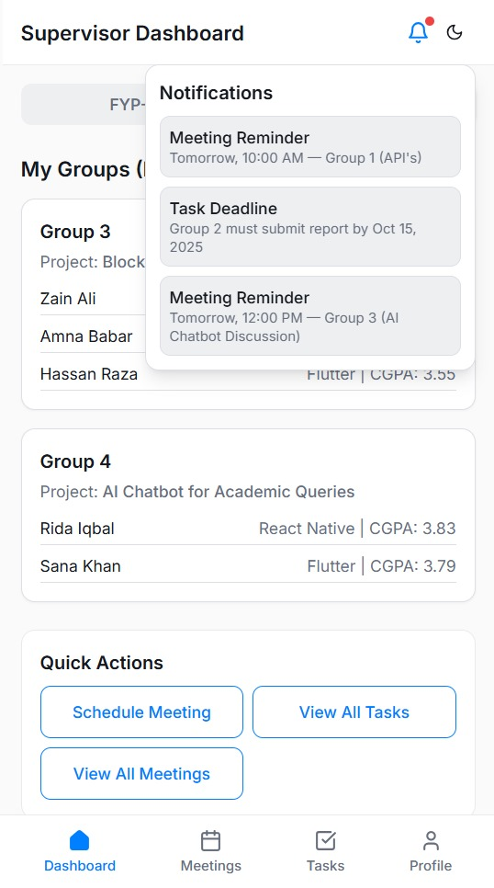

Slide 19
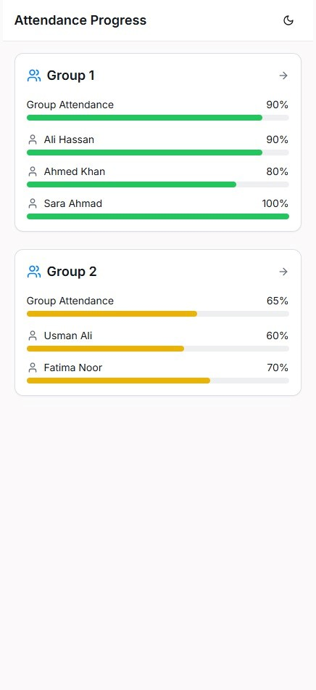
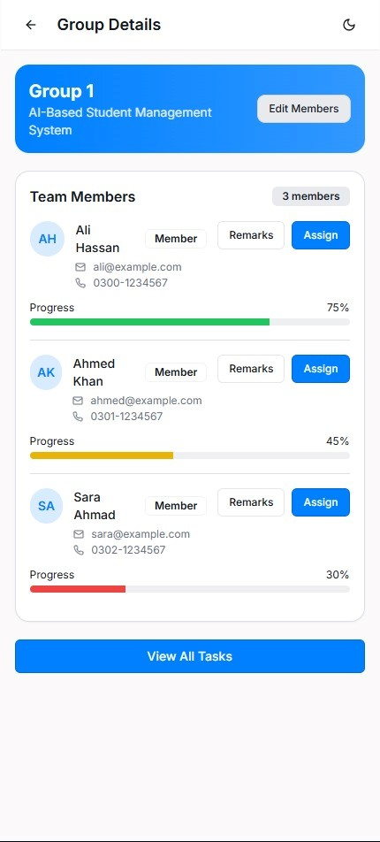

Slide 20
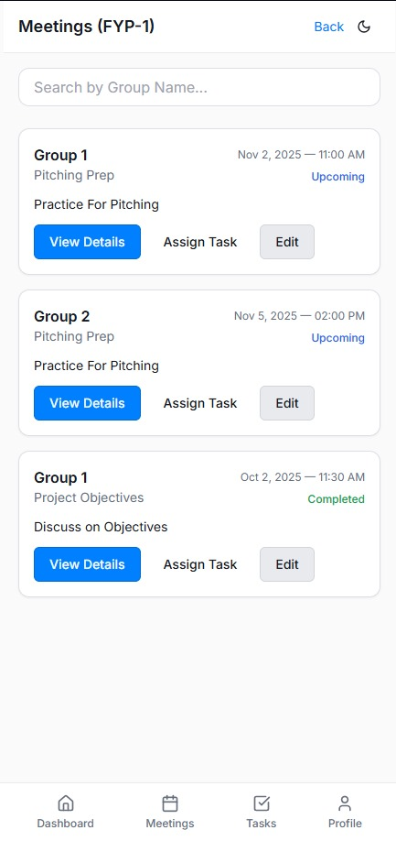
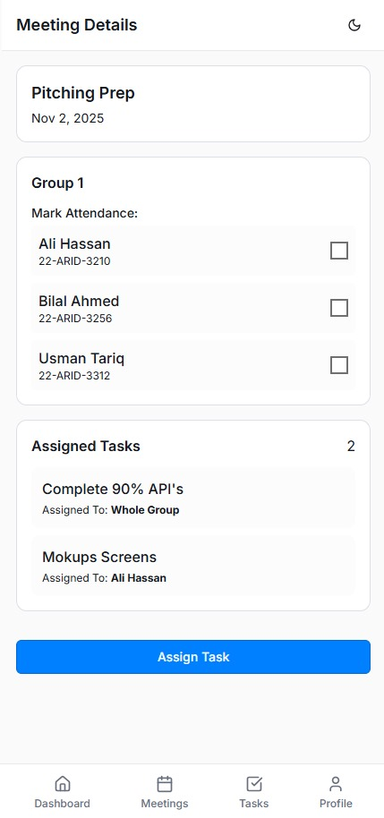

Slide 21
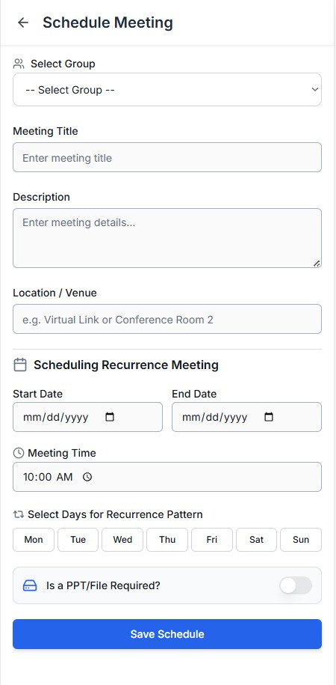
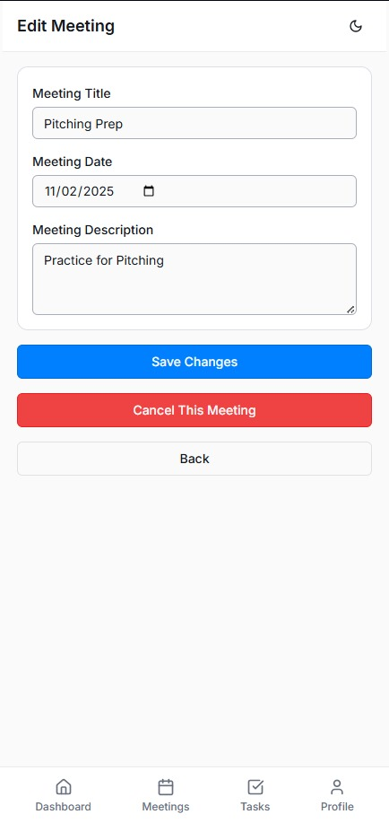

Slide 22
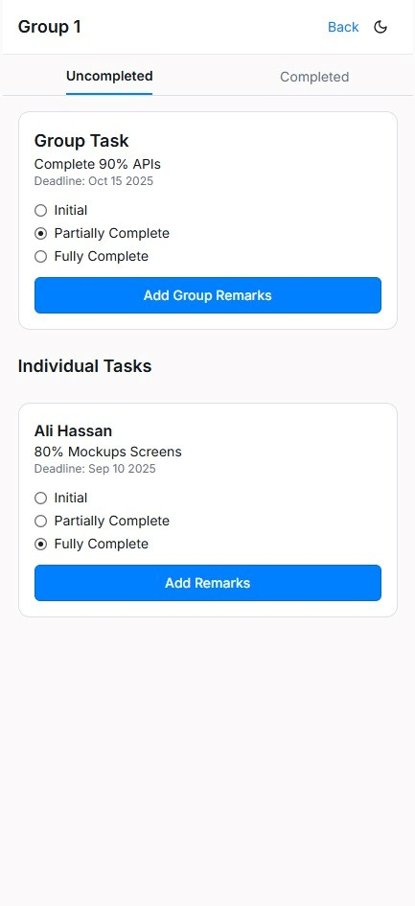
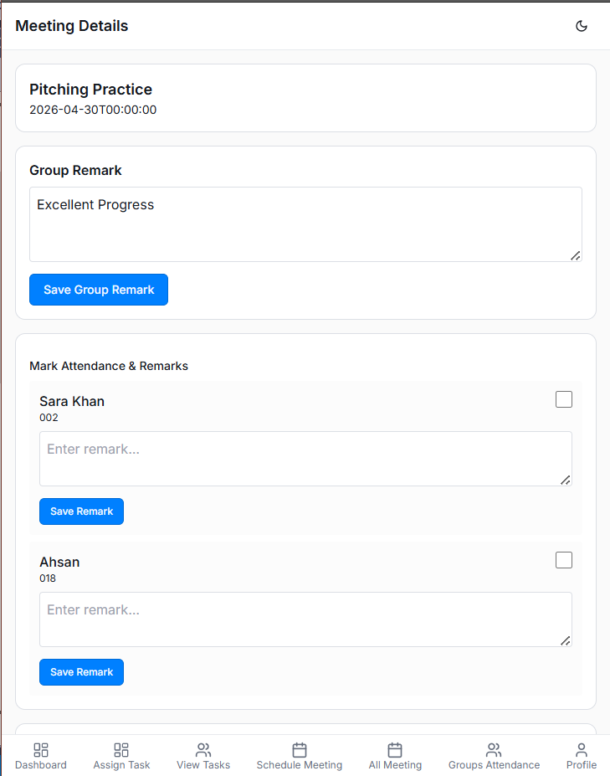

Slide 23
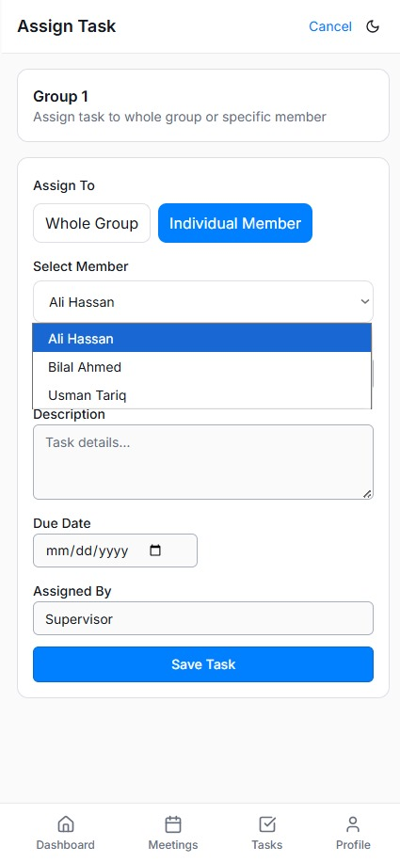
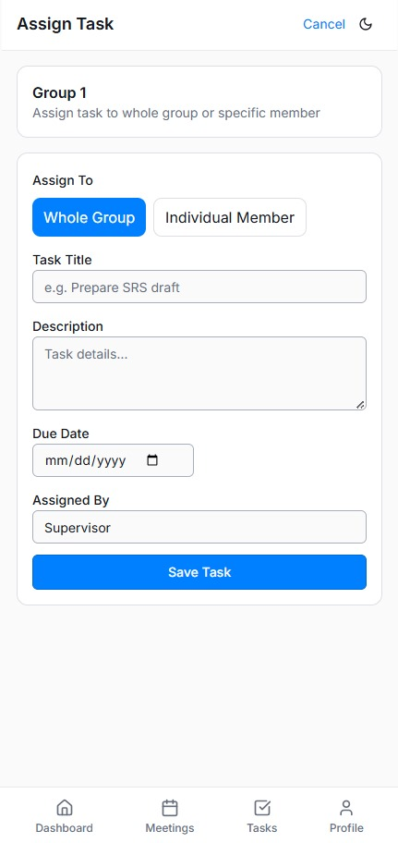

Slide 24
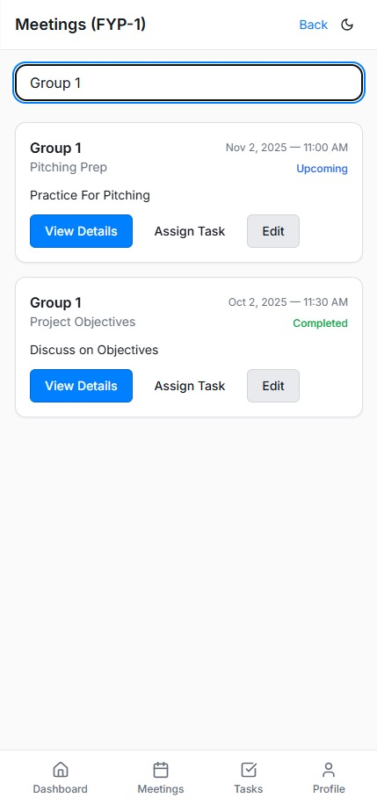
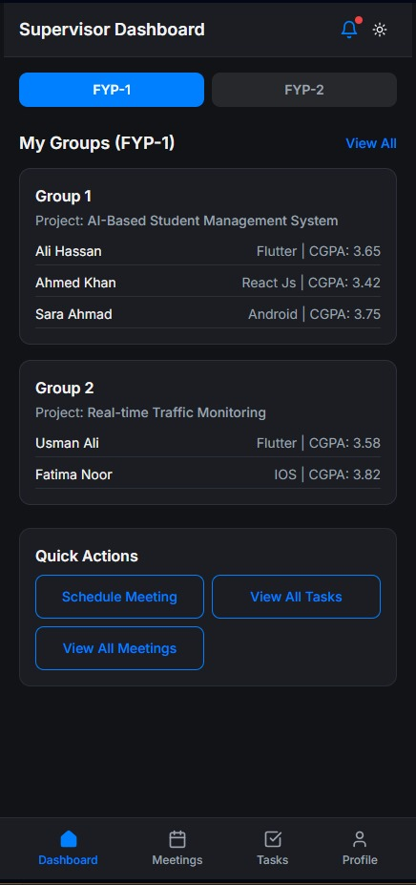

Slide 25
Queue Handler

Slide 26
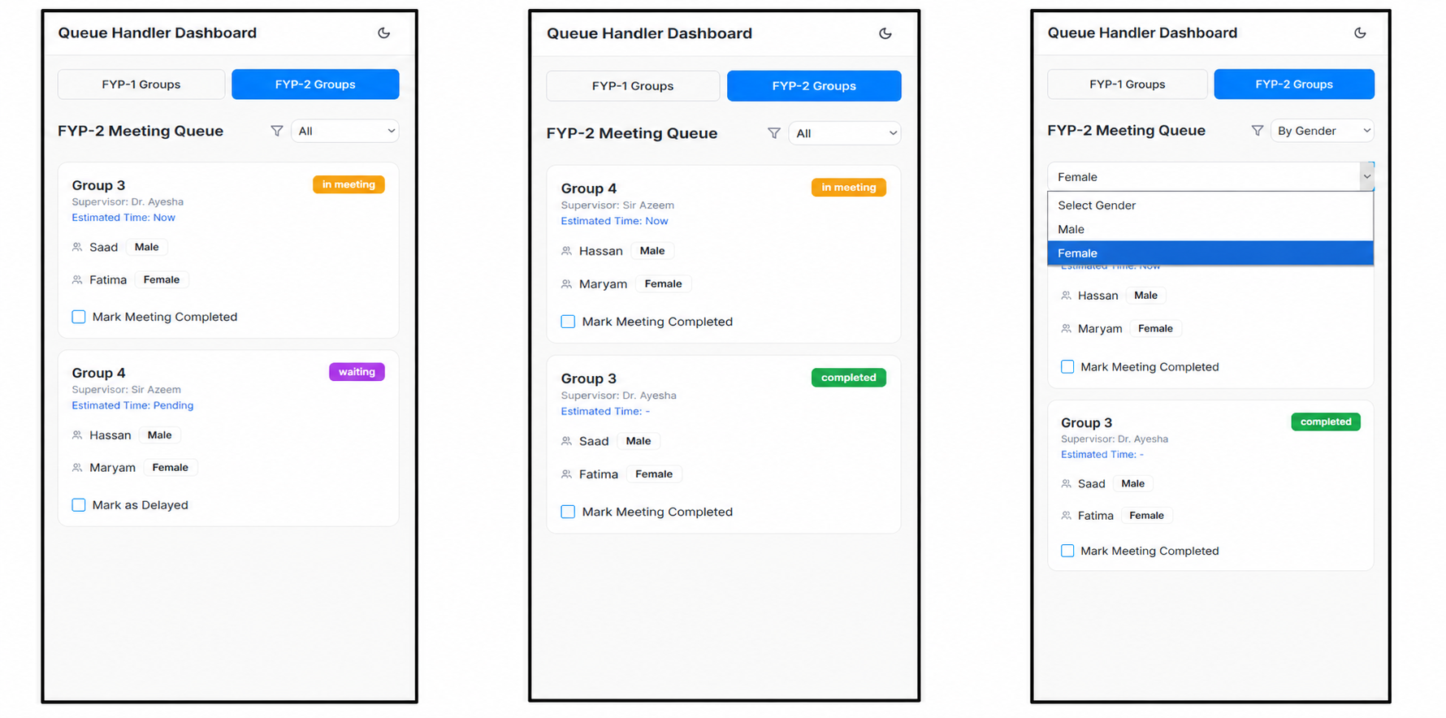
Queue Handler Dashboard

Slide 27
Committee Head

Slide 28
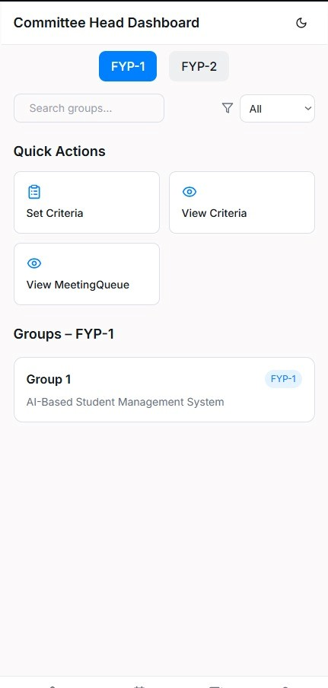

Slide 29
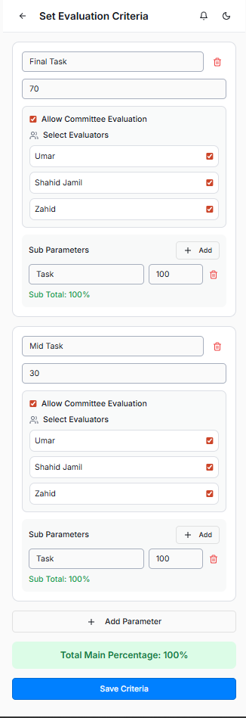
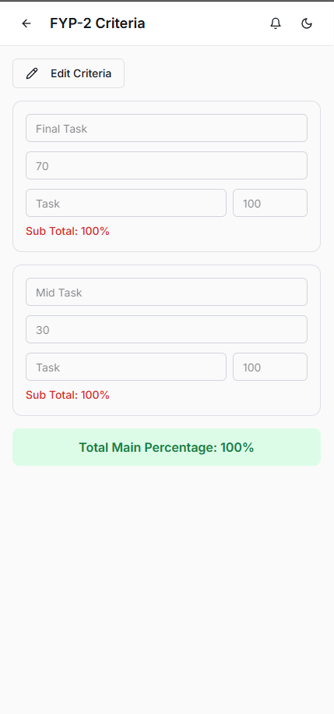

Slide 30
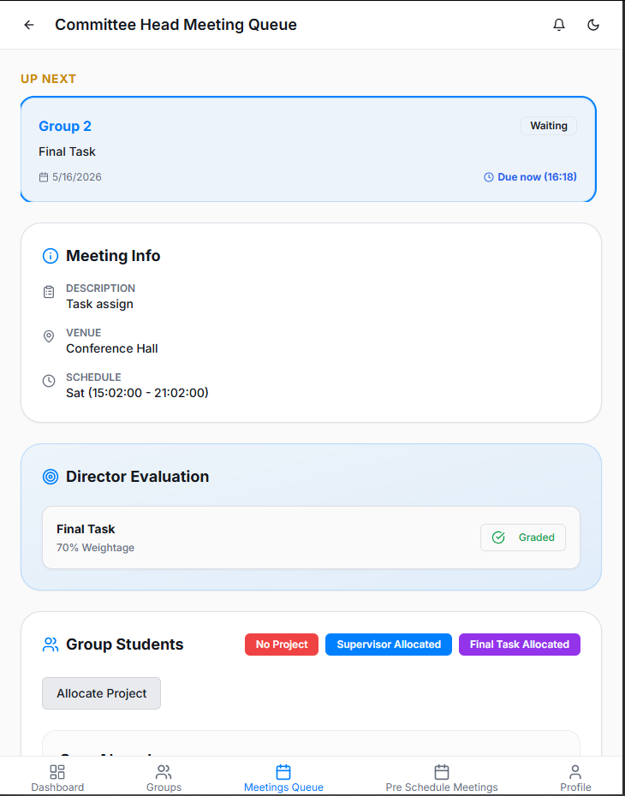
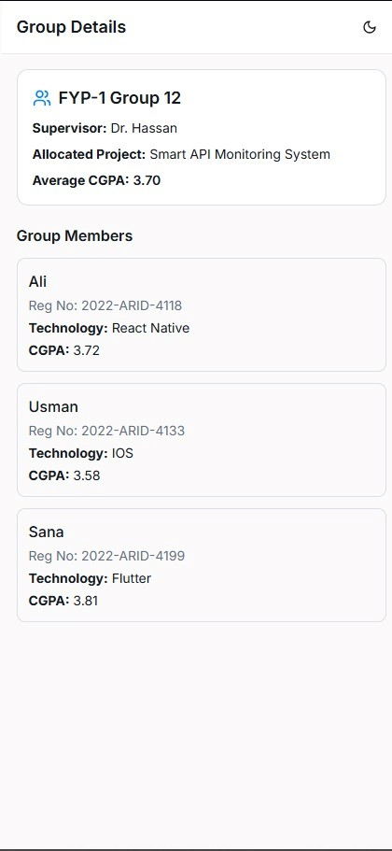


Slide 31
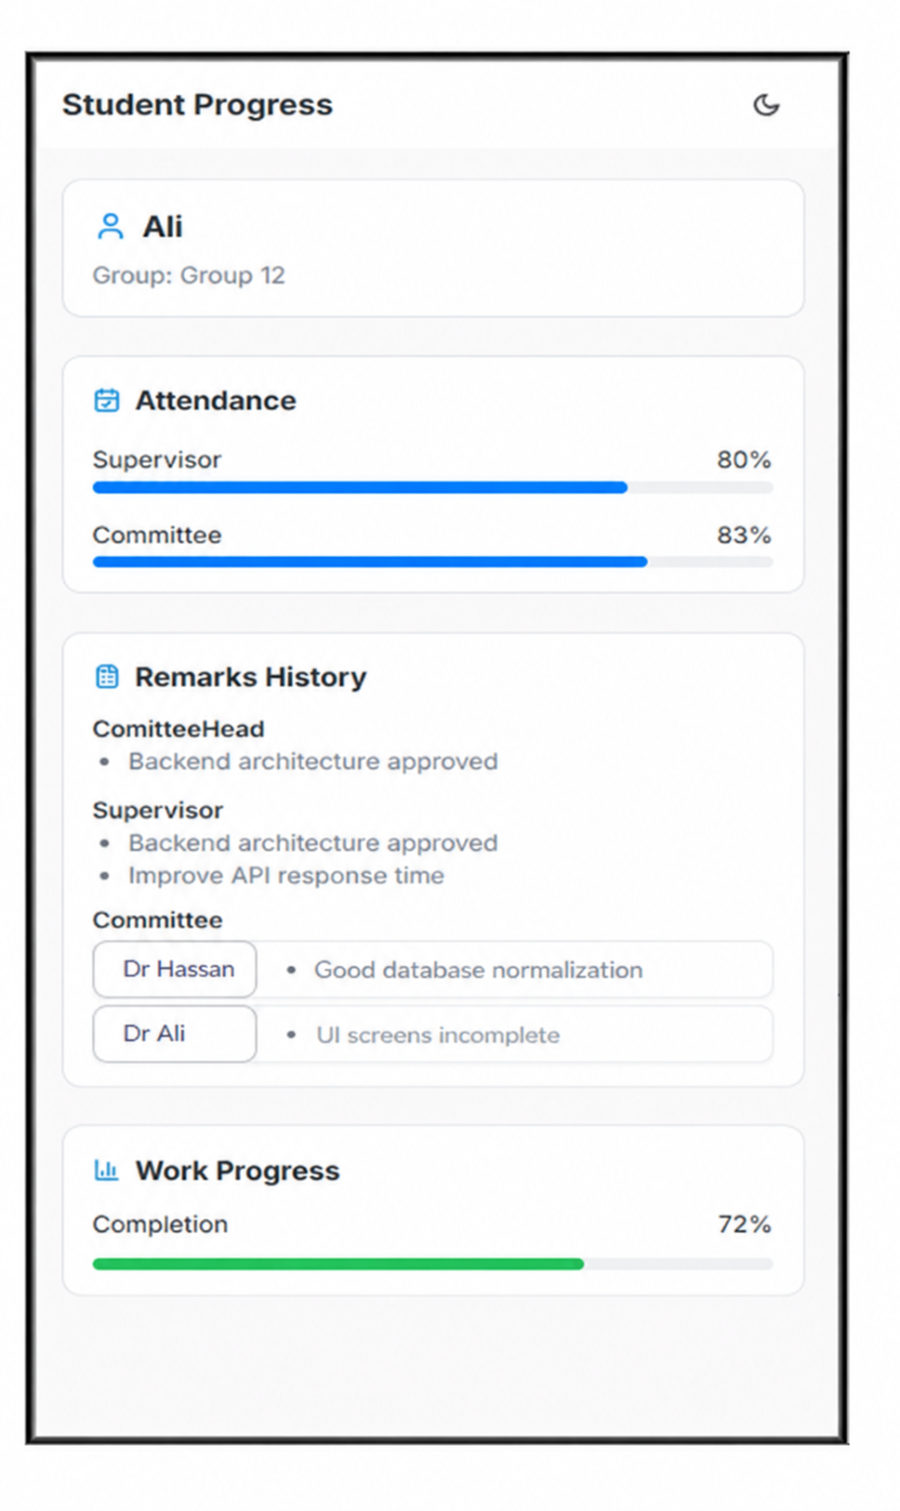
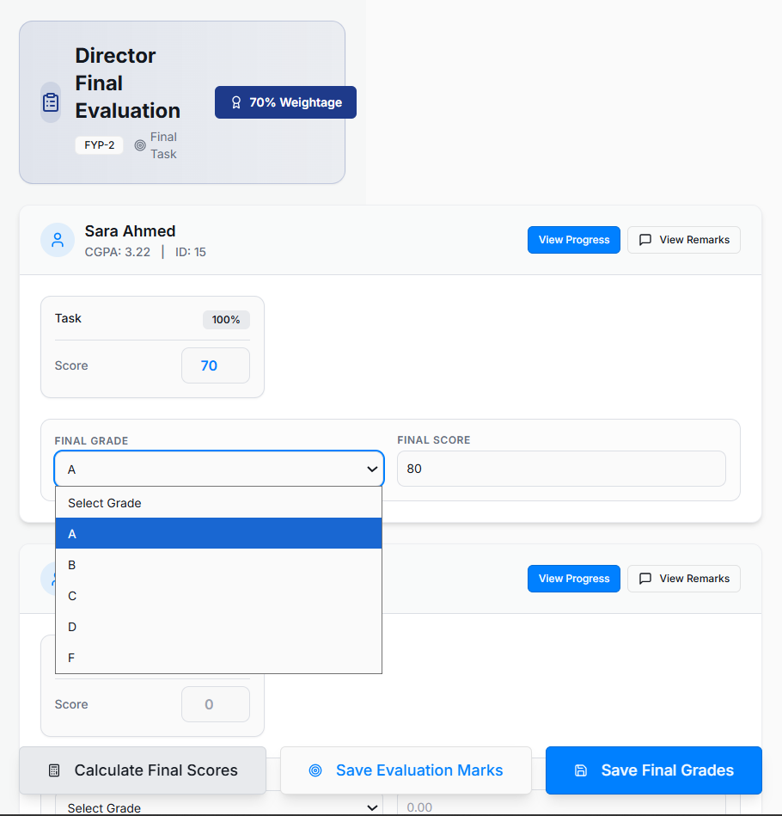

Slide 32



Slide 33
TAHA’S SCREENS (Flutter)

Slide 34



IMPLEMENTED + INTEGRATED

Slide 35



IMPLEMENTED + INTEGRATED

Slide 36



IMPLEMENTED + INTEGRATED

Slide 37


IMPLEMENTED + INTEGRATED

Slide 38
IMPLEMENTED
Supervisor Dashboard

Slide 39

IMPLEMENTED

Slide 40

IMPLEMENTED

Slide 41

IMPLEMENTED

Slide 42

IMPLEMENTED

Slide 43
IMPLEMENTED

Slide 44
IMPLEMENTED

Slide 45



Queue Handler Dashboard
IMPLEMENTED

Slide 46



IMPLEMENTED
Alternative

Slide 47
SIMRAN HAFEEZ’S SCREENS (REACT NATIVE)

Slide 48



IMPLEMENTED + INTEGRATED

Slide 49


IMPLEMENTED + INTEGRATED

Slide 50





Student Dashboard

Slide 51



Slide 52


Slide 53






Supervisor Dashboard

Slide 54






Slide 55




IMPLEMENTED + INTEGRATED

Slide 56




Slide 57


IMPLEMENTED + INTEGRATED

Slide 58





IMPLEMENTED + INTEGRATED

Slide 59





IMPLEMENTED + INTEGRATED

Slide 60





IMPLEMENTED + INTEGRATED

Slide 61


IMPLEMENTED + INTEGRATED

Slide 62


Queue Handler Dashboard

Slide 63


Slide 64







Committee Head

Slide 65




Slide 66





