Slide 1

PROJECT PROGRESS MONITORING
2022-Arid-4158 Raja Muhammad Taha
2022-Arid-4198 Simran Hafeez
2022-Arid-4118 M. Sabih Ul Hassan

Slide 2
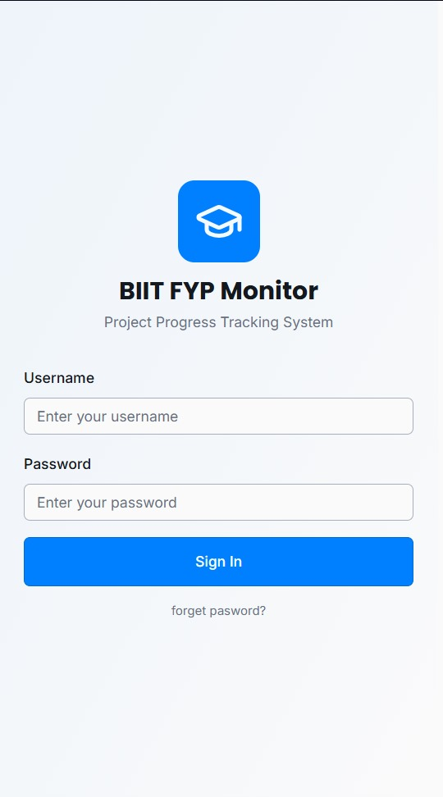
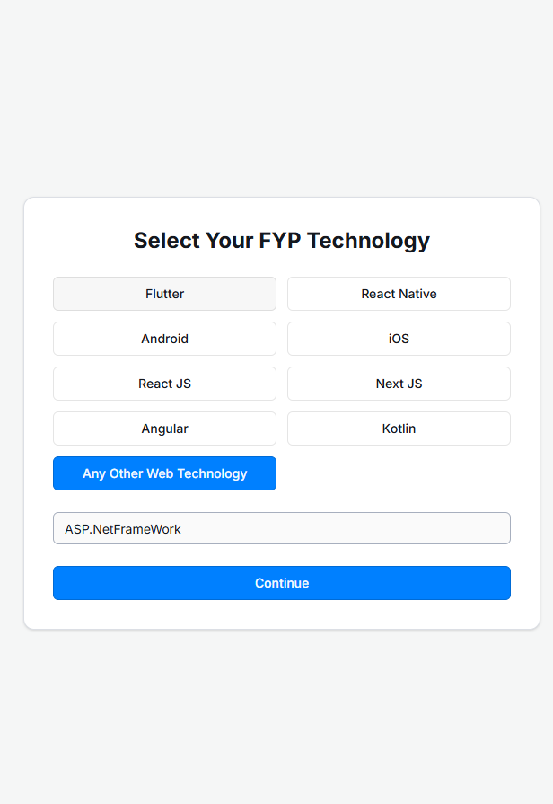
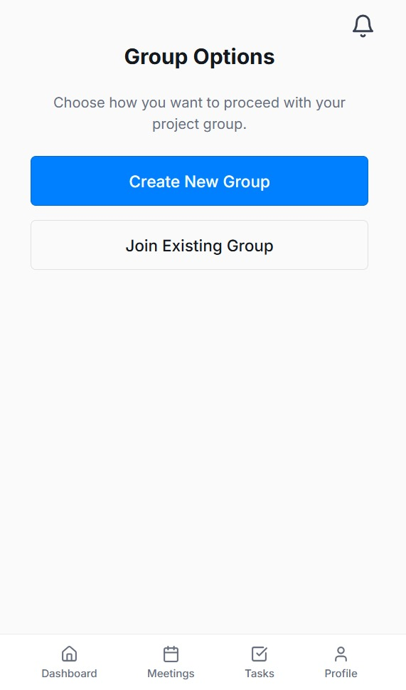
IMPLEMENTED + INTEGRATED

Slide 3
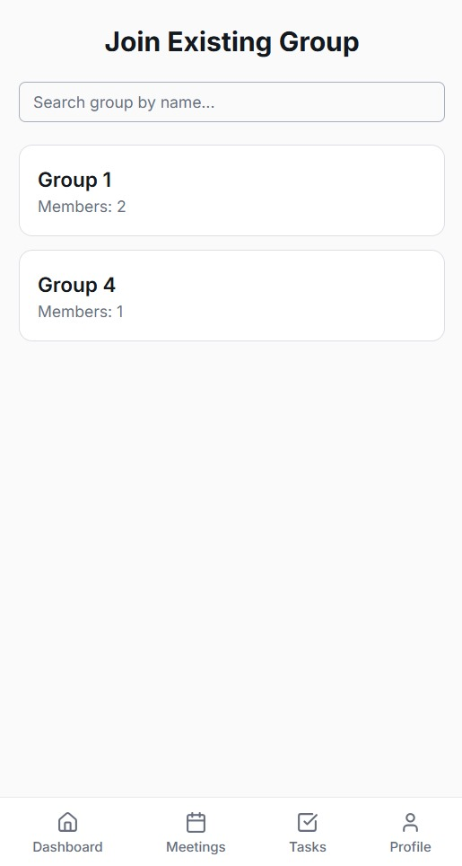
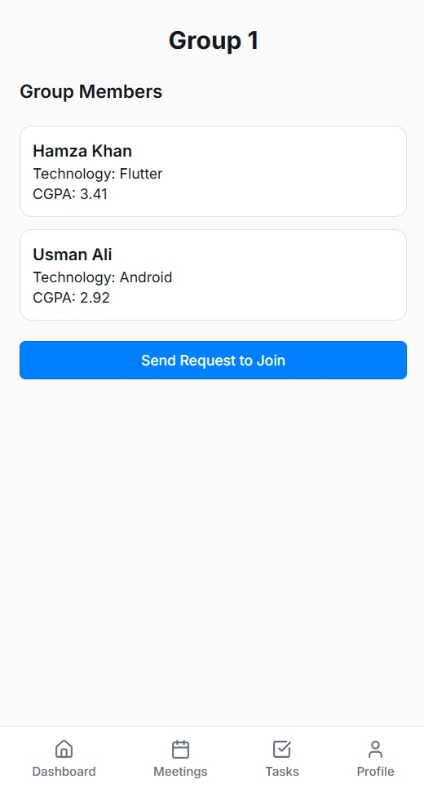
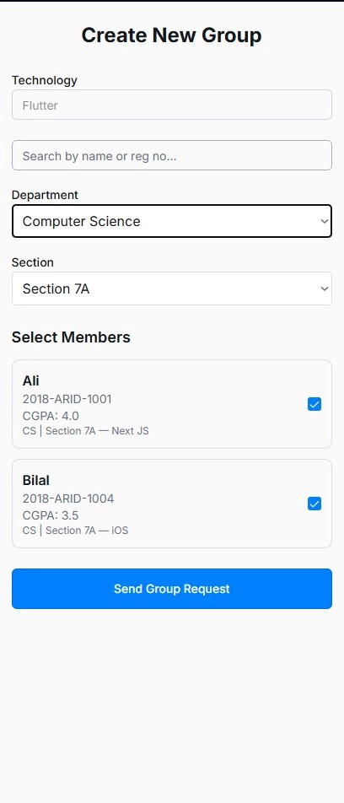
IMPLEMENTED + INTEGRATED

Slide 4
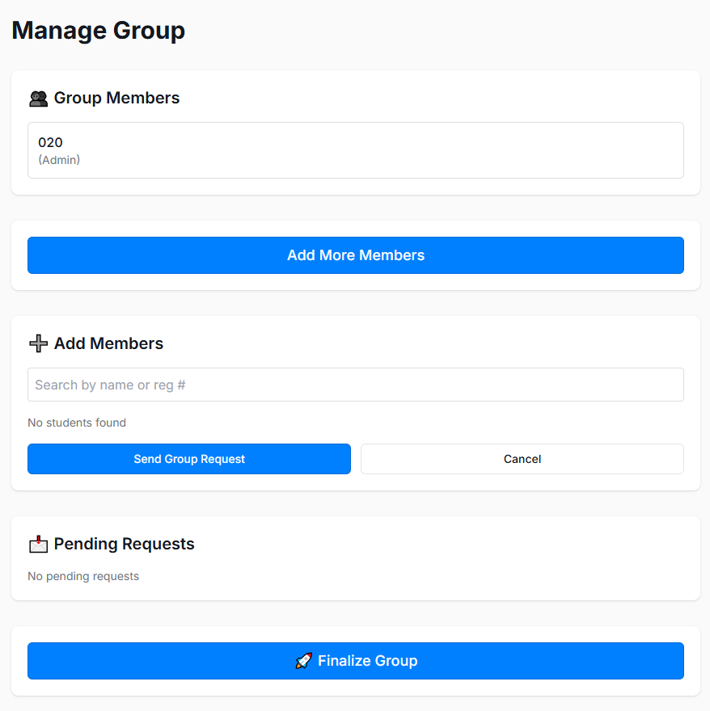
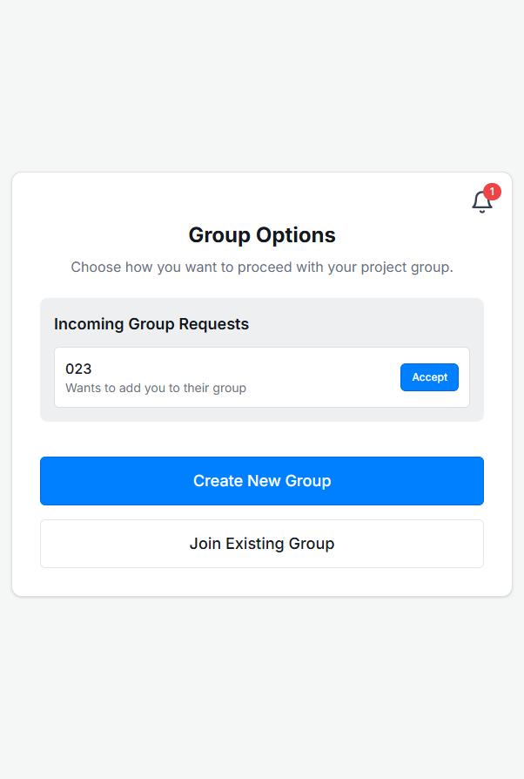
IMPLEMENTED + INTEGRATED

Slide 5
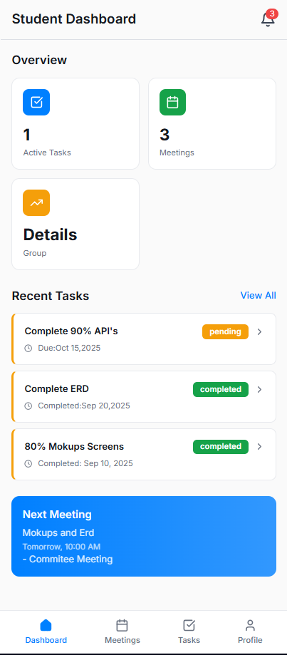
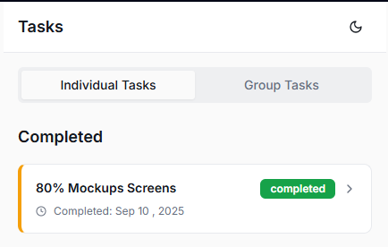
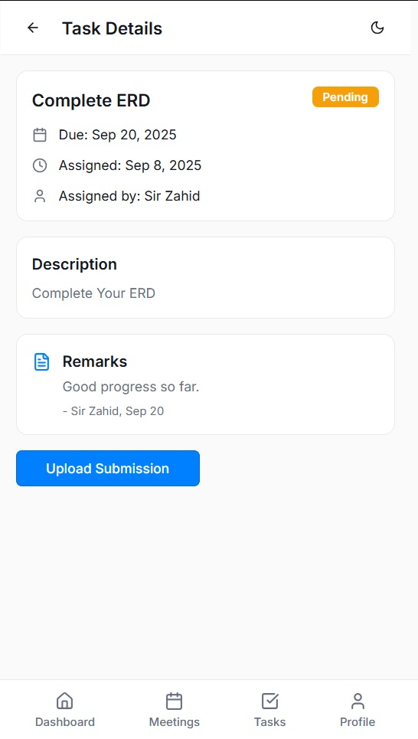
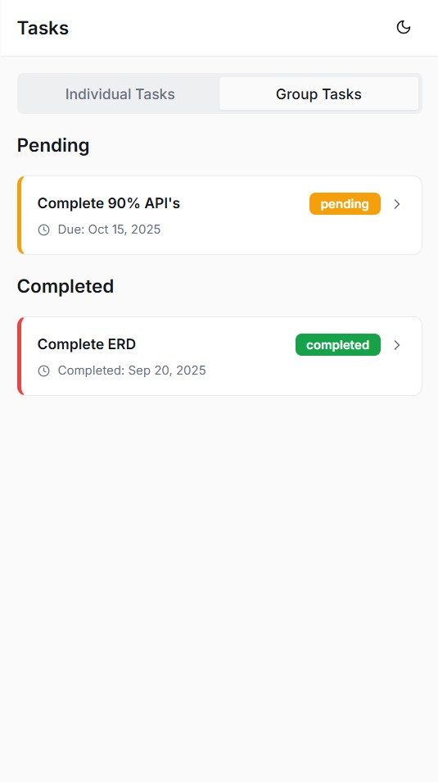
IMPLEMENTED + INTEGRATED
Student Dashboard

Slide 6
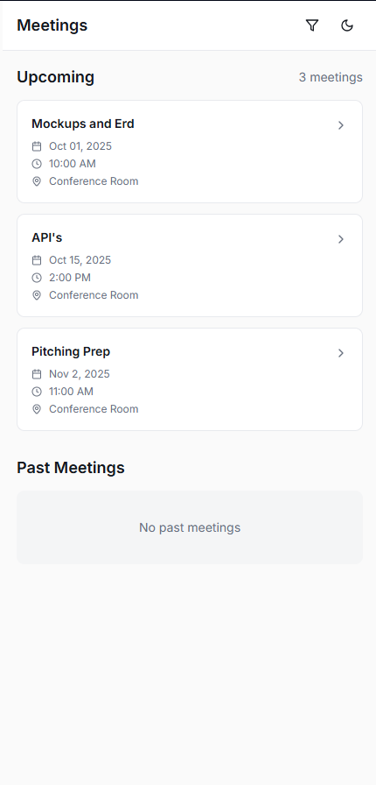
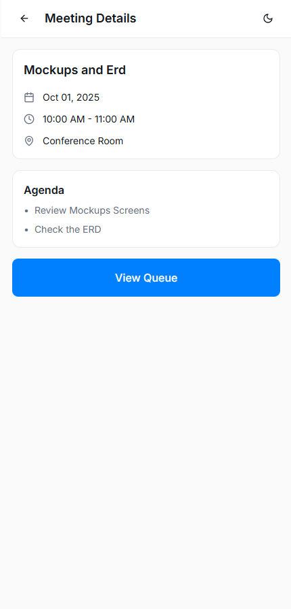
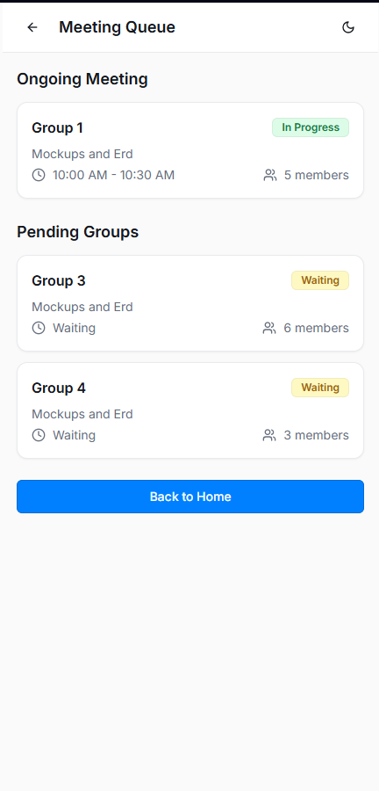
IMPLEMENTED + INTEGRATED

Slide 7
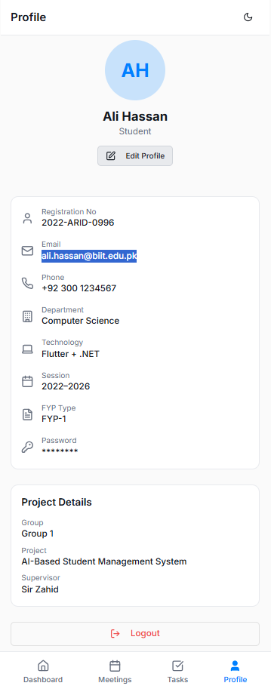
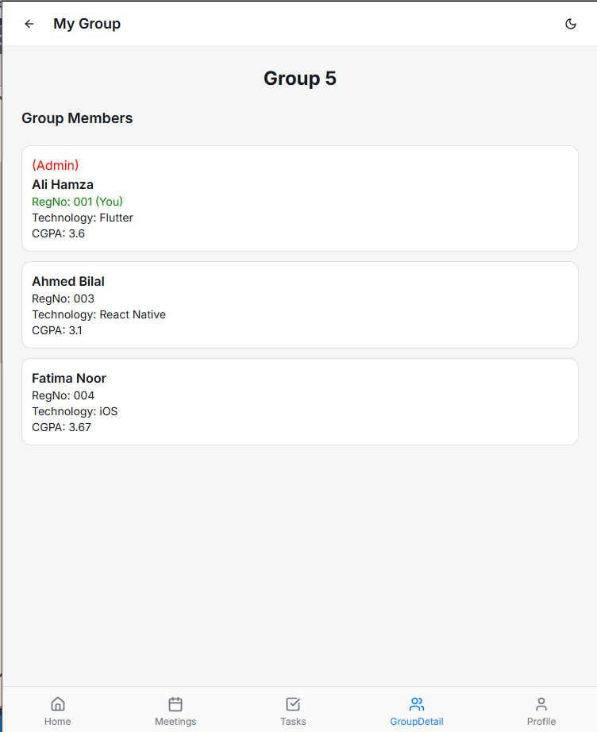
IMPLEMENTED + INTEGRATED

Slide 8
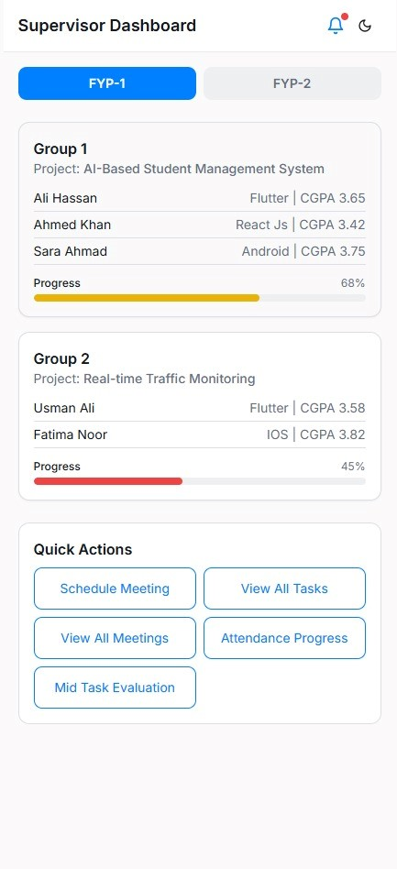
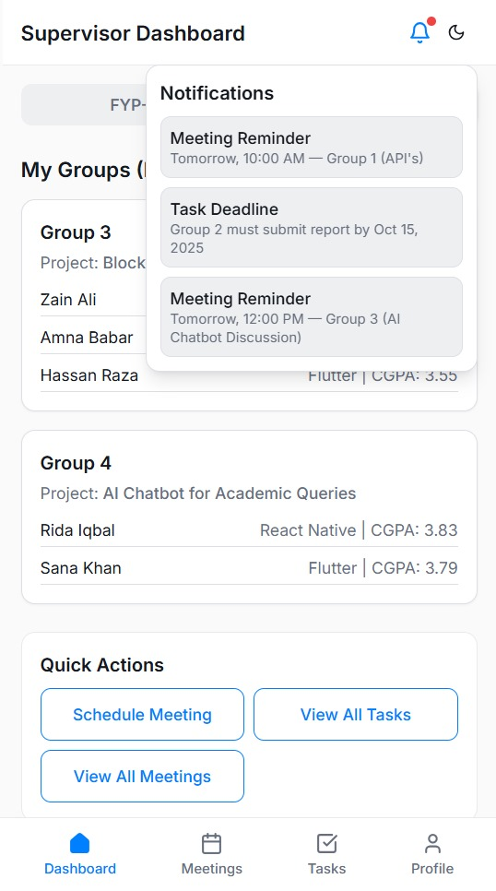
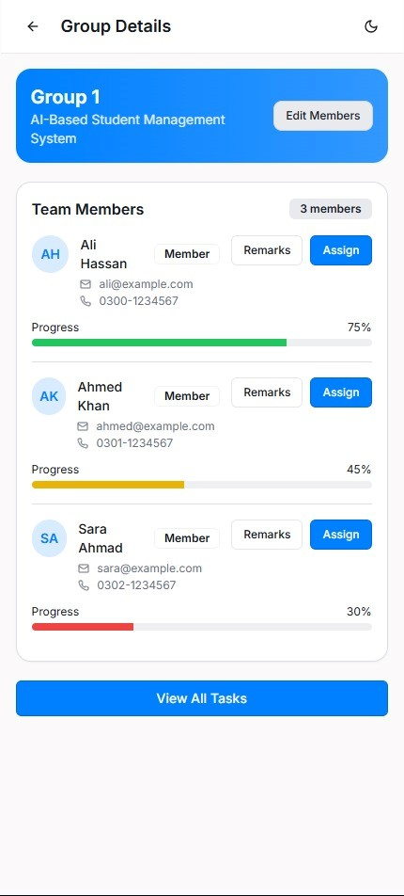
IMPLEMENTED + INTEGRATED
Supervisor Dashboard

Slide 9
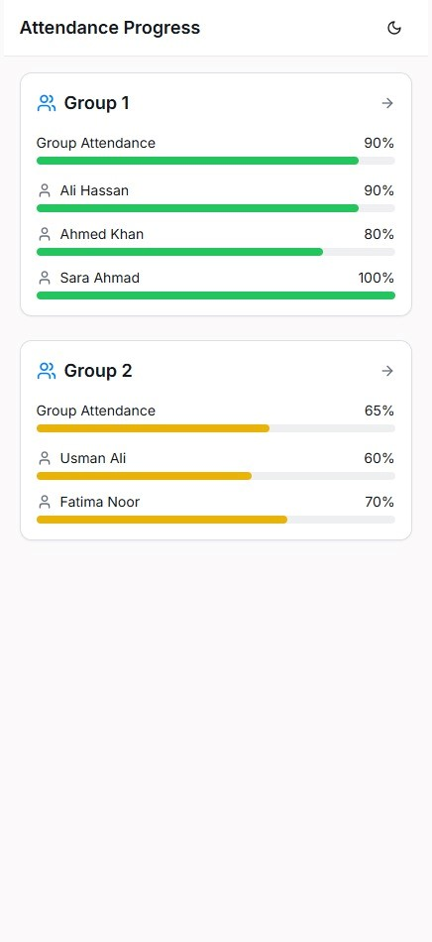
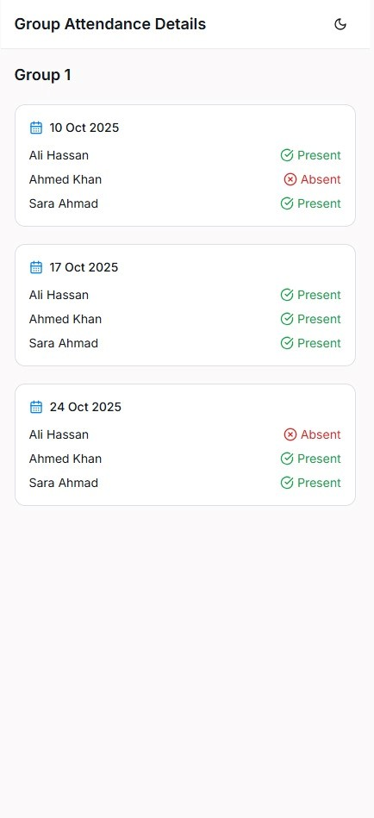
IMPLEMENTED + INTEGRATED

Slide 10
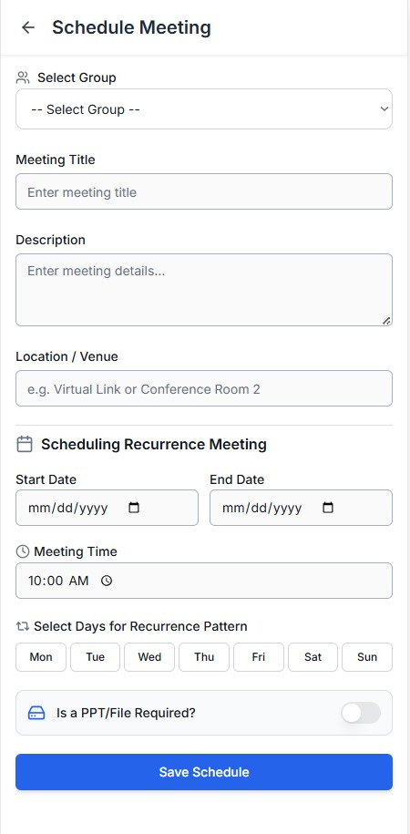
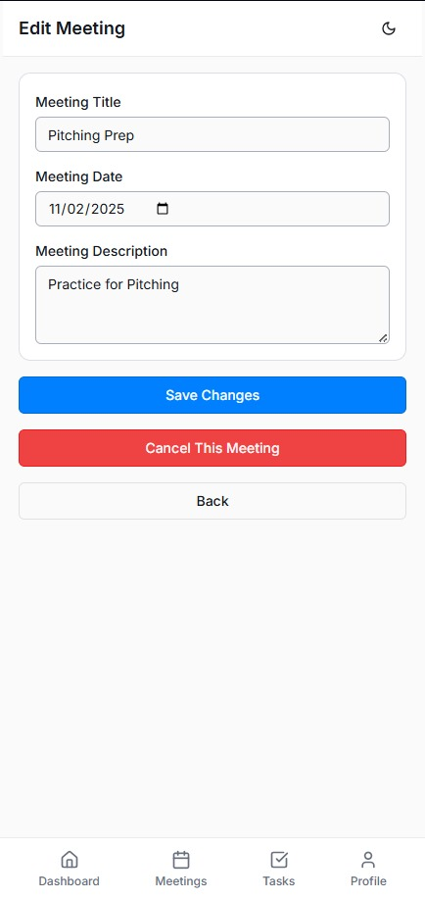
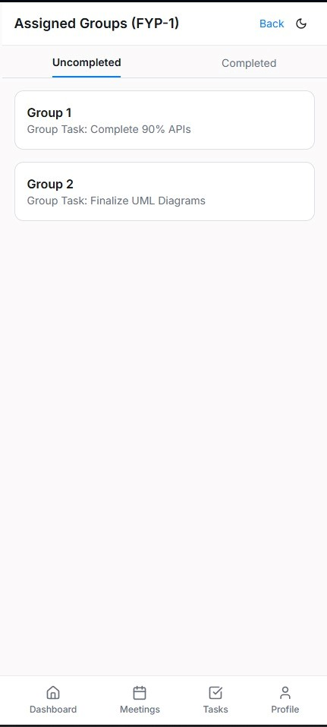
IMPLEMENTED + INTEGRATED

Slide 11
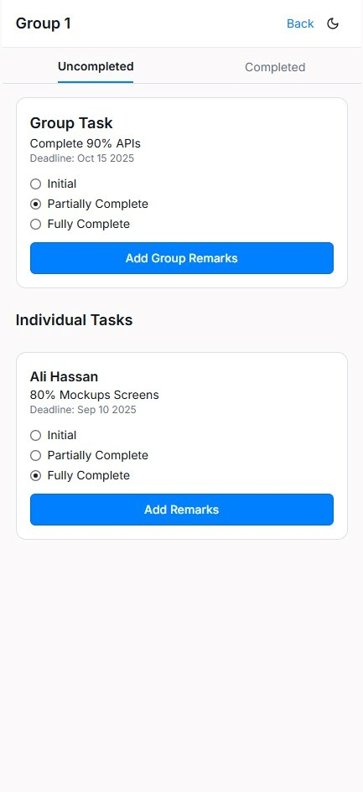
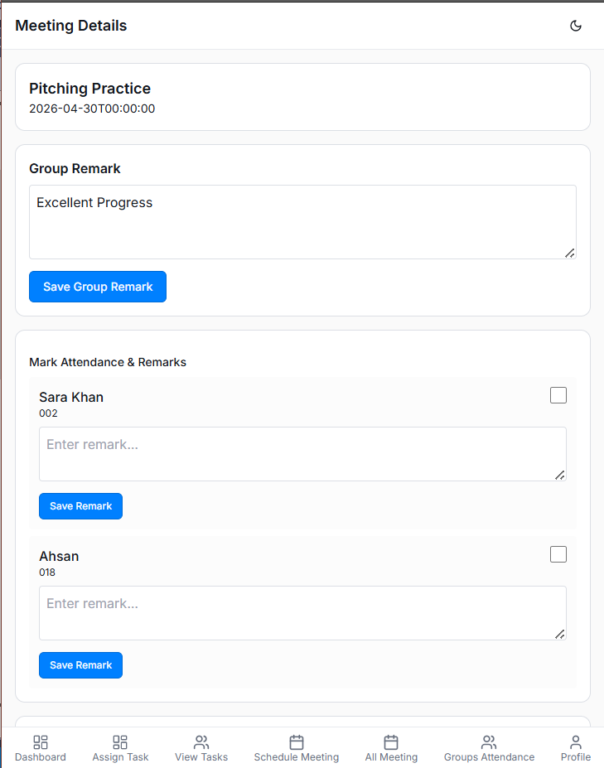
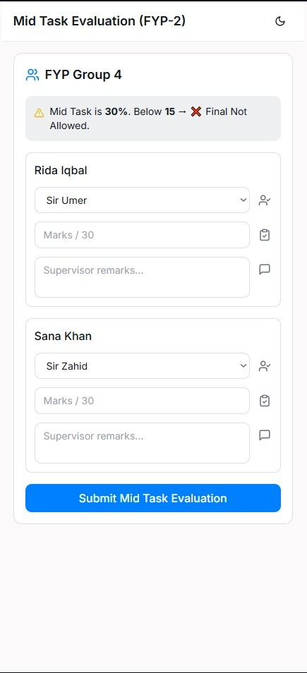
IMPLEMENTED + INTEGRATED

Slide 12
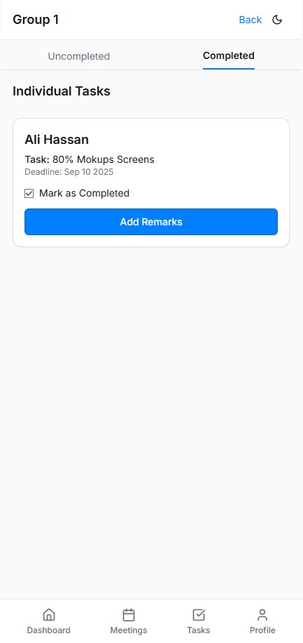
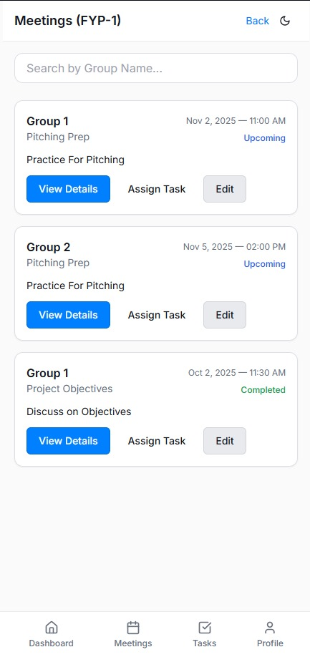
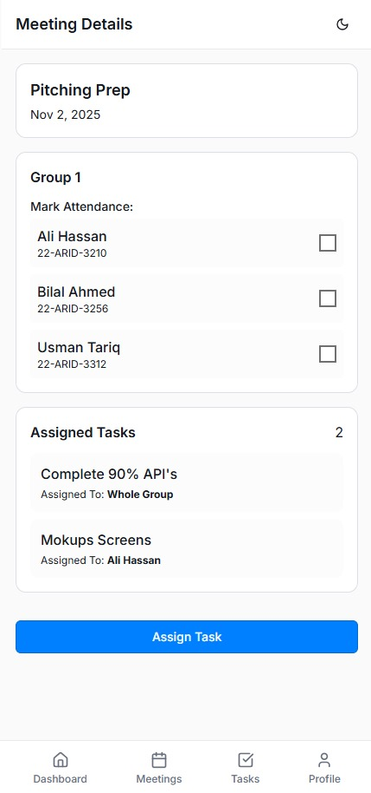
IMPLEMENTED + INTEGRATED

Slide 13
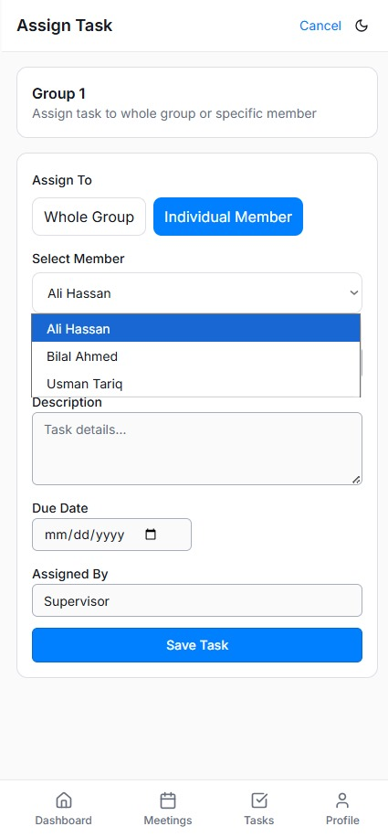
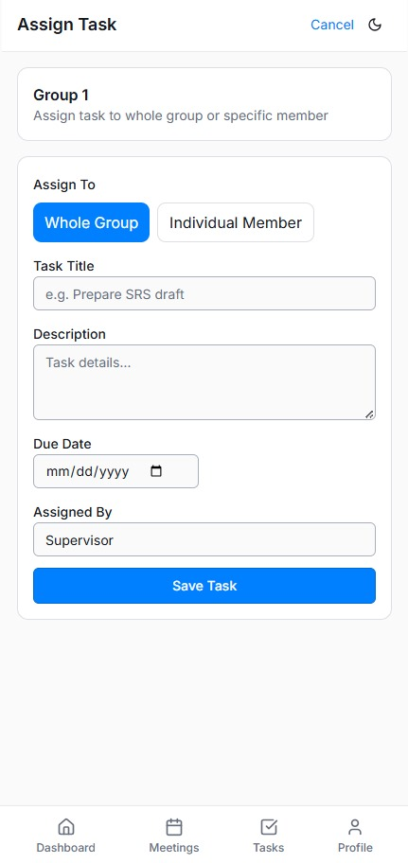
IMPLEMENTED + INTEGRATED

Slide 14
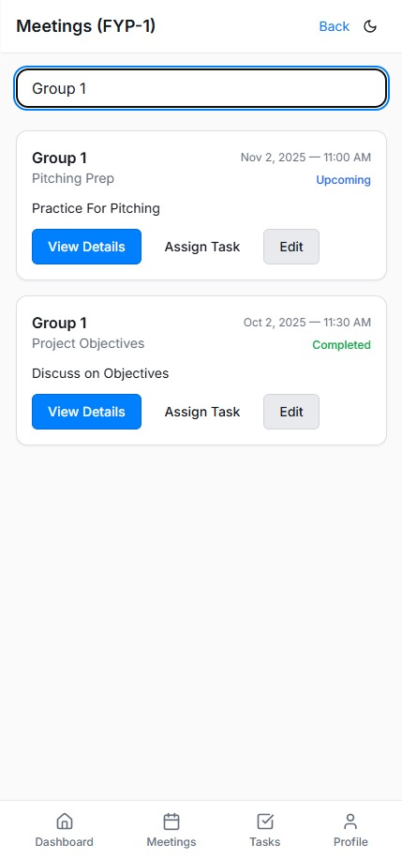
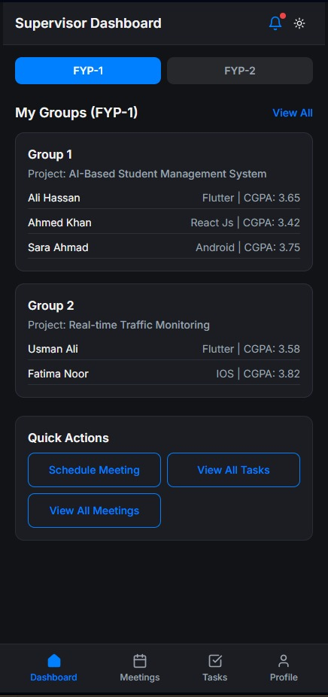
IMPLEMENTED + INTEGRATED

Slide 15
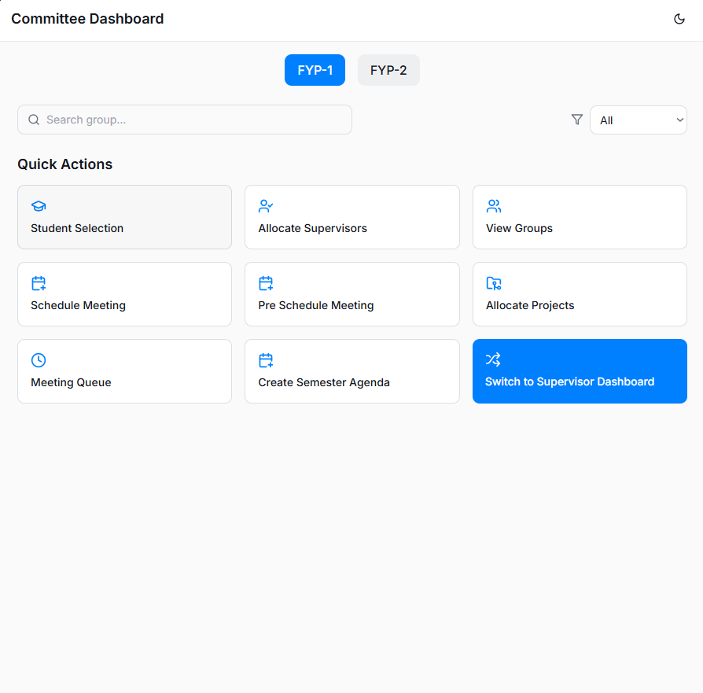
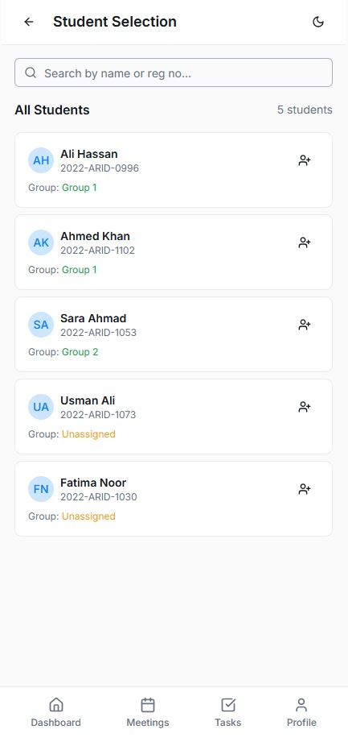
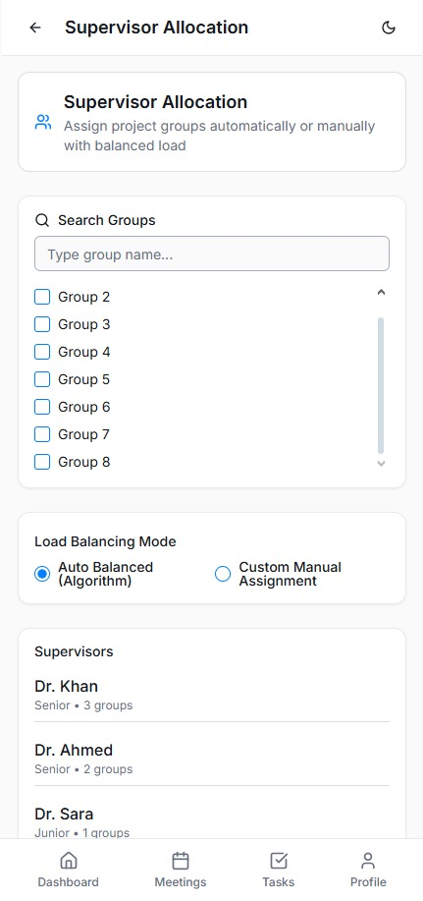
Committee Dashboard
IMPLEMENTED + INTEGRATED

Slide 16
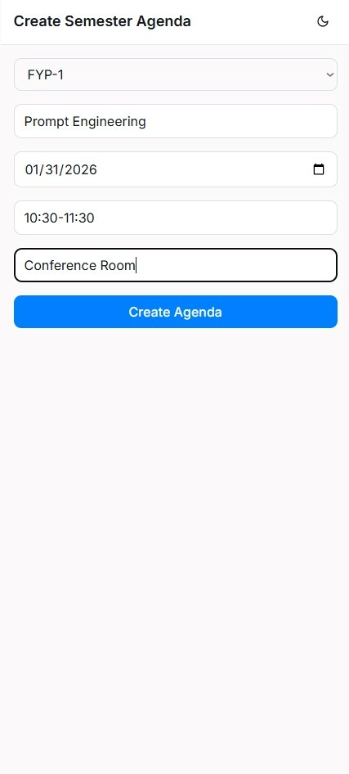
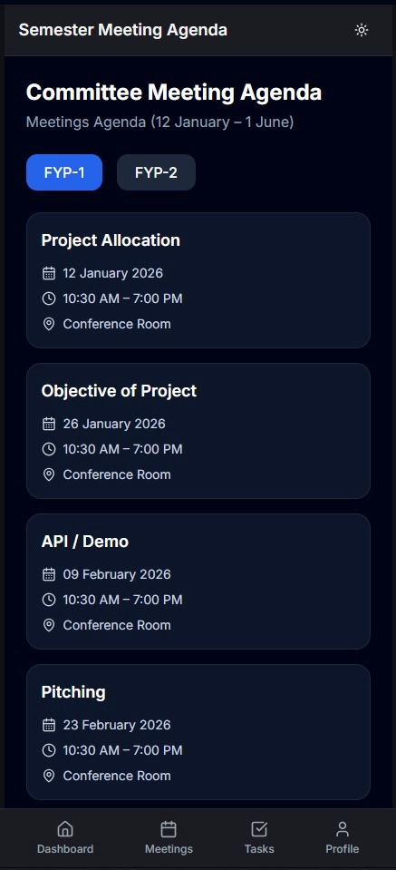
IMPLEMENTED + INTEGRATED

Slide 17
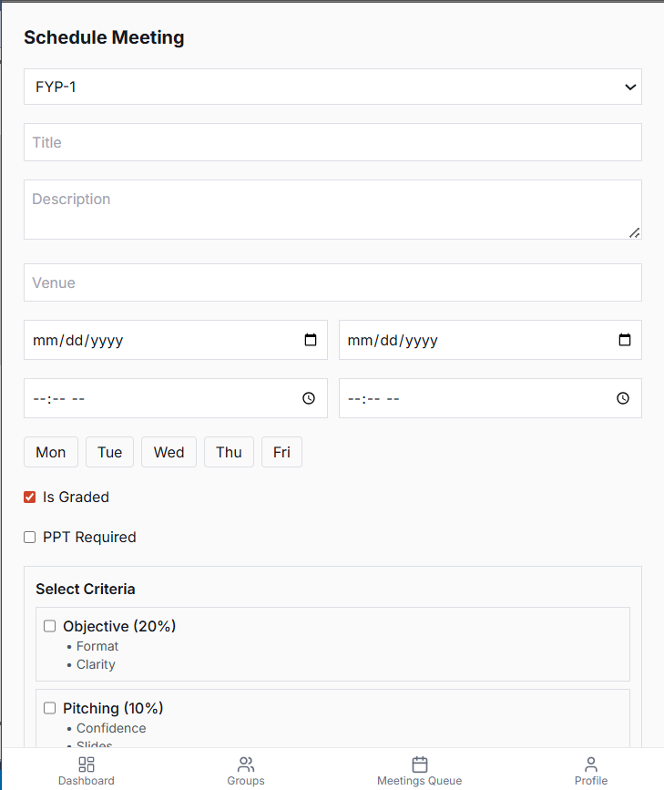
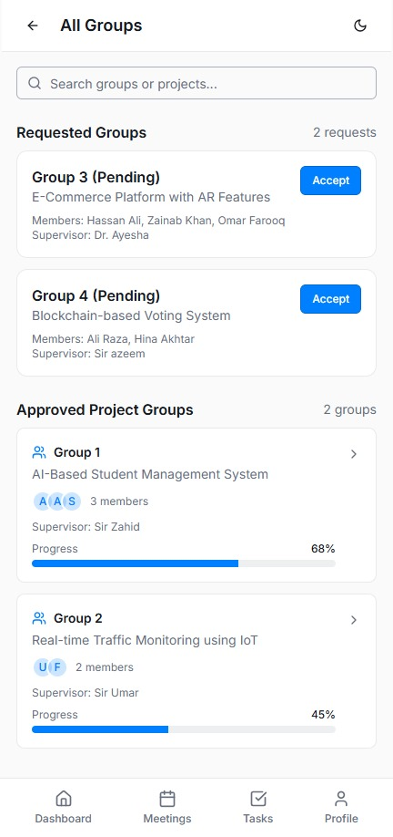
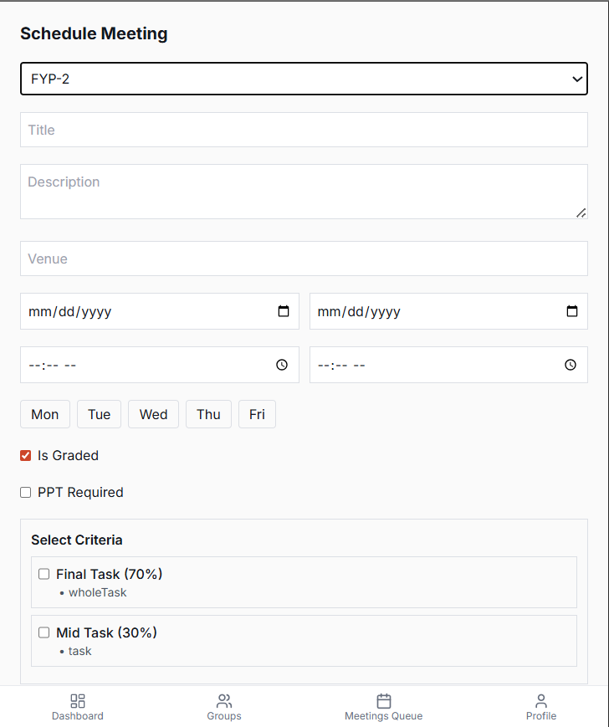
IMPLEMENTED + INTEGRATED

Slide 18
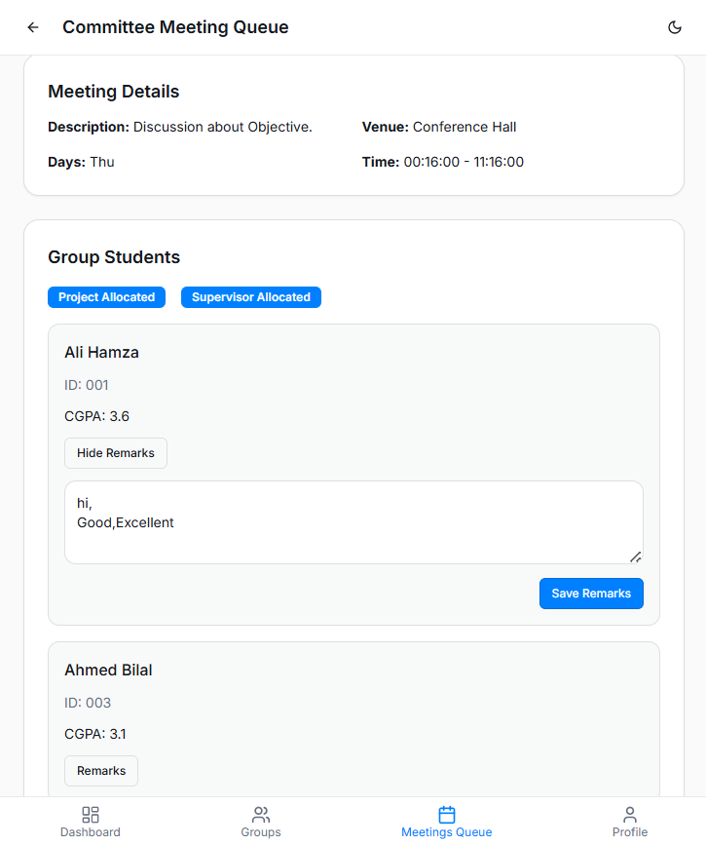
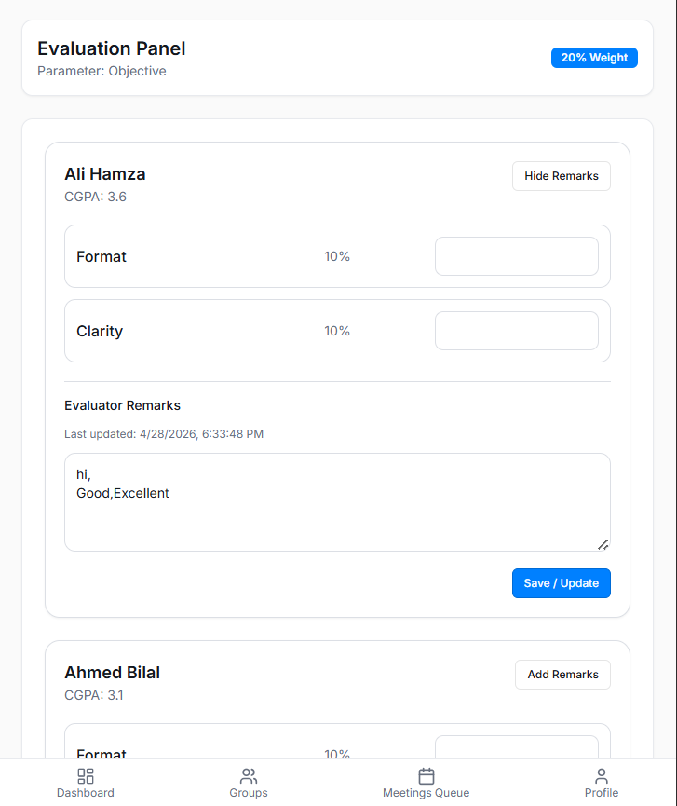
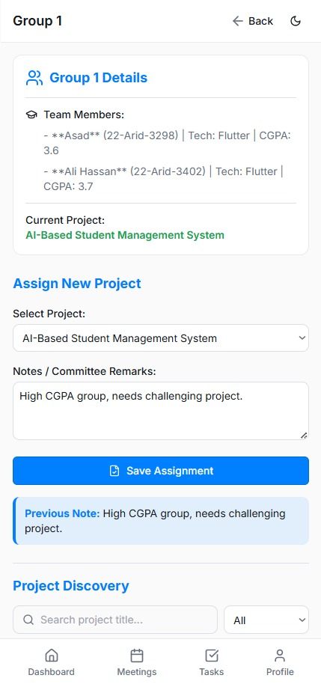
IMPLEMENTED + INTEGRATED

Slide 19
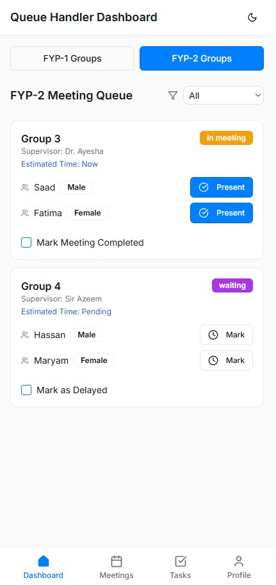
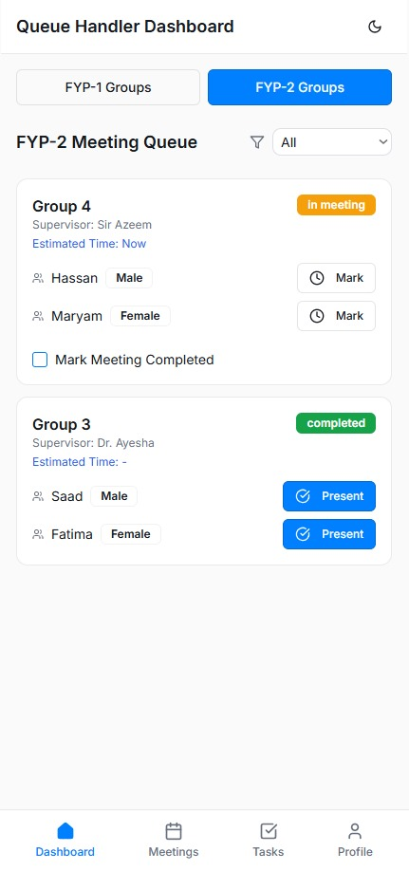
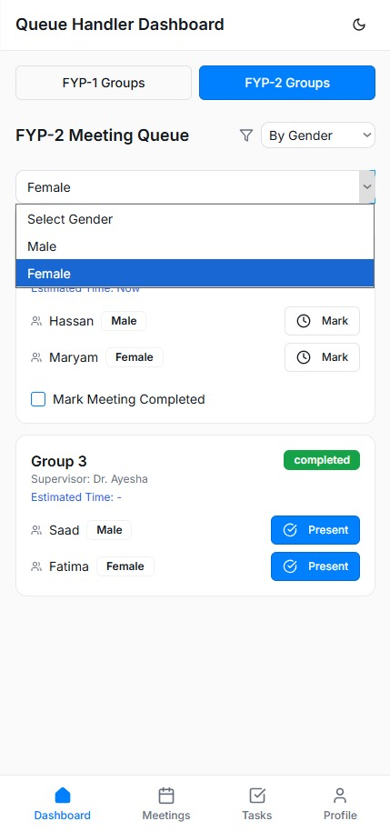
Queue Handler Dashboard
IMPLEMENTED + INTEGRATED

Slide 20
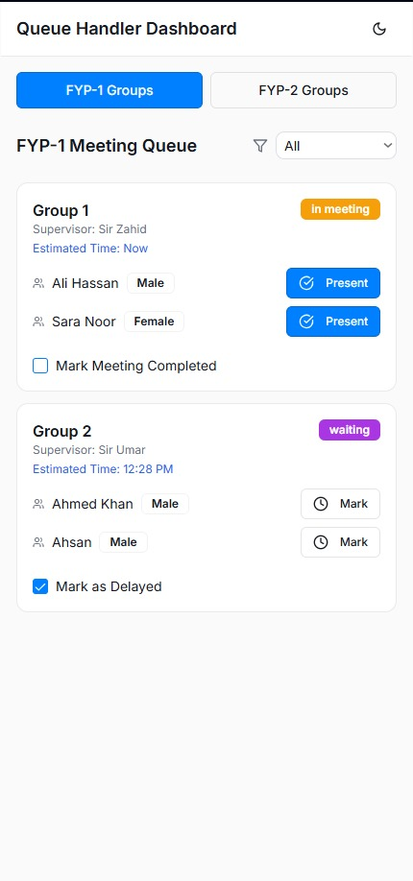


IMPLEMENTED + INTEGRATED
Alternative

Slide 21

IMPLEMENTED + INTEGRATED

Slide 22



Committee Head Dashboard
IMPLEMENTED + INTEGRATED

Slide 23




IMPLEMENTED + INTEGRATED

Slide 24



IMPLEMENTED + INTEGRATED

Slide 25
IMPLEMENTED + INTEGRATED

Slide 26



Implemented Screens

Slide 27


Flutter

Slide 28



Slide 29


