Slide 1
A DEEP FACIAL RECOGNITION SYSTEM USING COMPUTATIONAL
INTELLIGENT ALGORITHMS
SABIHA MHATARNAIK

Slide 2
GOAL
Machine learning algorithms take a lot of resources, it's ideal to run them in a distributed environment like cloud computing, fog computing, or edge computing.
Build a deep FR system using transfer learning in fog computing.
This system is based on modern techniques of deep convolutional neural networks (DCNN) and machine learning.
The proposed approaches will be able to gather a person's biometric measurements from a certain distance for crime prevention reasons without having to engage with them.

Slide 3
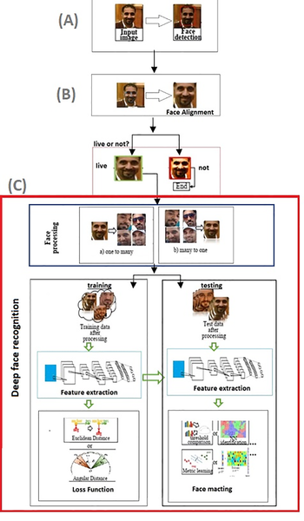
Traditional facial recognition components
Fig . Deep FR system with face detector and alignment.

Slide 4
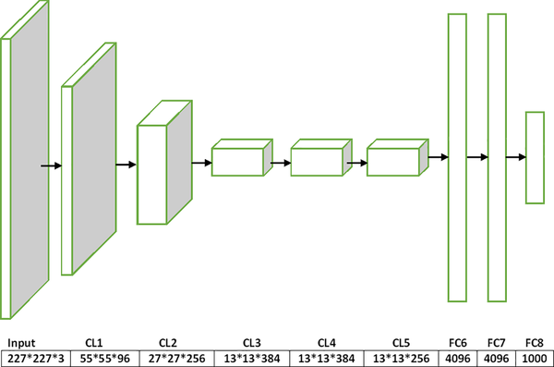
Traditional deep convolutional neural networks
Fig 2. AlexNet architecture.

Slide 5
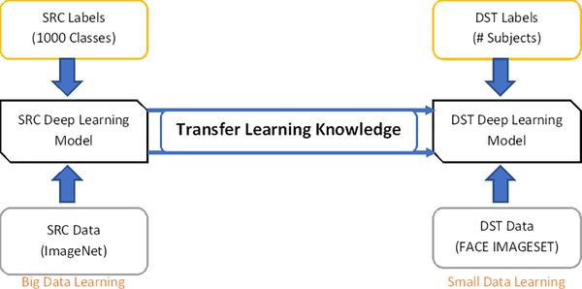
Fig 3. Core knowledge of transfer learning.

Slide 6
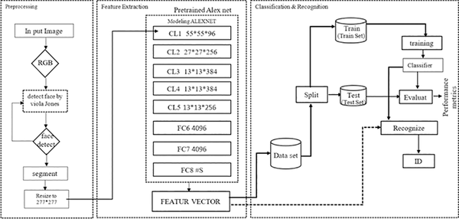
Proposed face recognition system
Fig 4. The general overall view of the proposed face recognition system.

Slide 7
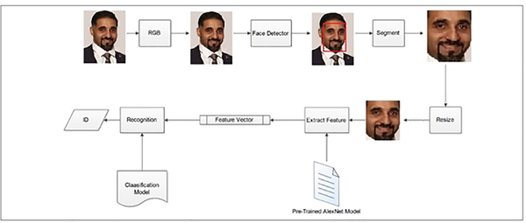
Fig 5. Block diagram of the proposed biometric system

Slide 8
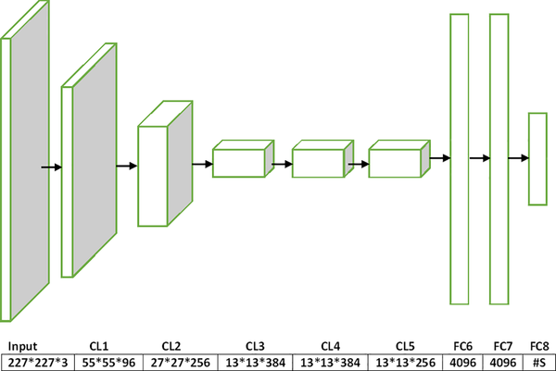
Fig 7. The schema of the modified AlexNet, where (#S) is the number of subjects in the dataset used during training.

Slide 9

Fig 8. Different types of activation functions for classification.

Slide 10
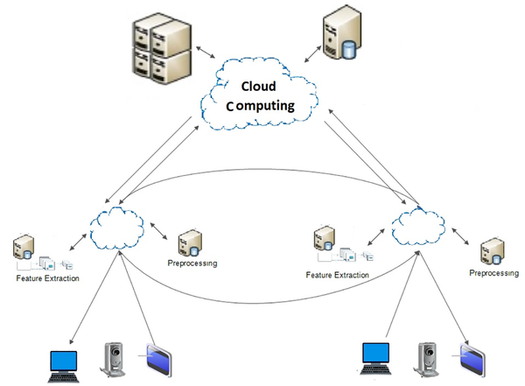
Fig 9. General block diagram of the fog computing FR system.

Slide 11
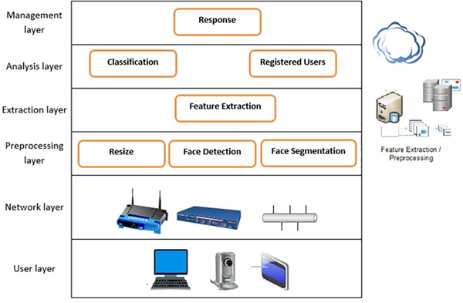
Fig 10. General architecture of the fog computing FR system.

Slide 12
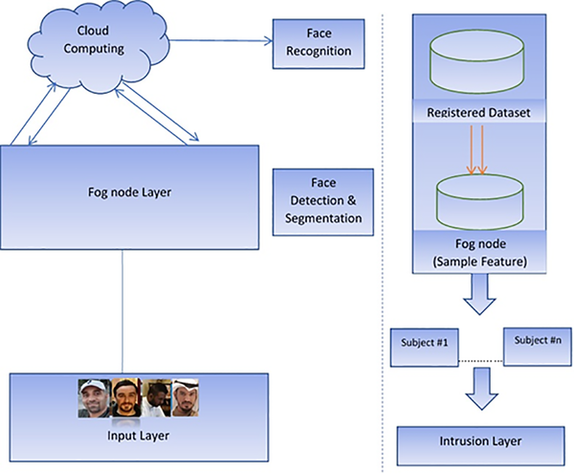
Fig 11. Fog computing network for the face recognition scheme.

Slide 13
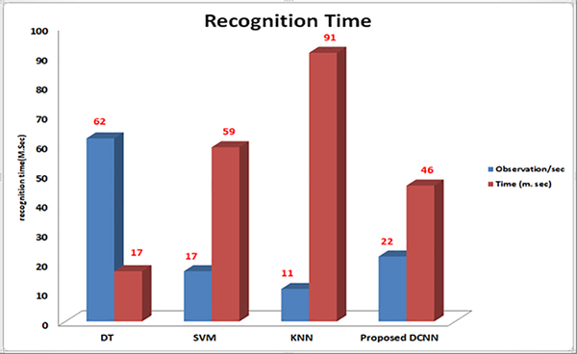
Fig 13. Recognition time of the proposed FR system and individual classifiers.

Slide 14
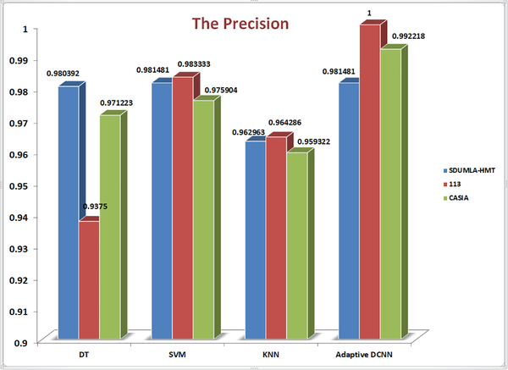
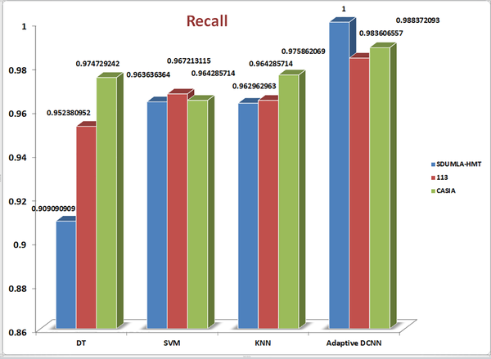
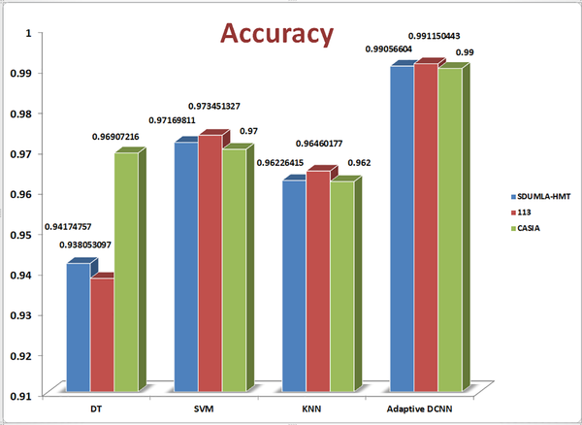
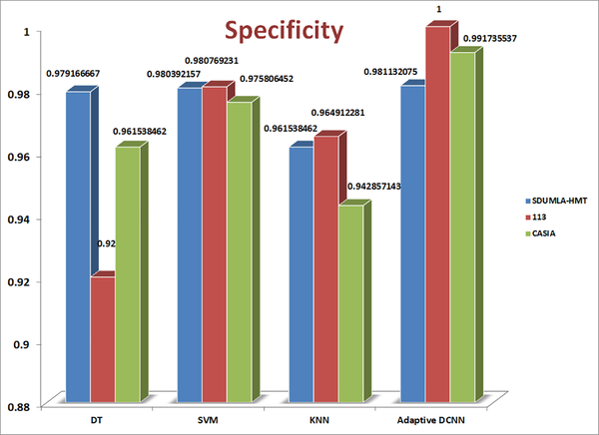

Slide 15
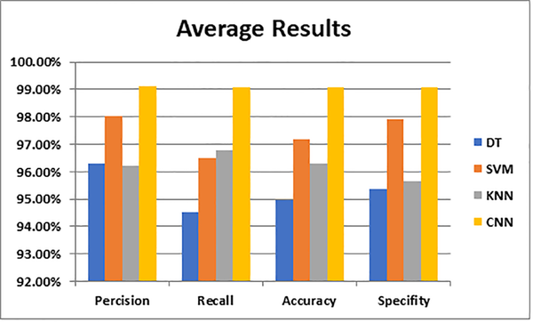
Average results of our proposed system and the three comparison systems.

Slide 16
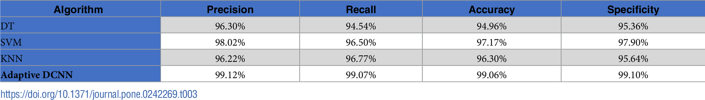
Table . Average results of our proposed system and the three comparison systems.
Salama AbdELminaam D, Almansori AM, Taha M, Badr E (2020) A deep facial recognition system using computational intelligent algorithms. PLOS ONE 15(12): e0242269. https://doi.org/10.1371/journal.pone.0242269
https://journals.plos.org/plosone/article?id=10.1371/journal.pone.0242269

Slide 17
CONCLUSION - 1
Solving this problem in a reasonable time requires an efficient optimization method. FR may face many difficulties and challenges in terms of the input image such as different facial expressions, subjects wearing hats or glasses and varying brightness levels.
This study is based on the adaptive version of the most recent DCNN algorithm, called AlexNet. This project proposed a deep FR learning method using TL in fog computing.
The proposed DCNN algorithm is based on a set of steps to process the face images to obtain the distinctive features of the face. These steps are divided by preprocessing, face detection, and feature extraction.

Slide 18
CONCLUSION - 2
The proposed method improves the solution by adjusting the parameters to search for the final optimal solution.
In this project, the proposed algorithm and other popular machine learning algorithms, including the DT, KNN, and SVM algorithms, were tested on three standard benchmark datasets to demonstrate the efficiency and effectiveness of the proposed DCNN in solving the FR problem.

Slide 19
THANK YOU

