Slide 1

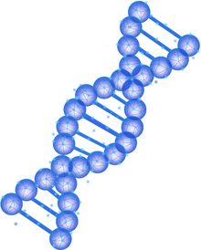

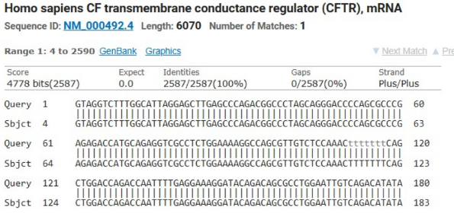

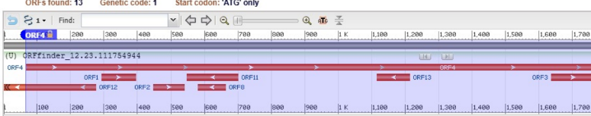
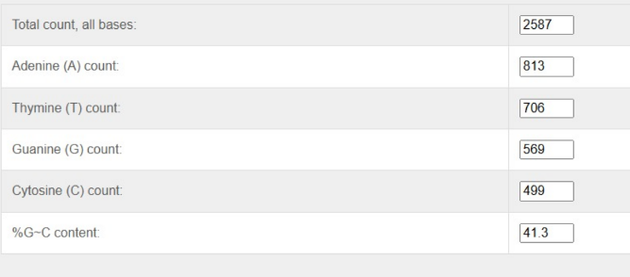
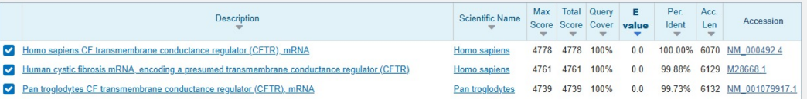

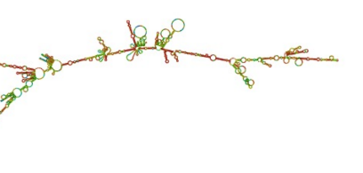

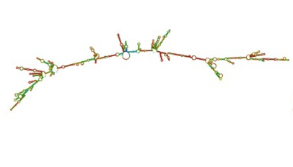
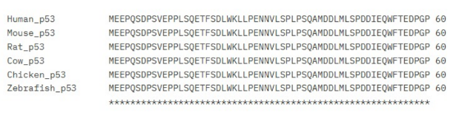

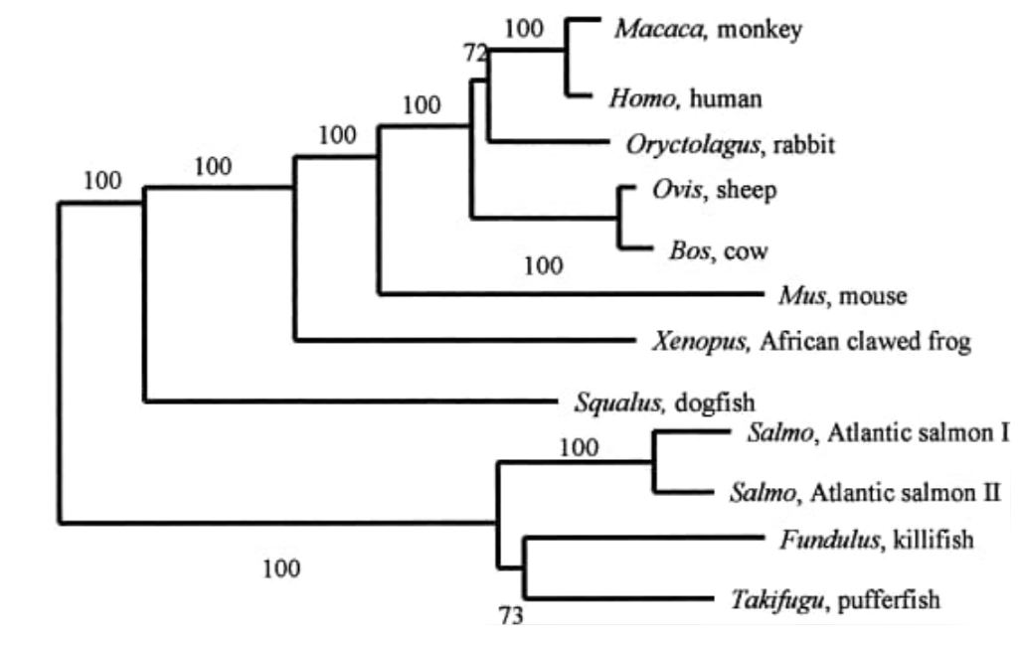
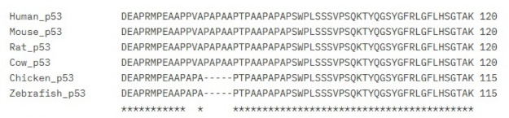

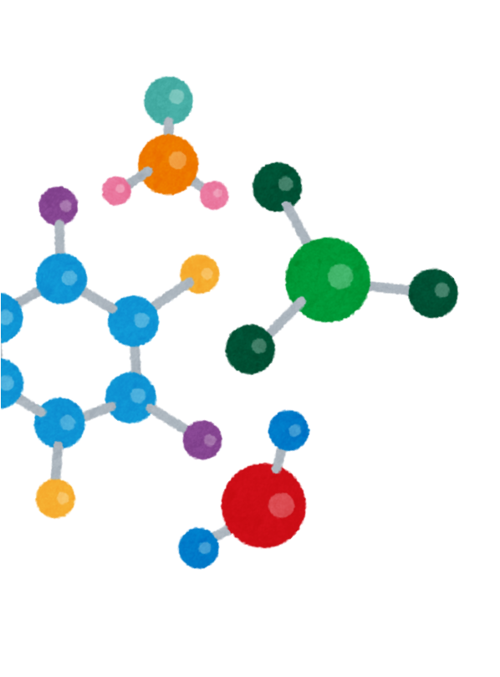



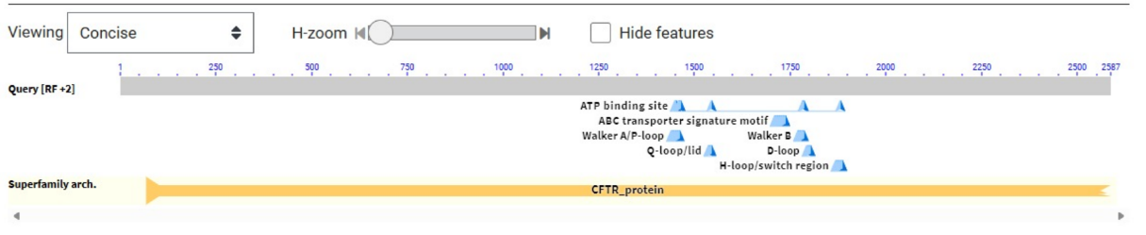
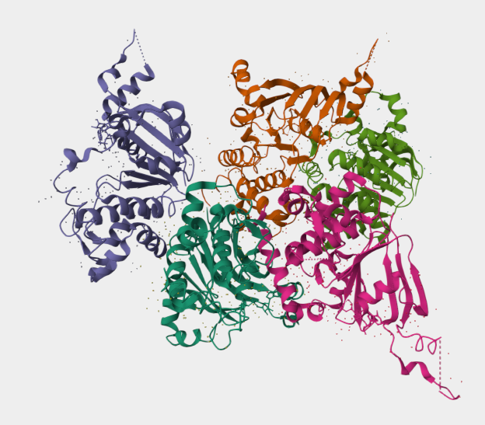
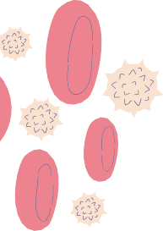

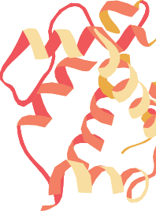
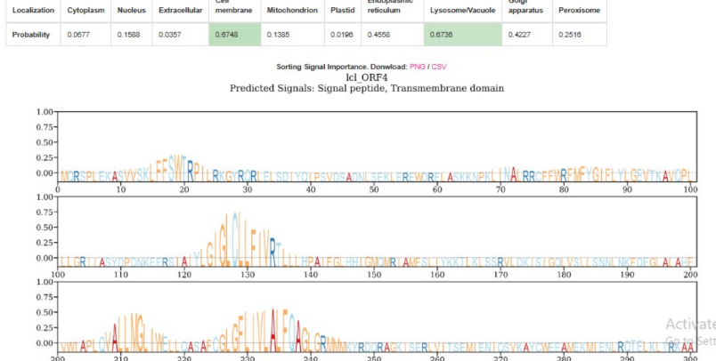
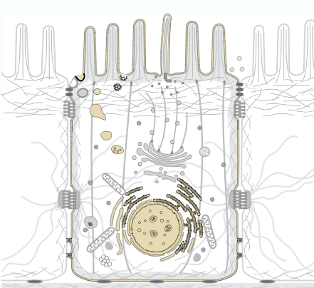
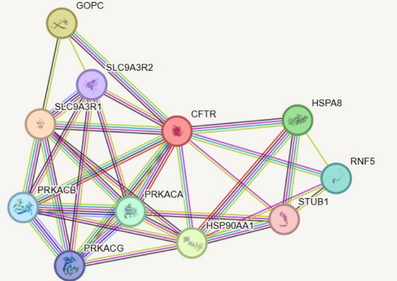
Computational Analysis of
Unknown DNA Sequences Using Integrated Bioinformatics Tools
GENE: CFTR
Amino Acids: 2587
ORGANISM: HOMO SAPIEN
MW: 213114.07
PROTEIN: Cystic Fibrosis
No. of Matches: 1
DNA Sequence
Analysis
RNA Analysis
Protein Analysis
Subcellular Localization
PHYLOGENETIC ANALYSIS
PROTEIN-PROTEIN INTERACTION
DNA SEQUENCE ANALYSIS (GENE LEVEL)
NCBi BLASTN
ORF FINDER
ALIGNMENT
DESCRIPTION
RNA Analysis (mRNA Features)
RNAFOLD
PHYLOGENETIC ANALYSIS
CLUSTALW (MSA)
CLUSTALTREE(PHYLOGENETIC )
RNAfold based on MFE, where -MFE values indicate greater thermodynamic stability. Stable stem-loop structures formed through complementary base
pairing protect the RNA from degradation.
PROTEIN ANALYSIS (STRUCTURE AND PROPERTIES)
PFAM
PredICTPROTEIN
PROTPRAM
SECONDARY STRUCTURE
AA
pI
2587
1.200
MW
II AI
213114.0
6.467
DOMAIN AND MOTIFS
SUBCELLULAR LOCALIZATION
PROTEIN-PROTEIN INTERACTION
CELLO
TAS1R2 is a G-protein–coupled taste receptor with multiple hydrophobic transmembrane helices, a hallmark of membrane-spanning proteins. Its function in detecting extracellular sweet ligands requires localization within the plasma membrane to transmit signals into the cell.
CFTR is co-expressed and functionally linked with PKA subunits (PRKACA/B/G) for cAMP-dependent activation, chaperones (HSPA8, HSP90AA1) for proper folding, and ubiquitin ligases (RNF5, STUB1) for quality control and degradation.
Scaffold proteins SLC9A3R1/2 and GOPC regulate CFTR membrane localization and stability, ensuring efficient epithelial ion transport.

