Slide 1

TEEGALA KRISHNA REDDY ENGINEERING COLLEGE
Department of Computer Science & Engineering
HEAD OF THE DEPARTMENT
Dr . CH. V. PHANI KRISHNA.
PROJECT COORDINATOR
Mrs. G. RANI
Asst. Professor

Slide 2
TITLE NETWORK INTRUSION DETECTION
TEAM MEMBERS
U. HARSHITH RAJ (17R91A05E6)
SK. SABIHA NAZAREEN (17R91A05D9)
N. RAMYA (17R91A05D2)
T. PRASHANTH (17R91A05E5)
INTERNAL GUIDE
A.SRINIVASA REDDY
Asst. Professor

Slide 3
CONTENTS
Abstract
Introduction
Existing System
Proposed System
Requirement Specifications
System Architecture
UML Diagrams
Modules
Code
Output Screens
Conclusion
Future Enhancement

Slide 4
ABSTRACT
An Intrusion Detection System (IDS) is a software that monitors a single or a network of computers for
malicious activities (attacks) that are aimed at stealing or censoring information or corrupting network
protocols. Most techniques used in today’s IDS are not able to deal with the dynamic and complex nature of
cyber attacks on computer networks. Hence, eﬃcient adaptive methods like various techniques of machine
learning can result in higher detection rates, lower false alarm rates and reasonable computation and
communication costs. We divide the schemes into methods based on classical artiﬁcial intelligence (AI) and
methods based on computational intelligence (CI). We explain how various characteristics of CI techniques
can be used to build eﬃcient IDS.

Slide 5
INTRODUCTION TO IDS
A set of techniques used for detection of abnormal behaviors on network.
Based on the assumption that the behavior of intruder is different from that of a normal user.
IDS is capable of detecting malicious activities that cannot be detected by conventional firewalls.
It is a passive alert system, i.e. it only detects attacks but not prevents it.
Dataset used in research work is KDD’99 Dataset.

Slide 6
SYSTEM ANALYSIS
Existing System
Proposed System

Slide 7
EXISTING SYSTEM
Present the attack in the from of signature and patterns.
Patterns are then maintained as a database of attacks.
These signature/patterns are compared with the data received on the network.
A simple example is antivirus system.
Advantages:
It produces very low false positives (which is not actually an intruder activity).
Easy to develop.
Requires less computational resources.
Disadvantages:
Detect only those threats that are in the database.
Can detect previously known attacks only.
Updating is to much times consuming.

Slide 8
PROPOSED SYSTEM
Based on the statistical analysis.
Detects attack based on irregularities in the pattern with respect the normal pattern.
Creates a model of the normal behavior of the system.
Then look for the activities that are different from the created model.
Advantages:
Anomaly IDS is capable of detecting new unknown threats.
Computational Intelligence (CI) based algorithms are used to enhance the prediction of threats.

Slide 9
REQUIREMENT SPECIFICATIONS
Tools & Techniques:
Tools: Python 3.8.6 (or above version) , Jupyter Notebook, Numpy , Pandas, Scikit-learn.
Techniques: Random Forest Classifier, KNN, Decision Tree.
Software Requirements:
OS : Windows
Python IDE : Python 3.8 x and above
: PyCharm IDE
setup tools and pip to be installed for 3.8.x and above

Slide 10
REQUIREMENT SPECIFICATIONS
Hardware Requirements:
RAM : 4GB and Higher
Processor : Intel i3 and above
Hard Disk : 500GB: Minimum

Slide 11
FUNCTIONAL REQUIREMENTS
Input Design:
Input design is a part of overall system design. The main objective during the input design is as given below:
To produce a cost-effective method of input.
To achieve the highest possible level of accuracy.
To ensure that the input is acceptable and understood by the user.
Input Stages:
The main input stages can be listed as below:
Data recording
Data transcription
Data conversion
Data verification
Data control
Data transmission
Data validation
Data correction

Slide 12
Error Avoidance:
At this stage care is to be taken to ensure that input data remains accurate form the stage at which it is recorded up to the stage in which the data is accepted by the system. This can be achieved only by means of careful control each time the data is handled.
Error Detection:
Even though every effort is make to avoid the occurrence of errors, still a small proportion of errors is always likely to occur, these types of errors can be discovered by using validations to check the input data.
Data Validation:
Procedures are designed to detect errors in data at a lower level of detail. Data validations have been included in the system in almost every area where there is a possibility for the user to commit errors. The system will not accept invalid data. Whenever an invalid data is keyed in, the system immediately prompts the user and the user has to again key in the data and the system will accept the data only if the data is correct. Validations have been included where necessary.

Slide 13
OUTPUT DESIGN
Outputs from computer systems are required primarily to communicate the results of processing to users. They are also used to provides a permanent copy of the results for later consultation. The various types of outputs in general are:
Operational outputs whose use is purely within the computer department.
Interface outputs, which involve the user in communicating directly.

Slide 14
NON FUNCTIONAL REQUIREMENTS
Security
Performance
Accuracy
Efficiency

Slide 15
SYSTEM ARCHITECTURE OF NETWORK INTRUSION DETECTION
Inputs
Ex : dst_bytes , src_bytes
Random Forest
Train and Test Model
DATA SET
PRE-PROCESSED DATA
KNN
Algorithm with max accuracy is selected
Decision Tree
Output
(Anomaly/Normal)

Slide 16
UML DIAGRAMS
1.Use Case Diagram
2.Sequence Diagram
3.Class Diagram
4.Activity Diagram
5.Data Flow Diagram

Slide 17
1.USE CASE DIAGRAM
Definition:
A use case diagram is a dynamic or behavior diagram in UML. Use case diagrams explains the functionality of a system using actors and use cases. Use cases are a set of actions, services, and functions that the system needs to perform.
In this context, a "system" is something being developed or operated, such as a web site. The "actors" are people or entities operating under defined roles within the system.
Purpose Use Case Diagram:
Use case diagrams are valuable for visualizing the functional requirements of a system that will translate into design choices and development priorities.
They also help identify any internal or external factors that may influence the system and should be taken into consideration.
They provide a good high level analysis from outside the system. Use case diagrams specify how the system interacts with actors without worrying about the details of how that functionality is implemented.

Slide 18
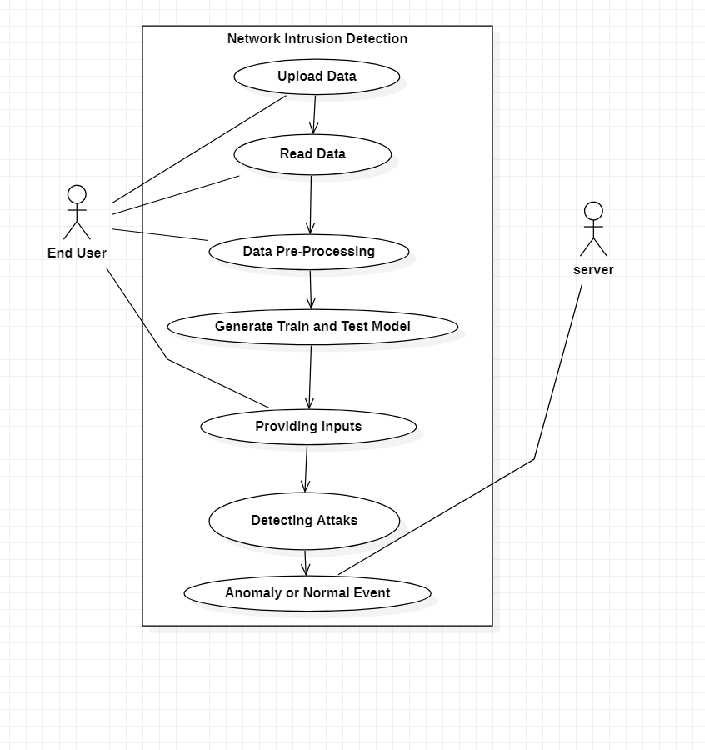
USE CASE DIAGRAM OF NETWORK INTRUSION DETECTION

Slide 19
2.SEQUENCE DIAGRAM
Defination:
Sequence Diagram are interaction diagrams that detail how operations are carried out. They capture the interaction between objects in the context of a collaboration.
Sequence Diagram are time focus and they show the order of the interaction visually by using the vertical axis of the diagram to represent time what messages are sent and when.
Purpose of Sequence Diagram:
Model high-level interaction between active objects in a system
Model the interaction between object instances within a collaboration that realizes a use case
Model the interaction between objects within a collaboration that realizes an operation
Either model generic interactions (showing all possible paths through the interaction) or specific instances of a interaction (showing just one path through the interaction)

Slide 20
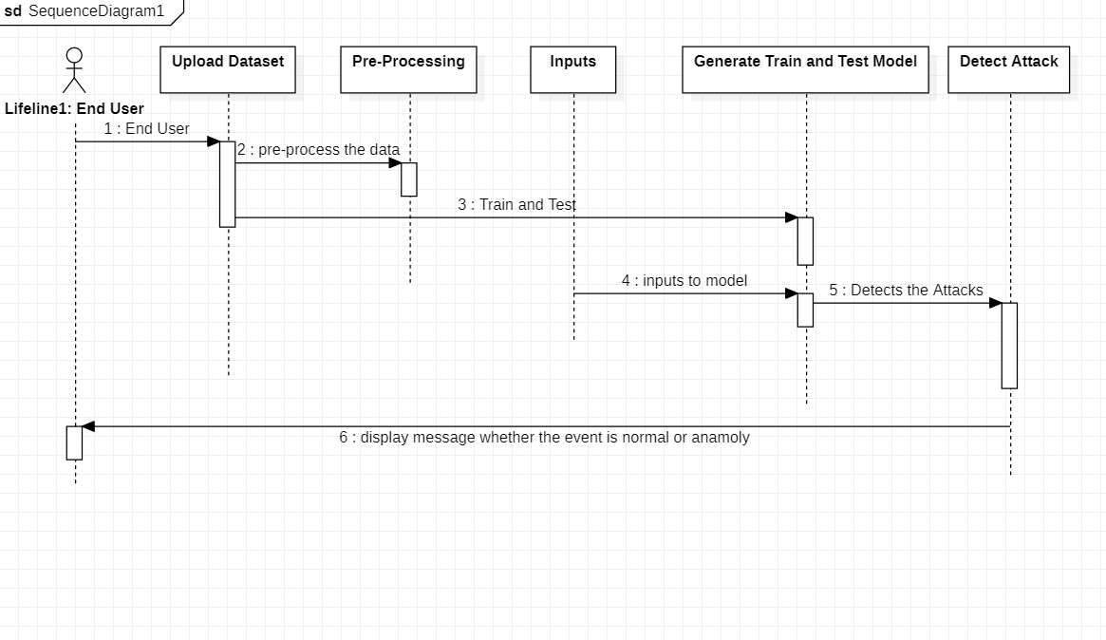
SEQUENCE DIAGRAM OF NETWORK INTRUSION DETECTION

Slide 21
3.CLASS DIAGRAM
Definition:
A class diagram in the Unified Modeling Language is a type of static structure diagram that describes the structure of a system by showing the system's classes, their attributes, operations (or methods), and the relationship among objects.
Purpose of Class Diagram:
Shows static structure of classifiers in a system
Diagram provides a basic notation for other structure diagrams prescribed by UML
Helpful for developers and other team members too
Business Analysts can use class diagrams to model systems from a business perspective

Slide 22
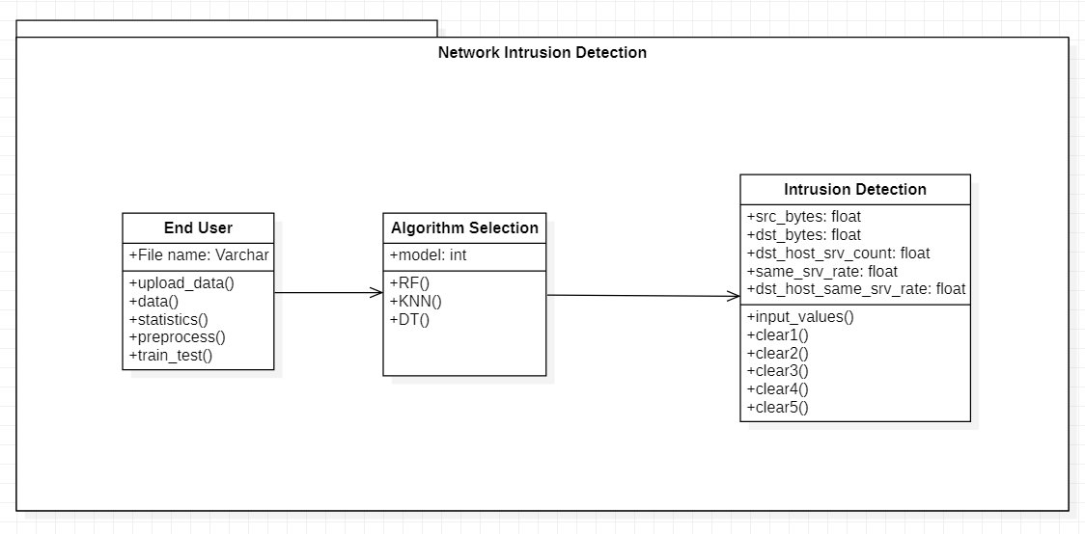
3.CLASS DIAGRAM OF NETWORK INTRUSION DETECTION

Slide 23
4.ACTIVITY DIAGRAM
Defination:
Activity diagram is another important diagram in UML to describe the dynamic aspects of the system.
Activity diagram is basically a flowchart to represent the flow from one activity to another activity. The activity can be described as an operation of the system.
Purpose of Sequence Diagram:
The basic purpose of activity diagrams is similar to other four diagrams. It captures the dynamic behavior of the system.
Activity diagram is used to show message flow from one activity to another.
Draw the activity flow of a system.
Describe the sequence from one activity to another.

Slide 24
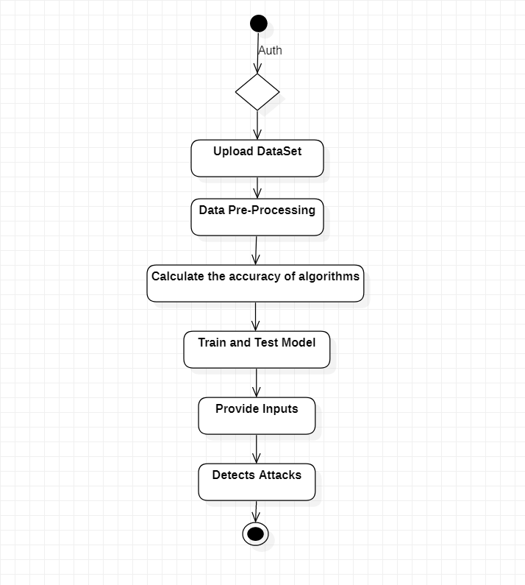
4.ACTIVITY DIAGRAM OF NETWORK INTRUSION DETECTION

Slide 25
5.DATA FLOW DIAGRAM
Definition:
A data flow diagram shows the way information flows through a process or system.
It includes data inputs and output, data stores, and the various sub processes the data moves through.
DFD are built using standardized symbols and notation to describe various entities and their relationships.
Purpose of Sequence Diagram:
It shows how data enters and leaves the system, what changes the information, and where data is stored.
The objective of a DFD is to show the scope and boundaries of a system as a whole.
It may be used as a communication tool between a system analyst and any person who plays a part in the order that acts as a starting point for redesigning a system.
The DFD is also called as a data flow graph or bubble chart.

Slide 26
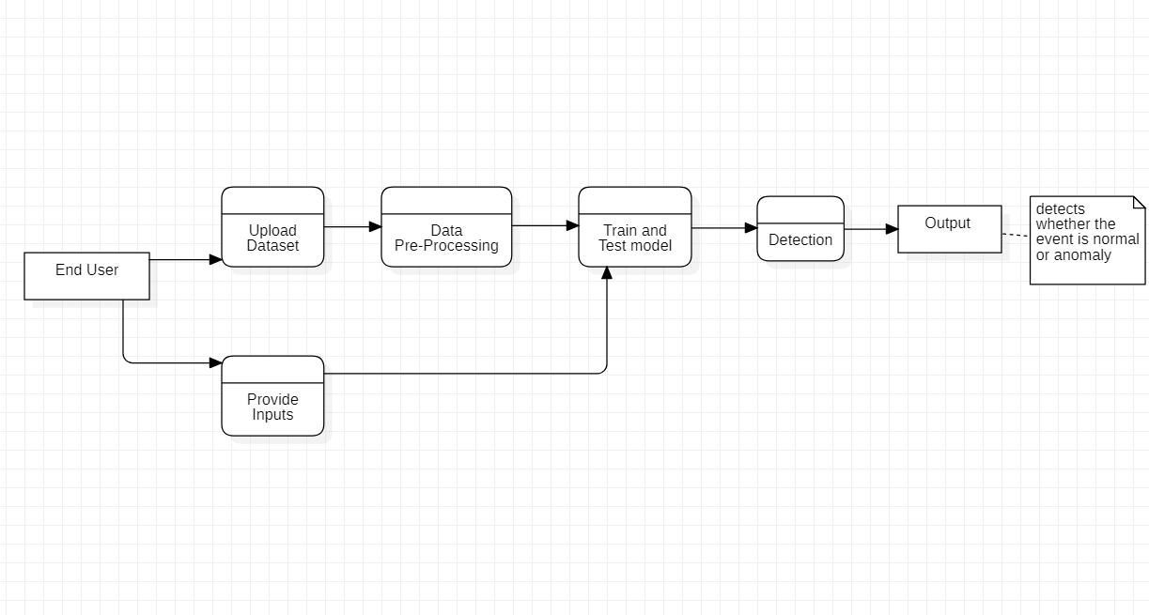
5.DATA FLOW DIAGRAM OF NETWORK INTRUSION DETECTION

Slide 27
MODULES
Data Upload And Preprocessing:
Initially we upload the data set and preprocess the data. The training and testing the machine is performed by using this data set and algorithms like Random forest, K-Nearest Neighbor and Decision tree.
Random Forest Classifier:
Random forest is a supervised learning algorithm. The "forest" it builds, is an ensemble of decision trees, usually trained with the “bagging” method. The general idea of the bagging method is that a combination of learning models increases the overall result.
Put simply: random forest builds multiple decision trees and merges them together to get a more accurate and stable prediction.

Slide 28
MODULES
Decision Tree Classification Algorithm:
Decision Tree is a Supervised learning technique that can be used for both classification and Regression problems, but mostly it is preferred for solving Classification problems. It is a tree-structured classifier, where internal nodes represent the features of a dataset, branches represent the decision rules and each leaf node represents the outcome.
The decisions or the test are performed on the basis of features of the given dataset.
K-nearest Neighbour:
K-Nearest Neighbour is one of the simplest Machine Learning algorithms based on Supervised Learning technique . K-NN algorithm assumes the similarity between the new case/data and available cases and put the new case into the category that is most similar to the available categories. K-NN algorithm stores all the available data and classifies a new data point based on the similarity. This means when new data appears then it can be easily classified into a well suite category by using K- NN algorithm.

Slide 29
MODULES
Anomaly Detection:
Anomaly IDS is capable of detecting new unknown threats. The trained and test model is given some input values such as src_bytes , dst_bytes , dst_host_srv_count , same_ srv_rate , dst_host_same_srv_rate which illustrate anomaly event.
Based on the training the model detects if any intrusion occurs and it print as “Anomaly” else it print “Normal” message as the output with less failure rate and high accuracy.

Slide 30
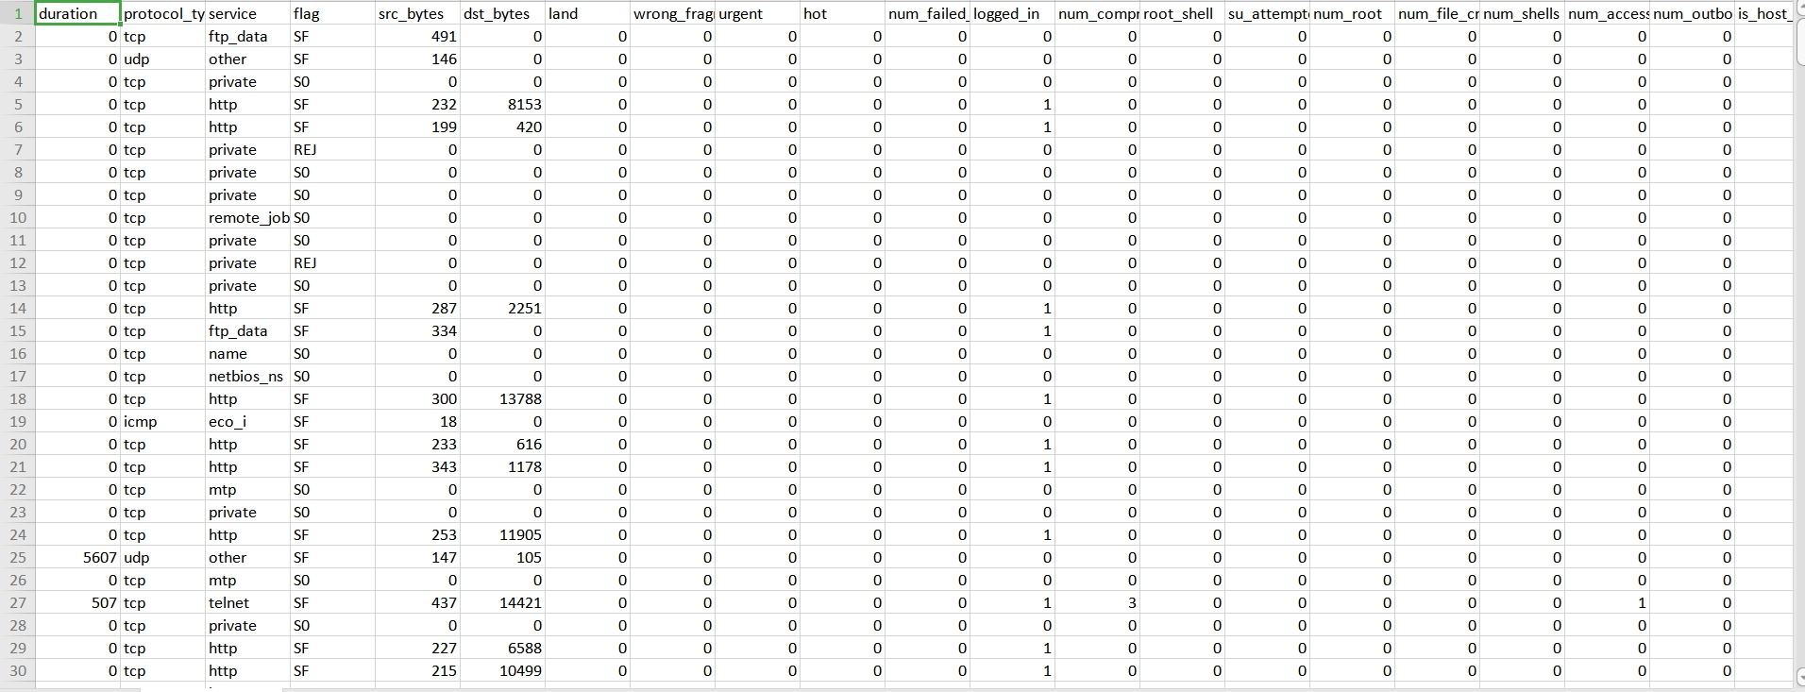
SAMPLE DATA

Slide 31
CODE
import tkinter as tk
from tkinter import messagebox,simpledialog,filedialog
from tkinter import *
import tkinter
from imutils import paths
from tkinter.filedialog import askopenfilename
import numpy as np
import pandas as pd
from matplotlib import pyplot as plt
from sklearn.preprocessing import MinMaxScaler
from sklearn.model_selection import cross_val_score
from sklearn.feature_selection import SelectFromModel
from sklearn.metrics import classification_report,confusion_matrix,accuracy_score
from sklearn.model_selection import train_test_split,KFold,cross_val_score,GridSearchCV
from sklearn.linear_model import LogisticRegression
from sklearn.tree import DecisionTreeClassifier
from sklearn.neighbors import KNeighborsClassifier
from sklearn.svm import SVC
from sklearn.naive_bayes import GaussianNB
from sklearn.ensemble import RandomForestClassifier

Slide 32
import warnings
warnings.filterwarnings('ignore')
root= tk.Tk()
root.title("Network Intrusion Detection")
root.geometry("1300x1200")
def upload_data():
global filename
filename = askopenfilename(initialdir = "Dataset")
text.insert(END,"Dataset loaded\n\n")
def data():
global filename
global df
text.delete('1.0',END)
df = pd.read_csv(filename)
text.insert(END,"Complete Dataset\n\n")
text.insert(END,df)
return df

Slide 33
def statistics():
global df
text.delete('1.0',END)
text.insert(END,"Top FIVE rows of the Dataset\n\n")
text.insert(END,df.head())
stats=df.describe()
text.insert(END,"\n\nStatistical Measurements for Data\n\n")
text.insert(END,stats)
def preprocess():
global df
text.delete('1.0',END)
df = df.drop(['protocol_type','service','flag'],axis=1)
df=df.loc[:, (df==0).mean() < .7]
df['label'] = df['label'].map({'anomaly':1,'normal':0})
text.insert(END,"\t\t\tPreprocessed Data\n\n")
text.insert(END,df)

Slide 34
def train_test():
global df
global x_train, x_test, y_train, y_test
text.delete('1.0',END)
x=df.iloc[:,:-1]
y=df.iloc[:,-1]
x_train,x_test,y_train,y_test=train_test_split(x,y,test_size=0.2,random_state=25)
text.insert(END,"Train and Test model Generated\n\n")
text.insert(END,"Total Dataset Size : "+str(len(df))+"\n")
text.insert(END,"Training Size : "+str(len(x_train))+"\n")
text.insert(END,"Test Size : "+str(len(x_test))+"\n")
return x_train,x_test,y_train,y_test

Slide 35
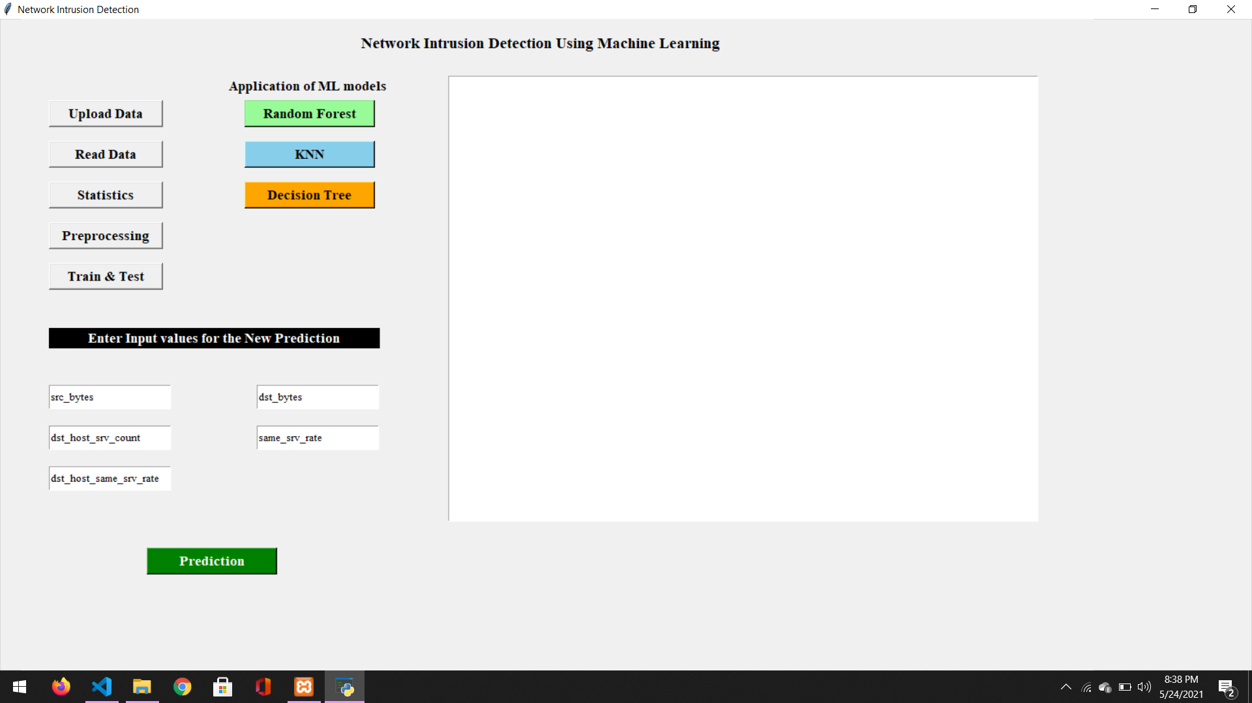
OUTPUT SCREENS

Slide 36
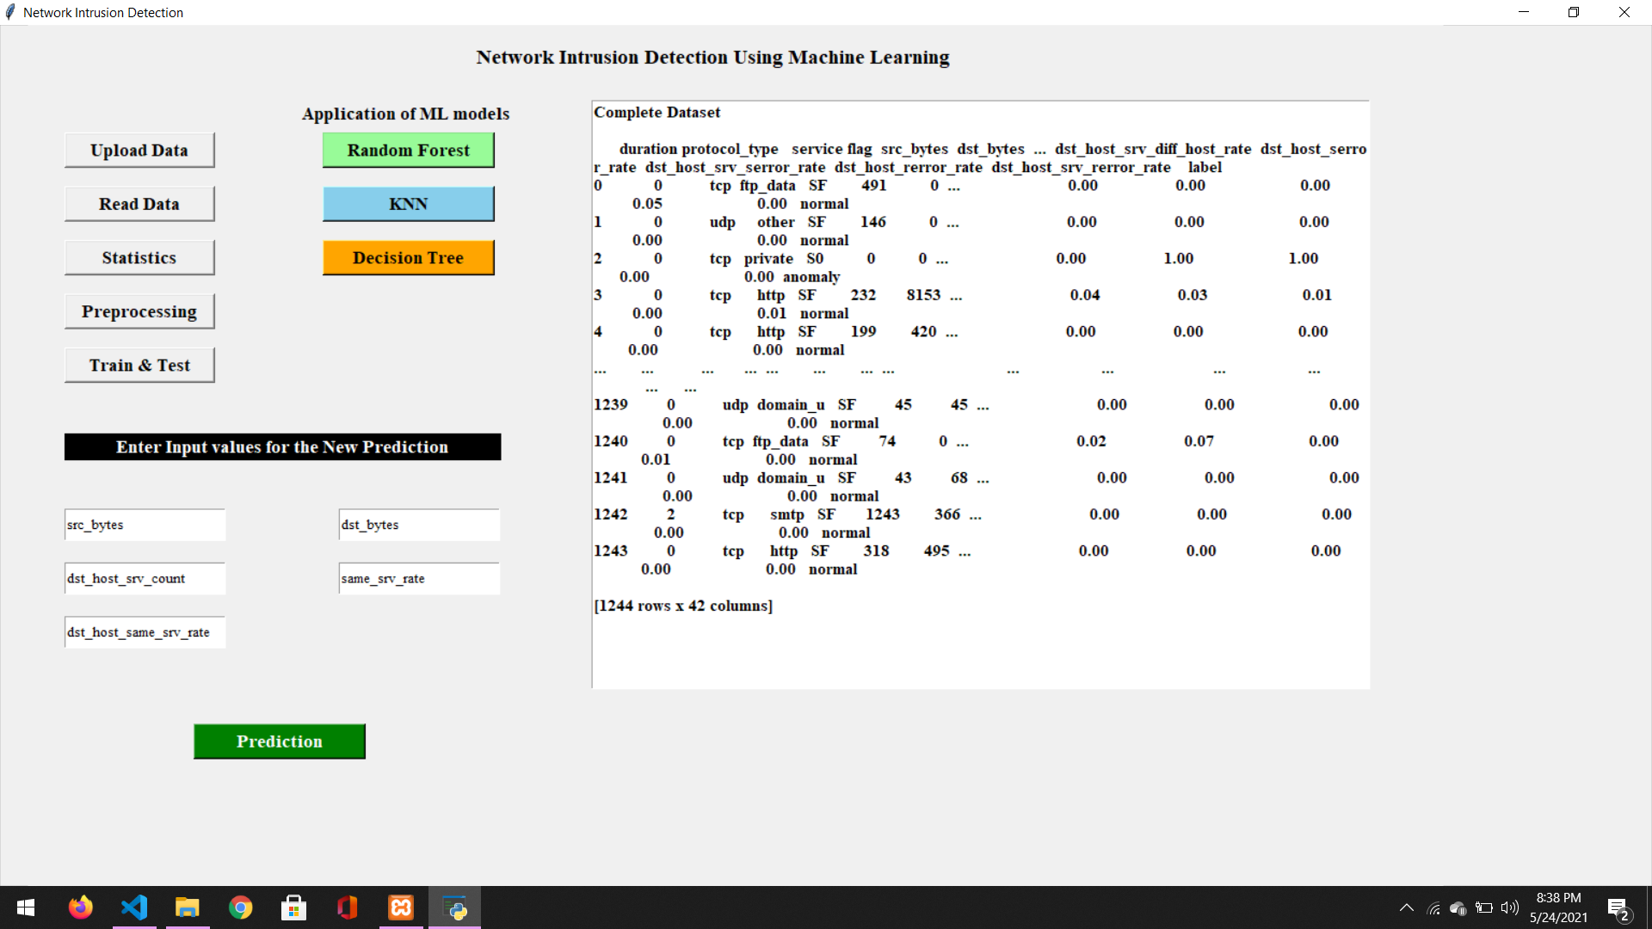

Slide 37
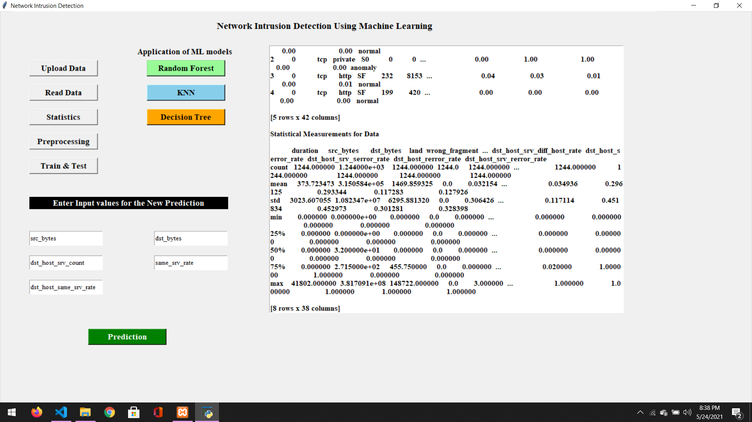

Slide 38
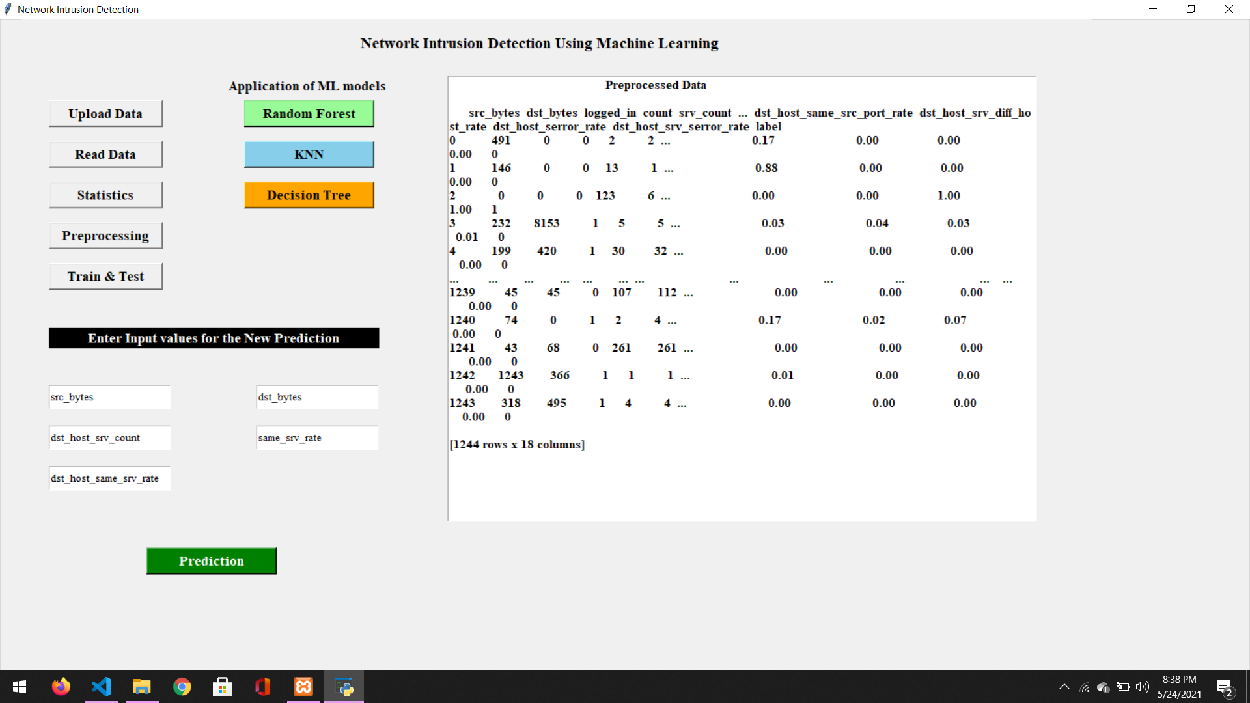

Slide 39
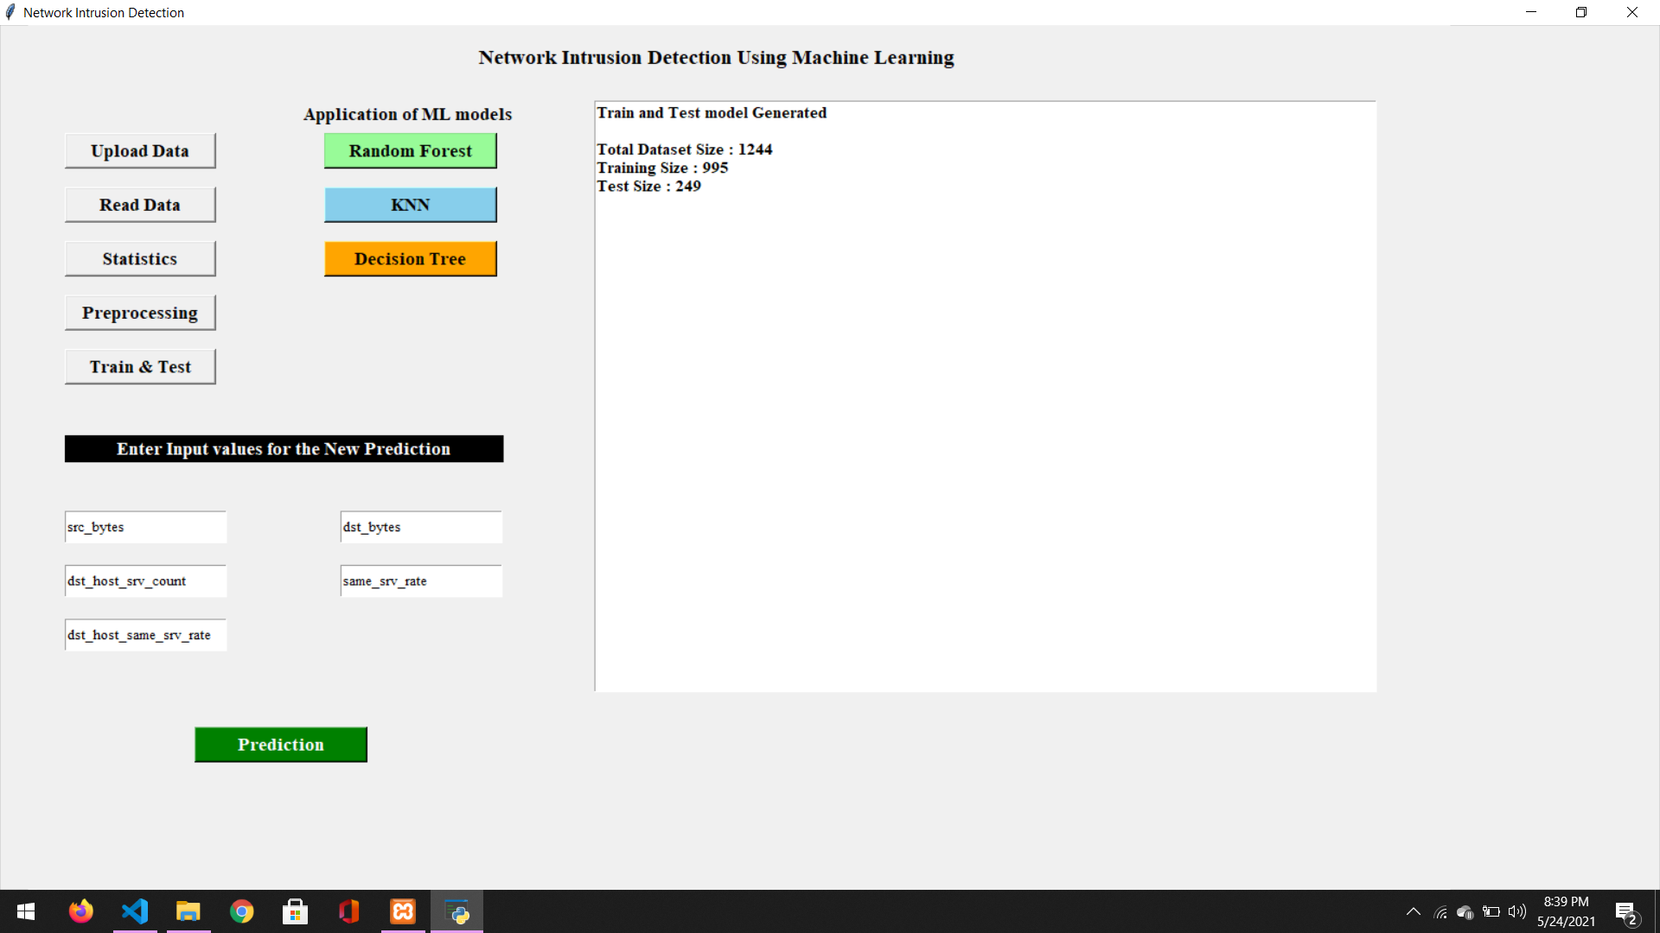

Slide 40
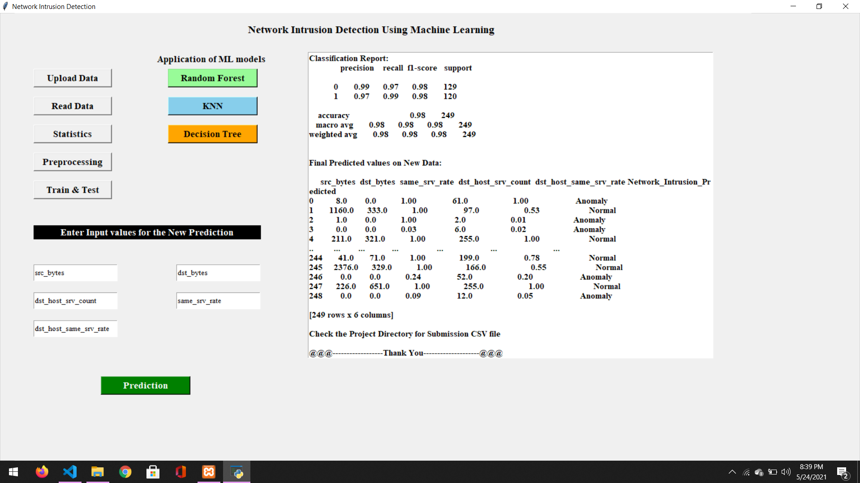

Slide 42


Slide 43


Slide 44
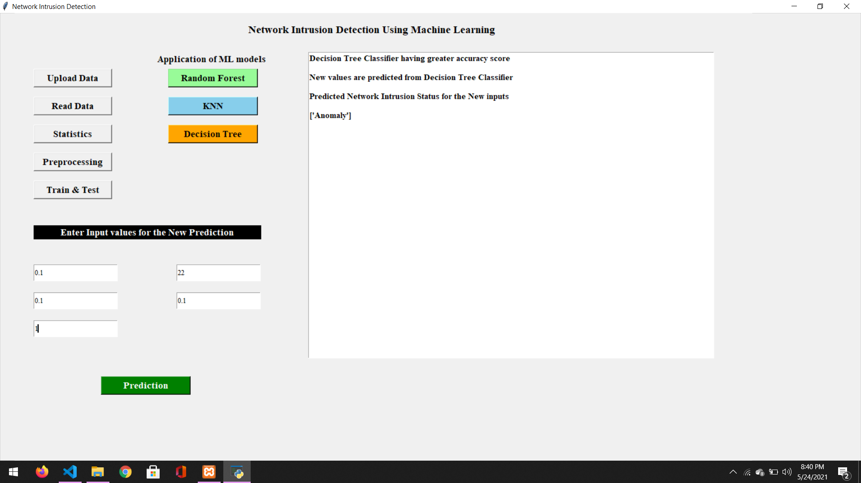

Slide 45
CONCLUSION
It is desirable for anomaly-based network intrusion detection system to achieve high classification accuracy and reduce the process complexity of extracting the rules from training data. A canonical correlation analysis is used to optimize the features toward designing the scale to detect the intrusions. The selection of optimal features simplifies the process of FAIS. The experiments were conducted using a benchmark KDD’99 Dataset. Decision Tree algorithm in machine learning has given highest accuracy of 98.3936% where as Random Forest and KNN algorithms has 97.992% and 94.7791% accuracy respectively. So Train and Test model follows Decision Tree algorithm to provide accurate and low FAIS rate.

Slide 46
FUTURE ENHANCEMENT
Intrusion Prevention, is another area that will grow dramatically in the future. Intrusion prevention is in its infancy.
Source Determination, means determining the origin of network traffic. Given how easy it is to spoof IP addresses, any source IP address in conventional IP packets must be viewed with suspicion. Tools that fabricate packets, inserting any desired IP address into the IP headers, are freely available on the Internet.
Target Detection, We’re also likely to see more widespread use of target detection in the future.

Slide 47
THANK YOU

