Slide 1

LeadIQ: AI-Powered Lead Intelligence and Sales Qualification Platform
Presented By:
Sabiha Khatoon(23BTCS048HY)
Habiba Mirza(23BTCS043HY)
Alfiya Mehroosh(23BTCS057HY)
Under the Supervision of:
Mrs Khaleda Afroaz

Slide 2
contents
Project Overview
Project Objectives & Workflow
Modeling & Evaluation
Explainability
Summary

Slide 3
Project Overview
01

Slide 4
The Problem Statement
Manual/rule-based lead review doesn't scale —
As the number of leads grows, sales teams can't manually review each one, and traditional point-based systems are set once and never updated based on actual outcomes.
No prediction based on past outcomes —
Traditional methods don't use historical data to identify which factors actually correlate with conversion.
No reasoning behind prioritization —
Sales teams have no way of knowing why a particular lead is prioritized, making decisions inconsistent and hard to trust.

Slide 5
LeadIQ Solution
ML Decision-Support Role
End-to-End Solution Pipeline
ML-based decision-support tool to augment sales teams, not replace them
Analyzes historical lead and conversion data to detect patterns
Predicts likelihood that a given lead will convert
Helps prioritize sales efforts based on data-driven insights
Lead data ingestion and preprocessing
ML model computes conversion probability for each lead
Leads classified into Hot / Warm / Cold based on probability thresholds
Explanations highlight key factors driving each score
Actionable recommendations provided to guide next best sales steps

Slide 6
Project Objectives & Workflow
02

Slide 7
Project Objectives
Explain & Recommend
Identify the key features and signals that most strongly influence each lead’s score
Generate clear, actionable next-step recommendations tailored to the sales team
Predict & Classify Leads
Predict the probability that each lead will convert using historical data
Automatically segment leads into Hot, Warm, and Cold groups for prioritization
Dashboard & Model Performance
Develop a centralized dashboard to display scores, explanations, and conversion analytics
Compare multiple machine learning algorithms to select and maintain the best-performing models

Slide 8
System Workflow
End-to-End Process Overview
Sequential pipeline from data intake to dashboard delivery
Each step transforms raw lead data into actionable insights
Workflow designed for repeatability, scalability, and monitoring
Data Collection
Aggregate lead source, website behavior, and purchase history
Integrate CRM, web analytics, and transactional databases
Standardize identifiers to enable cross-channel tracking
Data Preprocessing
Handle missing values with appropriate imputation strategies
Remove duplicate or inconsistent lead records
Encode text and categorical fields into ML-ready representations
EDA & Feature Engineering
Explore correlations between features and conversion outcomes
Detect outliers, biases, and data drift patterns
Create derived features capturing engagement intensity and recency
ML Modeling
Train supervised learning models to estimate conversion probability
Compare algorithms using validation metrics such as AUC and F1-score
Tune hyperparameters and perform cross-validation for robustness
Scoring & Categorization
Assign each lead a conversion probability score
Segment leads into tiers (e.g., high, medium, low priority) via thresholds
Feed scores into CRM systems for downstream sales workflows
Explanation & Recommendation
Use SHAP values to explain feature impact on each lead’s score
Generate tailored action recommendations for sales and marketing teams
Highlight key drivers to support transparent decision-making
Dashboard Integration
Present scores, segments, and explanations in an interactive dashboard
Enable filtering by segment, campaign, timeframe, and sales owner
Support continuous monitoring of pipeline health and model performance

Slide 9
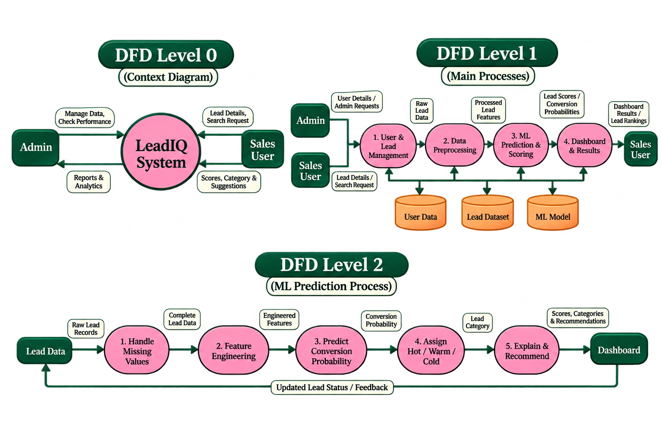
Data flow diagram(dfd)

Slide 10
Modeling & Evaluation
03

Slide 11
ML Algorithms Comparison
FIRST Logistic Regression | SECOND Decision Tree | THIRD XGBoost | FOURTH Random Forest
simple linear model suitable as a strong baseline for lead scoring | Provides human-readable decision rules for lead qualification | Gradient boosting algorithm that delivers top performance on tabular lead data Captures complex non-linear patterns and feature interactions in conversion behavior | Ensemble of many trees, improving robustness over a single decision tree
Fast training and prediction, scalable to large lead datasets | Naturally handles mixed data types and missing values Useful for explaining why a specific lead was scored high or low | Supports advanced regularization, improving generalization on noisy lead sets | Reduces variance and overfitting through averaging across multiple models
Outputs calibrated probabilities, enabling clear conversion risk ranking | Highly prone to overfitting when tree depth is not properly controlled | Needs careful hyperparameter tuning to reach optimal performance | Handles high-dimensional lead feature spaces relatively well
Performance can degrade when interactions between variables are strong | Generalization can be weak without pruning or regularization strategies | Increased model complexity can slow experimentation and complicate deployment | Global model behavior and feature interactions are harder to interpret

Slide 12
Evaluation Metrics
Core classification metrics
Accuracy: measures overall correctness of predictions across all leads
Precision: proportion of predicted converters who are actual buyers
Recall: proportion of actual converters correctly identified by the model
F1-score: harmonic mean of precision and recall, balancing both objectives
Handling imbalance and diagnostic tools
Avoid using accuracy alone, as lead datasets are typically imbalanced with far fewer conversions than non-conversions
ROC-AUC: quantifies the model’s ability to distinguish converters from non-converters across thresholds
Confusion matrix: visual representation of true positives, false positives, true negatives, and false negatives for deeper error analysis

Slide 13
Explainability
04

Slide 14
Explainable AI for Lead Scoring
Transparent Scoring Logic
SHAP-Based Explainability
LeadIQ replaces black-box scores with clear, human-readable explanations
Every lead score is accompanied by a breakdown of the main contributing factors
Users can quickly see a lead is classified as hot, warm, or cold
Improves trust in the model and supports better sales decision-making
Uses SHAP (SHapley Additive exPlanations) for per-lead feature importance
Quantifies how each feature increases or decreases the predicted conversion probability
Supports both global understanding (overall feature importance) and local view (single lead)
Enables sales teams to tailor outreach based on the specific drivers of each lead’s score

Slide 15
Project Progress & Current Status
1 Work Completed
Designed and developed the frontend user interface.
Created the main dashboard layout and visual components.
Added sample lead entries for demonstration purposes.
Designed the interface for lead management and prediction results.
2 Current Status
Frontend currently displays static sample data.
Backend functionality is not yet integrated.
Database connectivity and user interactions are pending.
ML prediction and lead scoring modules are yet to be implemented.
3 Upcoming Development
Backend development and API integration.
Database design and connectivity.
User authentication and interactive lead management.
ML model training, testing and evaluation.
Integration of lead scoring, explainability and recommendations.
http://localhost:5173/

Slide 16
Summary
05

Slide 17
Summary
Addressed inefficient manual lead qualification that wastes sales resources
Built LeadIQ: a machine learning–driven lead scoring and explanation engine
Enable a shift from intuition-based decisions to data-driven lead prioritization
Supports more focused outreach, higher conversion potential, and better use of sales capacity

Slide 18
Thank you

