Slide 1
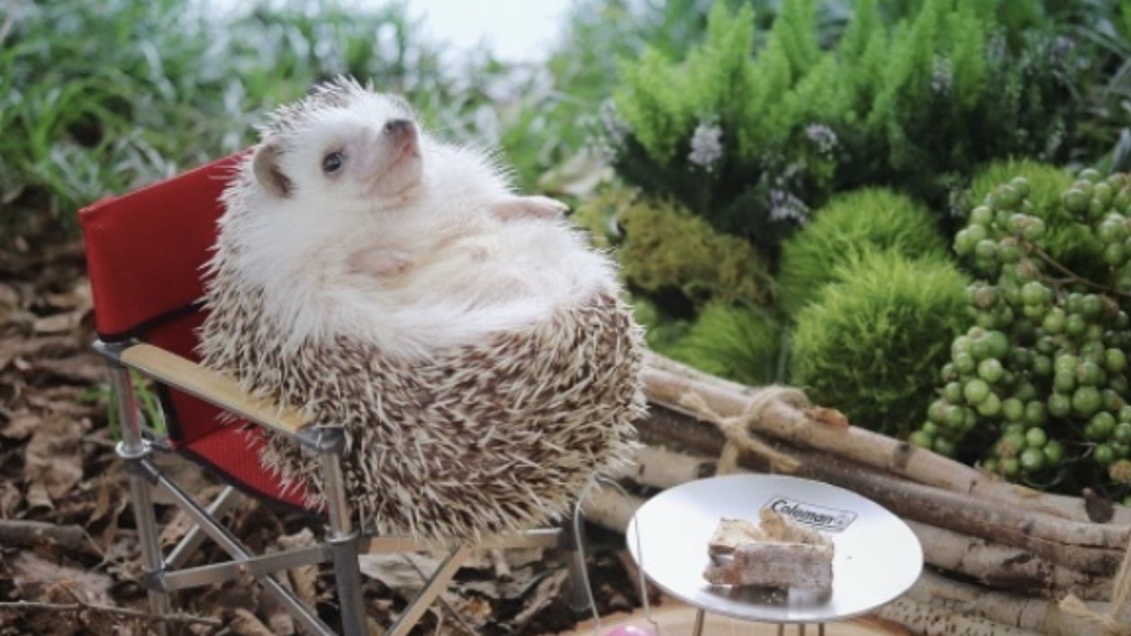
Maandelijkse voortgang
01-12-2023 – 05-01-2024

Slide 2
Overzicht
Structural ambiguity
Tree probing
LCA
Chunking
Unaries
Interchange interventions
Ending of constituents

Slide 3
Structural ambiguity
We decided to wait

Slide 4
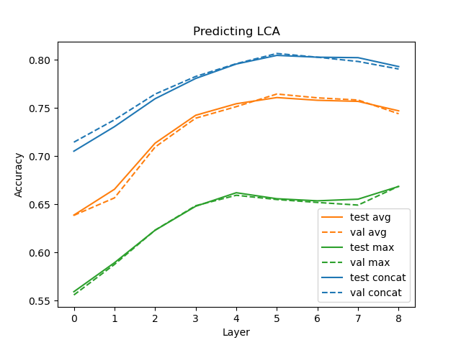
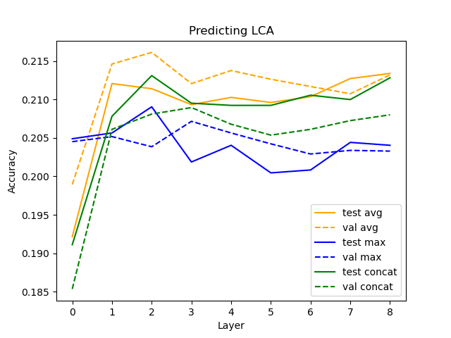
Tree probing: LCA

Slide 5
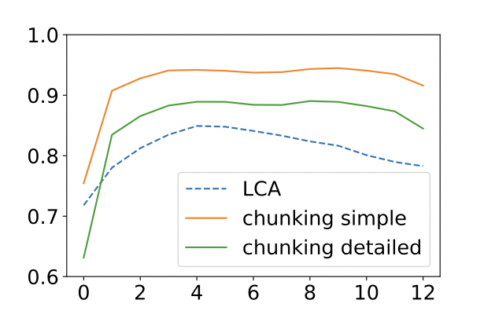
Comparison original paper

Slide 6
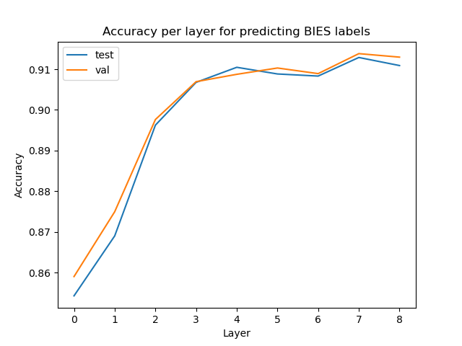
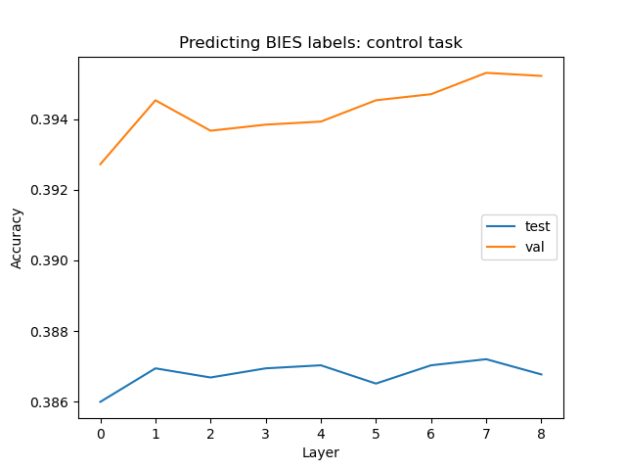
Tree probing: chuncking

Slide 7
Tree probing: chuncking

Slide 8
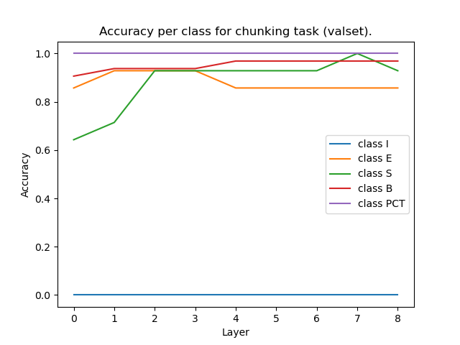
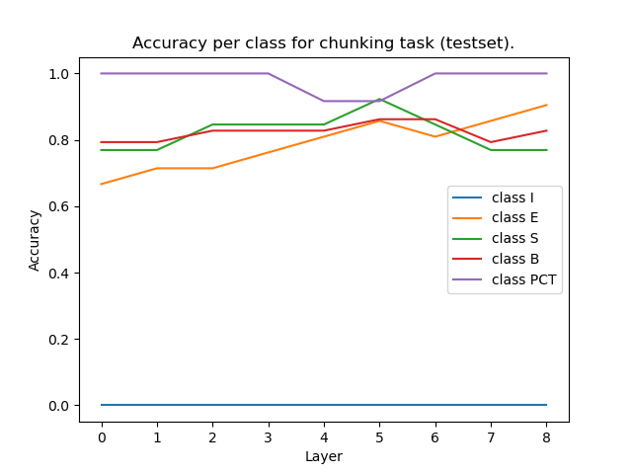
Chuncking per class

Slide 9
Tree probing: full tree
Probe trained on combination of activations from layer 3, 6, and 8
Goal: combine these predictions to create a full tree
Current: making the code to create a tree again work
Task | Test | Val
LCA | 0.824 | 0.825
Shared levels | 0.702 | 0.702
Unaries | 0.938 | 0.939

Slide 10
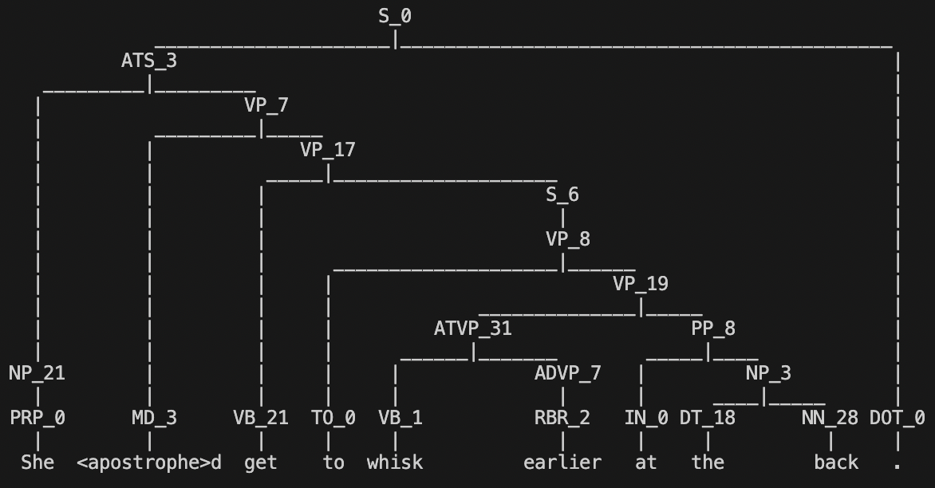
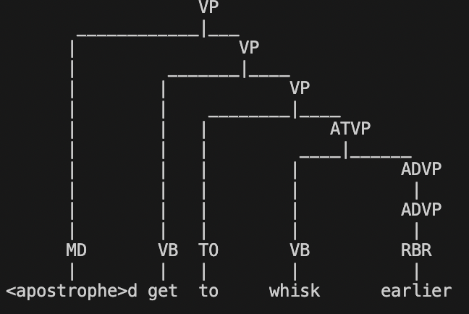
Current attempt
Reconstructed one (bonsai boom ) 🌳
Gold parse tree

Slide 11
Interchange interventions
Idea: task is predicting wether a word is an ending of a PP

