Slide 1
PATIENT EDUCATION
ON STROKE RECOVERY AND REHABILITATION

Slide 2
Content of this session
What happens in stroke
How does your brain recover
Why should you be physically active
What all modifications you need to make in your lifestyle after stroke
What all treatment that will help in faster recovery
What will happen if you continue to be Inactive
How to live a healthy life after stroke

Slide 3
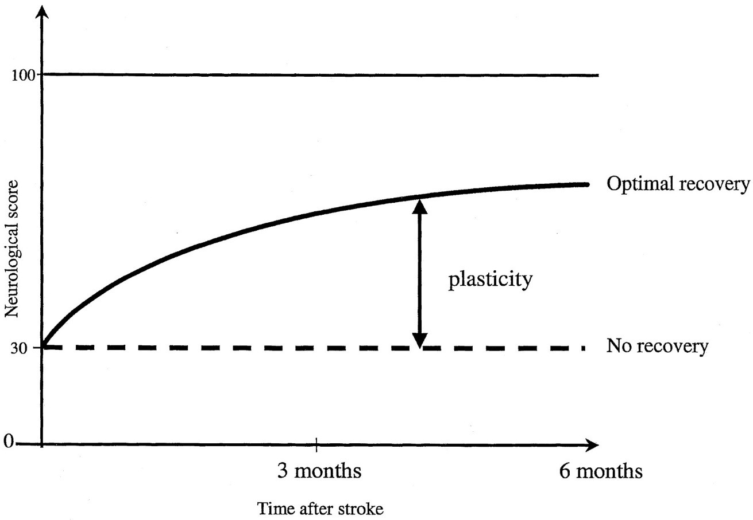
Recovery after stroke
Recovery from a stroke is a life long process

Slide 4
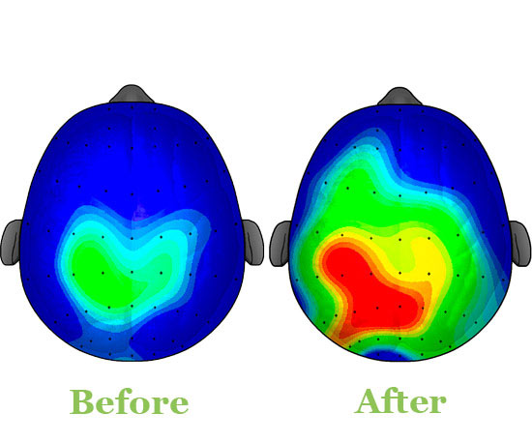
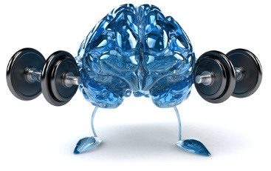
How does your brain recover
Exercise!!!

Slide 5
Role of family in recovery
Family support is essential for patient who feels despair and depressed due to the unexpected disability he is faced with
The re-assurance and motivation by family members and relatives will make the patient optimistic and encourage better engagement in the therapy
Family member should understand that patient needs continuous physical and mental support

Slide 6
When providing patient care, be on the affected side of the patient
Patience and tolerance are essential as some patients lose their temper easily
Patients may become depressed and unwilling to engage in activities of daily living
Do not tell the patient unpleasant problems or give sad news

Slide 7
Even small improvements need to be appreciated
Use the words “You are better than the previous day”.
DONOT talk about weaknesses/problems
Prevent complications related to stroke by close attention and proper care

Slide 8
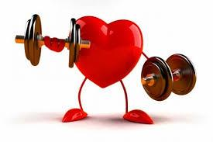
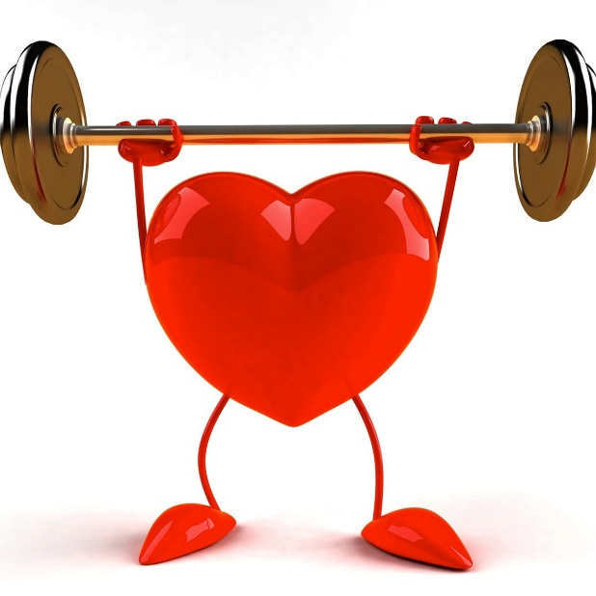
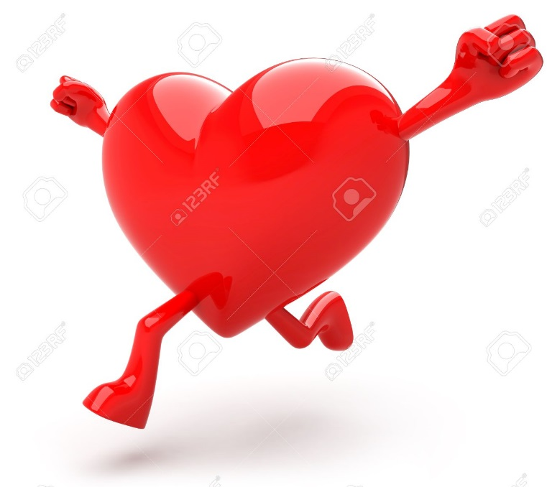
Why should you be physically active
Healthy heart

Slide 9
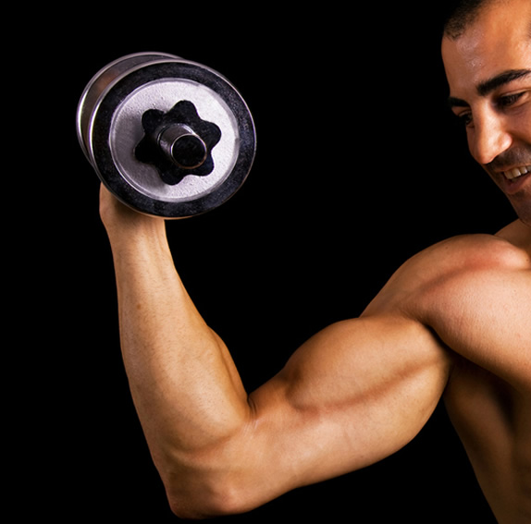

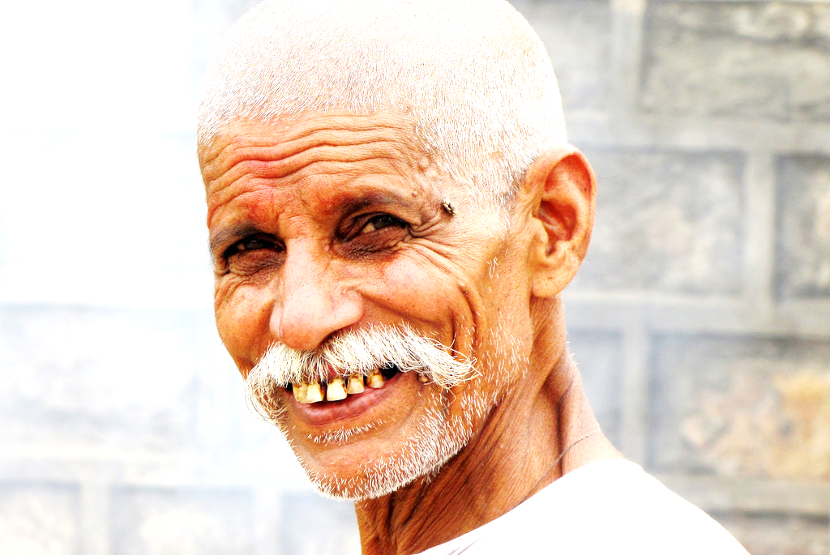
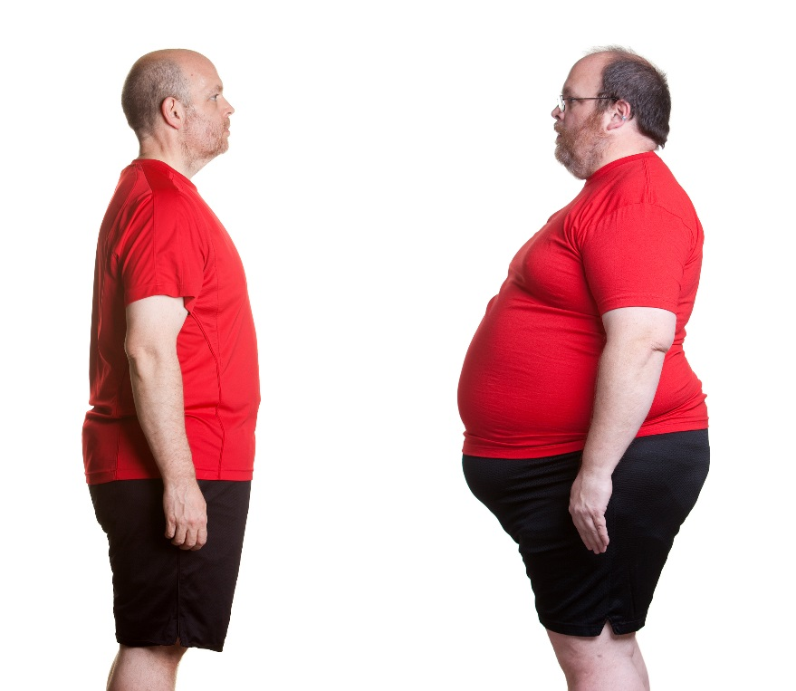
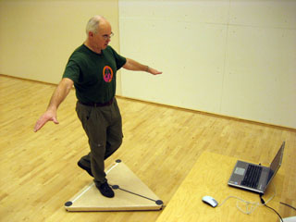
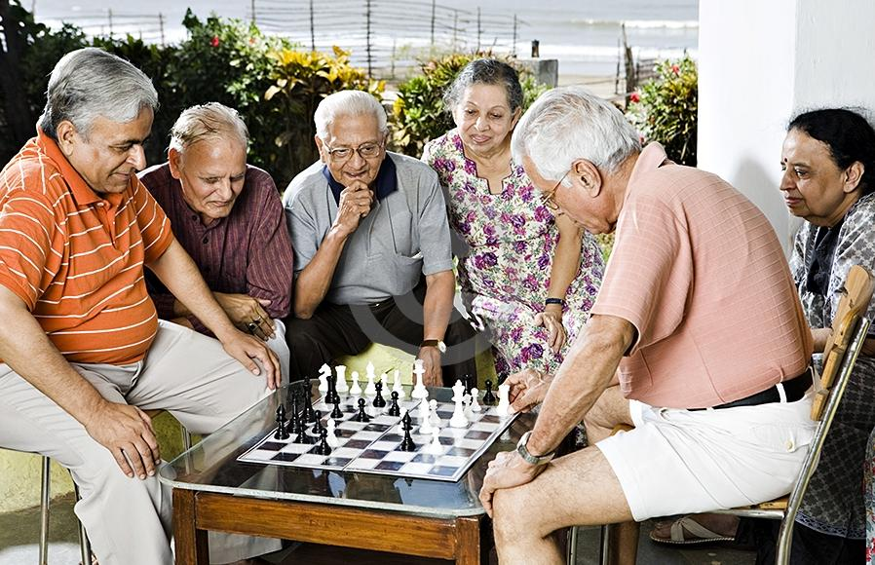
Walk better
More happy
Good strength
Weight control
Good Balance
Good memory

Slide 10
What all modifications you need to make in your lifestyle after stroke
Lifestyle modification involves altering long-term habits, typically of eating or physical activity, and maintaining the new behaviour for months or years
Lifestyle modification can be used to treat a range of diseases including cardiovascular diseases, stress, hypertension, obesity
It Includes:
Strengthening the healthy behaviours
Weakening the unhealthy behaviours
Notes:
including obesity.

Slide 11
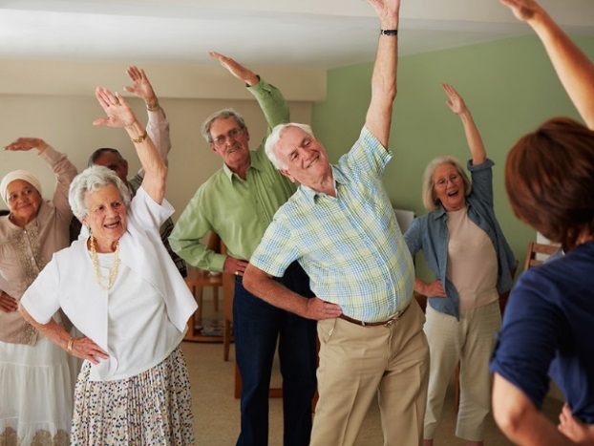
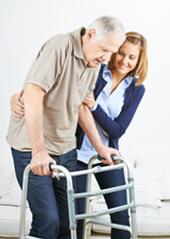
Physical activity
Healthy diet
Blood pressure check
Blood profile check up
Follow prescribed treatment
What you SHOULD DO regularly…

Slide 12
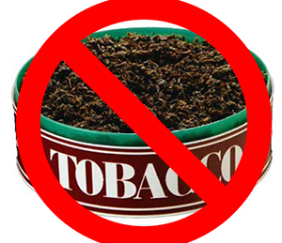
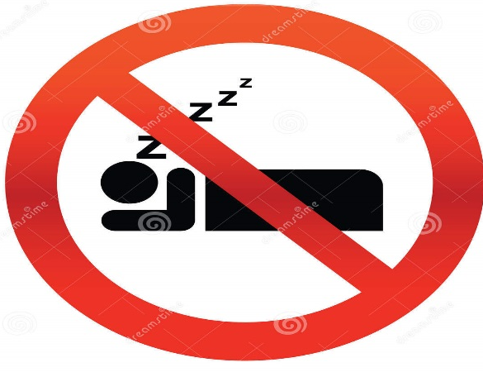
Alcohol
Tobacco
Junk food
Resting
What you should
NOT DO…

Slide 13
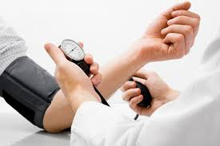
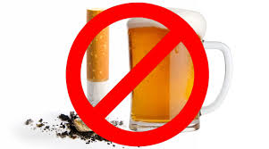
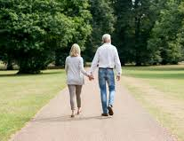
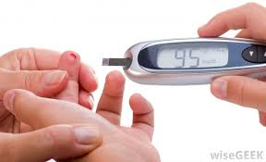
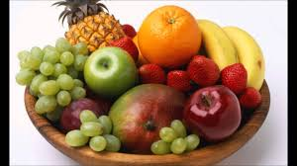
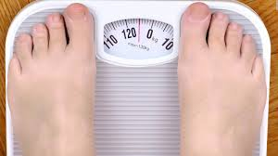
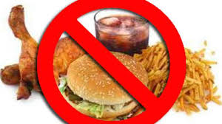
CONTROL HIGH BLOOD PRESSURE with active lifestyle or medication
DO MODERATE EXERCISE
5 times a week
EAT FRUITS AND VEGETABLES
three or more times a day
REDUCE YOUR CHOLESTEROL
by eating healthy food
CONTROL YOUR BODY WEIGHT
STOP SMOKING AND AVOID ALCOHOL INTAKE
DIABETES
If you have diabetes, talk to your doctor about treatment.
8 out of 10 people who follow these advices regularly remain healthy

Slide 14
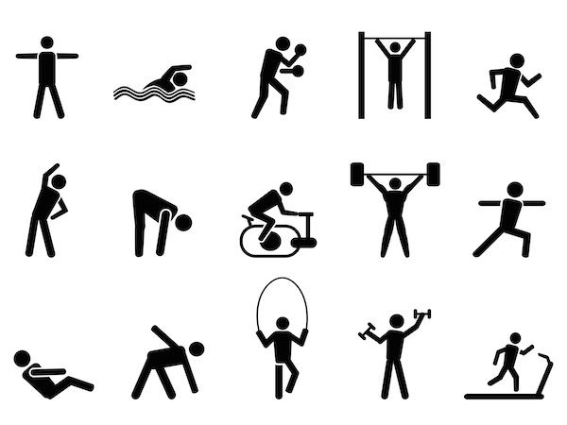
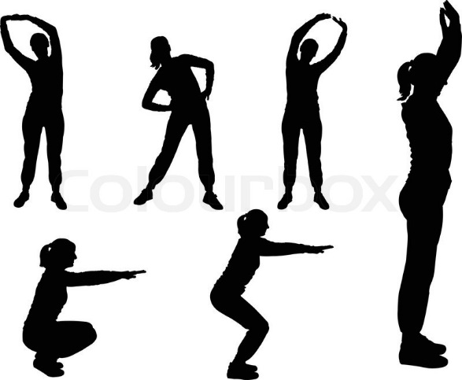
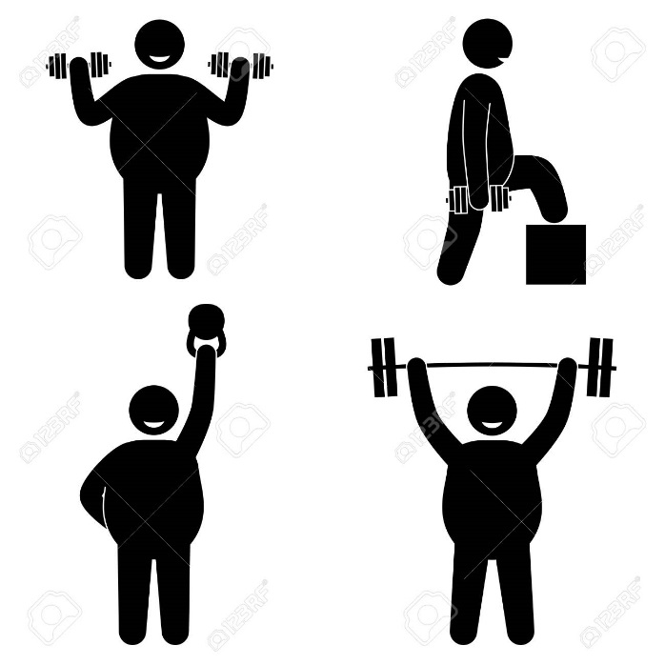
What all exercises help in faster recovery
Stretching muscles
Lifting weight
Free exercises

Slide 15
How much exercise is needed to improve
Start with moving your arm and legs in sitting or standing for 10 minutes
Walk at least 30 minutes every day OR any activity in which whole body is moving like standing up, climbing stairs etc.
Lift weights that are not very difficult at least 10-15 times in morning and evening
Do all the above for at least 3-5 days in a week

Slide 16
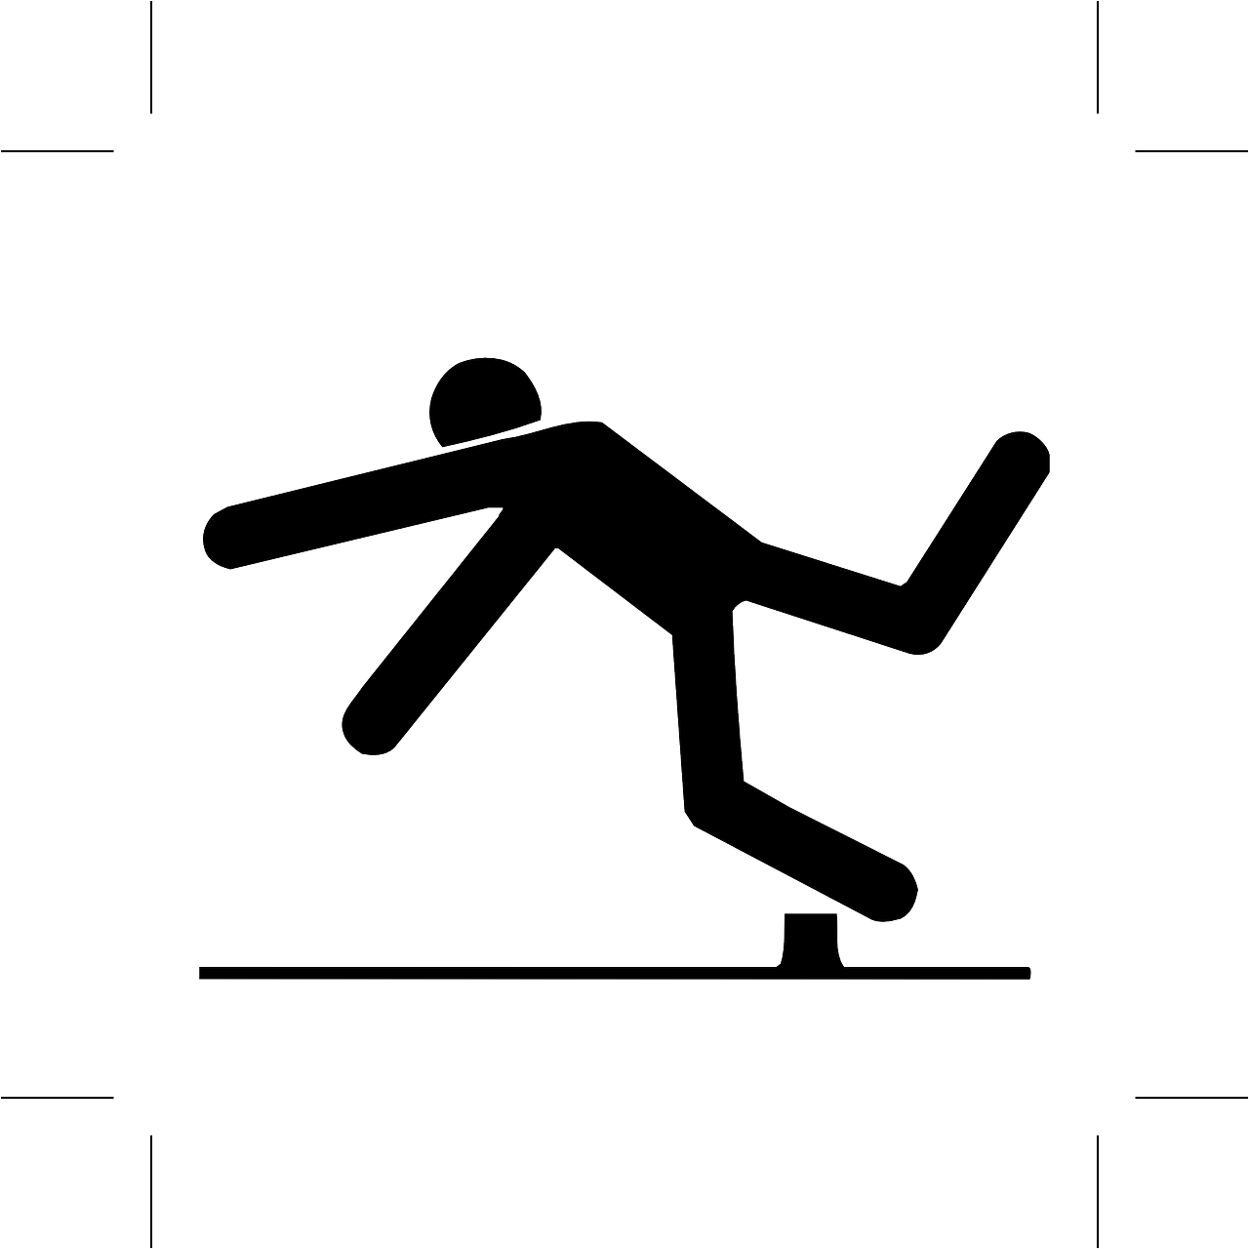
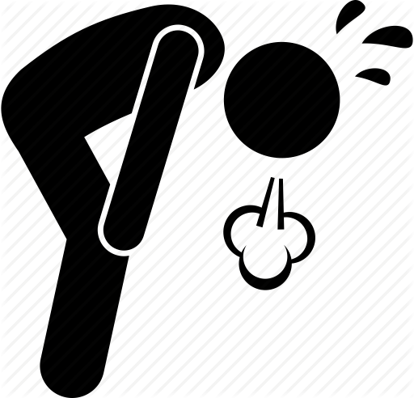
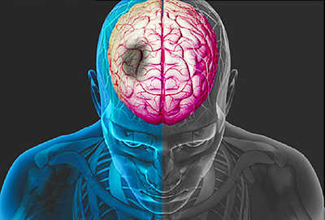
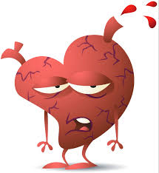
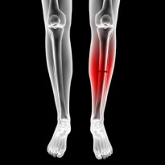

What may happen if you continue to be INACTIVE
Falls
Another stroke
Tiredness
Fractures
Depression
Poor heart

Slide 17
So…. you should do these activities daily to live a HEALTHY LIFE AFTER STROKE….

Slide 18
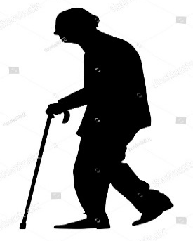
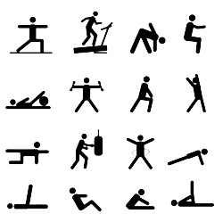
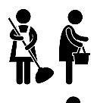
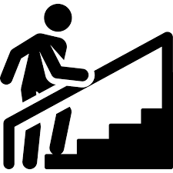

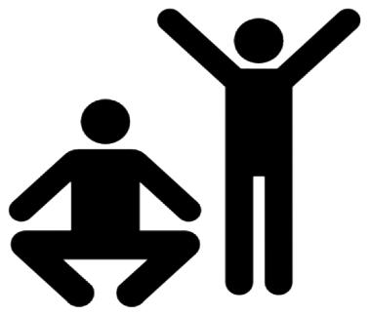

Slide 19


Slide 20
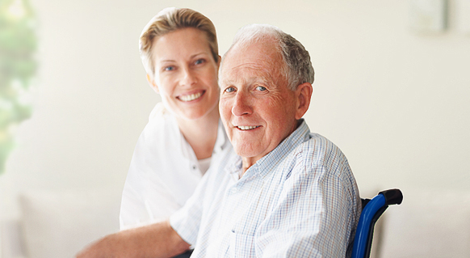
No matter where your are in the recovery journey, there is always Hope

