Slide 1

Bangla Handwritten Digit Recognition
CSE475 – Machine Learning
1

Slide 2
Instructor:
Md Mohsin Uddin
Group Members:
Md. Sabik Alam Rahat
ID: 2019-1-60-256
Naeem Mizan
ID: 2018-3-60-053
Sourav Saha
ID: 2018-3-60-052
Md. Abid Hasan Rafe
ID: 2018-3-60-108
2

Slide 3

Introduction
Handwritten digit classification is a well-known and important problem in the field of optical character recognition (OCR). The primary challenge is correctly classifying digits which are highly varied in their visual characteristics primarily due to the writing styles of different individuals.

Slide 4
Dataset Collection
Ekush
Bengali.ai.
Keras

Slide 5
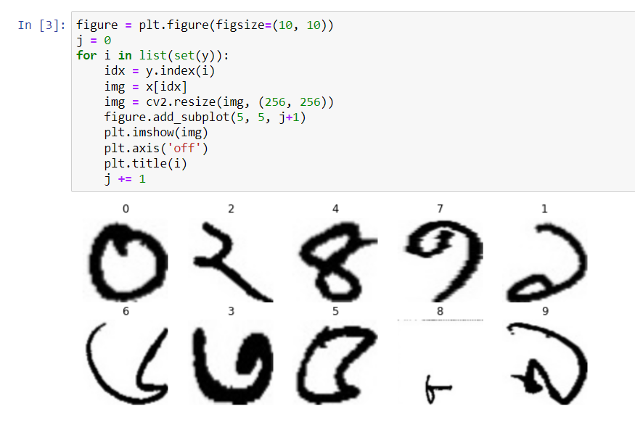
Visualizing Images in the Dataset

Slide 6
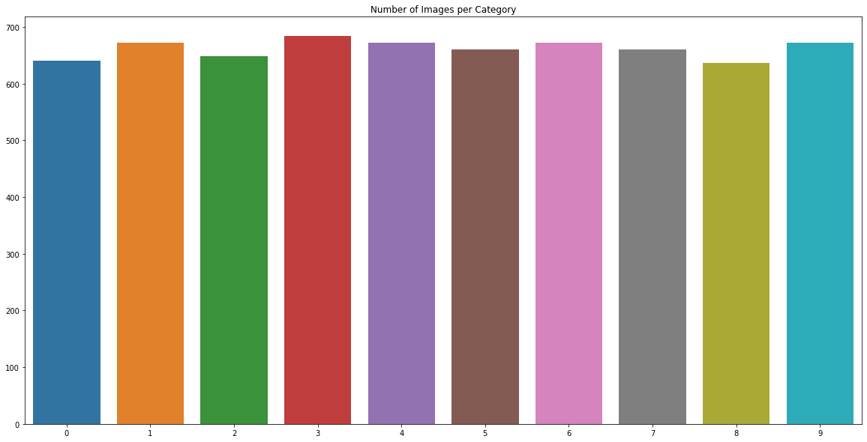
Data Distribution of the Dataset
N.B: The dataset is not much imbalanced. So balancing is not required here much.

Slide 7
Preprocessing the Data
We have taken around 600 images of each digits.
Divided the dataset in 80:20 ratio.
80% dataset are used for train the model.
20% dataset are used for test the model.
The value of random_state is 42

Slide 8
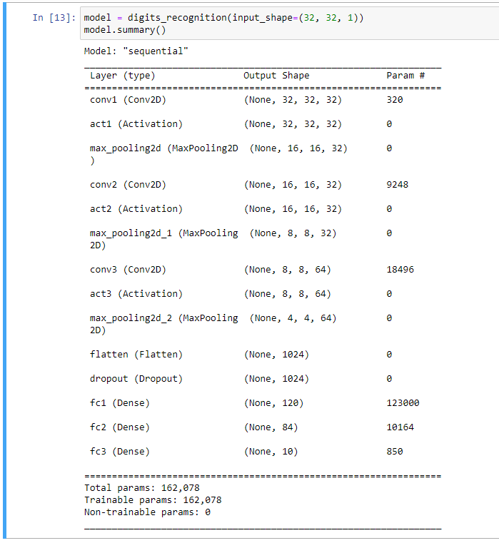
Defining the Model

Slide 9
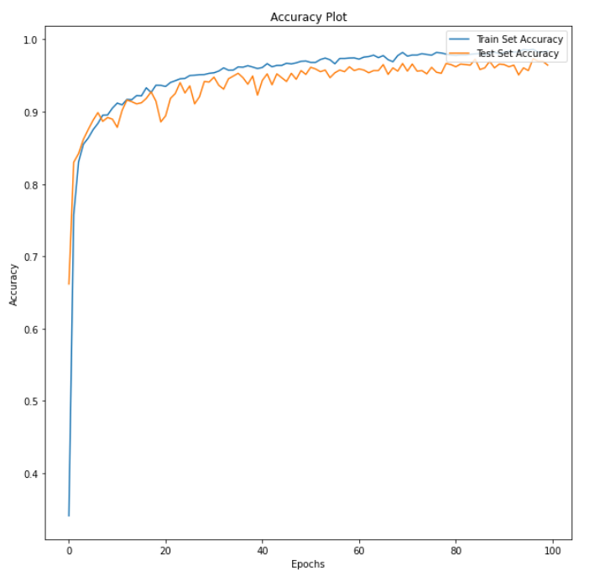
Accuracy Plot

Slide 10
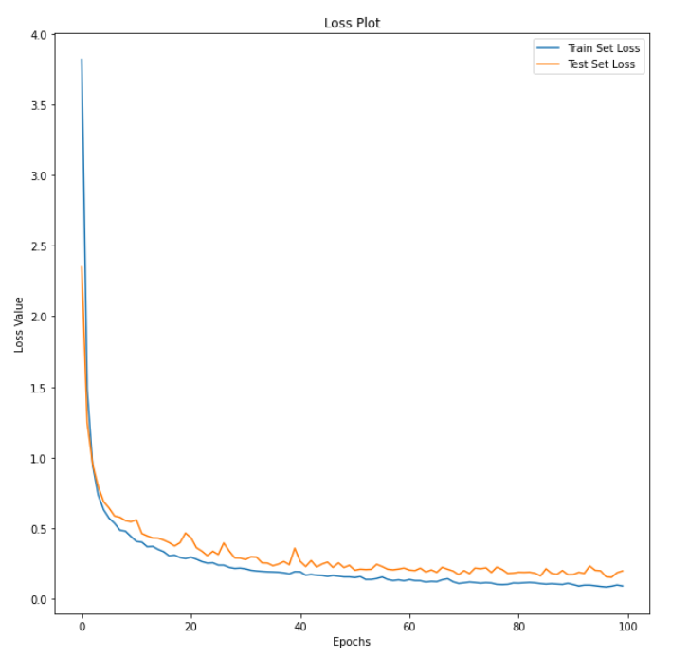
Loss Plot

Slide 11
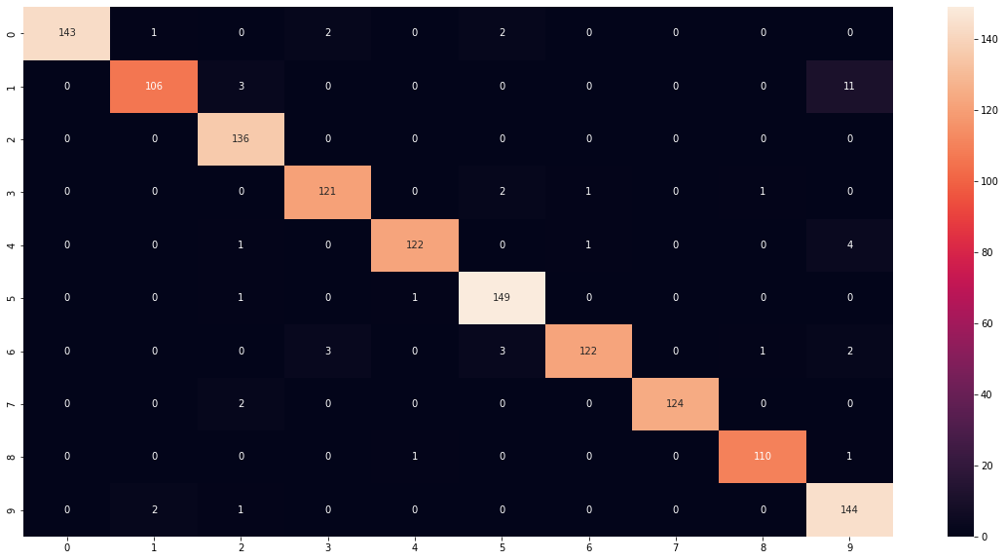
Confusion Matrix

Slide 12
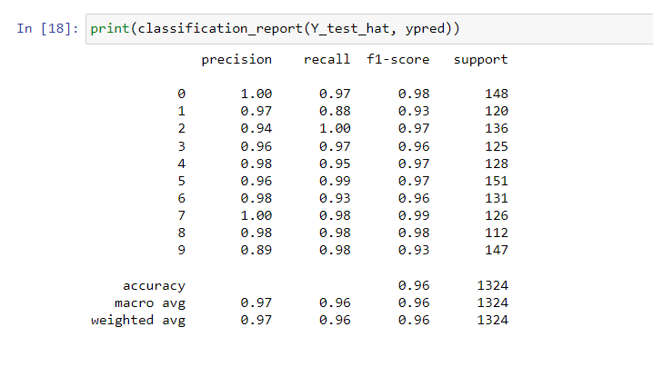
Classification Report

Slide 13
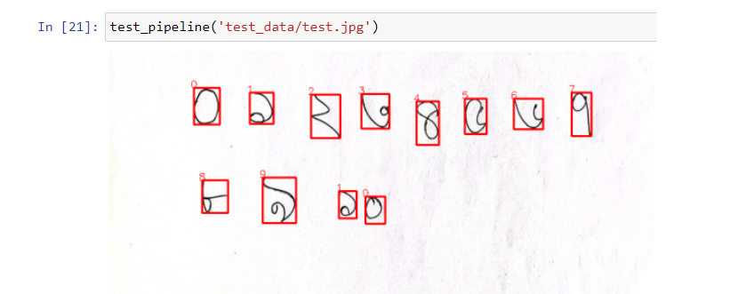
Testing the Model

Slide 14
THANK YOU

