Slide 1


Slide 2
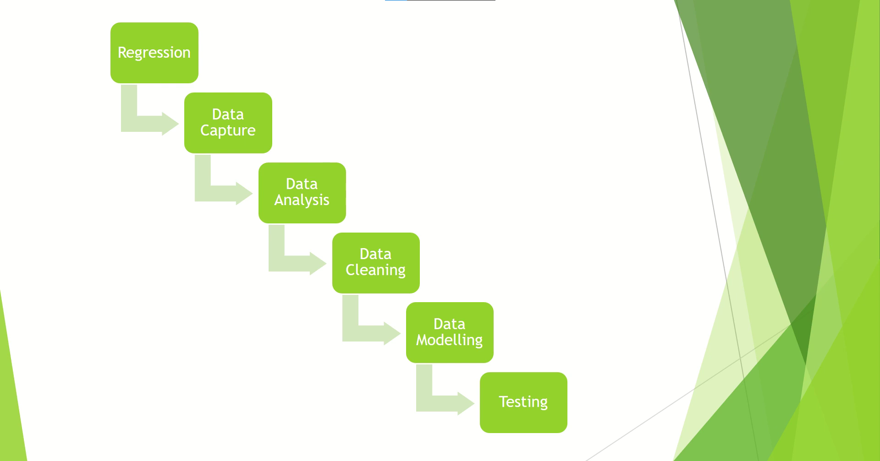

Slide 3
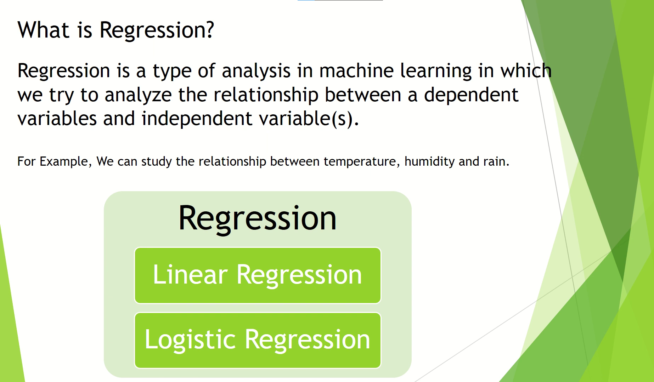

Slide 4
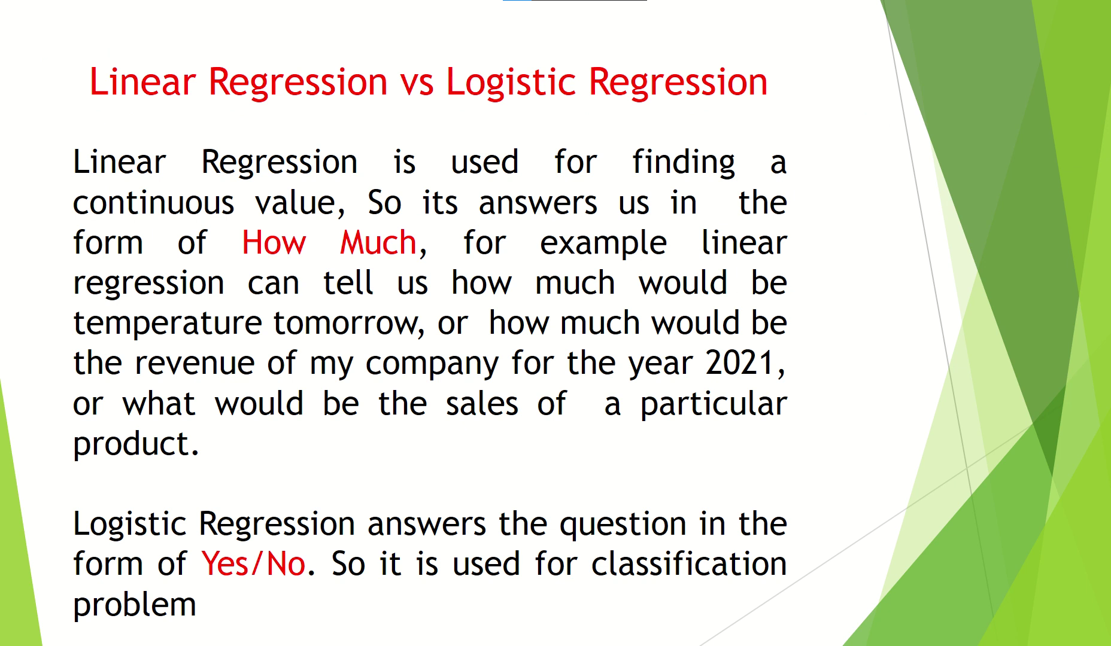

Slide 5
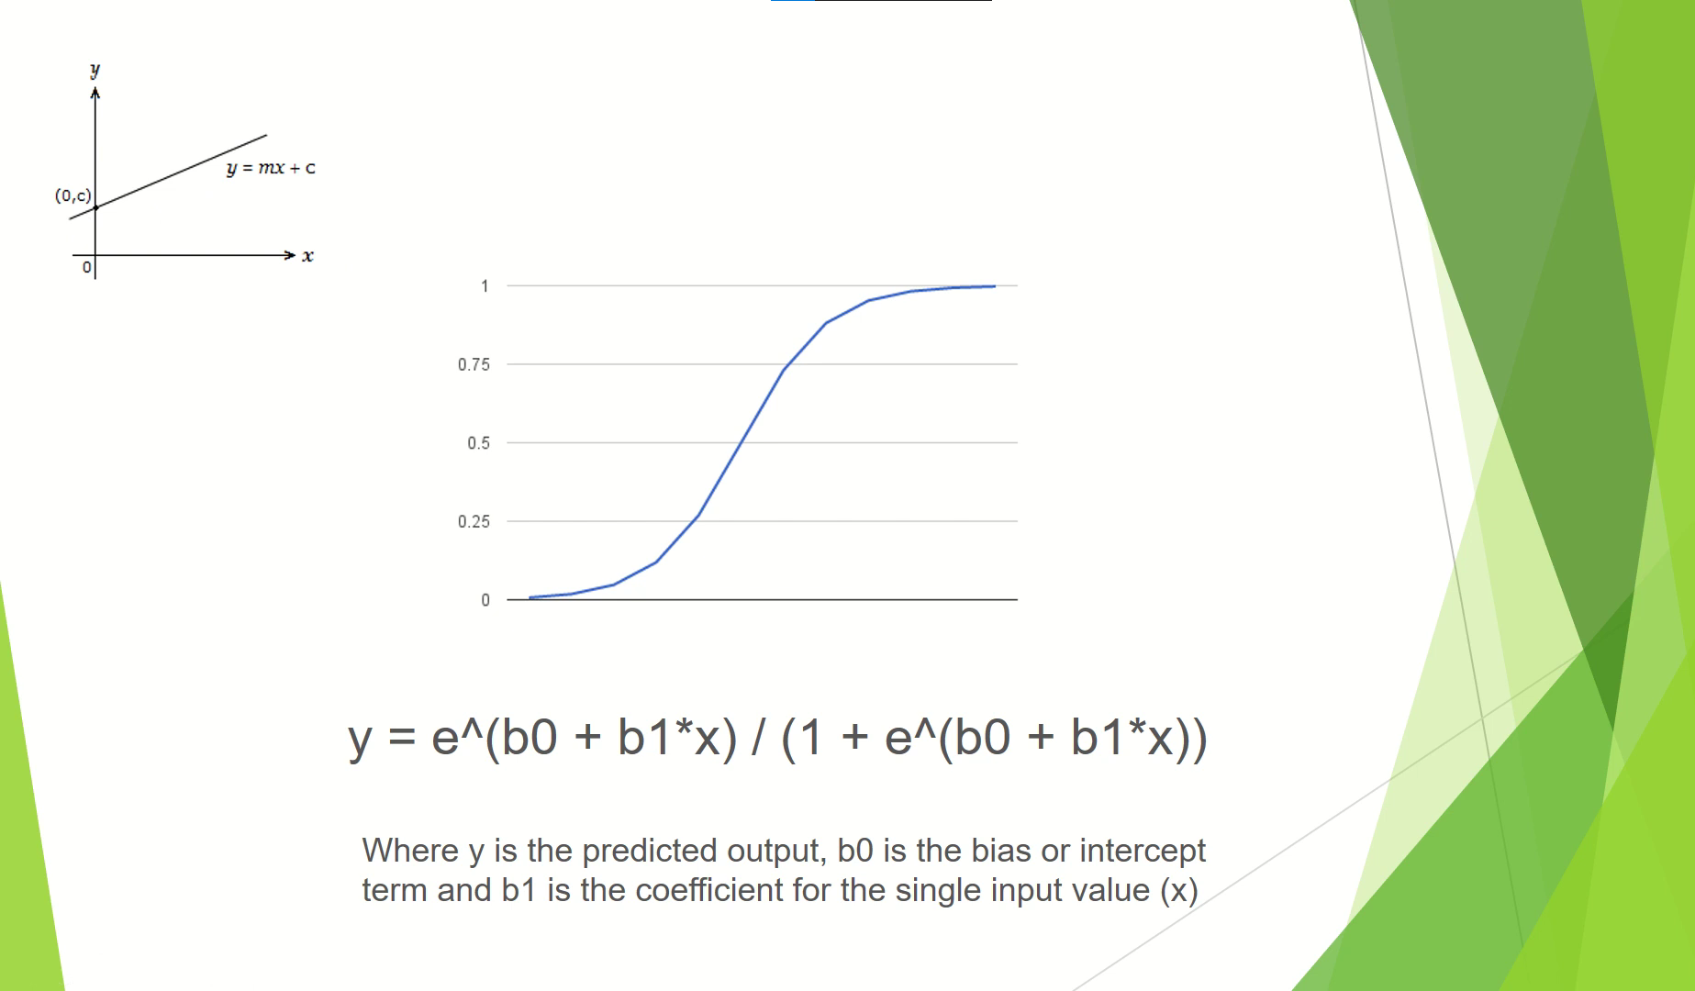
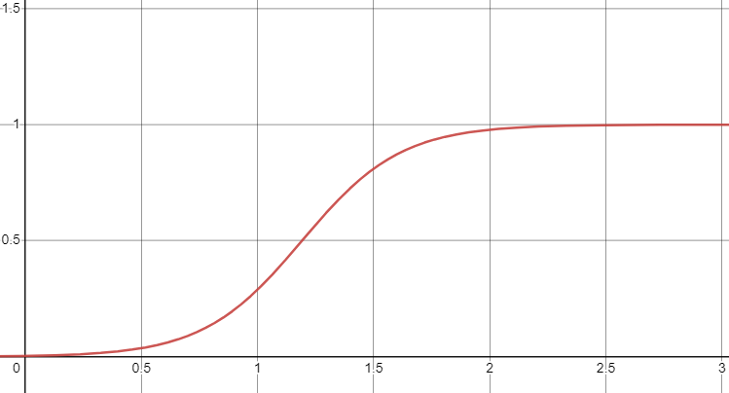
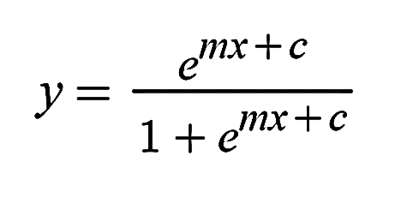
y is the predicted output where,
c is the intercept or bias and m is the coefficient of the single input value x

Slide 6
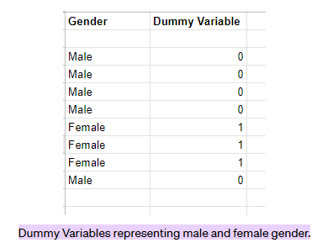
Dummy variables are numerical variables that represent the actual data.

Slide 7
Precision is the ratio of correctly predicted positive observations to the total predicted positive observations.
Recall is the ratio of correctly predicted positive observations to all observations in actual class
F1 Score is the weighted average of Precision and Recall.

Slide 8

?
?
?
?
A confusion matrix visualizes and summarizes the performance of a classification algorithm.
True Positive means the actual result was YES and the predicted one is also YES
True Negative means the actual result was NO and the predicted one is also NO
False Positive means the actual result was NO and the predicted one is YES
False Negative means the actual result was YES and the predicted one is also No

Slide 9
