Slide 1
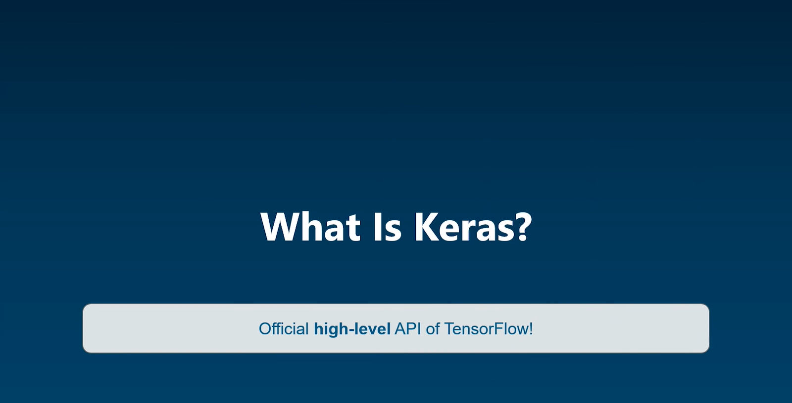

Slide 2
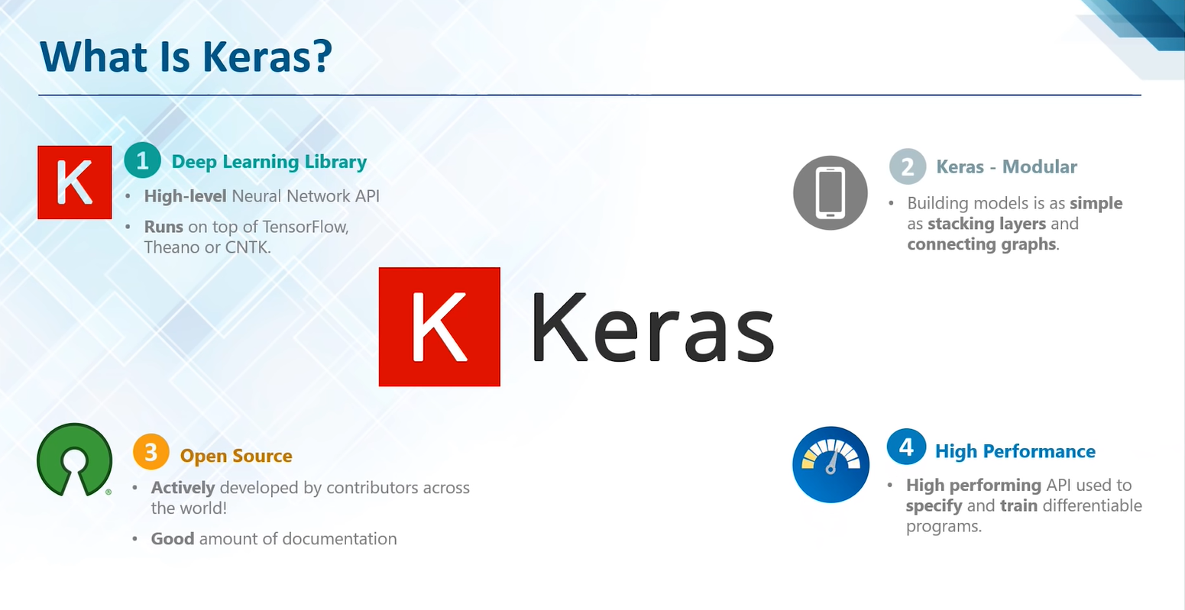

Slide 3


Slide 4
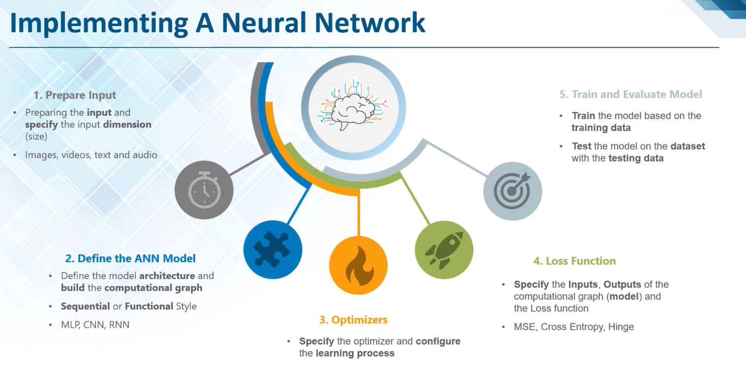

Slide 5
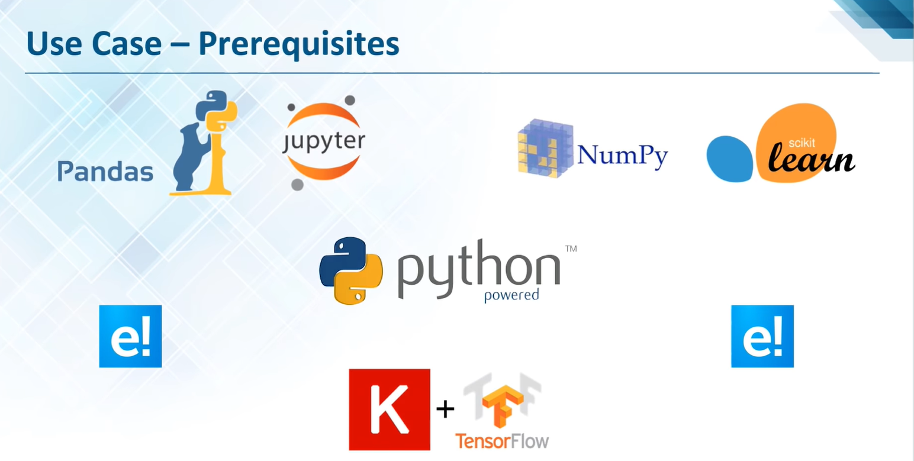

Slide 6
relu - rectified linear unit
epoch - forward and the backward pass of all of our training examples
batch size - number of training examples in one forward and backward pass
SGD - stochastic gradient descent
rmsprop - root mean square
mse - mean squared error
DATASET: https://github.com/laxmimerit/dog-cat-full-dataset
Loss function : keras.io/api/losses/
https://deeplizard.com/learn/video/Skc8nqJirJg

