Slide 1
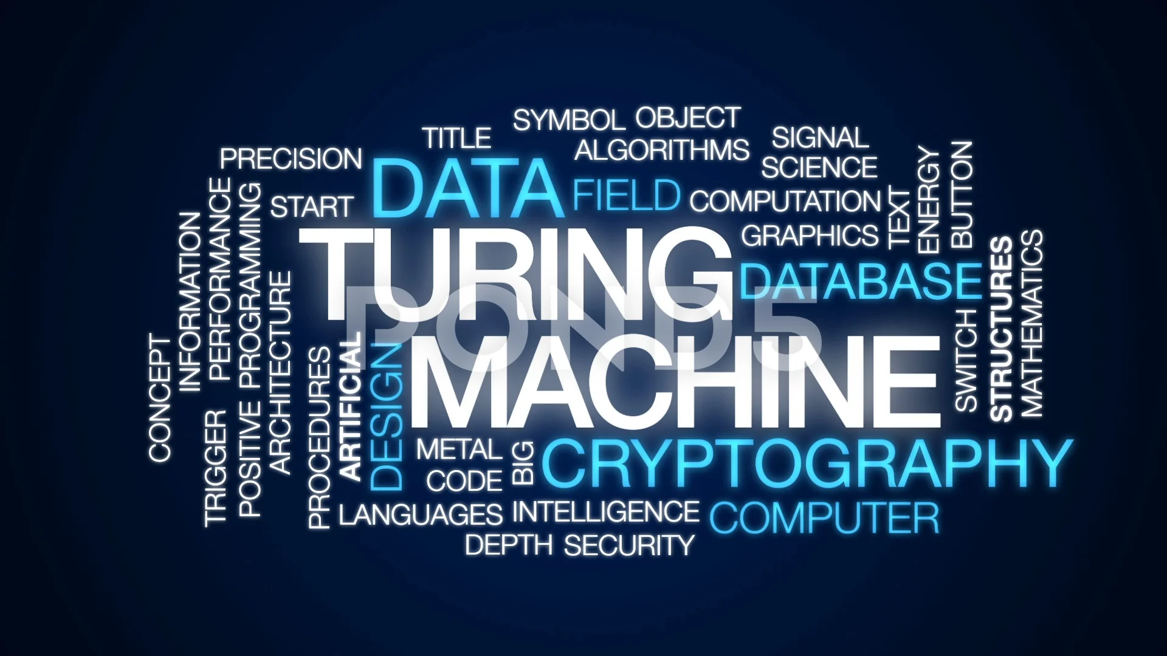

Slide 2
Team Members
Plabon Banik Md. Sabik Alam Rahat Abid Hasan Rafe
2019-1-60-167 2019-1-60-256 2018-3-60-108

Slide 3

What is
Turing Machine

Slide 4

History
TM invented in 1936
Invented by the British mathematician Alan Turing
Originally only built to define the word “algorithm”

Slide 5
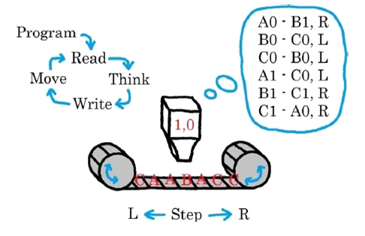
Problem Statements
& Objects
• Addition
• Subtraction
• Multiplication
• Division

Slide 6
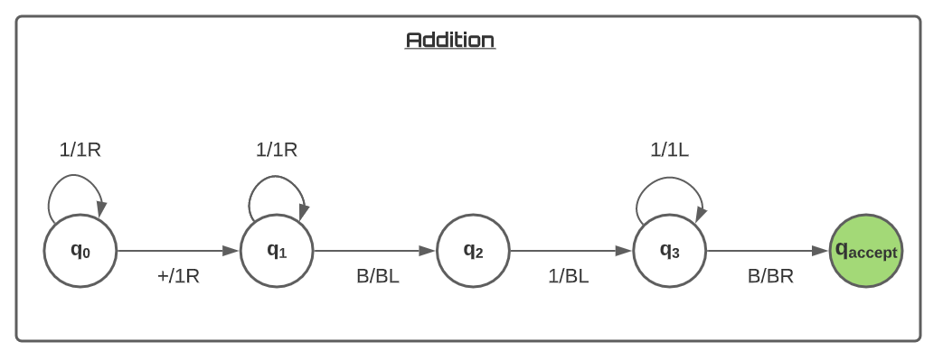
Addition

Slide 7
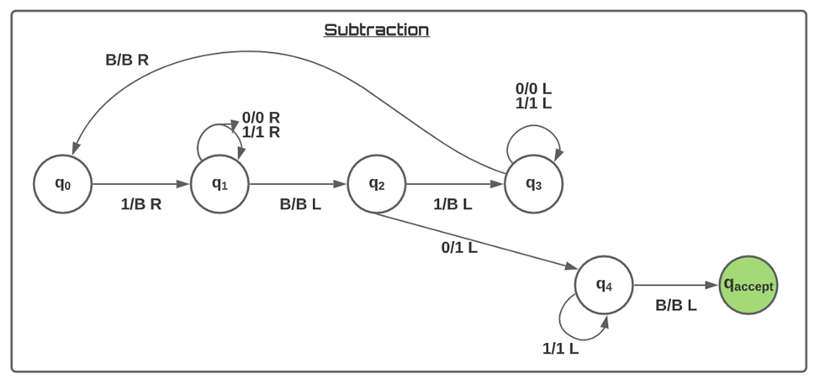
Subtraction

Slide 8
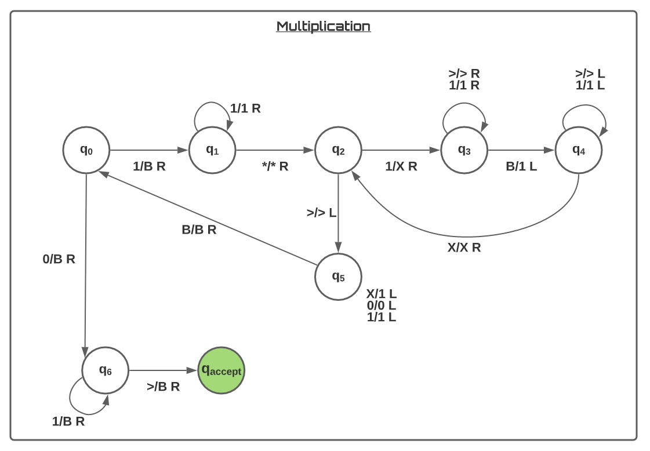
Multiplication

Slide 9
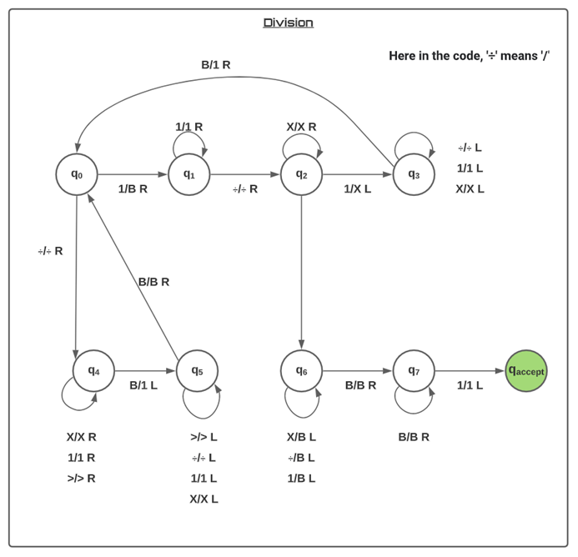
DIVISION

Slide 10

Summary
of Findings

Slide 11

Limitations
Only able to solve the basic mathematical operations as:
Our function can’t add any double or floating number.
Our function can’t calculate negative value.
In division function complexity can’t be handle.

Slide 12

Code Explanation

Slide 13

Future work
Equation
Square
Check Palindrome
Check Parity
Check even/odd

Slide 14

Thank You

