Slide 1
FITNESS MANAGEMENT SYSTEM
Submitted by:Group 10
Abhishek B
Akshay GopaL
Ashina Mol
George Mathew

Slide 2
CONTENT
ABSTRACT
MODULE DESCRIPTION
STRUCTURE CHART
TABLES
DATA FLOW DIAGRAM
DESIGN

Slide 3
ABSTRACT
People are always seeking to have a healthy body fitness and they are need to motivate them to it. So we believe that our website help to solve this problem through help user to manage the health life system in health fitness and nutrition .This website displays videos for exercise, and the preparation for healthy eating(diet chart) by selecting food items that are listed in the website, determine the nearest sports clubs , gym and hospitals through google map and calculate the calories either acquired or burned also shows scale for the shape for user body.in this website user can also interact with nutrition and dietitian. User can buy supplements and gym equipment from this website and user can take appointment in nearest hospital by the help of google map and can also take appointment to see dietitian in our website.In this website nutrition and dietitian can we diet chart of the user they can make changes in the chart of the user. Overall this fitness management system is a valuable tool for users

Slide 4
MODULE DESCRIPTION
1.USER
.Login
.Registration
.Medical form filling
.Create diet chart
.manage diet chart
.Interaction with dietitian
.Interaction with nutrition
.Book appointment
.View appointment
.Cancel appointment
.Buy supplements and gym equipments
.View the nearest sports clubs , gym and hospitals
.upload medical records

Slide 5
.can view exercise video
.make payment
.Submit feedback

Slide 6
2.Admin
.Login
.Manage user
.Manage dietitian and nutrition
.Manage food items list
.Manage supplements and gym equipments page
.Manage feedback

Slide 7
3.Dietitian
.Login
.View diet chart
.Interaction with user
.Write prescription
.view user medical records
.view appointments

Slide 8
GYM OWNER
.REGISTRATION
.LOGIN
.VIEW FEEDBACK
.REPLY TO FEEBACK

Slide 9
4.Nutrition
.Login
.registration
.View diet chart
.Interaction with user
.Manage Diet chart

Slide 10
STRUCTURE CHART

Slide 11
FITNESS MANAGEMENT SYSTEM
USER
ADMIN
DIETITIAN
NUTRITIAN
GYM OWNER
.register
.medical details
.login
.book appointment
.view dietitian
.create diet plan
.
.manage dietitian
.manage nutrition
.view user
.view diet report
.manage food table
.view payment
.view message
.send reply
.manage diet plan
Report to admin
.REGISTER
.LOGIN
.VIEW FEEDBACK
.REPLY TO FEEDBACK
.view appointment
.view message
.send reply
.manage diet plan
.report to admin

Slide 12
.view diet
Plan
.view nutrition
View exercise
Video
.send message
.make payment
feedback

Slide 13
TABLES
.REGISTRATION
FIELD NAME | DATA TYPE | CONSTRAINTS | DESCRIPTION
R ID | VARCHAR(10) | PRIMARY KEY | REGISTRATION ID
NAME | VACHAR(30) | NOT NULL | NAME
CONTACT NO | BIGINT(13) | NOT NULL | CONTACT NUMBER
EMAIL | VARCHAR(20) | NOT NULL | EMAIL ID
GENDER | VARCHAR(12) | NOT NULL | GENDER

Slide 14
.LOGIN
FIELD NAME | DATA TYPE | CONSTRAINTS | DESCRIPTION
U ID | VARCHAR(10) | FOREIGN | USER ID
U NAME | VARCHAR(30) | NOT NULL | USER NAME
U PASSWORD | VARCHAR(30) | NOT NULL | PASSWORD
U TYPE | VARCHAR(15) | NOT NULL | USER TYPE

Slide 15
. MEDICAL DETAILS
FIELD NAME | DATA TYPE | CONSTRAINTS | DESCRIPTION
M ID | VARCHAR(10) | PRIMARY KEY | MEDICAL RECORD NUMBER
R ID | VARCHAR(10) | FOREING KEY | USER REGISTRATION ID
NAME | INT(10) | NOT NULL | USER NAME
GENDER | INT(10) | NOT NULL | GENDER
HEIGHT | INT(10) | NOT NULL | USER HEIGHT
WEIGHT | INT(10) | NOT NULL | USER WEIGHT
AGE | INT(10) | NOT NULL | AGE

Slide 16
.CLUB DETAILS
FIELD NAME | DATA TYPE | CONSTRAINTS | DESCRIPTION
C ID | INT(10) | PRIMARY KEY | CLUB NUMBER
NAME | VARCHAR(10) | NOT NULL | CLUB NAME
ADDRESS | VARCHAR(30) | NOT NULL | CLUB ADDRESS
PLACE | VARCHAR(20) | NOT NULL | PLACE
CONTACTNO | BIGINT(10) | NOT NULL | CONTACT NUMBER
EMAIL | VARCHAR(20) | NOT NULL | EMAIL ID
PASSWORD | VARCHAR(20) | NOT NULL | PASSWORD

Slide 17
.FOODTABLE
FIELD NAME | DATA TYPE | CONSTRAINTS | DESCRIPTION
F ID | INT(10) | PRIMARY KEY | FOOD ID
FOOD ITEM | VARCHAR(10) | NOT NULL | FOOD NAME
QUANTITY | VARCHAR(10) | NOT NULL | AMOUNT
PROTEIN | VARCHAR(20) | NOT NULL | PROTEIN
CALORIE | VARHAR(15) | NOT NULL | CALORIE
TYPE | VARCHAR(20) | NOT NULL | TYPE

Slide 18
.PAYMENT
FIELD NAME | DATA TYPE | CONSTRAINTS | DESCRIPTION
P ID | INT(10) | PRIMARY KEY | PAYMENT ID
NAME | VARCHAR(10) | FORGIEN KEY | USER NAME
AMOUNT | INT(2) | NOT NULL | AMOUNT
EMAIL | VARCHAR(20) | NOT NULL | EMAIL
DATE | DATE | NOT NULL | DATE

Slide 19
.DIETITIAN TABLE
FIELD NAME | DATA TYPE | CONSTRAINTS | DESCRIPTION
D ID | VARCHAR(10) | PRIMARY KEY | DIETITIAN ID
NAME | VARCHAR(10) | NOT NULL | DIETITIAN NAME
AGE | INT(2) | NOT NULL | AGE
EMAIL | VARCHAR(20) | NOT NULL | EMAIL
GENDER | VARCHAR(15) | NOT NULL | GENDER

Slide 20
.NUTRITION TABLE
FIELD NAME | DATA TYPE | CONSTRAINTS | DETAILS
N ID | VARCHAR(10) | PRIMARY KEY | NUTRITION ID
NAME | VARCHAR | NOT NULL | NAME
AGE | INT(3) | NOT NULL | AGE
DETAILS | VARCHAR(30) | NOT NULL | DETAILS
FILE | VARCHAR(30) | NOT NULL | FILE UPLOAD
EMAIL | VARCHAR(30) | NOT NULL | EMAIL
CONTACT NO | INT(12) | NOT NULL | CONTACT NUMBER
ADDRESS | VARCHAR(30) | NOT NULL | ADDRESS

Slide 21
. APPOINTMENT TABLE
FIELD NAME | DATA TYPE | CONSTRAINTS | DETAILS
A ID | INT(10) | PRIMARY KEY | APPOINTMENT ID
D ID | VARCHAR(10) | FOREING KEY | DIETITIAN ID
U ID | VARCHAR(10) | FOREING KEY | USER ID
NAME | VARCHAR(10) | NOT NULL | USER NAME
TIME | INT(10) | NOT NULL | TIME FOR APPOINTMENT
DATE | DATE(10) | NOT NULL | DATE FOR APPOINTMENT
D NAME | VARCHAR(30) | NOT NULL | DIETITIAN NAME
DURATION | VARCHAR(10) | NOT NULL | DURATION
REASON | VARCHAR(30) | NOT NULL | REASON FOR APPOINTMENT
CONTACT NUMBER | BIGINT(13) | NOT NULL | CONTACT NUMBER
M RECORD | VARCHAR(30) | NOT NULL | MEDICAL RECORD
STATUS | VARCHAR(20) | NOT NULL | APPOINTMENT STATUS

Slide 22
.FOOD TABLE
FIELD NAME | DATA TYPE | CONSTRAINTS | DETAILS
F ID | INT(10) | PRIMARY KEY | FOOD TABLE ID
U ID | VARCHAR(20) | FOREING KEY | DIETITIN ID
NAME | VARCHAR(20) | NOT NULL | USER NAME
FDETAILS | VARCHAR(30) | NOT NULL | FOOD DETAILS
DIET PLAN | VARCHAR(30) | NOT NULL | DIET PLAN

Slide 23
DATA FLOW DIAGRAM
LEVEL-0
DIETITIAN
ADMIN
USER
BEFIT
GYM OWNER
NUTRITION

Slide 24
MEDICAL DETAILS
APPOINTMENT
APPOINTMENT FOR DIETITIAN
LEVEL-1
E-commerce
AGE,WEIGHT,
HEIGTH,…
MEDICAL FORM
DIET PLAN
USER
USER DETAILS
CALORIE CALCULATOR
REPORT TO ADMIN
AGE,WEIGHT,..
FOOD TABLE
USER DETAILS
USER DETAILS
USER DETAILS
NUTRITION
CHAT MESSAGES
CHAT INTERACTION
MESSAGE

Slide 25
APPOINTMENT
APP_TABLE
DIET PLAN
LOGIN
TABL_DIETPLAN
DIETITIAN
LOGIN
REPORT TO ADMIN
TBL_FOOD
FOOD DETAILS

Slide 26
MESSAGE
TBL_LOGIN
TBL_MSG
NUTRITION
LOGIN
REPLY MSG

Slide 27
MANAGE DIETITIAN
TBL_DIET
TBL_LOGIN
MANAGE NUTRITIOAN
TBL_NUTRITION
MANAGE USER
TBL_USER
ADMIN
LOGIN
MANGE DIET PALN REPORT
TBL_DIETPLAN
PAYMNET
TBL_PAYMENT

Slide 28
LOGIN
REPLY
TBL_MSG
LOGIN
GYM OWNER
FEEDBACK

Slide 29
DESING

Slide 30
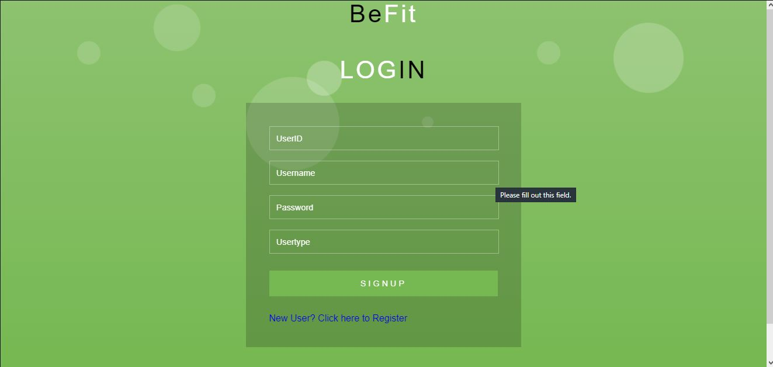
LOGIN PAGE FOR USER, ADMIN,DIETITIAN,NUTRITION

Slide 31
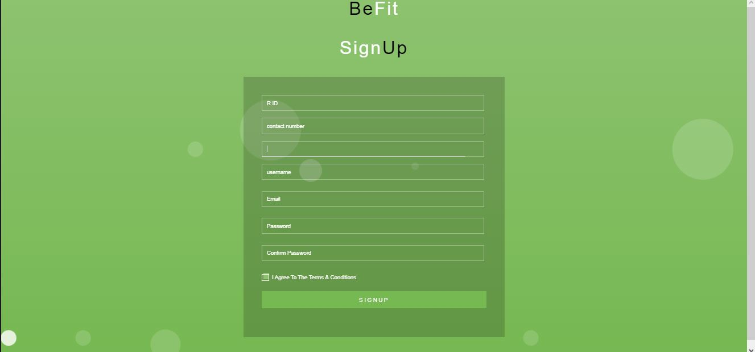
Registration page for user

Slide 32
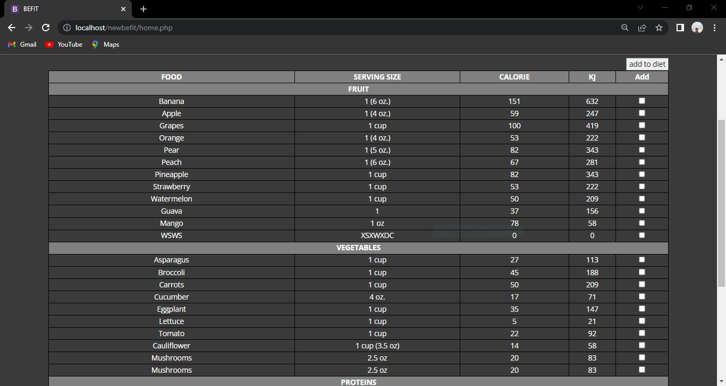
Food table

Slide 33
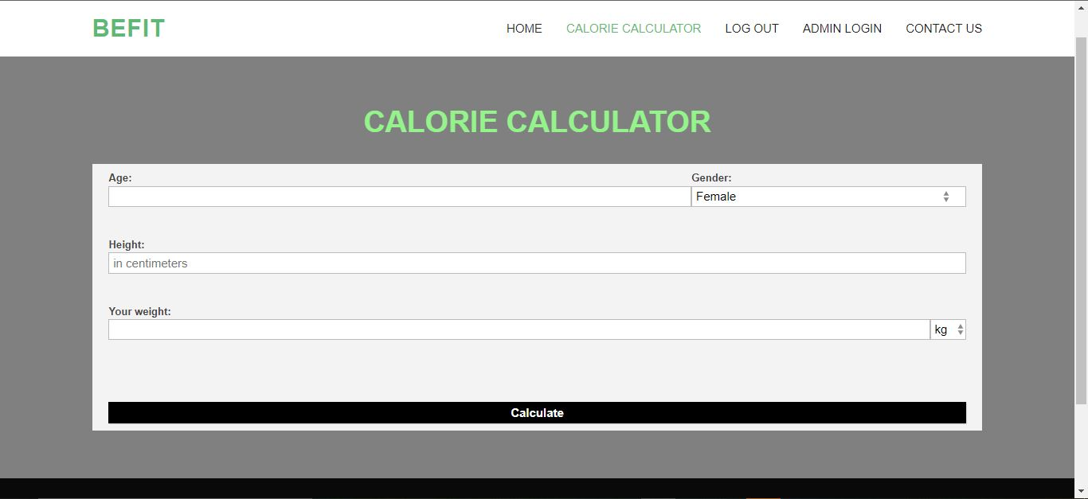
Calorie calculator

Slide 34
CODING
def login(request):
return render(request,'login.html')
def dietitian(request):
return render(request,'dietitian.html')
def healthclub(request):
return render(request,'healthclub.html')
def medical(request):
return render(request,'medical.html')
def nutrition(request):
return render(request,'nutrition.html')
def viewdieti(request):
return render(request,'viewdieti.html')

Slide 35
def Registration(request):
return render(request,'Registration.html')
/………………………………………………………………………………………………………………………………/
def Registrationaction(request):
cursor=connection.cursor()
un=request.GET['username']
c=request.GET['contact']
e=request.GET['email']
g=request.GET['gender']
p=request.GET['password']
cp=request.GET['conpass']
sql="insert into registration(name,email,contactno,gender,password,conpass)values('%s','%s','%s','%s','%s','%s')"%(un,e,c,g,p,cp)
cursor.execute(sql)
return render(request,'Registration.html')
/…………………………………………………………………………………………………………………………………………./
def medicalaction(request):
cursor=connection.cursor()
a=request.GET['age']
h=request.GET['height']
w=request.GET['weight']
g=request.GET['gender']
op=request.GET['yes-no']
db=request.GET['deabetic']
bp=request.GET['bp']

Slide 36
sql="insert into medical(age,height,weight,gender,operation,deabetic,bp,medicalcontinous)values('%s','%s','%s','%s','%s','%s','%s','%s')"%(a,h,w,g,op,db,bp,mc)
cursor.execute(sql)
return render(request,'medical.html')
/…………………………………………………………………………………………………………………………………………/
def nutritionaction(request):
cursor=connection.cursor()
n=request.GET['name']
a=request.GET['age']
d=request.GET['details']
f=request.GET['file']
e=request.GET['email']
c=request.GET['contact']
ad=request.GET['address']
p=request.GET['password']
sql="insert into nutrition(name,age,details,file,email,contactno,address,password)values('%s','%s','%s','%s','%s','%s','%s','%s')"%(n,a,d,f,e,c,ad,p)
cursor.execute(sql)
return render(request,'nutrition.html')

Slide 37
return render(request,'nutrition.html')
def dietitianaction(request):
cursor=connection.cursor()
e=request.GET['email']
p=request.GET['password']
a=request.GET['age']
g=request.GET['gender']
n=request.GET['name']
sql="insert into dietitian(email,password,age,gender,name)values('%s','%s','%s','%s','%s')"%(e,p,a,g,n)
cursor.execute(sql)
return render(request,'dietitian.html')
def healthclub(request):
return render(request,'healthclub.html')
def healthclubaction(request):
cursor=connection.cursor()
cn=request.GET['name']
ad=request.GET['address']
pl=request.GET['place']
ca=request.GET['category']
cno=request.GET['contact']
em=request.GET['email']
pas=request.GET['password']
sql="insert into club(name,address,place,category,contactno,email,password)values('%s','%s','%s','%s','%s','%s','%s')"%(cn,ad,pl,ca,cno,em,pas)

Slide 38
cursor.execute(sql)
return render(request,'healthclub.html')
def viewdiet(request):
return render(request,'viewdiet.html')
/……………………………………………………………………………../
def viewdietaction(request):
cursor=connection.cursor()
t=request.GET['time']
d=request.GET['date']
dn=request.GET['name']
dur=request.GET['duration']
re=request.GET['reason']
c=request.GET['contact']
mr=request.GET['medical']
sql="insert into viewdietitian(time,date,name,duration,reason,contact,medicalrecord)values('%s','%s','%s','%s','%s','%s','%s')"%(t,d,dn,dur,re,c,mr)
cursor.execute(sql)
return render(request,'viewdiet.html')

Slide 39
THANK YOU

