Slide 1
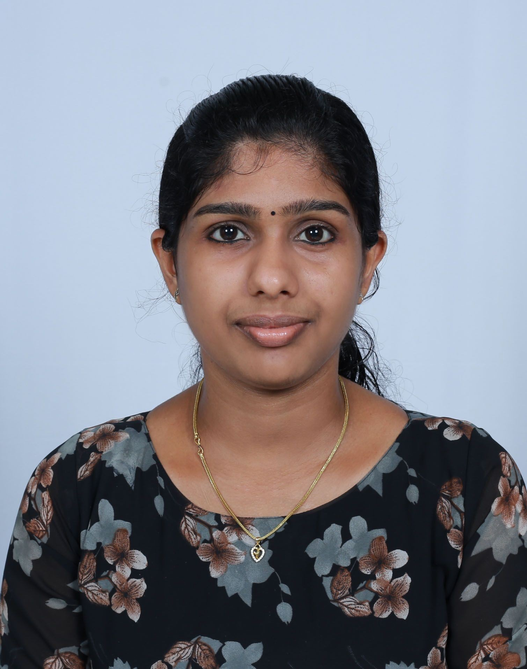
CAREER OBJECTIVES
I am looking for an opportunity to secure the position of software developer where I can employ all my skills for the company's benefit. EDUCATION
School Name | Course | Year | Mark
College of Applied Science IHRD | Msc computer | 2021-2023 | 3.06 CGPA(curre
vattamkulam,edappal science
kerala
nt)
St Mary’s College, Thrissur, Kerala, India (Calicut University) | B.Voc (Bachelor Of Vocational Studies) Software | 2018-2021 | 67.90%
 | Developme
 | nt
S.S.V.H.S.S Chavakkad, | computer science and | 2016-2018 | 72%
APARNA
CONTACT
Panthayil (H), punnayurkulam P O, Thrissur-679561
Ph: 6238967907
EMAIL
641aparna@gmail.com
Thrissur, Kerala,
India
information technology
Ponnani Girls Higher Secondary school Malappuram
Kerala, India
S.S.L.C
2016
84%
HOBBIES
•
•
Listening music Dancing
PROJECT EXPERIENCE
Project Technology Used
STRENGTHS
Project description
Enthusiastic and hardworking
Possess a positive attitude
Responsible for work
Self-motivated and directed
Determination and persistence
Flexibility
Strong Analyzing and problem solving
Believe in team work
Examdesk (Degree 2nd semester Project
PHP
2nd semester mini project
Online crash-course
Students can study different subject in online
CO-OPERATIVE SOCIETY
(Degree 4 ^{th} semester Project)
Java
4th semester project
Live project,
Banking Software
Online Tax
(Degree 6th semester project)
Python
6thsemester project based on paying tax through
online website

Slide 2

Project | Technology Used | Project description
Crypto Fog (Post Graduation Main project) | PHP PYTHON | 4rd Semester Main project(PG) Research oriented project for Preserving the privacy of Medical BigData.
EXPERIENCE
Company | Position | Time Period
Fab Studioz, Thrissur | Internship (Student Intern) | 9/12/2020- 31/3/2021
COMPUTER SKILLS
Programming in Python, HTML, Java,php.
Well-versed with Microsoft Word, Power Point
OS: Windows and Linux
COMMUNICATION SKILL
Languages | Speak | Read | Write | Mother Tongue
Malayalam | Yes | Yes | Yes | Yes
English | Yes | Yes | Yes | No
Hindi | No | Yes | No | No
Tamil | Yes | No | No | No
PROFESSIONAL ENHANCEMENT
Successfully completed ADVANCED EXCEL course in 2021
REFERENCE
Mr. Gopala Krishnan
Assistant Professor: - Department Of
Computer Science
College of Applied Science IHRD vattamkulam Contact Number: 7902471858
DECLARATION
I do hereby declare that all the information given above is true to the best of my knowledge and belief.
APARNA

