Slide 1
IMDb: TOP 25 WEB SERIES
Sabin Binoy

Slide 2
objective
This presentation will explore the world of web series through the lens of IMDb data analysis. We will delve into a dataset of top 25 web series and their corresponding IMDb ratings.
To understand the user preferences about web series by analyzing some key facts about the dataset using MySQL queries.

Slide 3
Tools used
MySQL
METHODOLGY
Data Collection
Data Cleaning
Data analysis
Database management & Querying

Slide 4
Database Overview
Webseries_db
(Database)
Shows (25 records)
platform (8 records)
show_id(primary key)
title
genre
Imdb_rating
episodes
release_year
platform_id
platform_id(primary key)
platform

Slide 5
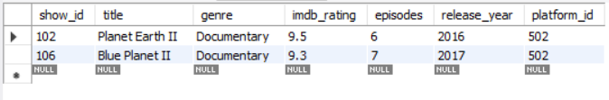
Q&a about the dataset
Which are the documentary shows in the database?
select * from shows where genre='Documentary’;
This query fetches the details of all series in the documentary genre.
Output :-

Slide 6

How many series were released in 2016 ?
select count(*) as 'No.of shows released in 2016' from shows
where release_year = 2016;
This query fetches the number of shows released in 2016 and alias it as
“No. of shows released in 2016”.
Output :-

Slide 7

Which series has the highest IMDb rating ?
select title,imdb_rating from shows
where imdb_rating=(select max(imdb_rating) from shows);
This query fetches the title and IMDb rating of the series which has the highest rating value.
Output :-

Slide 8

Which web series has the highest no. of episodes?
select title,episodes from shows
where episodes=(select max(episodes) from shows);
This query fetches the titles and no.of episodes of the series which has the highest no. of episodes.
Output :-

Slide 9
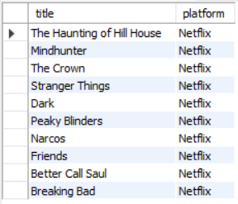
Fetch the details of all shows streamed on Netflix?
select title,platform from shows as S inner join platform as P
on S.platform_id=P.platform_id where platform='Netflix';
This query fetches the titles and streaming platform by combining shows table and platform table using inner join. It uses the ‘platform_id’ to connect with the secondary table because it is the common field in both the tables.
Output :-

Slide 10
SUMMARY
In conclusion, the analysis of the IMDb web series dataset reveals valuable insights into viewer preferences and factors influencing popularity. While IMDb ratings offer a useful gauge of public perception, it's crucial to remember that they represent a subjective metric.
This data-driven approach can inform content creation, marketing strategies, and ultimately, help predict and enhance the success of future web series.

Slide 11
THANK YOU
Sabin Binoy
sabinbinoy421@gmail.com

