Slide 1

SCHOOLLENS Â· 8-MINUTE AI BRIEFING
Yangon American or KINGS?
Facebook scored them. We open the sources.
A real parent enquiry. Silent recording of the running app. No invented ranking.
Notes:
0:00-0:20
Good afternoon. I will not repeat the deck you already have. This briefing is a real parent, then the product running.
A parent asked: Yangon American or KINGS, and what are the fees? Facebook answered with 84 percent recommended versus not yet rated.

Slide 2
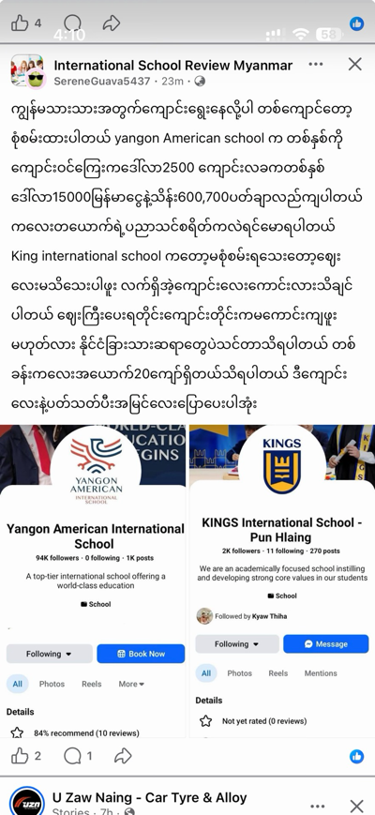
REAL PARENT Â· INTERNATIONAL SCHOOL REVIEW MYANMAR
This parent asked a fee question. Facebook answered with a score.
Yangon American or KINGS Pun Hlaing. They compared deposits and yearly fees in Burmese. The group UI answered 84 percent recommended versus not yet rated.
Yangon American
KINGS Pun Hlaing
84% recommended
Not yet rated
Notes:
0:20-1:20
I want to start where every Yangon parent already is. Not a slide about AI. A Facebook group.
Hours ago, in International School Review Myanmar, a parent asked: Yangon American or KINGS. They compared fees in the comments. Facebook put 84 percent recommended next to not yet rated.
That score is not a fee table. It is not a source. It cannot tell you whether Nursery is 19.25 million kyat.
This parent asked for help. The group will send opinions. None of that comes with a poster you can open tonight.

Slide 3
THE GAP SCHOOLLENS FILLS
They need facts they can inspect. The group will send opinions.
FACEBOOK TONIGHT
THIS PARENT NEEDS
SCHOOLLENS
84% recommended
Fees they can inspect
Collect Â· reconcile Â· Ask
A page score and a not-yet-rated badge. No excerpt. No date. No fee poster you can open.
Deposit, early-bird, Nursery, Year 10. Gossip numbers stay gossip until a source is on file.
Show the poster. Label it likely until a second source agrees. If a name has no record, say unknown - do not invent 84%.
Notes:
1:20-2:10
What does this parent actually need? Not 84 percent. They need the fee poster. Deposit. Early-bird. Nursery. Year 10.
Facebook cannot do that. A chatbot will invent a fluent fee and sound sure.
SchoolLens does three jobs. Collect the poster. Extract and label it likely - one source. Ask only from retrieved evidence. If Yangon American is not on file, we say so. We do not invent a recommendation score.
Click the next slide. Silent recording of the live app. No music.

Slide 4
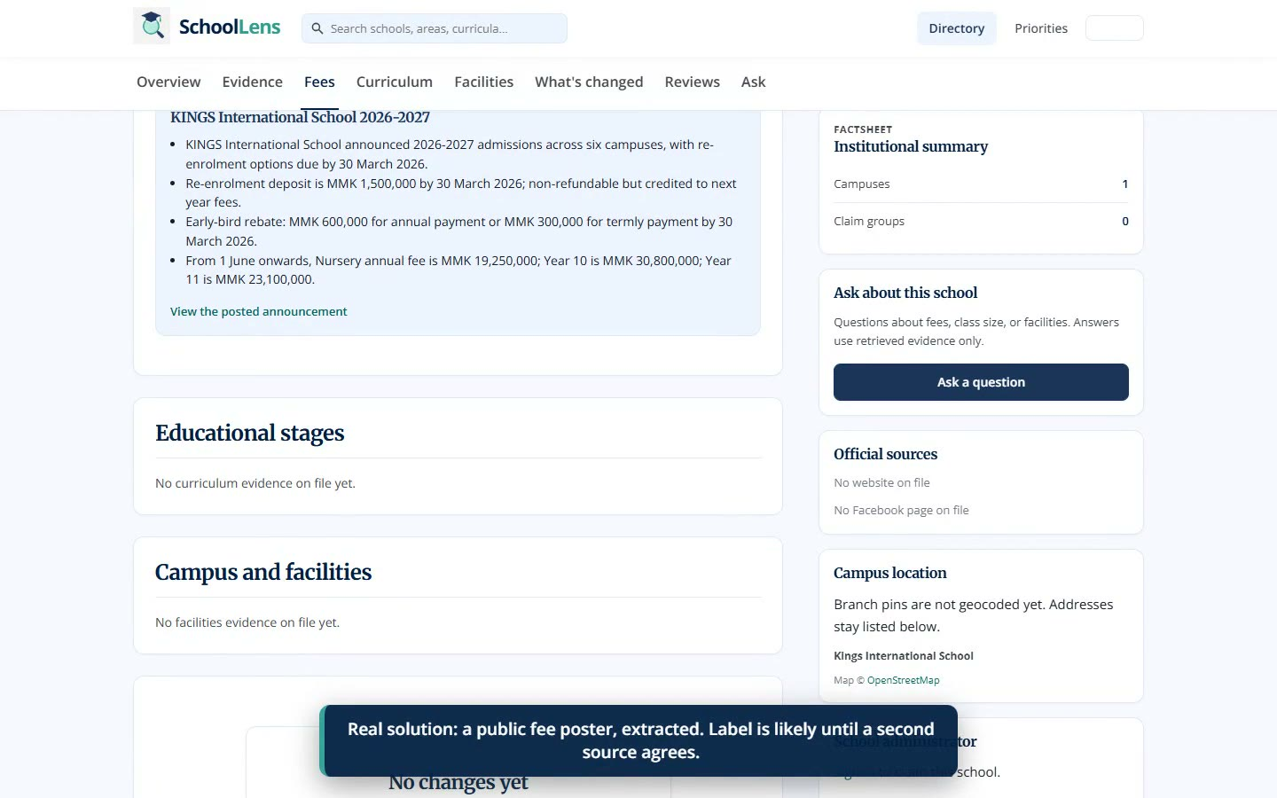
CLICK ONCE TO PLAY Â· SCREEN RECORDING OF THE LIVE APP
Same path as the product: the Facebook post, Yangon American empty, KINGS fees labelled likely.
1 min 31 sec Â· silent Â· pause if you need to talk Â· actual SchoolLens UI, not a mock
Notes:
2:10-7:20 TALK OVER THE VIDEO. Click the picture once to play. Spacebar pauses in presenter view.
OPEN: Real Facebook post. Yangon American or KINGS. 84 percent versus not yet rated.
HOME: The AI does not pick a school.
YANGON AMERICAN: Zero rows. Honest empty. We do not invent an 84 percent score.
KINGS: Facebook said not yet rated. We do not rate. Zero claim groups is unknown, not a badge.
FEES: Public poster, extracted. Nursery 19.25 million, Year 10 30.8 million. Label is likely - one source.
ASK: The parent question is fees, not which school is better. If Ask is silent, the poster is still the answer.
Do not name a winner.

Slide 5
BACK TO THAT PARENT
They asked for a score. We can hand them a source.
Not this
84 percent recommended versus not yet rated. A comment thread about 15 million and 20 million kyat.
This
Yangon American stays unknown if we have no record. KINGS fees stay likely until a second source agrees.
The rule
The AI still does not pick Yangon American or KINGS. It shows the poster - or says we do not have one.
Directories invent a number one. Facebook invents a percent. SchoolLens labels evidence.
Notes:
7:20-8:00
Let me put us back in that Facebook thread.
They asked Yangon American or KINGS, and what the fees are. Facebook gave 84 percent and not yet rated.
What we can hand them is not a winner. If a name is missing, unknown. If a poster is on file, likely. The parent still chooses.
Directories invent a number one. Facebook invents a percent. Chatbots invent fluency.
SchoolLens tells that family what sources say - and how sure we are.
I will stop there. Questions.

