Slide 1
Pitch Deck AI YOUTH COMPETITION 2026
SchoolLens: The Evidence Ledger
for Myanmar Education
An AI platform that turns scattered Facebook posts, outdated websites, and MOE records into grounded, citation-backed school facts — without ranking schools.
Tean Sabina
Notes:
Good morning, esteemed judges, teachers, and fellow innovators. My name is Soe, I am 15 years old, and I am an IGCSE student here in Yangon.
Today, I am proud to present SchoolLens — an AI-driven educational evidence platform that turns the messy, rumor-filled world of Myanmar school information into grounded, verifiable truth.

Slide 2
Why I built this
From personal frustration to clear action
The school move
Nearly 10 years study American curriculum.
Grade 9: family search for British IGCSE and university abroad.
What shocked us
Finding honest facts in Yangon took stressful weeks: Facebook late at night, 2022 flyers, guessing MOE accreditation.
The lesson
My father taught me: when something is confusing, explain it to others. That struggle became SchoolLens.
What families actually search
Random Facebook comment threads
Blurry Viber flyers and old PDFs
Contradictory fee numbers
Abandoned school websites
No single source was complete. No source was clearly dated. None showed when they disagreed.
SchoolLens · STI College AI Youth Competition 2026
2 / 16
Notes:
For nearly ten years, I studied under the American curriculum at Future Kidz International School. When I reached Grade 9, my family and I decided that I should transition to the British IGCSE curriculum at City School Yangon to prepare for university abroad.
Moving schools after almost a decade is already terrifying. But what shocked us most was how difficult it was just to find honest facts about schools in Yangon. We spent stressful weeks scrolling through random Facebook posts late at night, reading outdated 2022 flyers, and trying to guess whether schools were actually accredited by the Ministry of Education.
My father always taught me that when something is confusing, explaining and teaching it to others is the best way to understand and find knowledge gaps. That personal struggle inspired me to build SchoolLens.

Slide 3
The evidence crisis
Myanmar parents lack evidence, not advertisements
252+
>80%
0
Registered private &
international schools
Live updates locked in
unstructured Facebook posts
Citation-backed, public
verification platforms
Why 5-star ratings fail families
Websites sit abandoned for 3–4 years while 2026 fees live in Viber. Parent reviews are Burmese; accreditations are English. Bought stars hide whether the science lab exists or teachers leave mid-year.
A rating is a verdict. SchoolLens is a ledger of what sources actually say.
SchoolLens · STI College AI Youth Competition 2026
3 / 16
Notes:
Myanmar parents don't lack school advertisements — we lack verifiable evidence.
Over 80% of real-time school announcements are buried in unstructured Facebook posts. Official school websites are often abandoned for three or four years, advertising old fees while real 2026 inflation fees are only mentioned in Viber chats. Important parent reviews are in Burmese, while accreditations are in English.
Worst of all, existing review sites use 5-star ratings that are easily bought by marketing teams. In education, a 5-star badge doesn't tell a mother if the science lab has real equipment or if teachers leave mid-year.

Slide 4
The product
An objective evidence ledger — not a rating app
AI crawls MOE registries, websites, and Facebook, extracts facts, checks agreement, and shows confidence. It never picks a “best” school.
Supported
Likely
Conflicting
Outdated
Unknown
Independent sources agree
Support, not fully corroborated
Sources disagree — inspect both
Newer evidence superseded this
Not enough to say
If a website fee contradicts a Facebook announcement, SchoolLens shows both quotes side by side.
If there is no evidence, it says Unknown. 100% transparency — zero fake certainty.
SchoolLens · STI College AI Youth Competition 2026
4 / 16
Notes:
SchoolLens replaces subjective star ratings with an objective Evidence Ledger.
Our AI does not tell parents which school is 'best' — because every child has unique needs. Instead, SchoolLens continuously crawls government registries, school websites, and Facebook pages, extracts discrete factual claims, checks if they agree or contradict each other, and displays clear confidence badges.
If a website fee contradicts a new Facebook announcement, our AI flags the conflict side-by-side. If there is no evidence, it honestly says 'Unknown'. 100% transparency.

Slide 5
System architecture
How SchoolLens is built
01
Parent & staff UI
Next.js 15 + React 19. English chrome, Noto Sans + Noto Sans Myanmar. Public browse with no login. Roles: parent, school admin, moderator, operator.
02
API & data plane
Supabase Postgres with Row Level Security, Auth, and pgvector. Canonical tables: schools, raw_sources, claims, evidence, claim_groups, school_summaries.
03
Evidence Intelligence Engine
FastAPI RAG service. Website crawler + Facebook queue (Apify). Gemini extracts claims and writes summaries. Reconciliation groups matching facts and labels confidence. Grounded Ask cites claim groups only.
04
Source layers
MOE registry (baseline) → official websites (structured facts) → official Facebook (freshness). Facebook is an update layer. If it fails, cached verified claims stay with timestamps.
SchoolLens · STI College AI Youth Competition 2026
5 / 16
Notes:
Under the hood this is not a chatbot wrapper. Parents hit a Next.js app. Facts live in Postgres with RLS. A FastAPI service crawls sources, extracts claims with Gemini, reconciles them into confidence-labelled groups, and answers questions only from retrieved evidence.

Slide 6
Evidence Intelligence Engine
Four-step multilingual grounding pipeline
01 Ingest
02 Extract
03 Reconcile
04 Serve
• Crawl MOE records, school websites, official Facebook.
• Gemini Flash-Lite pulls discrete claims (fees, curriculum, safety).
• pgvector groups the same fact across languages.
• Directory + profile read stored claim_groups.
• Convert Zawgyi → Myanmar Unicode (myanmar-tools).
• Structured claim_text normalized to English.
• Gemini labels Supported / Likely / Conflicting / Outdated / Unknown.
• Ask retrieves relevant groups, then generates with citations.
• Store raw HTML/text in raw_sources with crawl timestamps.
• Facebook excerpts stay verbatim Burmese.
• Conflicts keep both excerpts — never a silent winner.
• If retrieval is empty: “no verified evidence.”
• Skip unchanged pages via content hash.
• Each claim tagged: source type, trust tier, category.
• school_summaries generated from Supported + Likely only.
• Operator recrawl queue; moderator reviews disputes.
SchoolLens · STI College AI Youth Competition 2026
6 / 16
Notes:
First, ingestion converts Zawgyi to Unicode so Burmese is not corrupted. Gemini Flash-Lite extracts discrete facts — fees, ratios, exam codes — in English while original Burmese quotes stay untouched. Reconciliation groups matching claims and flags contradictions. Grounded Q&A answers only from those groups, with citations.

Slide 7
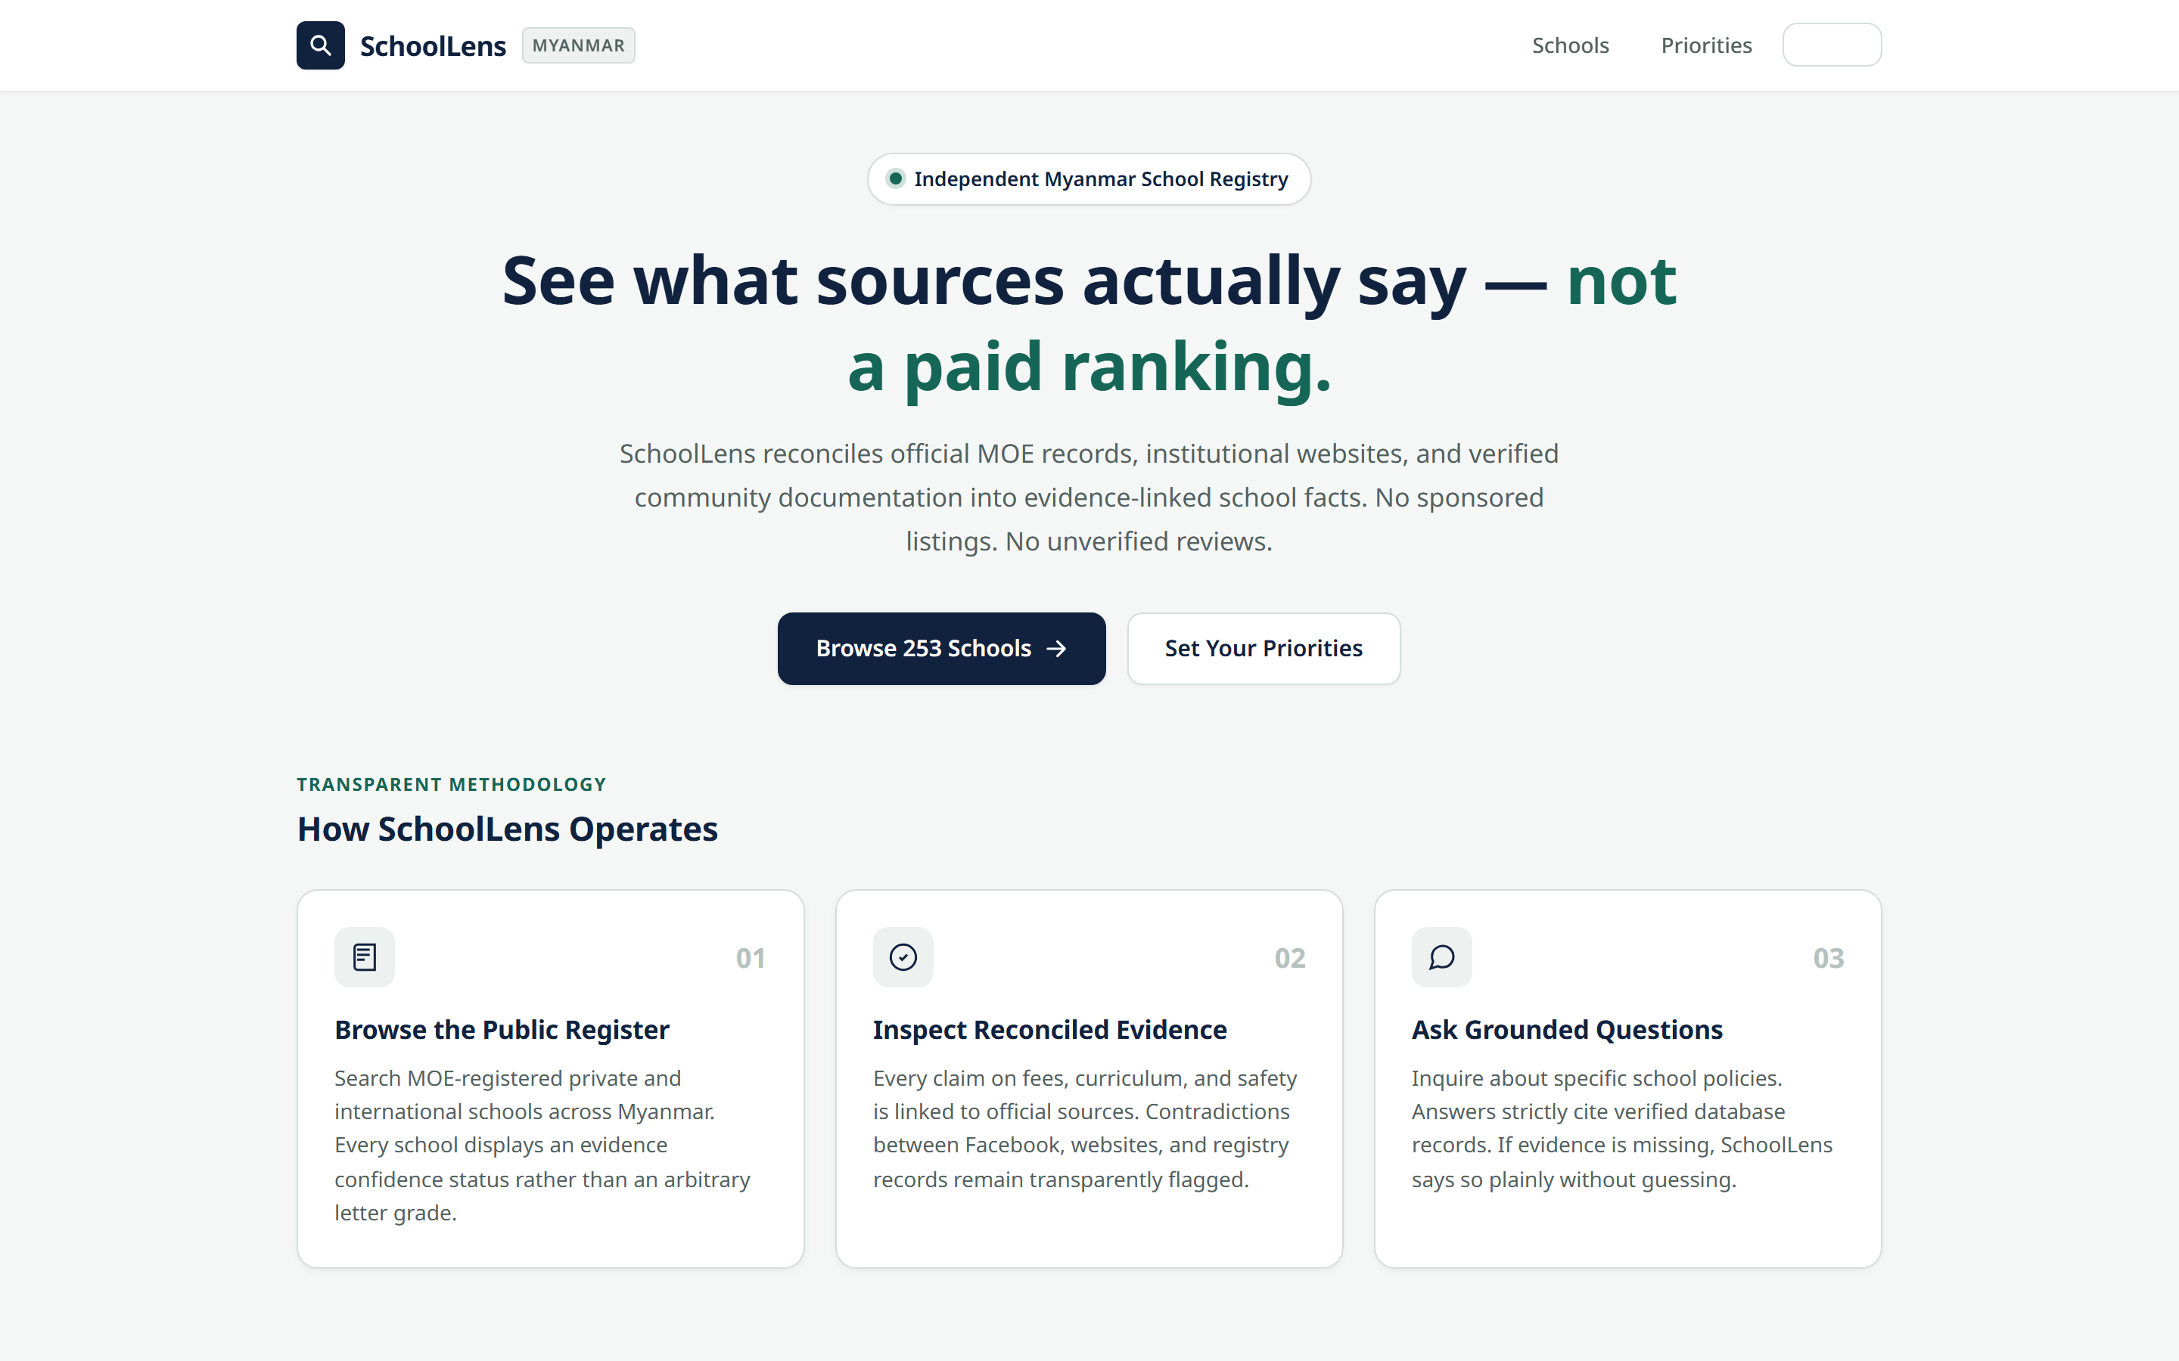
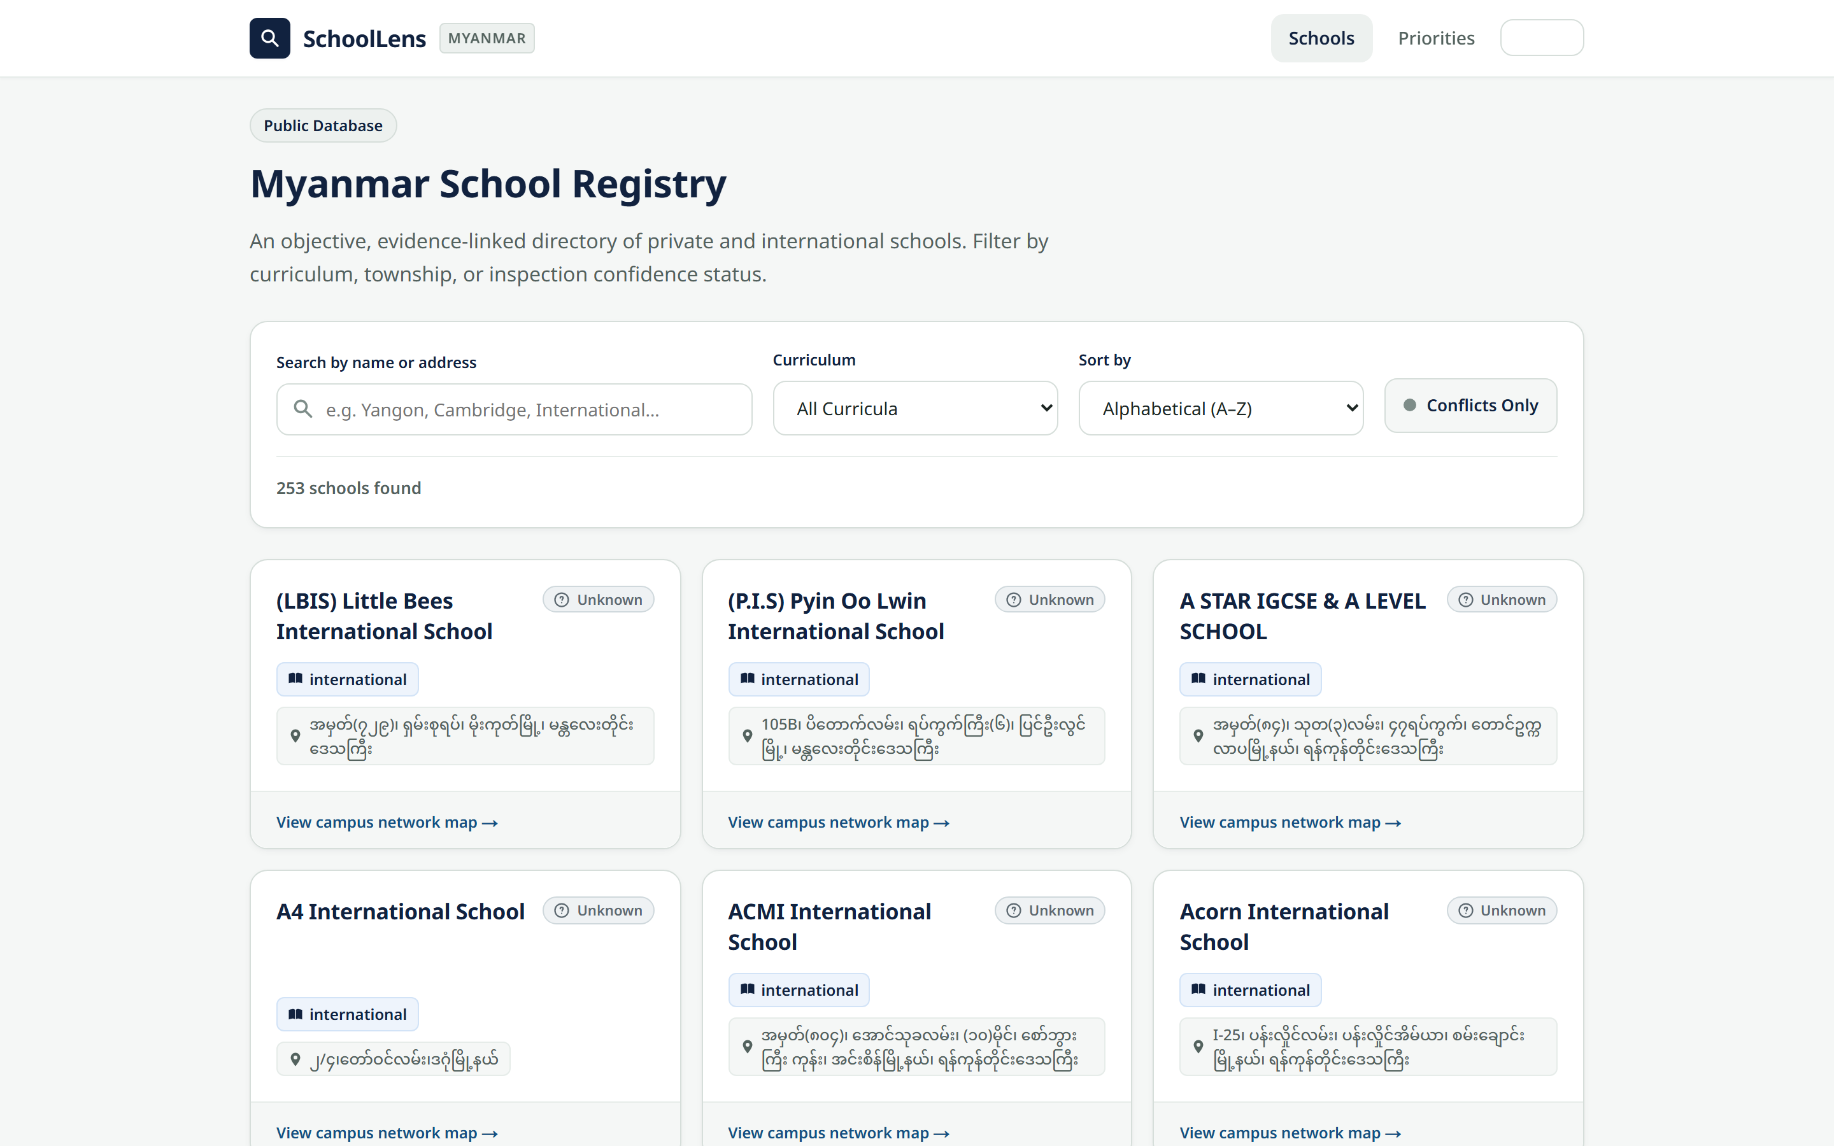
Working prototype — captured from the live app
Public home and the school register
Home: evidence, not a ranking. 253 MOE-listed schools.
Directory: search, curriculum filter, Conflicts only. Confidence chip on every row.
SchoolLens · STI College AI Youth Competition 2026
7 / 16
Notes:
Let's see the live application. The home page states the product plainly: we reconcile sources, we do not sell a ranking. The directory is the public register — 253 schools, filterable, with a confidence chip on every row and a Conflicts only switch.

Slide 8
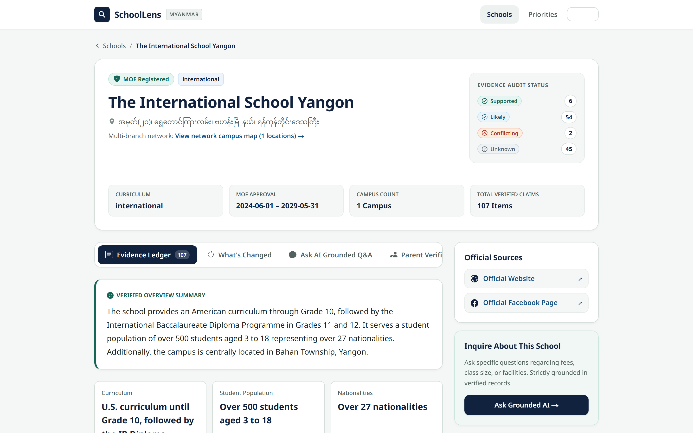
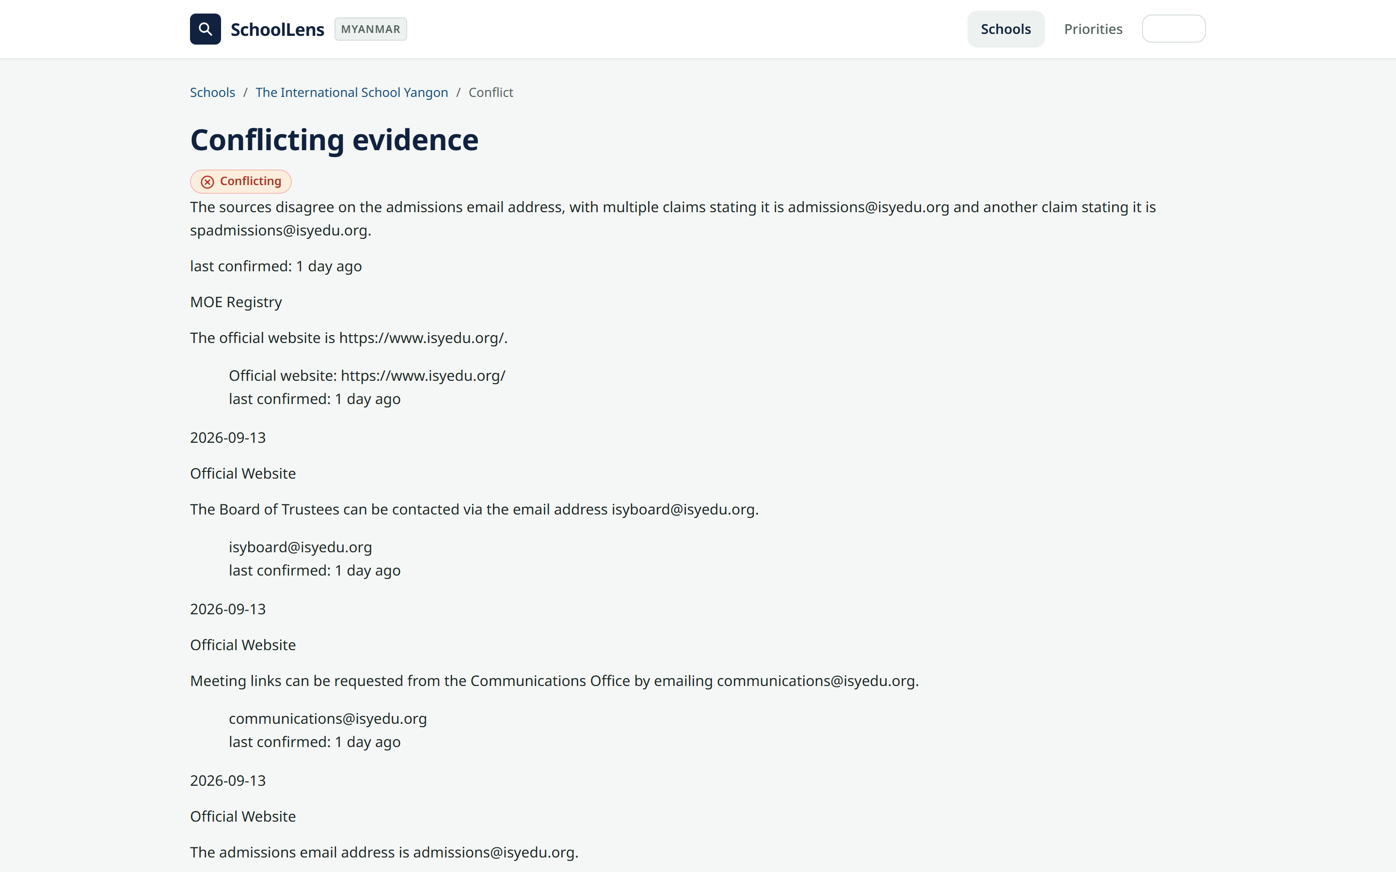
Working prototype — real school records
Evidence ledger and conflict inspector
The International School Yangon: 107 claim groups, Supported / Likely / Conflicting / Unknown counts, grounded Ask.
Real conflict: admissions@isyedu.org vs spadmissions@isyedu.org — both quotes kept, dated.
SchoolLens · STI College AI Youth Competition 2026
8 / 16
Notes:
On a school profile every claim group has a confidence badge. ISY currently shows supported, likely, conflicting, and unknown counts — not a star rating. In the conflict inspector you can see a real disagreement on the admissions email, with both source excerpts kept. If Q&A has no proof, it says no verified evidence. Zero hallucinations.

Slide 9
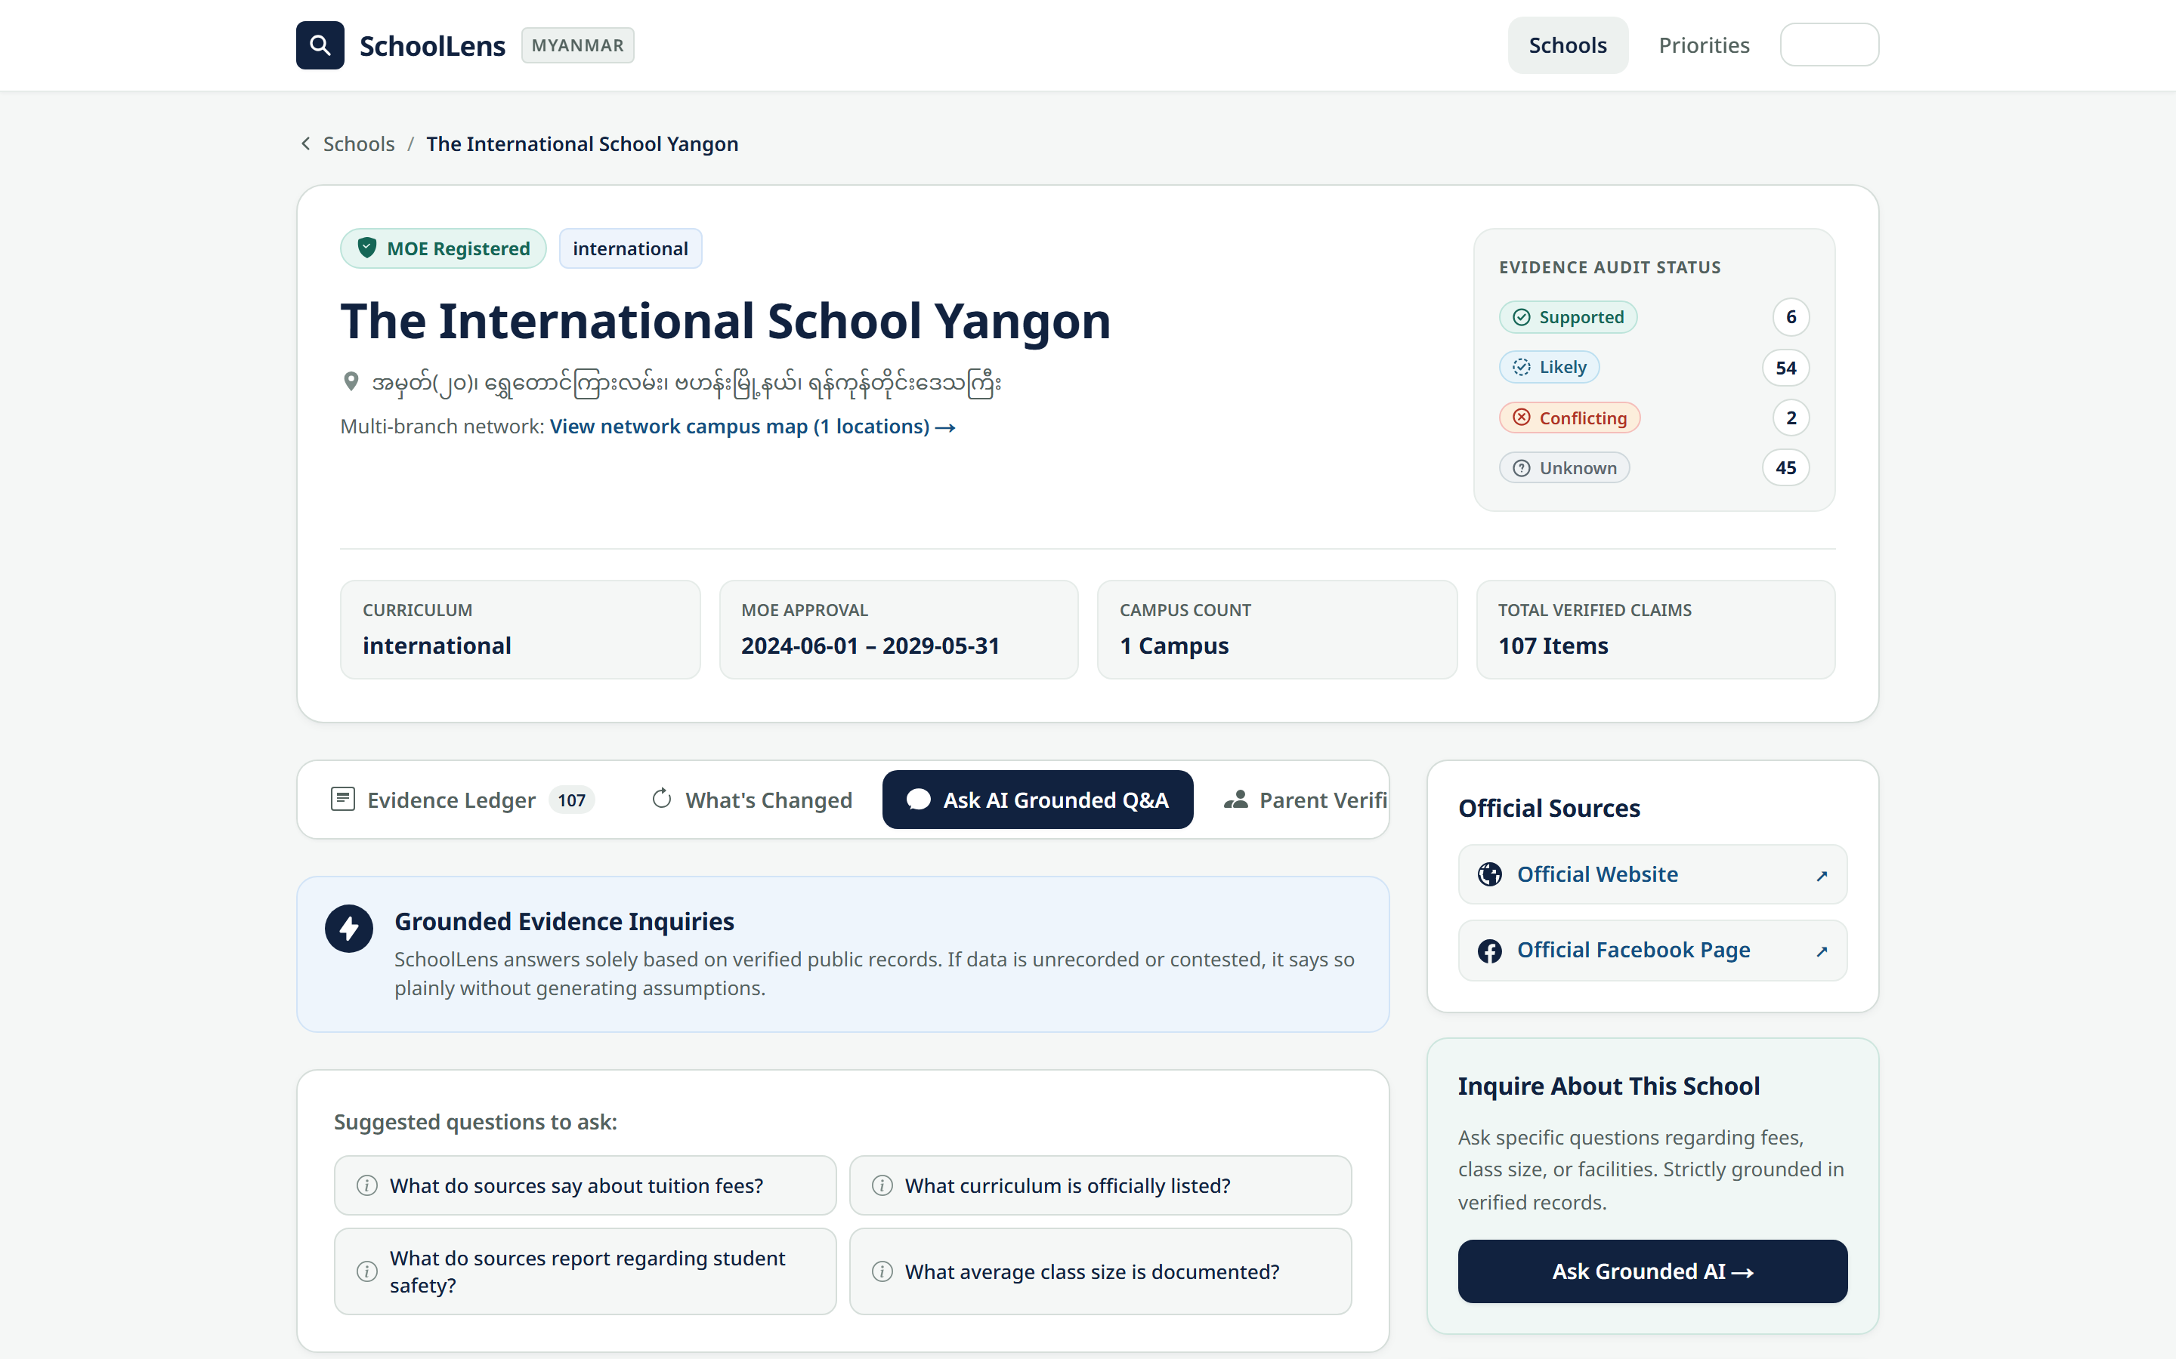
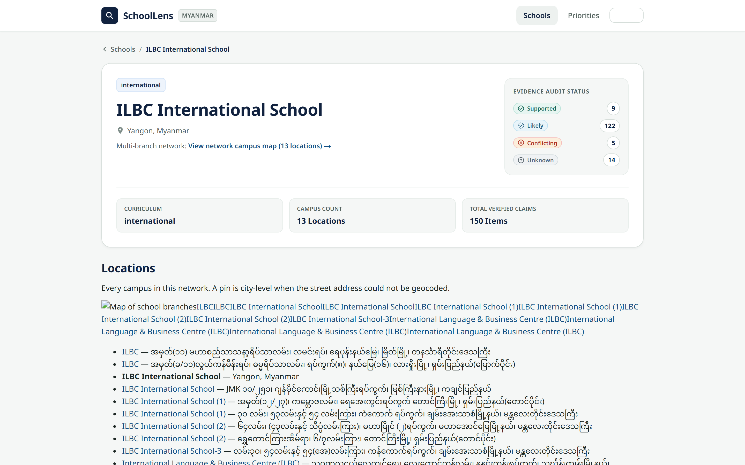
Working prototype — Ask and multi-branch
Grounded Q&A and a 13-campus network
Grounded Ask tab — suggested questions, answers only from retrieved evidence.
ILBC network profile — 13 campuses, 150 claim groups, 5 conflicts flagged.
SchoolLens · STI College AI Youth Competition 2026
9 / 16
Notes:
Ask is the demo centerpiece: parents type a question and receive a cited answer or an honest unknown. Multi-branch schools such as ILBC show the network once, then each campus profile.

Slide 10
Sustainability
Ultra-lean unit economics and ethical revenue
Monthly cost for all 252 schools
Three ethical revenue streams
1. Verified school-admin SaaS · $15–$25 / mo
Official uploads, dispute alerts, verified badge.
2. Sponsored open-day listings · $20 / event
Clearly labelled. Never mixed into confidence.
3. Aggregated education trend reports
Anonymized demand insights for NGOs and researchers.
~$14 / month
Vercel + Supabase
$0
Crawler VPS (n8n)
$4
Gemini Flash-Lite extract
$1.50
Claude reconcile (batch)
$2.50
Grounded Q&A
$3
Apify social crawl
$3
Comfortably inside the $20/month youth budget. Change-detection skips unchanged sites.
Integrity charter: schools cannot buy a higher confidence score, hide a contradiction, or pay to rank. The ledger stays independent.
SchoolLens · STI College AI Youth Competition 2026
10 / 16
Notes:
How is SchoolLens sustainable? We engineered our system to be extremely frugal. By using modern serverless hosting and efficient API batching, our entire platform covering all 252 registered schools across Myanmar runs for under $15 per month — comfortably within our $20 youth budget.
We follow a strict ethical charter: schools can never pay to change their confidence badge or hide a contradiction. Our revenue comes from software tools for verified school principals to manage official profiles, sponsored open-day event listings, and aggregated education research summaries.

Slide 11
Social impact
Advancing UN Sustainable Development Goals
SDG 4
SDG 10
SDG 16
Quality Education
Reduced Inequalities
Strong Institutions
Match students to accredited, recognized schools so diplomas remain valid. Surface curriculum mismatch and unaccredited scams before families pay.
Working-class families get the same clear, free evidence that wealthy parents currently buy through consultants and private networks.
Public, citation-backed accountability. Private centres cannot hide contradictions behind marketing.
SchoolLens · STI College AI Youth Competition 2026
11 / 16
Notes:
SchoolLens directly supports the United Nations Sustainable Development Goals.
For SDG 4: Quality Education, we ensure students are matched to accredited, recognized schools so their diplomas are valid internationally.
For SDG 10: Reduced Inequalities, we democratize educational data so that every Myanmar parent — regardless of wealth or personal connections — has free access to the truth.
And for SDG 16: Strong Institutions, we encourage private educational centers to be honest, accountable, and transparent.

Slide 12
Why SchoolLens is unique
Grounded domain intelligence vs generic AI
 | ChatGPT | Listing sites | SchoolLens
Fees & facts | Hallucinates; stale training data | Ad copy, not citations | Grounded claims + dates
Myanmar Facebook | No live access | Rarely structured | Crawled as an update layer
Fonts | Breaks Zawgyi/Unicode | N/A | myanmar-tools normalization
Conflicts | Smooths over disagreement | Hidden by stars | Side-by-side inspector
Q&A | No citations | No Q&A | Cited answers or “unknown”
Maps | Mixes branches | Static list | Multi-branch network map
SchoolLens · STI College AI Youth Competition 2026
12 / 16
Notes:
Why can't parents just use ChatGPT? General AI chatbots make up school fees, mix up branch locations, and cannot access Myanmar's real-time Facebook ecosystem. Traditional directory sites are just static advertising billboards.
SchoolLens is the only platform combining Myanmar-specific font processing, automated cross-source contradiction detection, and citation-anchored Q&A.

Slide 13
CLEAR EVIDENCE. HONEST CONFIDENCE. BETTER EDUCATION.
Empowering every Myanmar family
to choose with confidence
Education is the most important investment a family can make. Accurate facts let students focus on learning — not on rumours.
Team Sabina
Thank you. I look forward to your questions.
Notes:
Education is the single most important investment a Myanmar family can make in their child's future. Having accurate facts puts a family's heart at ease, so students can focus on learning, working hard, and reaching their dreams.
As a 15-year-old student who lived through this problem, I invite you to support SchoolLens in bringing transparency, trust, and intelligence to education in Myanmar.
Thank you very much, and I look forward to your questions!

