Slide 1
Chapter Eight: The Quality System
BBA/BIM/BBM/BBA-F

Slide 2
Topics to be covered: LH8
Introduction to quality
Historical evolution of Total Quality Management
Definitions of Quality
Philosophy/Principles and Concepts of Total Quality Management
Costs of Quality
Quality Control: Introduction, Objectives, Advantages
Statistical Quality Control-Control Charts-control charts for variable and attributes (Numerical)
JIT and Six-Sigma
Quality Management System: ISO 9000 series
7 tools for the quality

Slide 3
1. Introduction to quality
The quality refers to the ability of product or service to consistently meet or exceed customer requirements or expectations.
Quality may be defined as the sum total of features of a product which influence its ability to satisfy a given demand.
The quality of product or service is a customer's perception of the degree to which the product or service meets his or her expectations.
Quality is a relative term, generally used with reference to the end-user of a product.
Quality is defined as fitness for use for certain purpose.
Quality is a readiness to pay or quality is free.

Slide 4
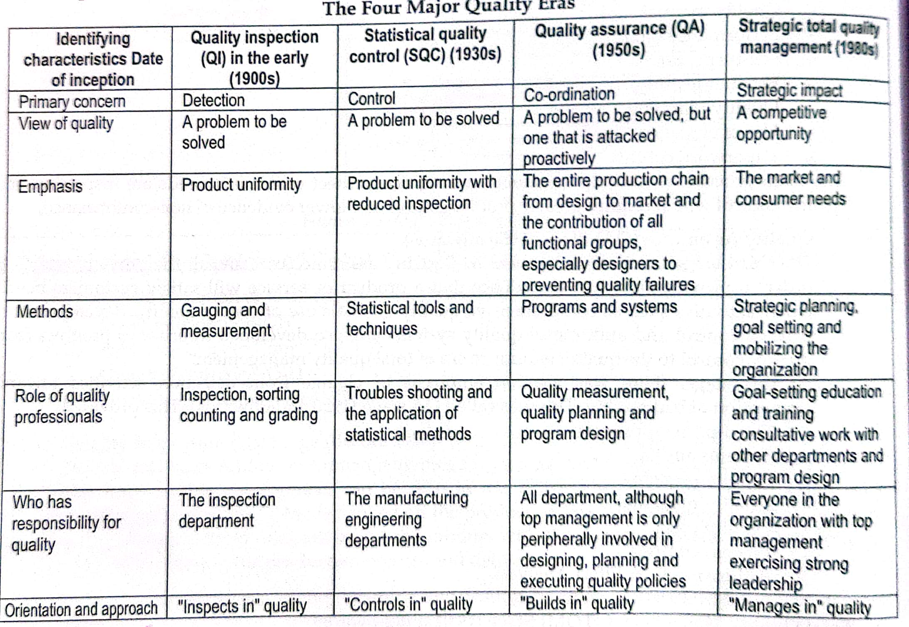
2. Historical Evolution of Total Quality Management

Slide 5
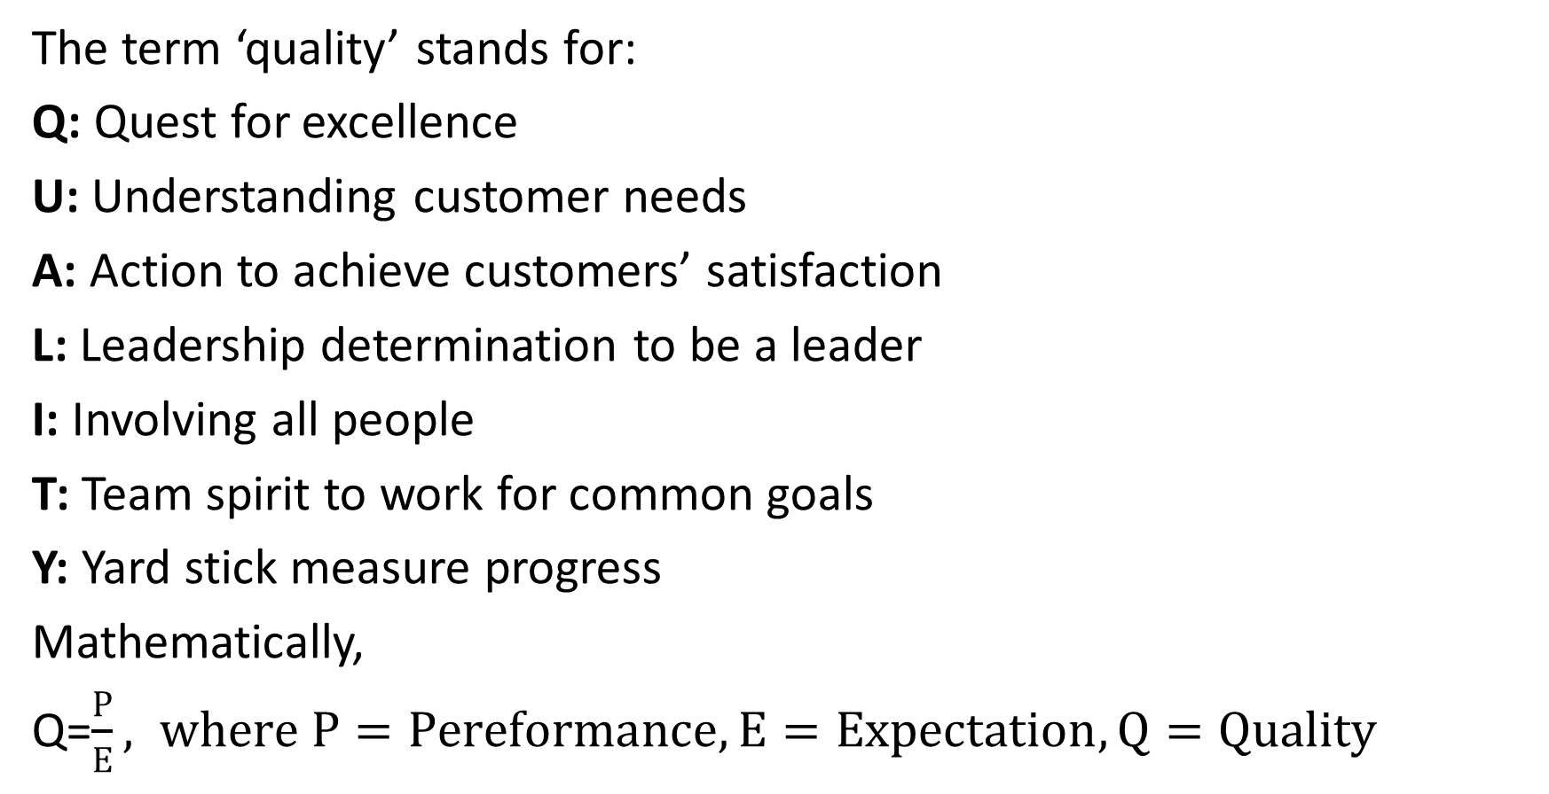
3. Definitions of Quality
The term ‘quality’ stands for:
Q: Quest for excellence
U: Understanding customer needs
A: Action to achieve customers’ satisfaction
L: Leadership determination to be a leader
I: Involving all people
T: Team spirit to work for common goals
Y: Yard stick measure progress
Mathematically,
Q=$\frac{P}{E}, where P=Pereformance, E=Expectation, Q=Quality$

Slide 6
If performance is equal to expectation, then Q=1.
If Q>=1, then product is perceived to be of good quality
If Q<1, then product is perceived to be of bad quality
If Q>1, then the customer has a good feeling about the product or service.
Quality is the performance of the product as per the commitment made by the producer to the customer.
The quality is defined as “the degree of excellence”.
Quality is conformance to requirement(Crossby, 1984)

Slide 7
4. Philosophy/Principles and Concepts of Total Quality Management
The words “Total Quality Management” stands for:
Total- Made up of whole
Quality- Degree of excellence a product or service provides
Management- Art of Planning, organizing, controlling, directing etc.
Enhancement of the traditional way of doing business
Technique to guarantee survival in world-class competition
Art of managing the whole to achieve excellence in terms of the product

Slide 8
Contd.
Principles of TQM:
Customer Focus
Leadership
People Involvement
Process Approach
Systematic Approach to Management
Continual Improvement
Factual Approach to Decision Making
Mutually Beneficial Supplier Relationship

Slide 9
Contd.
Benefits of TQM:
It helps the organization to identify and meet the needs of the market in a better way
It assures better quality performance in every sphere of activity
It helps in checking non-productive activities and waste
It provides an opportunity to the organization to meet the competition by resorting to the techniques of TQM
It helps in developing an adequate system of communication
It helps to review the process needed to develop the strategy of never ending improvement
It helps to reduce the quality costs.

Slide 10
Contd.
Limitations of TQM:
It requires strong leadership-often missing in a business
It requires extremely demanding of management and staff time
It can become overly bureaucratic and mechanical, and lead to an emphasis on consistency of procedures, rather than a focus an improvement, or the means rather than the end
It can only help it the organization is heading in the right direction
It is not a quick fix. TQM takes years to implement
It can lead to too much attention.

Slide 11
5. Costs of Quality
The costs of carrying out company quality program are known as cost of quality.
Quality cost(Cost of Quality) is a methodology that allows an organization to determine the extent to which its resources are used for activities that prevent poor quality, that appraise the quality of the organization’s products or services, and that result from internal and external failures.
Prevention Cost
Appraisal Cost
Internal-Failure Cost
External-Failure Cost

Slide 12
6. Quality Control
A quality control system is designed to ensure economical production of products of uniform quality which is acceptable to the customer.
Quality control refers to the systematic control of those variables encountered in a manufacturing process which affect the excellence of the end product.
Quality control begin with product design and includes materials, bought-out items, manufacturing processes and finished goods at the hands customer
Objectives of Quality Control:
To establish the desired quality standards which are acceptable to the customers
To discover flaws or variations in the raw materials and the manufacturing processes in order to ensure smooth and uninterrupted production
To evaluate the methods and processes of production and suggest further improvements in their functioning.
To study and determine the extent of quality deviation in a product during the manufacturing process.
To analyze in detail the causes responsible for such deviation.
To undertake such steps which are helpful in achieving the desired quality of the product.

Slide 13
Contd.
Advantages/Benefits of Quality Control:
Uniform quality and reliability of product help in increasing sales turn over
Reduced variability resulting in-higher quality and reduced production bottle necks.
Reduced cost of labour material as a result of reduced defectives.
Increased quality consciousness among employees.
Higher operating efficiency.
Better utilization of resources.
Reduced inspection and reduction inspection costs.
Reduced customer complaints
Minimum scrap or rework due to reduced defectives
Better customer satisfaction and employee satisfaction

Slide 14
7. JIT and Six-Sigma
JIT, or Just-In-Time, is a production strategy in operations management that emphasizes the synchronization of production with demand.
The goal of JIT is to eliminate waste by producing only what is needed, when it is needed, and in the amount needed.
JIT reduces the need for excess inventory, which can lead to cost savings and less waste.
One of the key principles of JIT is continuous improvement, which means that the production process is constantly evaluated and adjusted to eliminate waste and improve efficiency.

Slide 15
Contd.
Six Sigma is a methodology in operations management that aims to reduce defects and variations in production processes by applying statistical methods and tools.
The goal of Six Sigma is to achieve a level of quality where the number of defects per million opportunities (DPMO) is extremely low, typically less than 3.4 defects per million opportunities.
Six Sigma can be a powerful tool for improving quality and reducing waste.
Phases of Six-Sigma are(DMAIC):
Define, Measure, Analyze, Improve, Control

Slide 16
8. Quality Management System: ISO 9000 series
ISO 9000 Series | Standards | Meaning and Explanations
ISO 9000 | Quality Management and Quality Assurance Standards, Guidelines for selection and use | It describes fundamental quality concept, defines key terms and providing guidelines for selecting, using and tailoring ISO 9001, 9002 and 9003 standards. It is the roadmap for the use of all standards.
ISO 9001 | Quality Systems-Model for Quality Assurance in design, development, production, installation and servicing | It is the most comprehensive standard in the series. It contains 20 elements covering the need for an effective quality system from the receipt of a contract through the design/development stage and finally the after sales service. 20 points in ISO 9001 shown in the content below.
ISO 9002 | Quality Systems-Model for Quality Assurance in production, installation and servicing | It deals with prevention, detection and correction of problems during production and installation. It is for the use of organizations that are not involved in design. This standard addresses 19 of the 20 elements covered in ISO 9001 standards.

Slide 17
Contd.
ISO 9000 Series | Standards | Meaning and Explanations
ISO 9003 | Quality Systems-Model for Quality Assurance in Final Inspection and Test | It is the least comprehensive all standards covering 16 of the 20 elements in ISO 9001. It is not a quality control system. ISO 9003 addresses only those requirements for the detection and control of problems found during final inspection stage and testing.
ISO 9004 | Quality Management and Quality System Elements Guidelines | It provides guidance for a supplier to use in developing and implementing a quality system and it determining the extent to which each quality system element is applicable. It examines each of the elements in greater detail. It is useful for internal auditing purpose.

Slide 18
9. 7 tools for the quality
Check sheet(tally sheet)
Histogram
Pareto Chart
Scatter Diagram
Cause and Effect diagram(also known as the “Fishbone” or “Ishikawa” diagram)
Control graph
Graph

Slide 19
Assignment-8
Short Answer Questions:
What is quality? Mention the benefits of total quality management. Explain costs of quality with suitable example.
How is the control chart for variables different from control chart for attributes? Describe with their applications.
Explain the concepts of Just-In-Time(JIT). How it can be implemented? Explain.
Describe ISO 9000 standard and its implications in quality management?
Explain the concept of six-sigma.

Slide 20
The End Chapter Eight

