Slide 1
Chapter One: Introduction
BBA/BIM/BBM/BBA-F

Slide 2
Topics to be covered: LH6
Meaning, definition and objectives
The transformation process
Differences Between production and services operations
Scope of operations management
Operations and supporting functions
Role of the operations manager
Key issues operations managers
Production system: Intermittent and continuous
Historical evolution of operations management
Productivity: concepts, types, productivity measurement, factors affecting productivity
Concept on green productivity
Supply chain management (concept only)

Slide 3
Meaning and definition of Operations Management
the process, which combines and transforms various resources(inputs) used in the production(operations) subsystem of the organization into value added of desired outputs of product/services
it is that part of an organization, which is concerned with the transformation of a rang of inputs into the required output(products/services) having the requisite quality level
The operation management consists of two words operation and management where operation is the subsystem of a business organization that is responsible for producing desired level of final goods or services from the transformation of the different kinds of inputs (materials, labours and so on) and management is the process of effectively and efficiently utilizing organizational resources in order to achieve organizational objectives.
Operations management means an area of management concerned with overseeing, designing, and controlling the of production and redesigning business operations in the production of goods or services involves the responsibility of ensuring that business operations are efficient in terms of using as few resources as needed, and effective in terms of meeting customer requirements.
It is concerned with managing the process that converts inputs into outputs.The set of interrelated management activities, which are involved in manufacturing certain products is called as production management.

Slide 4
Some Definitions of Operations Management
Various management scientists variedly define operations management. Some common definitions are enlisted below as:
Operations management is the set of activities that creates value in the form of goods and services by transforming inputs into outputs. By-Jay Heizer and Barry Render.
Operations management may be defined as the design, operation, and improvement operations of the production systems that create the firm's primary products or services. By- Richard B. Chase, Nicholas J. Aquilano and F. Robert Jacobs.
The term operations management refers to the direction and control of the processes that transform inputs into products and services. By - Lee J. Krajewski, Larry P. Ritzman.

Slide 5
Objectives of Operations Management
Operations Management are mainly concerned with planning, organizing, and controlling all the activities affecting human behavior through use of models which helps in converting the raw materials and human efforts into valuable goods and services for satisfying customer needs. The key objectives of operations management can be categorized as follows:
Production (Design, Deliver, Develop, Direct)
Performance (Quality, Speed, Dependability, Flexibility, Cost)
People and group of people
Customer Service
Resource Utilization

Slide 6
2. The Transformation Process
Transformation is the conversion of inputs into outputs
All operations produce products and services by changing inputs into outputs using an input-transformation-output process. (Figure 1.1 shows this general transformation process model. )
feedback mechanisms are required to monitor the performance of the transformation process.
Operations are processes that take in a set of input resources which are used to transform something or are transformed themselves, into outputs of products and services.
A transformation process is any activity or group of activities that takes one or more inputs. transforms and adds value to them, and provides outputs for customers or clients

Slide 7
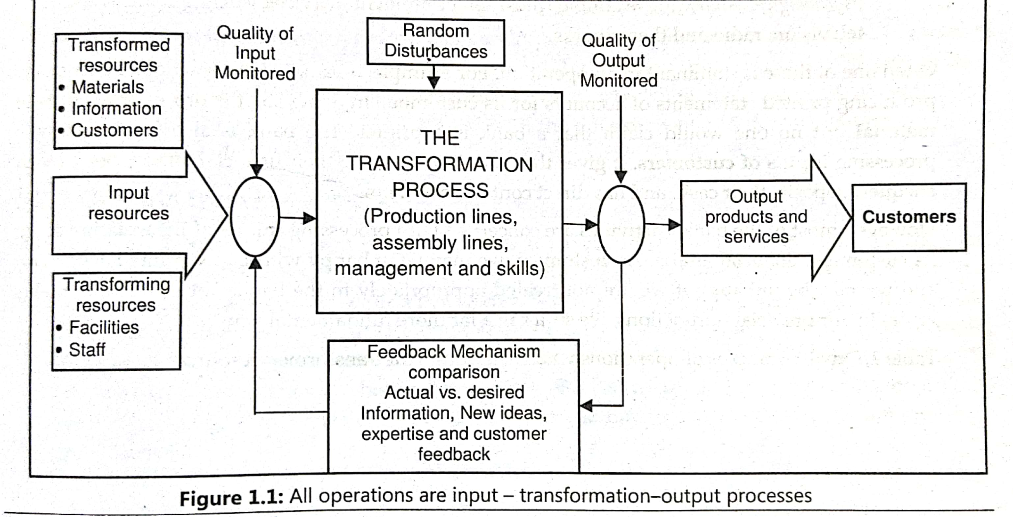
Contd.

Slide 8
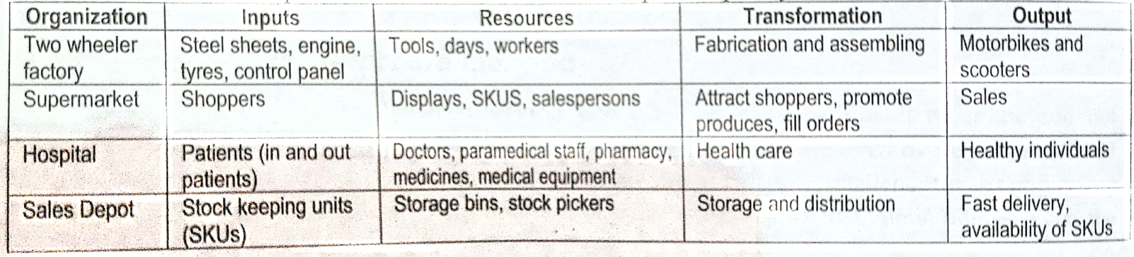
Contd.
Some operations described in terms of input-output transformation are given below:

Slide 9
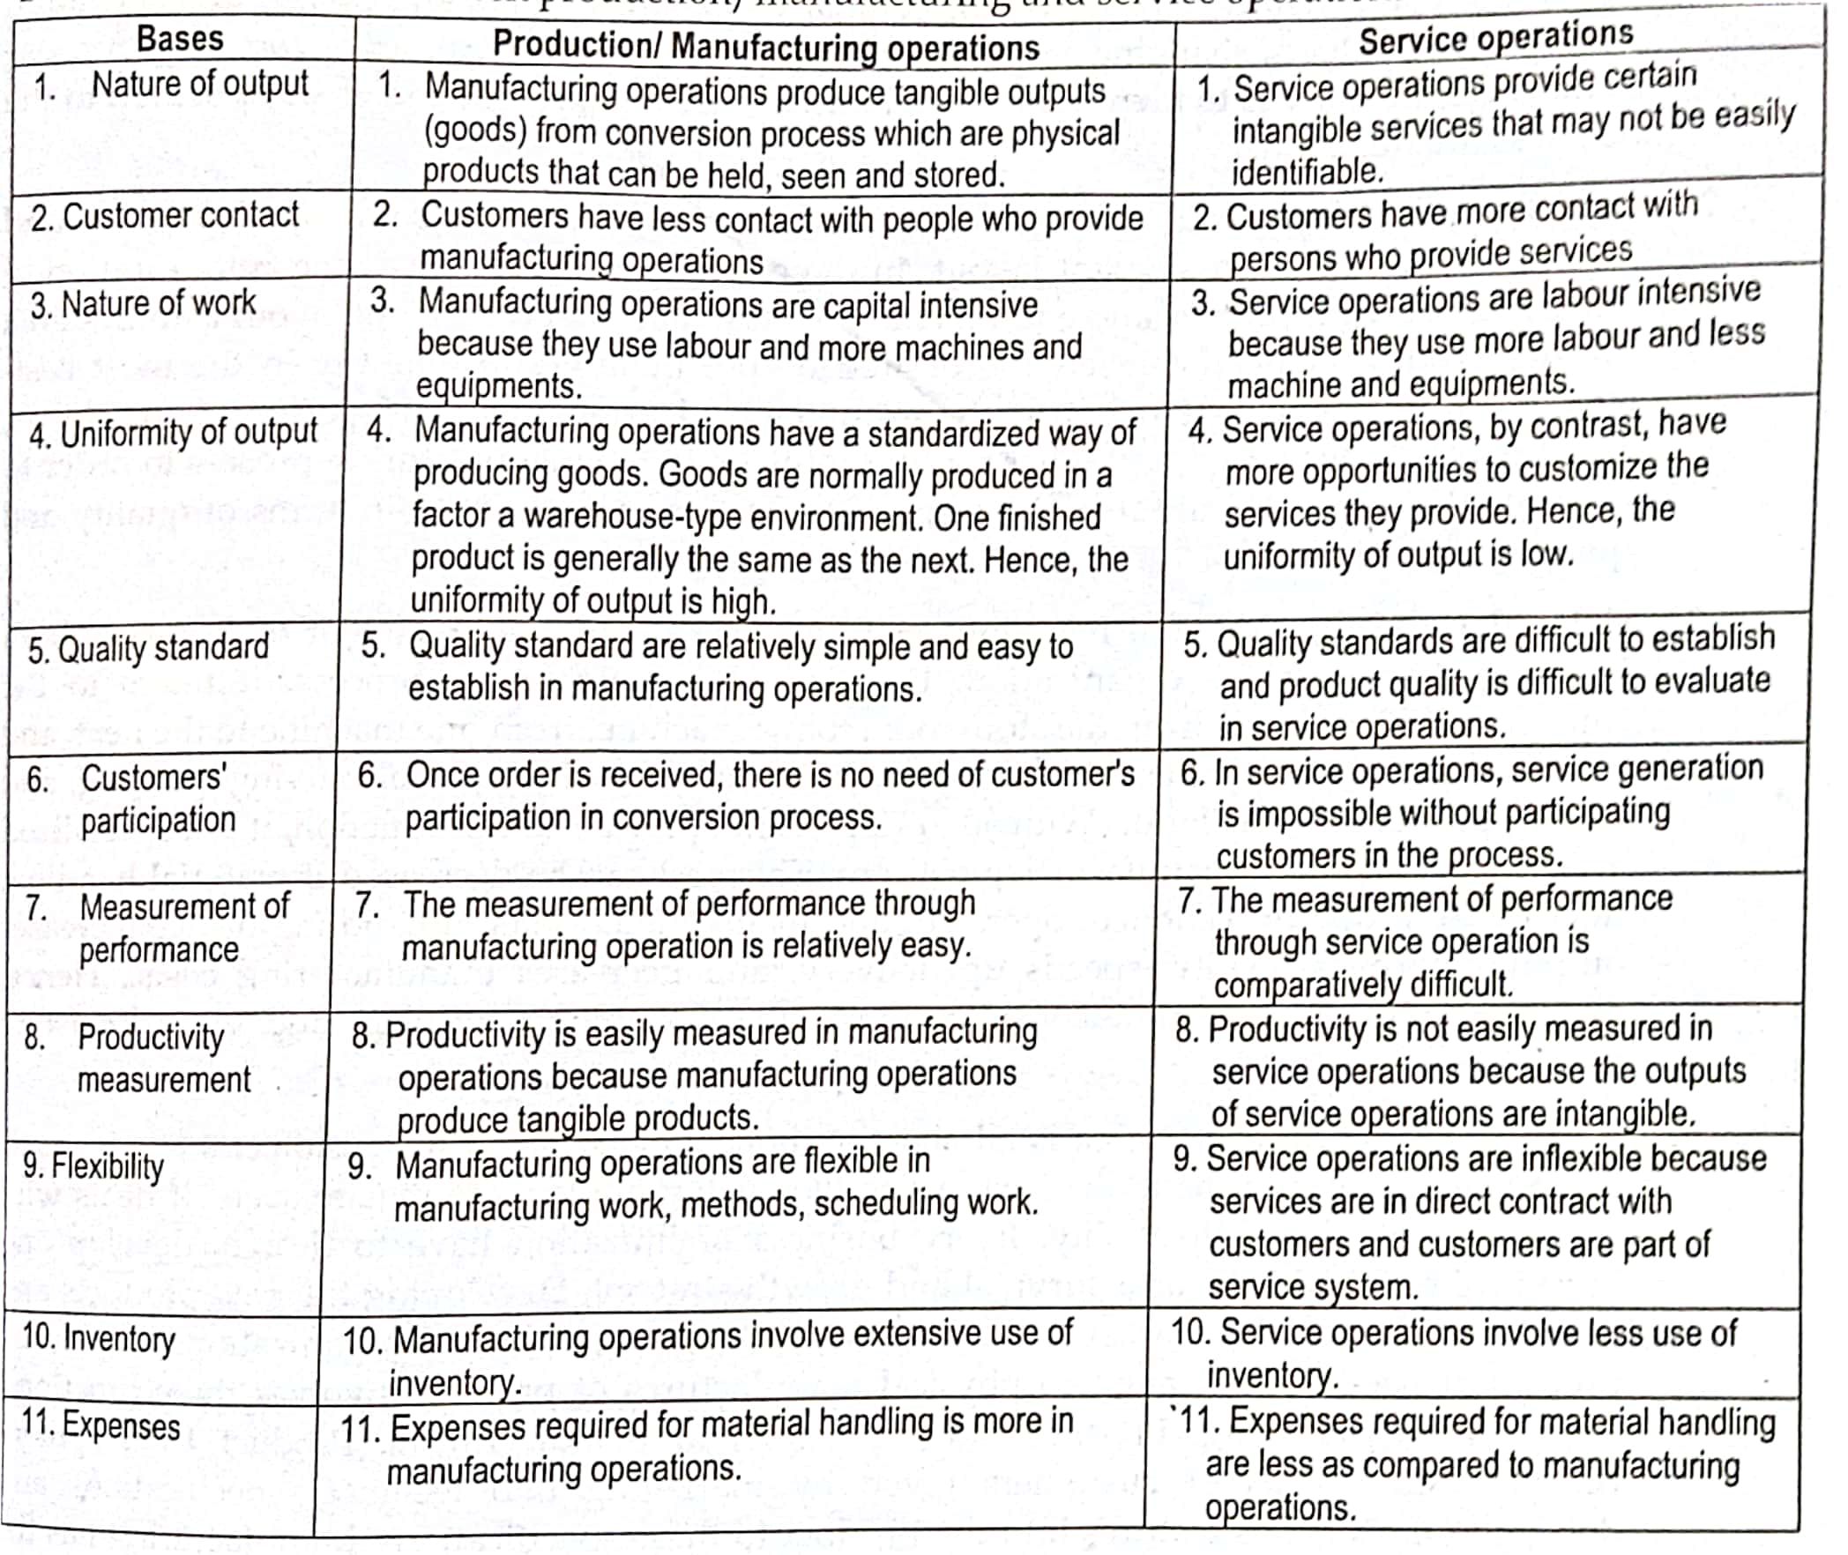
3. Differences between Production(Manufacturing) and Services Operations

Slide 10
4. Scope of Operations Management
The scope of operations management encompasses all aspects of an organization's operations, including the conversion of inputs into outputs. Under operations management functions, the following activities are listed:
Location of facilities
Plant Layouts
Material Handling
Product Design
Process Design
Production Planning and Control
Quality Control
Maintenance Management

Slide 11
5. Operations and Supporting Functions
The arrangement of resources that are devoted to the production and delivery of products and resources is known as operation function or operation system.
Operation function (system) of an organization is responsible to manage people, equipment, technology, materials and information for producing products and delivering services.
Operating functions (system) converts inputs in order to provide outputs which are required by a customer. Majority of companies’ function can be split into two categories: Core(operations) and Supporting Functions
Core Functions
Marketing and sales function
Product/Service Development
Operations Fucntions

Slide 12
Contd.
b. Supporting Functions
Accounting and Finance function
Human Resource function
Information technology function
Engineering function
Forecasting
Assuring quality

Slide 13
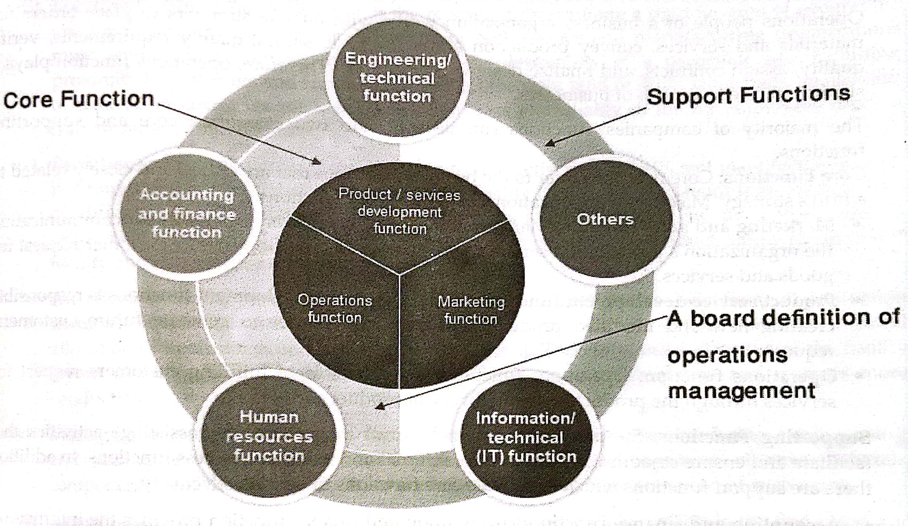

Slide 14
6. Role of Operations Manager
Operation Manager oversees operational activities at every level of an organization
Their duties include hiring, training employees, managing quality assurance programs
They are ultimately responsible for maintaining and increasing the efficiency of a business
The responsibilities of operations managers in the effective and efficient production of goods and services can be divided into :
Direct roles
Indirect roles
Broad roles

Slide 15
Contd.
Direct Roles
Understanding the operation’s strategic objective
Developing an operations strategy for the organization
Designing the operation’s products, services and processes for the organization
Planning, Controlling and sequencing the operation
Improving the performance of the operation
b. Indirect Roles
Understanding process technology needs
Understanding capabilities and constraints of operations processes
Understanding HR needs
Provision of relevant information to other departments eg. Accounts and Finance

Slide 16
Contd.
c. Broad Roles
The broad responsibilities of operations managers include understanding of:
Globalization issues
Environmental protection
Social responsibility
Technology awareness
Knowledge management

Slide 17
7. Key issues for Operations Manager
Operations managers are in responsibility of all key administrative departments, including human resources, finance, marketing and communication, IT and logistics as well as troubleshooting and operations management. The key issues/challenges for operations managers are as follows:
Coordinating the relationships between mutually supportive but separate organizations
Optimizing global supplier, production, and distribution networks
Increased co-production of goods and services
Managing customer touch points
Raising senior management awareness of operations as a significant competitive weapon

Slide 18
8.Production System
The production system is that part of an organization, which produces products of an organization.
It is that activity whereby resources, flowing within a defined system, are combined and transformed in a controlled manner to add value in accordance with the policies communicated by management.
The production system has the following characteristics:
Production is an organized activity, so every production system has an objective.
The system transforms the various inputs to useful outputs
It does not operate in isolation from the other organization system.
There exists a feedback about the activities, which is essential to control and improve system performance.

Slide 19
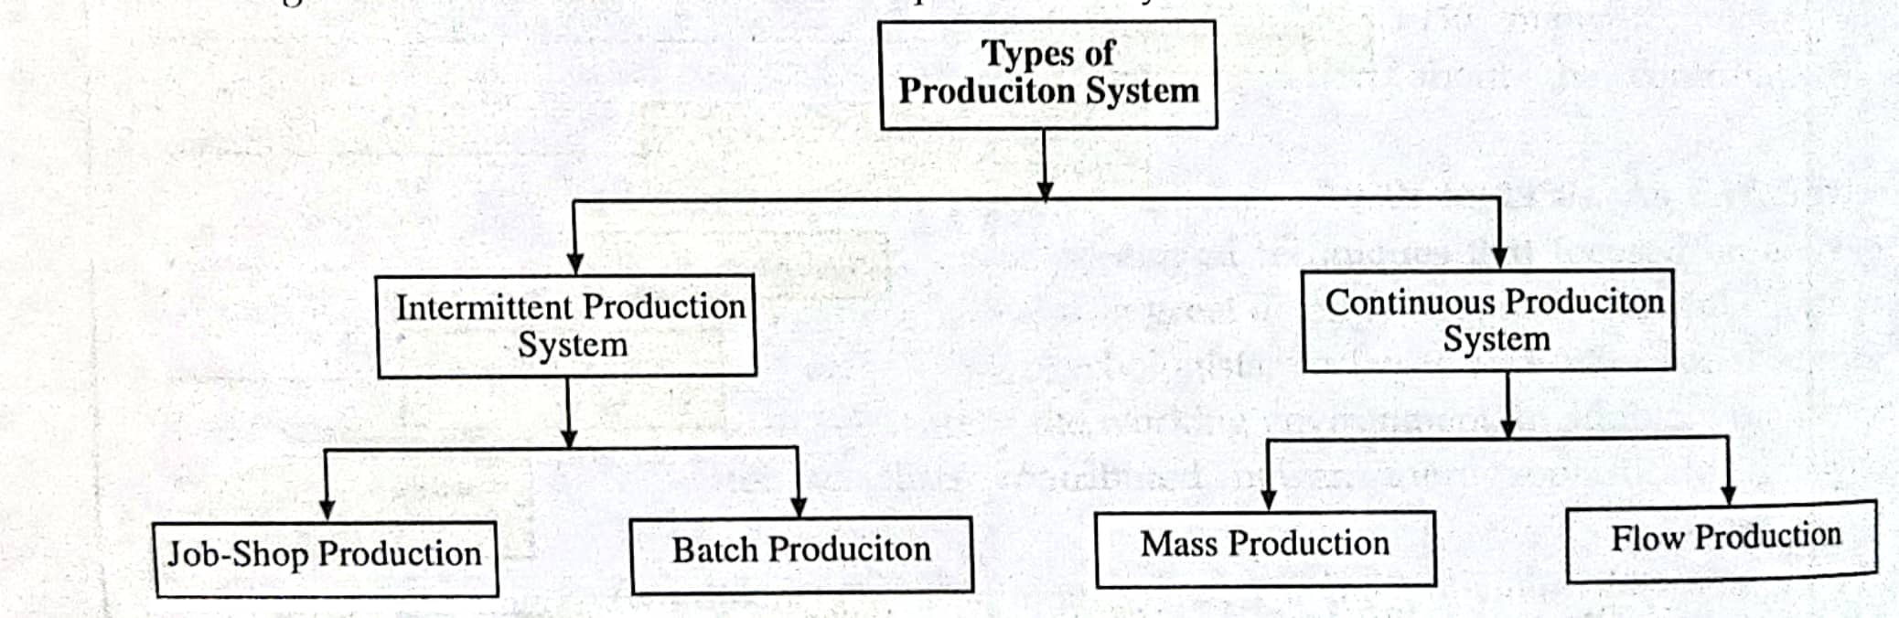
Types of Production Systems

Slide 20
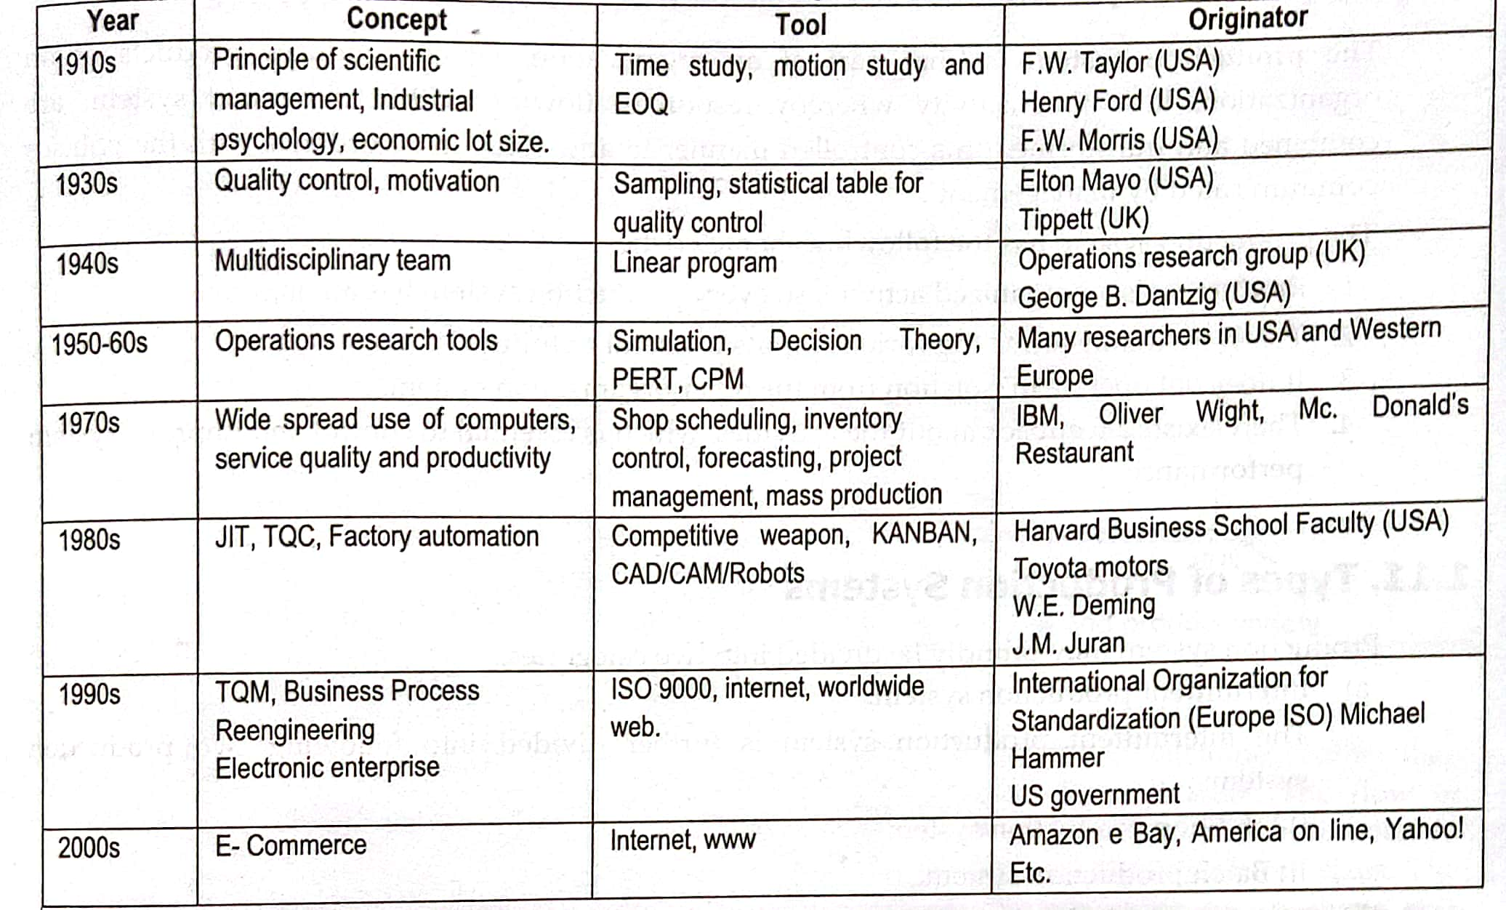
9. Historical Evolution of Operations Management

Slide 21
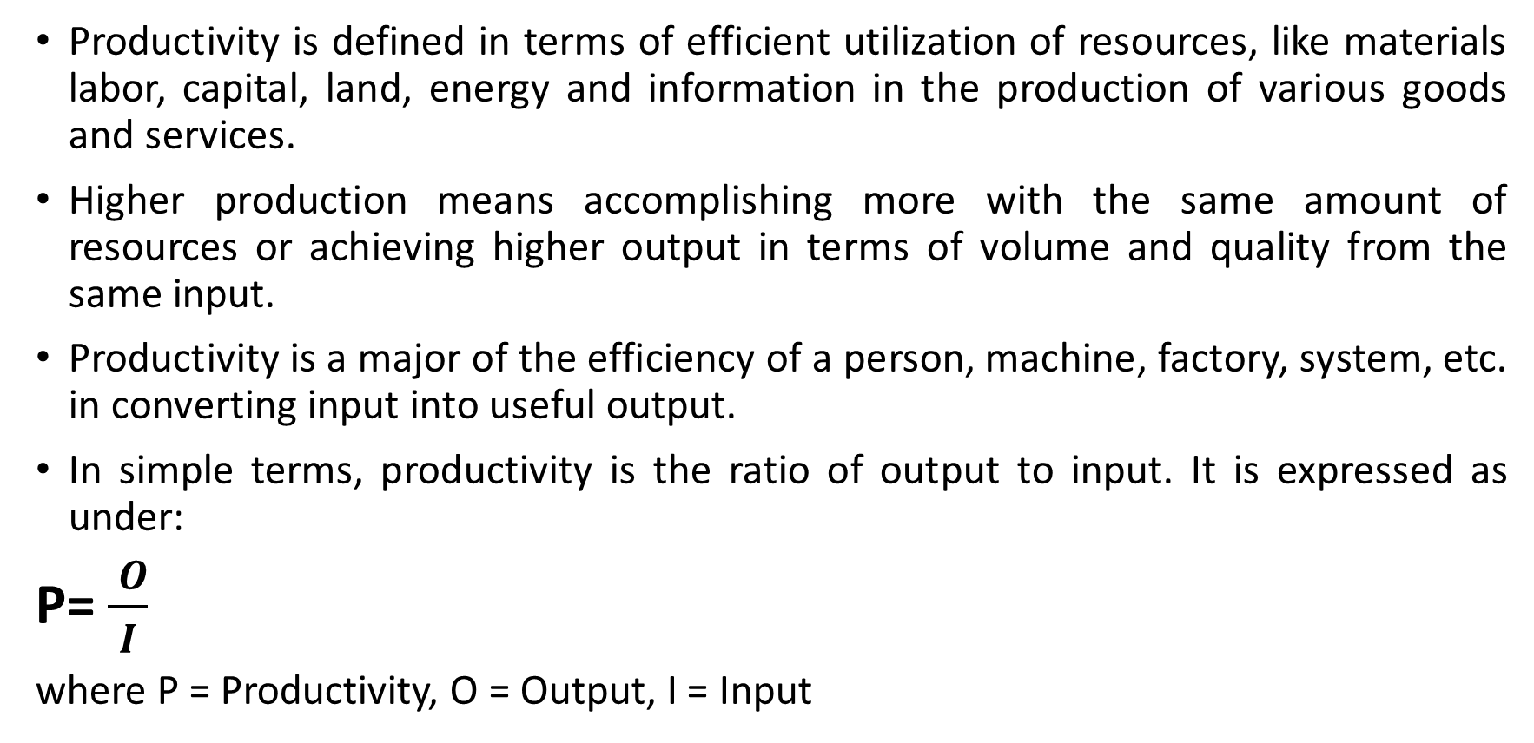
10. Productivity: concepts, types, productivity measurement, factors affecting productivity
Productivity is defined in terms of efficient utilization of resources, like materials labor, capital, land, energy and information in the production of various goods and services.
Higher production means accomplishing more with the same amount of resources or achieving higher output in terms of volume and quality from the same input.
Productivity is a major of the efficiency of a person, machine, factory, system, etc. in converting input into useful output.
In simple terms, productivity is the ratio of output to input. It is expressed as under:
P= $\frac{ O}{I}$
where P = Productivity, O = Output, I = Input

Slide 22
Types of Productivity
The productivity is expressed in terms of ratio between output ad input, and it is measured in terms of the output per unit of input. There exists a well-defined relationship between output (O) and the input (I) in a particular industry.
In fact, the output is a function of the input and so mathematically it can be expressed as O=f (I).
The output is nothing but the "value added" in various types of inputs such as labor, capital etc.
As productivity measures the output per unit of input, it can broadly be classified as under.

Slide 23
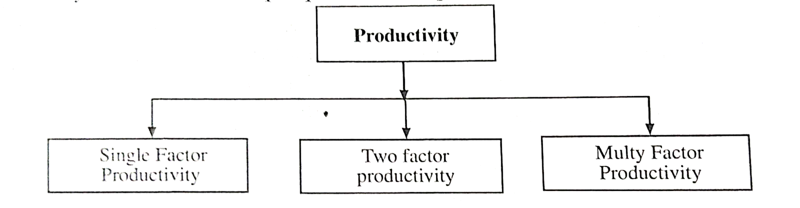
Contd.

Slide 24
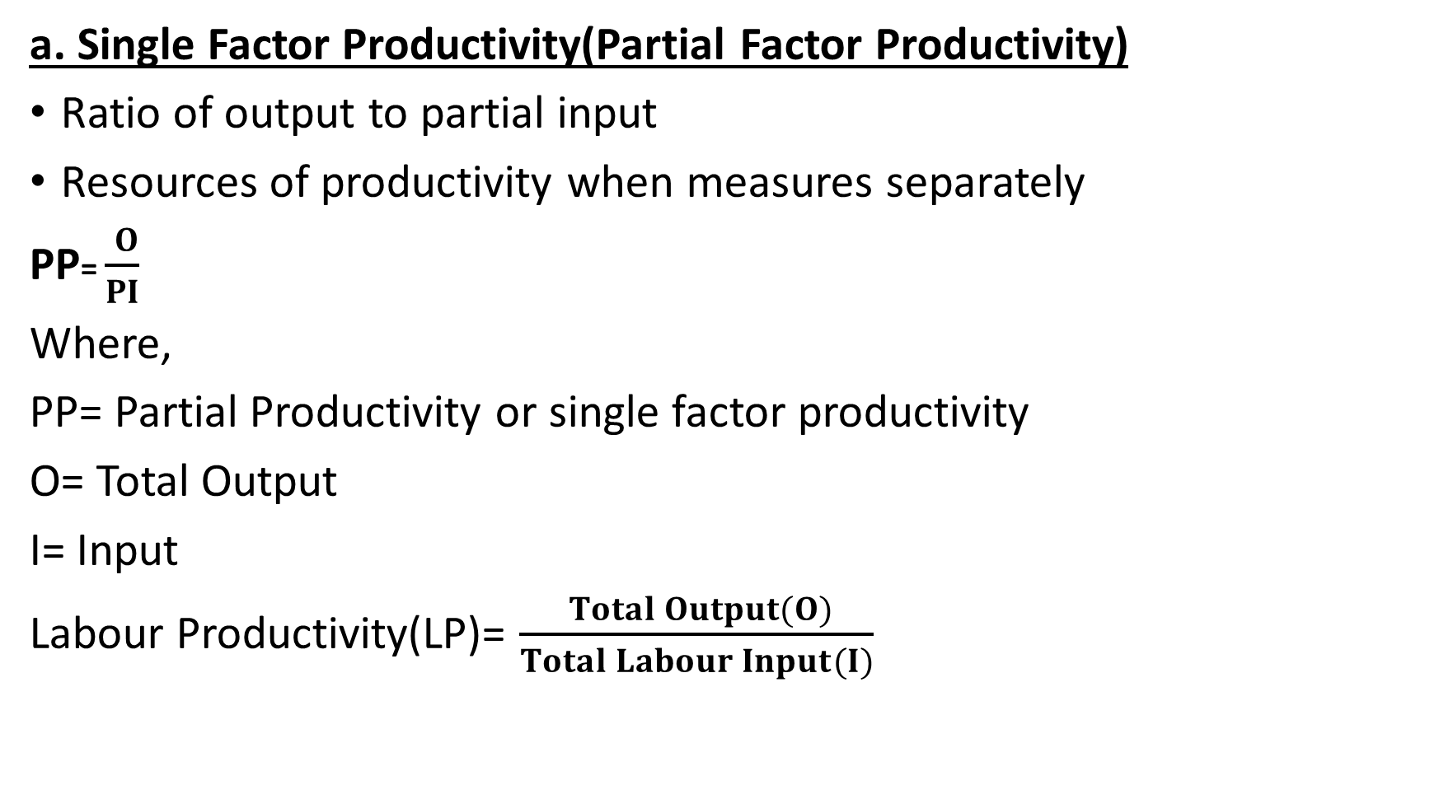
Contd.
a. Single Factor Productivity(Partial Factor Productivity)
Ratio of output to partial input
Resources of productivity when measures separately
PP= $\frac{ O}{PI}$
Where,
PP= Partial Productivity or single factor productivity
O= Total Output
I= Input
Labour Productivity(LP)= $\frac{ Total Output(O)}{Total Labour Input(I)}$

Slide 25

Contd.
Capital Productivity(CP)= $\frac{ Total Output(O)}{Total Capital Input(I)}$
Material Productivity = $\frac{ Total Output(O)}{Total Material Input(I)}$
Machinery Productivity(LP)= $\frac{ Total Output(O)}{Total Machinery Input(I)}$

Slide 26
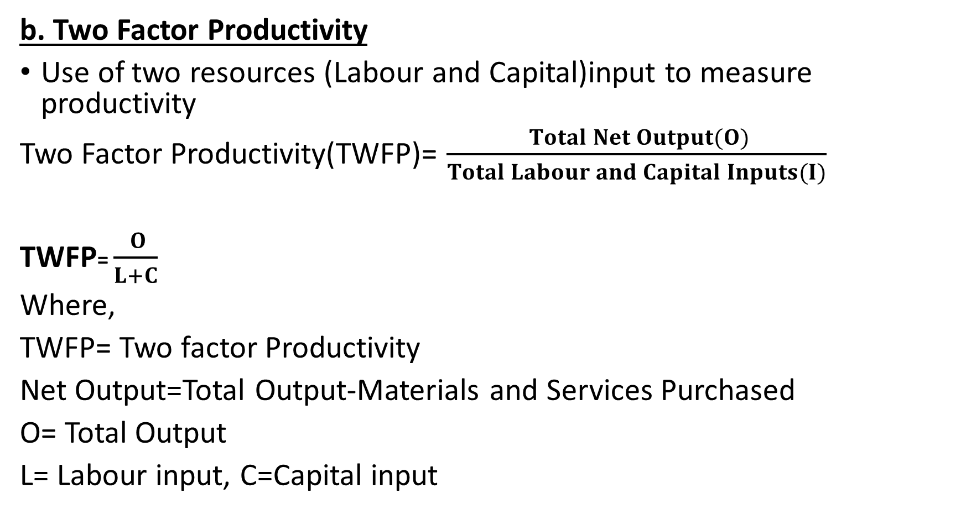
Contd.
b. Two Factor Productivity
Use of two resources (Labour and Capital)input to measure productivity
Two Factor Productivity(TWFP)= $\frac{ Total Net Output(O)}{Total Labour and Capital Inputs(I)}$
TWFP= $\frac{ O}{L+C}$
Where,
TWFP= Two factor Productivity
Net Output=Total Output-Materials and Services Purchased
O= Total Output
L= Labour input, C=Capital input

Slide 27
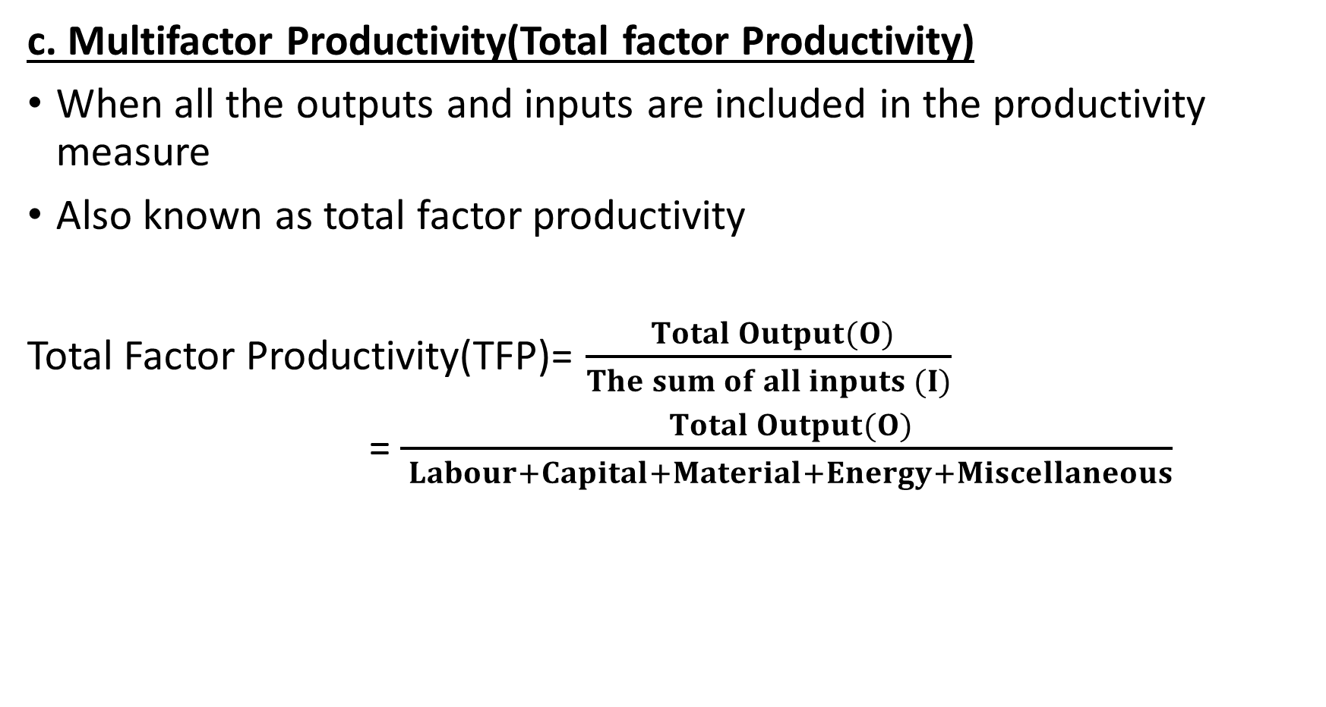
Contd.
c. Multifactor Productivity(Total factor Productivity)
When all the outputs and inputs are included in the productivity measure
Also known as total factor productivity
Total Factor Productivity(TFP)= $\frac{ Total Output(O)}{The sum of all inputs (I)}$
= $\frac{ Total Output(O)}{ Labour+Capital+Material+Energy+Miscellaneous}$

Slide 28
Factors affecting Productivity
Internal Factors (Controllable Factors)
Hard Factors
Products
Plant and Equipment
Technological Innovations
Material and Energy
Soft Factors
Manpower(Human Resource)
Organization and Systems
Work Methods
Management Styles

Slide 29
Contd.
2. External Factors (Uncontrollable Factors)
Structural adjustments
Natural Resources
Government and infrastructure

Slide 30
11. Concept of Green Productivity
First introduced in 1994 by the Asian Productivity Organization(APO)
Green Productivity (GP) is a strategy for simultaneously enhancing productivity and environmental performance for overall socio-economic development that leads to sustained improvement in the quality of human life.
It is the combined application of appropriate productivity and environmental management tools, techniques and technologies that reduce the environmental impact of an organization's activities, products and services while enhancing profitability and competitive advantage
Green productivity is a dynamic strategy to harmonize economic growth and environmental protection for sustainable development.

Slide 31
12. Supply Chain Management
A supply chain consists of a series of activities involving many organizations through which the material moves from initial suppliers to final customers.
A supply chain activity is depicted as follows:
Raw material -> Semi-finished products ->Finished products->Distributors-> Retailers->End customers
Supply chain management is the active management of supply chain activities of the flow of goods and services and includes all processes that transform raw materials into final products.
Five Stages/Process of Supply Chain Management
Planning, Sourcing, Manufacturing, Delivery and Logistics, Return

Slide 32
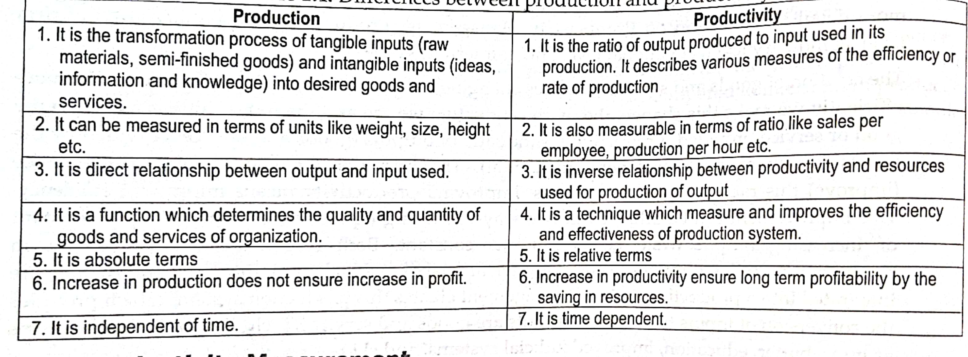
Extra Booster
Production Vs Productivity

Slide 33
Assignment-1
Short Answer Questions:
Define operations management. Explain the objectives and importance of operations management?
What are the differences between manufacturing and service operations? Describe the operations and supporting functions of operations management.
Define Productivity. Also, explain factors affecting productivity.
Describe the roles and key issues of operations manager?
Elaborate the transformation process of operations management.

Slide 34
The End Chapter One

