Slide 1
Chapter Three: Product and Service Design
BBA/BIM/BBM/BBA-F

Slide 2
Topics to be covered: LH5
Concept on product and service design
Product Development Process
Difference between product and service design
Emerging issues in product and service design
Value analysis
Concurrent Engineering and Quality function deployment
Waiting line theory(Single Channel Only)

Slide 3
Concept on product and service design
Product is among 4Ps(i.e. product, price, place, promotion)
Defines the appearance of the product, sets standard for performance, specifies which materials are to be used and determines dimensions and tolerance etc.
An iterative decision-making process which generates detailed plans of how raw materials and purchased items are to be transformed into useful products is known as product design.
Process of creating a new product to be sold by a business to its customers
Decisions Ideas Methods Product Design Detailed plans of useful products

Slide 4
Contd.
Objectives of product design
To ensure growth of the organization
To utilize the surplus capacity of the organization, such as physical facility, man power etc.
To increase company’s market share and to target new market segment
To ensure complete product range in company’s portfolio
Features of good product design(Maintainability, Cost Effectiveness)
Concept of Service Design
the responsibility of business decision-makers who were encouraged to understand and consider the interaction of all their business processes when developing operating procedures.

Slide 5
Contd.
Service design is the activity of planning and organizing people, infrastructure, communication and material components of a service in order to improve its quality and the interaction between the service provider and its customers.
Service design practice can be both tangible and intangible

Slide 6
2. Product Development Process
Product development is the set of activities, beginning with the perception of a market opportunity and ending in the production, sales and delivery of a product.
It may involve modification of existing product or its presentation, or formulation of an entirely new product that satisfies a new defined customer want or market opportunity.
The product development process describes the eight steps needed to take a product from initial concept to final market launch.

Slide 7
Contd.
The process consists of following steps:
Idea generation(ideation)
Idea screening
Concept development and testing
Marketing strategy development
Business analysis
Product development
Market testing
Commercialization(Production ramp-up)

Slide 8
3. Difference between product and service design
The basic differences between product and service design are as follows:
Service design is an intangible aspect that cannot be touched, while product design is tangible.
Services are created and delivered simultaneously as they cannot be stored, whereas the products can be held in the inventories.
While making the service design, one has to organize the people and communicate the goals to them as services are rendered on the spot. In product design, one has to focus more on the knowledge of the product and assembling the raw material for the product.
Service design is the coordination and combination of people, communication, and material components to create quality service whereas product design is the combination of manufacturing capabilities with product and business knowledge to convert ideas into physical and usable objects.
Service design must be people-centered whereas product design may also be people- centered, but it is not inherently so.

Slide 9
Contd.
Service design is about the complete end to end of a user's journey within the service on whereas product design focuses more on the thing and less on the way people discover it, get hold of it or get help with it
Service design is broader, more holistic whereas product design often more vertical and specific.
In service design, services are location-based while in product design, products are transported to through distribution channels.
In service design, customers want most of their services to be customized while in product design, customers like many of their products to be standardized.
Service design and its efficiency is measured in terms of outcomes while product design and its efficiency is measured in terms of output.
It is very difficult to patent service design and hence the chance of imitation is very high while product design can be patented for a certain period of time.

Slide 10
4. Emerging issues in product and service design
The emerging issues/challenges in product and service design faced by operations manager are given below:
Managing multiple customers:
Understanding the product and service concept
Managing the outcome and experience
Managing in real-time
Knowing, implementing and influencing strategy
Continually improving operations
Encouraging innovations

Slide 11
5. Value Analysis
It means the organized and exhaustively critical study of a product in terms of the design, functions and costs with the object of cost reduction.
Value Analysis reviews the design changes with the objective of eliminating high-cost materials and the materials that are technically obsolete and reducing the number of parts without diminishing quality, reliability, performance and appearance of the products.
Value Analysis can be defined as a process of systematic review that is applied to existing product designs in order to compare the function of the product required by a customer to meet their requirements at the lowest cost consistent with the specified quality, performance and reliability needed.
Value Analysis is a technique of cost reduction based on systematic and organized examination of every item of cost which goes into the manufacture of the industrial product in terms of the value or customer satisfaction it adds to the product.

Slide 12
Contd.
Procedure of Value Analysis:
The stages involved in a value exercise consist of the following the steps:
Examine all the products/materials that are being reordered and identify each product/material that needs an improvement.
Gather all possible information about the designs, costs and so forth of the product.
Form a team that includes experts from various functional areas that are related to the functions performed by the material.
Generate alternatives by generating new ideas and evaluate different ways of accomplishing the task
Evaluate the alternatives on criteria like cost and feasibility and eliminate the alternatives
Refine the feasible alternatives and select the optimal one.

Slide 13
Contd.
Benefits of Value Analysis:
To reduce costs
To maintain high quality
To provide an opportunity to use new technologies
To eliminate waste
To encourage new ideas
To improve brand image
To improve design
Objectives of Value Analysis:
To provide better value to a product/service
To improve the company's competitive position
To ensure that every element of cost (labour, materials suppliers equally to the function of the product)
To eliminate unnecessary cost.

Slide 14
6. Concurrent Engineering and Quality Function Deployment
Concurrent engineering, also known as integrated product development (IPD) or simultaneous engineering (SE), is a method of designing and developing new products, in which the different stages run simultaneously, rather than consecutively.
It decreases product development time and also the time to market, leading to improved productivity and reduced costs.
Concurrent Engineering is a long-term business strategy, with long term benefits to business.
Objectives of Concurrent Engineering
To improve the interactive work of different disciplines affecting a product

Slide 15
Contd.
To eliminate the redesign procedure of product.
To maximize product quality and performance spending more time and money initially in the design cycle and ensuring that optimize the concept selection.
To increase the prospect of delivering a quality product to customer
To work together for a common product by teamwork human resources. To decrease product/service design and development time.
To gain competitive advantage over competitors by reduction in time to market.
To decrease production cost results from the minimization of the product life cycle

Slide 16
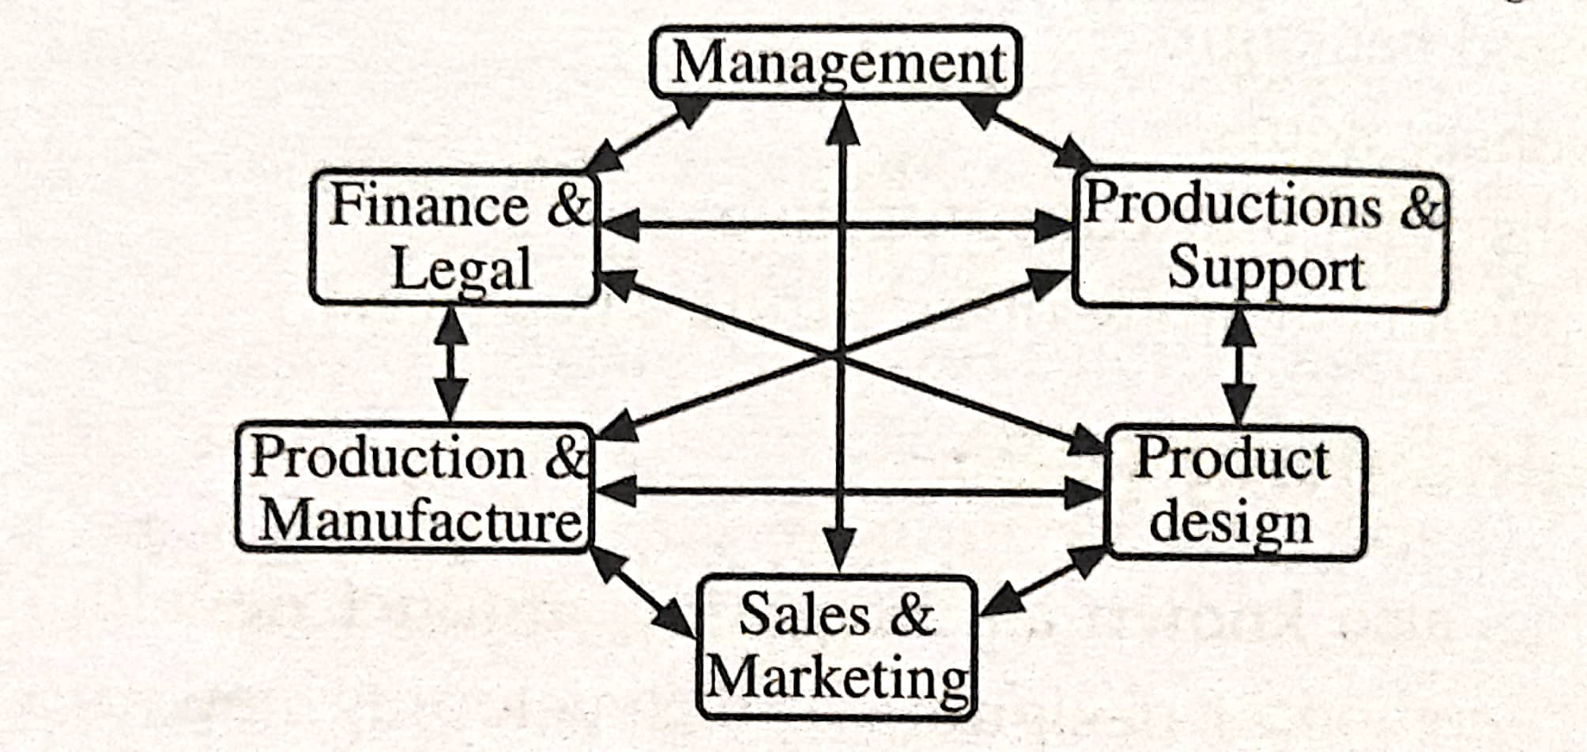
Contd.
Fig: Concurrent Engineering Interaction

Slide 17
Quality Function Deployment
Quality function deployment (QFD) is basically a planning process with a quality approach to new product design, development, and implementation driven by customer needs and values.
Quality Function Deployment (QFD) is a structured approach to defining customer needs or requirements and translating them into specific plans to produce products to meet those needs.
QFD aims at translating voice of customer into measurable and detailed design targets and then drives them from the assembly level down through sub-assembly level, component level, and production process levels.
The Quality Function Deployment process begins with collecting input from customers (or potential customers), typically through surveys.

Slide 18
Contd.
Steps Employed for Performing QFD
Step1: Identify the Customers.
Step2: Determine the customers' requirement.
Step3: Determine the relative importance of the requirements.
Step4: Identify and evaluate the competition.
Step5: Generate engineering specifications.
Step6: Relate the customer requirement to the engineering specifications.
Step7: Engineering importance targets with their importance.
Step8: Identify relationships between engineering specifications.

Slide 19
7. Waiting line theory(Single Channel Only)
Meaning: A queue (or a waiting line) is a line or list of customers who remain waiting for getting certain goods or services from service center.
Definition: Queuing theory, also known as waiting line theory, is a branch of mathematics that studies all the various dynamics of waiting lines or "queues" (i.e., how lines form, how they function, and why they malfunction). Queuing theory examines every component of waiting in line, including the arrival process, service process, number of servers, number of system places, and the number of customers which might be people, data packets, cars, or anything else.
Objectives: The main objective of the queuing theory is to minimize the two important costs namely
the waiting time cost of the customers and
the service idle cost of the service centers.

Slide 20
Assignment-3
Short Answer Questions:
Give the importance of concurrent engineering and write the emerging issues in product and Service Design.
How does Quality Function Deployment Work?
Define value analysis? Difference between product and service design.
Elaborate product development process.

Slide 21
The End Chapter Three

