Slide 1
Understanding Individual Behavior Unit 2

Slide 2
Individual Behavior
Concept
Individuals are influenced by a number of diversified factors both genetic/inborn and environmental and the influence of these factor determines the pattern of behavior.
Individual behavior is the result of interaction between individual characteristics and environmental characteristics by which behavior occurs. .
Both individual and environmental characteristics serves as the foundation of individual behavior.
The major cause of individual behavior is due to inherited characteristics and environmental factors.
The inherited characteristics involve biographical and psychological factors.

Slide 3
Biographical factors involve age, gender, education level, abilities, and marital status.
Psychological factors involve personality, perception, attitudes, beliefs, values, and learning.
The environmental factors involve organizational and social factors.
Organizational factors are physical facilities, organizational structure and design, leadership pattern, reward system.
Social factors are economic condition, culture, value, political and legal environment and social norms.

Slide 4
Individual Behavior as an Input-output System
Individual behavior is influenced by both internal and external factor. It is also considered as system consisting of input-process and output. For further understanding of individual behavior it can be understanding by the following way.

Slide 5
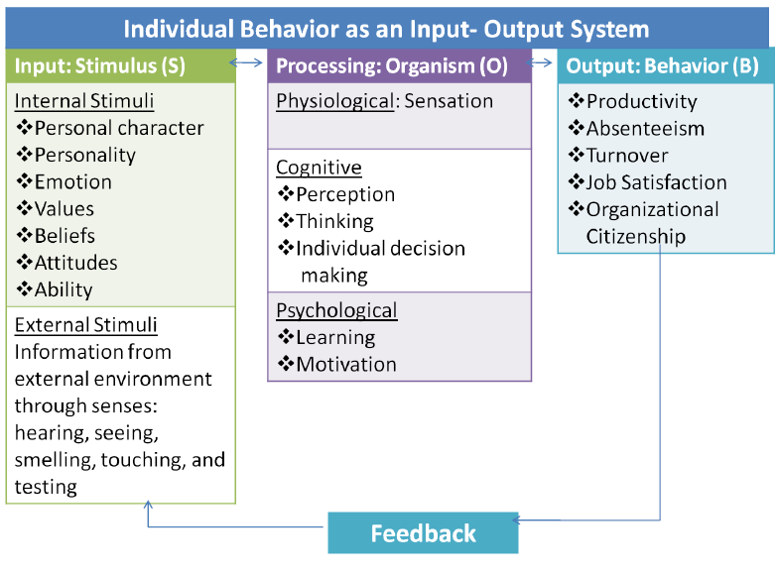

Slide 6
Inputs
Input is the main operator of system. Input provides stimuli for individuals.
It can be internal and external stimuli. Internal stimuli are the force inherited with the individual. External stimuli are the forces received from social factors.
Internal stimuli
It is within the individual. Consist of:-
Personal characteristics
They are age , gender , marital status, academic qualification, experience, emotional intelligence . These factor makes people different.
b. Personality
Personality is the outcome of internal and external traits of individuals.
Personality is a key factor that influences individual behavior in organization.

Slide 7
c. Emotions
Emotions are reactions to a person or event.
It is a conscious metal reaction that is directed toward a specific object.
They are the intense/powerful feelings that are directed someone or something. They create state of readiness for behavior. Joy , love , sadness , and fear are some forms of it.
d. Values
Values represent individual’s sense of what is right or wrong, good or bad, and desirable or undesirable.
Value contain an element of judgment and tend to be stable as well as long lasting.
Most values are acquired from parents, teachers, friends, reference group and medias as well.

Slide 8
e. Beliefs
Beliefs are internal feeling that something is true.
Beliefs are thoughts about the characteristics of objects , people or events.
They can be based on knowledge, opinion, and reference group member.
Beliefs are formed by past experience, available information and generalization.
f. Attitude
It is also known as an evaluative judgment concerning object , people , or event.
An attitude can be as a positive or negative evaluation of people, objects, event, activities, ideas, or just about anything in environment.
It is either favorable or unfavorable.

Slide 9
g. Ability
It is an individual’s current capacity to perform the various task or job.
It derives from learning.
It can be intellectual(it performs mental activity) and physical(it performs skilled activity).
2. External Stimuli
It consist of the information which an individual collects from external environment about other people , object or event. The information received through:
Physical forces:- They are concern with organizational climate, work environment , work place , etc.
Socio-cultural forces:- they consist of management style , value , norms , organizational culture.

Slide 10
Processing (Organism)
Processing (Organism) is important element of understanding individual behavior.
Processing is the organism aspects of individual behavior.
It facilitates between input and output. In processing the information are analyzed in meaningful way.
It plays the important role to develop behavior of individual.
It consists of :
Physiological process
It is concerned with biological foundation of individual behavior such as , heredity , five sense of organs.
They influence sensation.
Sensation is the process of receiving information and signals from environment and discharge response.

Slide 11
b. Cognitive process
It is concern with mental or knowledgeable part.
It consists of individual’s perception , thinking , decision making , problem solving and other mental process.
c. Psychological process
It consists of learning (permanent change in behavior) and motivation (it stimulates and energizes the individuals).
Learning is the permanent change in behavior as result information and experience.
Motivation is concerned with encouraging and inspiring individual to perform activities to achieve goal.

Slide 12
Outputs
Behavior of individual is the consequence of input and processing.
Generally, individual shows behavior in terms of covert or overt.
Covert is mental or psychological response.
Overt is physical or outward response.
The outputs of individual behavior can be seen in terms of productivity, absenteeism, turnover, job satisfaction, and organizational citizenship.

Slide 13
Feedback
It is also source of information.
Positive feedback fulfils personal needs and makes individuals more confident.
Similarly, if any deficiency is found in output it would be necessary to improve future performance to gain expected outcomes.

Slide 14
Mental Process
Simply, a person’s behavior is affected by mental process or
his/her thinking. Mental process is the capacity of an individual
to select, organize and interpret information.
Mental process are:
Belief
Attitudes
Values
Needs
Motives and Behavior
Sensation
Emotion
Cognitive Dissonance

Slide 15
Beliefs
Beliefs are internal feeling that something is true.
Beliefs are thoughts about the characteristics of objects , people or events.
They influence individual behavior.

Slide 16
Features of Beliefs
Belief may be different from the fact.
Beliefs develops person’s attitude.
Employee’s belief impact on their performance.
Individual beliefs are affected by cultural factor.
It is a mental process. And can be change overtime.

Slide 17
Development of Beliefs
Generally, individual beliefs develop through two sources. They are:
1. Culture factors
They provide impact on individual beliefs.
These factors involve tradition, custom, value considered by the individuals in the society.
The change in culture value affect on individual beliefs and behavior.
2. Functional factors
Individuals are involved in the organization to do work.
In doing job, they come into interaction with managers, colleagues, and juniors.
These factors develop and change in individual beliefs and behavior.

Slide 18
Attitudes
Concept
It is also known as an evaluative judgment concerning object , people , or event.
Attitudes are a result of beliefs.
It may be positive or negative. Positive attitude people find solution in every problem but negative attitude people find problem in every solution.

Slide 19
Characteristics of Attitude
It can be positive or negative.
It is related with event or person.
It is affected by environment.
It differs with person to person.
It may be constant until change.

Slide 20
Components of Attitudes
1
Affective/emotional
2
Cognitive
3
Behavioral
The belief, opinions, knowledge or information held by an individual.
The predispositions to act on favorable or unfavorable evaluation of something
The feeling, sentiments, moods and emotion about a person, idea, event or object.

Slide 21
1. Affective/Emotional Component
The affective component of an attitude contains our feelings or emotions about a given object or situation.
The feeling about object, event or people may be positive, negative or neutral.
Affective = Feeling
Eg. I dislike my supervisor.

Slide 22
2. Cognitive Component
The cognitive component of an attitude reflects our beliefs or ideas about an object or situation.
It consists of information and belief about object, people, and events.
cognitive=evaluation
Eg. My supervisor gave a promotion to a co-worker who deserve less than me. My supervisor is unfair

Slide 23
3. Behavioral Component
The behavioral component refers to the way we intend or expect to act toward someone or something.
It show the intention of an individual to behave in certain way toward an object, event or people.
Behavioral= Action
Eg. I am looking for another job.

Slide 24
Types of Job Relation Attitudes
Job satisfaction
Job involvement
Organizational commitment

Slide 25
1. Job Satisfaction
Job satisfaction is positive attitude towards job.
It may be positive or negative.
Basically , job satisfaction is affected by challenging work, equitable rewards , supportive working environment , and supportive colleagues.
2. Job involvement
It is the degree to which a person identifies with his job actively participates in it.
High involvement >low absenteeism.
3. Organizational commitment
It is the degree of loyalties of employee towards their organization.
Highly loyal employees wants to maintain organizational membership and citizenship of organization.

Slide 26
Determinants/ Formation of Attitude
Family
Peer groups
Society
Associations
Experience
Personality
Environmental factors
Media
Educational institutions

Slide 27
Importance of attitude
It determines job satisfaction and high level of job performance.
It facilitates to maximize productivity.
It encourage for expressing value and honor to others.
It gives rise to positive and constructive feeling.
It helps individuals to adapt with their working environment.
It helps to reduce absenteeism and employee turnover.

Slide 28
Values
Concept
Value represent an individual’s ideas of what is right and what is wrong, good or bad, and desirable or undesirable.
Most values are acquire from parents, teachers, friends, reference group and medias as well.

Slide 29
Types of Values
Milton Rokeach conducted a research on human values. He identified two types of values. They are:
Terminal values
Instrumental values

Slide 30
1. Terminal values
They refer to the goals of individuals to be achieved in their life time
Comfortable and exciting life, sense of accomplishment, self-respect, social recognition, freedom, happiness, friendship, inner harmony, professional excellence, luxurious life, social prestige, good social network, etc. are some example of terminal values.
2. Instrumental values
They refer to the means of achieving terminal values.
Ambitious, capable, cheerful, honest, independent, responsible, cooperative, consistent, helpful, polite, obedience, hard working, etc. are some most common instrumental value.

Slide 31
Determinants/ Formation of Values
Family
Peer groups
Society
Associations
Experience
Personality
Environmental factors
1. Family
It is primary unit of individual development.
2. Peer group
Share ideas, knowledge, habit, experience with peer group.
It affects on the value of an individual.

Slide 32
3. Society
Social culture, language, tradition, affiliation, interaction
Society plays an important role in developing value of an individual.
4. Associations
Associations also affects in values of an individual.
5. Experience
Job experience provides impact in the values of an individual.
6. Personality
Physical fitness, self- confidence, intelligence, sense of responsibility, vision and foresight, flexibility, human character
Personality traits of an individual affect in his values.
7. Environmental factors
They affect on the values an individual.

Slide 33
Importance of values
They influence perception of individuals.
They are the foundation for understanding attitudes of individuals.
They influence on motivation of an individual for effective performance.
They encourage for achieving organization as well as individual goals.
They influence an individual to select appropriate types of activities.
They provide for stabilities and uniformities in group interaction.

Slide 34
Cross-culture Values
Geert Hofstede surveyed more than 116,000 IBM employees in 40 countries about their work-related values and found that manager and employees very on four value dimensions of national culture.
Power distance
Uncertainty avoidance
Individualism or collectivism
Masculinity or femininity

Slide 35
1. Power distance
Power distance is concerned with that all individuals in societies are not equal, indicating a culture towards inequalities amongst individuals.
Centralized power culture allows the individual for unequal distribution of authority and resource allocation.
Diffused power culture play down individual differences by sharing or decentralizing power.
2. Uncertainty avoidance
Uncertainty avoidance is concerned with the degree of taking risk on certain things.
Strong uncertainty avoidance culture is the tendency of avoiding future uncertainty.
People use rule, laws, and controlled system to reduce uncertainty.
Weak uncertainty avoidance culture is the tendency of accepting the uncertainty and ambiguity.
People use less rule and laws oriented.

Slide 36
3. Individualism versus collectivism
Individualism is the degree to which people prefer to act as individual rather than as members of groups. They believe individual rights.
Collectivism is concerned with people like to work group. They believe group rights.
4. Masculinity versus femininity
Masculinity is the degree to which the culture favors traditional masculine values.
Femininity is the degree to which the culture favors liberal feminine values.

Slide 37
Needs
Concept
A need is a deficiency, which creates tension within the people.
Needs are created whenever there is a psychological or physiological imbalance.

Slide 38
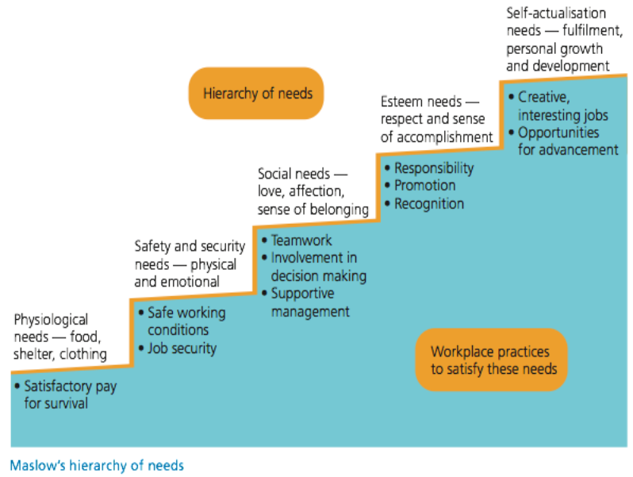
Types of Needs
1. Primary Needs: these are basic needs.
2. Secondary Needs: these needs involve safety and security, social, esteem or ego, and self-actualization needs.

Slide 39
Motives and Behavior
Motives
Concept
Motive is Latin words, which meaning is moving for action to fulfill needs.
Motive is a person’s reason for choosing a specific behavior from among several alternative choices.
Motives are derived from needs.
Motives are the driving forces for any particular action.
For example, an individual may decide to have lunch to satisfy need for food.

Slide 40
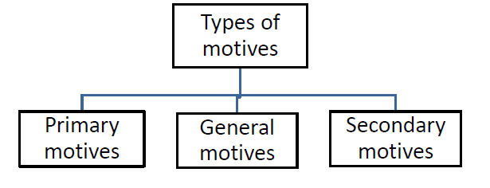

Slide 41
Primary motives
Primary motives are physiological based and unlearned.
They reduce the tension.
Hunger, sleep, shelter, cloths, etc. are primary motives in individual.
2. General motives
General motives are stimulating motives which are unlearned and interest based.
Curiosity, manipulation and activity motives are general motives.
3. Secondary motives
Secondary motives are psychological based learned motives.
Goal achievement , power achievement , social affiliation, social status and recognition etc. are secondary motives.

Slide 42
Behavior
Behavior is concerned with series of activities and interaction that individuals do in the organization.
Human behavior can be observed and studied. Behavior is goal directed.

Slide 43
Sensation
Concept
Sensation refers to the process of sensing our environment through touch, taste, sight, sound, and smell.
It is concerned with receiving information from external environment.
It involves major role of sense organs.

Slide 44
Factors Affecting Sensation
There are three factors affecting sensation of an individual. They are stimulus, receptors, and central nervous system.
1. Stimulus
Stimulus are the forces providing impact on sensing.
There are two types of stimuli.
Internal stimuli are in inside the body like muscles, digestive system.
External stimuli are inflows from outside the body like hearing, seeing, smelling, touching and tasting.
Individual receive environmental information through sense organs which provide impact on internal stimulus.

Slide 45
2. Receptors
Receptors are attached to sense organ.
They convert environmental information into neural events.
Hearing receptors include hear cells located in the inner ear.
Seeing receptors include rods and cones located in eyes retina.
They provide support to sense organs for sensing information received from external environment.
3. Central nervous system
It is responsible for integrating sensory information and responding accordingly. It consists of spinal cord and brain.
Spinal cord connects the brain and the body’s main receptors, and serves as a conduit for signals between the brain and the rest of the body.
Brain is the centre of sense organs. Brain is responsible for integrating most sensory information and coordinating body function, both consciously and unconsciously.

Slide 46
Emotion
Concept
The word emotion is derived from the Latin emovere which means ‘to mobilize’, ‘to excite’. Therefore, word emotion indicates a ‘moved’ sate of an organism.
Emotions are reactions to a person or event
We show our emotion when we are happy about something , angry at someone , afraid of something.
Emotions are reactions to an object, not a trait.

Slide 47
Emotions involve three component.
Cognitive component involves the conscious experience of emotions trust, expectation, anticipation.
Physiological component includes emotional excitement such as fear, anger, sadness, joy.
Expressive component involves body language such as gaze, gestures, postures, walk, smile.

Slide 48
Features of Emotion
It is caused by specific event.
Its effect is very brief in duration such for seconds or minutes.
It is specific and numerous in natures such as anger, fear, sadness, happiness, surprise etc.
It is usually accompanied by distinct facial expression.
It is action oriented in nature in terms of behavior or response.
It differ from individual to individual.
It disturbs the physical and psychological state of individual.

Slide 49
Types of emotions
1. Positive emotion
Individual always expresses good feeling that will develop better working environment.
Positive emotion involve love/affection, happiness/ joy, surprise, hope, confidence, thankfulness, trust, optimistic.
2. Negative emotion
Individual always expresses unexpected feeling that will develop worse working environment.
Negative emotion involve fear, sadness, anger, guilt, depression, self pride, jealousy, anxiety, envy, frustration, regret, worried.

Slide 50
Cognitive Dissonance
Concept
Cognitive dissonance is an uncomfortable feeling caused by two conflicting or different ideas simultaneously. It is concern with intrapersonal conflicts.
In the late 1950s, Leon Festinger proposed the theory of cognitive dissonance. This theory sought to explain the linkage between attitudes and behavior.
Dissonance can be eliminated by reducing the importance of the conflicting beliefs, acquiring new beliefs that change the balance, or removing the conflicting attitude or behavior.

Slide 51
Strategies to Reduce Cognitive Dissonance
According to Festinger’s theory of cognitive dissonance, people try to seek consistency in their thoughts, belief and opinions.
There are three key strategies to reduce or minimize cognitive dissonance. They are:
Focus on supportive beliefs
Reduce conflicting beliefs
Change the conflicting beliefs

Slide 52
1. Focus on supportive beliefs
The strategy of reducing cognitive dissonance is to focus on supportive beliefs that balance the dissonant behavior.
2. Reduce conflicting beliefs
Another important strategy is to reduce the importance of the conflicting belief.
3. Change the conflicting beliefs
An important strategy of reduce cognitive dissonance is to change the conflicting belief so that it is consistent with other beliefs or behaviors.

Slide 53
Thank you

