Slide 1
Perception Unit 3

Slide 2
Perception
Concept
Perception is the process of getting information from environment through sense organs and attempting to organize it in systematic way and interpret such information for making it meaningful.
Perception is a process by which an individual organizes and interprets its sensory impressions in order to give meaning to their environment.
“Perception is defined as the process by which an individual selects, organizes, and interprets information inputs to create a meaningful picture of the world”. – Bernard and Gray

Slide 3
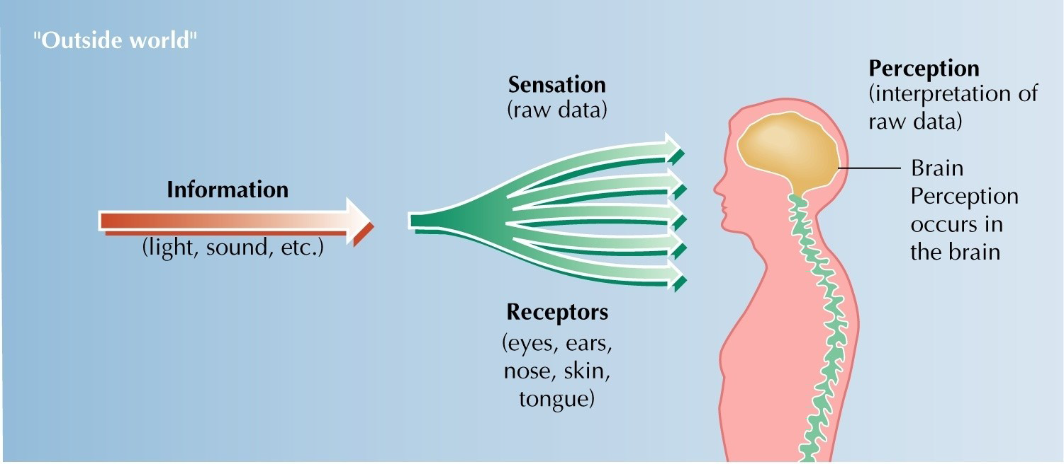
Sensation versus Perception
Sensation refers to the process of sensing our environment through touch, taste, sight, sound, and smell.
Perception is the process of making judgment over the sensory messages received from sensory organs in mind.

Slide 4
Different between sensation and perception
1 | Sensation activates the functioning of the physical sensory organs. | Perception activates the functioning of mental and intellectual process.
2 | It precedes perception | It follows sensation.
3 | It does not provide any meaning to external stimuli. | It provides meaning to external stimuli.
4 | It is concerned with receiving information from external environment. | It is concerned with filtering information received from external environment.
5 | It does not require past experience and practice. | It requires past experience and practices to provide meaningful responses.
6 | It involves major role of sense organs. | It involves major role of brain.

Slide 5
Perceptual Process
Several aspects of perception is known as perceptual process.
External stimuli
Perceptual organization
Perceptual interpretation
Perceptual selection

Slide 6

1. External stimuli
It refers to the environmental forces that provide impact in our five senses in term of feeling, hearing, seeing, smelling, and testing.

Slide 7
2. Perceptual selection
It is the process of filtering information that is received by five senses from external force.
The process of filtering information depends on internal and external factors.
External factors involve size, intensity, motion, contrast, repetition, novelty, and familiarity of objects.
Internal factors involve personality, interest, motivation, and learning, attitude.

Slide 8


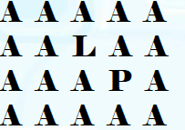
Intensity
Size
Repetition
Contrast
Motion object
Stationary object

Slide 9

3. Perceptual organization
It is a process of systematic classification and grouping of selected information in logical manner.
An individual makes grouping of information by considering some basic principles such as closure, continuity, similarity, and proximity.

Slide 10

4. Perceptual interpretation
It is the process understanding and giving meaning to the organized stimuli.

Slide 11
Factors Affecting Perception
Characteristics of Perceiver
Characteristics of Objects
Feature in the Situation
Attitude
Experience
Motives
Personality
Values
Interest
Expectation
Contrast
Intensity
Motion
Size
Novelty
Repetition
Proximity
Time
Work Setting
Social Setting

Slide 12
A. Characteristics of the perceiver
1. Attitude
Evaluative statements or judgments concerning objects, people or events.
2. Experience
Experience makes an individual matured and practical.
3. Motives
Motive is a person’s reason for choosing a specific behavior from among several alternative choices.
Motives are derived from needs.
4. Personality
It involves internal and external traits of an individuals.

Slide 13
5. Value
Value represent an individual’s ideas of what is right and what is wrong, good or bad, and desirable or undesirable.
The elements of value are freedom, pleasure, self-respect, honesty, obedience, and equality.
6. Interest
The focus of an individual is influenced by his interest.
7. Expectation
Every person will see what he expects to see.

Slide 14
B. Characteristics of the object/ target
1. Contrast
The contrast in color, size, and design provides impact on perceptual process.

Slide 15
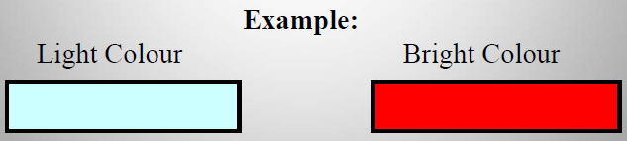
2. Intensity
the intensity of an external stimulus determines its probability of being perceived.
Loud sounds, strong smells and deep colors are attractive in nature.

Slide 16
3. Motion
Individual gives more attention to moving objects than the stationery objects.
Motion object
Stationary object

Slide 17
4. Size
The size of the object attracts the attention of the individuals.
A larger object is more likely to be noticed than a smaller object.

Slide 18
5. Novelty/ Familiarity
Novelty is concerned with newness whereas familiarity relates to experience.
6. Repetition
More repeated external stimuli will draw the attention of perceiver than a single one.

Slide 19

7. Proximity
A group of objects that are close together will be perceived as a whole. (group nearby figures together)

Slide 20
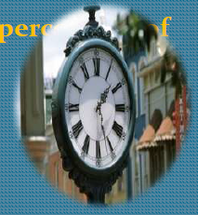
C. Features in the Situation
1. Time
It also affects perception.

Slide 21

2. Work setting
The work setting situation also provide impact in perception of individuals.

Slide 22
3. Social setting (How an individual perceives other)
Social values and norms are considered by all the individuals.
The changing social setting also provides impact on perception of individuals.

Slide 23
Specific Application of Perception in Organization
Employee Interview
Performance Expectation
Performance Evaluation
Employee Effort
Employee Loyalty

Slide 24
1. Employee interview
The concept of perception is applicable while interviewing new candidate for employment.
2. Performance expectation
Manager’s behavior and expectation will have a signification impact on the performance of an employee.
3. Performance evaluation
Performance evaluation of employees depend on the perception of the manager.
4. Employee effort
If manager’s judgment is true and fair, the employees put more effort and help the organization to achieve objectives.
5. Employee loyalty
For assessing employees , manager consider whether employees are loyal toward organization or not.

Slide 25
Application of Perception Theories in Organizations
Make accurate self perception
Enhance self concept
Support of empathetic
Develop positive attitude
Avoids perceptual distortion
Facilitates open communication
Avoids attribution
Healthy OB

Slide 26
1. Make accurate self perception
Perception makes awareness to the managers.
They need to understand and perceive subordinates accurately to deal with them effectively.
2. Enhance self concept
Perception helps managers to enhance self concept about any subject matter that they are dealing.
3. Support of empathetic
Empathetic is concerned with understanding the situation which is perceived by others.
4. Develop positive attitude
Perception helps to develop positive attitude.

Slide 27
5. Avoids perceptual distortion
Perception helps to avoid one’s perceptual distortion about an object, people or event.
6. Facilitates open communication
Perception plays an important role in the process of interpersonal communications within organizations.
7. Avoids attribution
Attribution is the process by which people interpret the causes of others’ behavior.
It provides explanation about perception.
8. Healthy organizational behavior
Perception develops the environment of mutual trust between managers and subordinates.

Slide 28
Attribution
Attribution is the process by which people interpret the causes of others’ behavior.
Attribution refer to the way people try to understand the causes of others behavior.
Personal (internal, dispositional) attribution (personality traits, motivation, ability, emotions)
Situational (external) attribution (other people, equipment, social influence from others)

Slide 29
Attribution theory
Attribution Theory tries to explain how people make judgments about the causes of other people’s behavior.
Attribution theory attempts to determine whether an individual’s behavior is internally or externally caused.
Internally caused behaviors are under control of an individual.
Externally caused behaviors results from the situation in which the individual has no control.
Behavior can be attributed to internal or external factors.

Slide 30
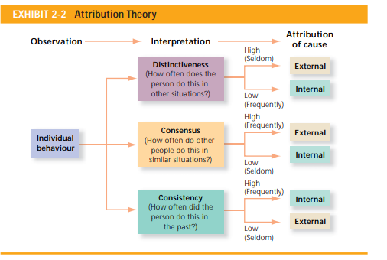
Determination of Attribution Theory

Slide 31
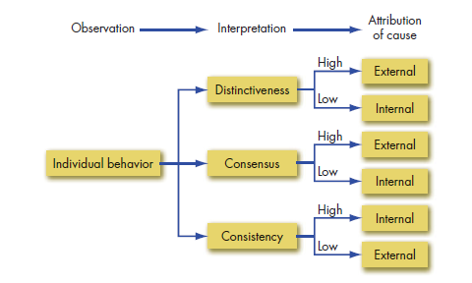
Determination of Attribution Theory

Slide 32
1. Distinctiveness
Distinctiveness refers to whether an individual shows different behavior in different situation.
2. Consensus
It refers to whether everyone faced with a similar situation response in the same way.
3. Consistency
It refers to whether a person shows similar behavior over time.

Slide 33
Attribution Errors
1
Fundamental Attribution Error
2
Self Servicing Bias
3
Other Perceptual Errors
Selective Perception
Halo Effect
Contrast Effect
Stereotyping
Projection
Primacy & Regency
Effect

Slide 34
1. Fundamental attribution error
It is concerned with making judgments about the behavior of other people by focusing internal factors rather than external factors.
It is the tendency to underestimate the influence of external factors and overestimate the influence of internal factors in making judgments about the behavior of others.
2. Self servicing bias
It is concerned with individual’s attribution of giving importance for success to internal factors whereas as putting the blame for failure to external factors.
The self-servicing bias is the tendency to attribute successes to internal factors and failures to situational factors.

Slide 35
3. Other Perceptual Errors
Selective perception
This is the process of selecting some of the stimuli for interpretation.
Example: among many employees working in same level and nature of work, manager gives warning only to few employees due to their inefficiency.
b. Halo Effect
Under the halo effect the person is perceived on the basis of one trait.
c. Contrast effect
In this approach, a person’s efficiency is evaluated by comparing the efficiency and traits of other persons who are recently faced by the evaluators.

Slide 36
d. Stereotyping
The term stereotype refers to the tendency to perceive another person as belonging to a single class or category.
stereotyping the person is perceived according to a single category.
e. Projection
It is the tendency of seeing one’s own traits in others.
f. Primacy and regency effect
Primacy effect is concerned with providing first impression to perceiver.
Regency effect is concerned with making impression to perceiver through new information and technology.

Slide 37
Thank you

