Slide 1
Predicting SONG POPULARITY on spotify using album artwork FOR VISION RECORDS
SABINA BAINS
OCTOBER 2022

Slide 2
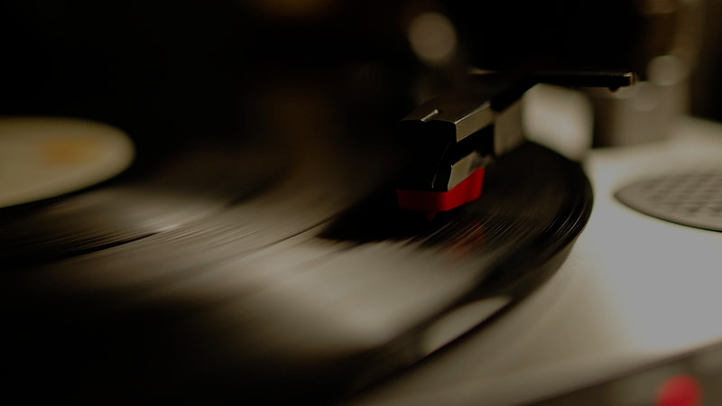
”I try to explain that to my kids - the experience of going to a record store, flipping through racks and finding that album cover that intrigues you - but my kids don't want to know about it. They download the one song on the album they like, and pay their 99 cents.”
-Jon Bon Jovi

Slide 3
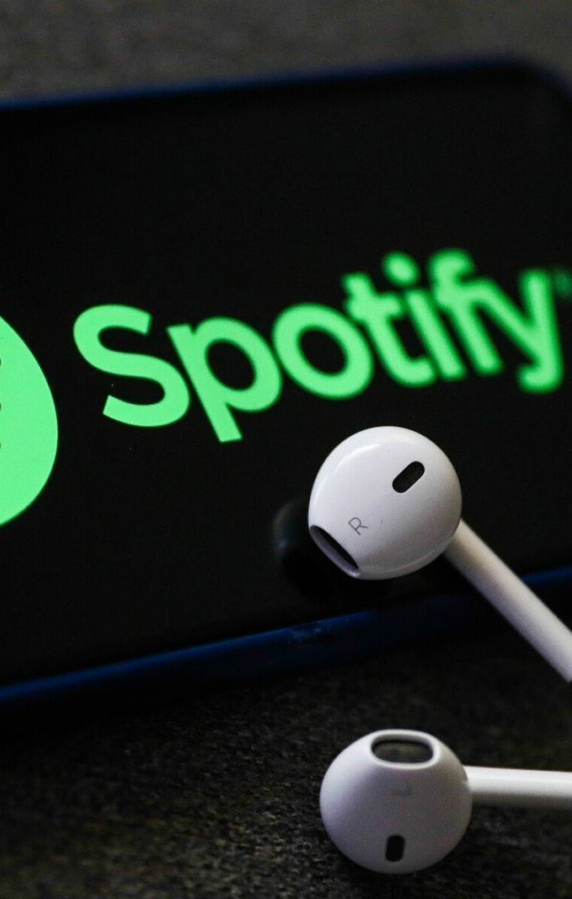
BUSINESS OBJECTIVE
New record label Vision preparing to upload artists’ music to Spotify
Determine how resources should be allocated towards album artwork creation
Understand album artwork styles that resonate with Spotify subscribers

Slide 4
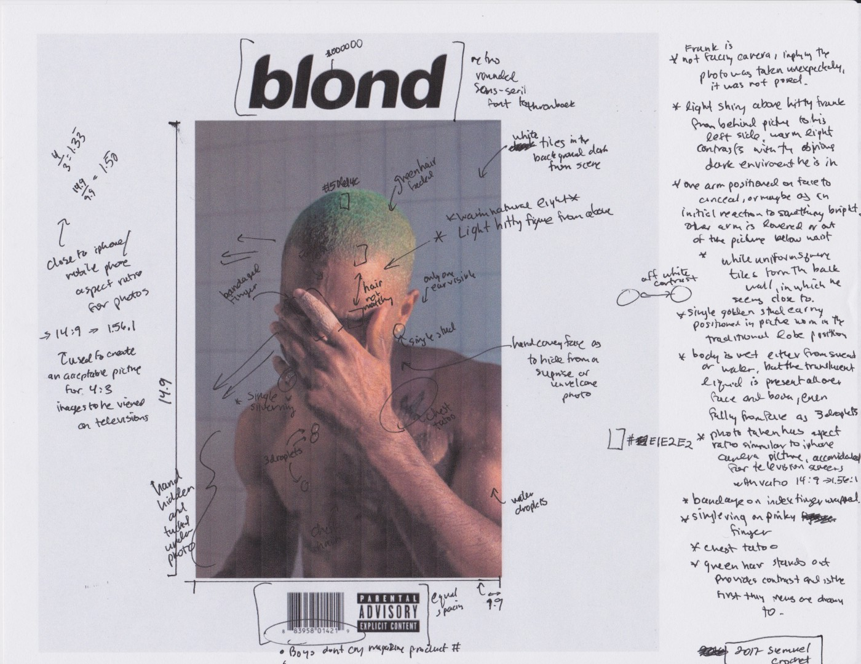
OUR SOLUTION
Analyze songs from ”Fresh Finds” playlists on Spotify
Playlist highlights artists on independent labels
Use album artwork and popularity index of each track
Determine if album art plays a role in track success, and which artwork styles

Slide 5
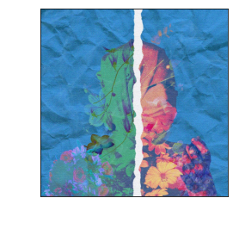
DATA UNDERSTANDING
Popularity index is a calculation between 0-100, with 100 indicating popular
Calculated by total number of plays, and play recency
Album artwork reformatted to be “viewed” by algorithm to predict popularity
An image is matrix of pixel values.
Each pixel is represented as the height and width of a matrix
Depth of matrix represents the Red, Green, Blue values
Album artwork example from Spotify

Slide 6
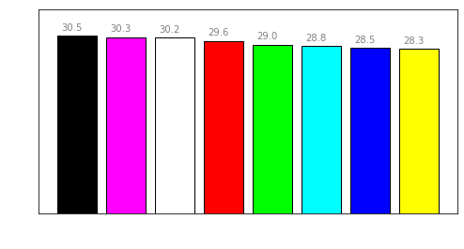
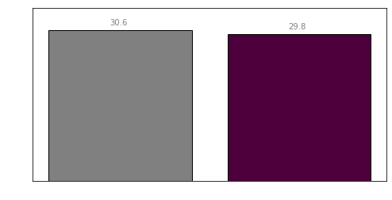
COLOR OF ALBUM ARTWORK DOES NOT INDICATE SIGNIFICANT DIFFERENCES IN POPULARITY
Artwork with black as a dominant color have a slightly higher index than other colors on average
Black-and-white images have a slightly higher average index than colored images
Data source: https://developer.spotify.com/

Slide 7
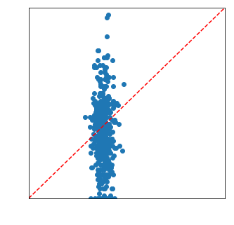
FINAL MODEL SUGGESTS ALBUM ARTWORK DOES NOT PLAY A SIGNIFICANT ROLE IN SPOTIFY POPULARITY
Scatterplot of True vs. Predicted Values
Model was within a 5-point threshold of predicting popularity only 25% of the time.
Generated a Root Mean Squared Error of 12
Model generated a Coefficient of Determination value of 0
artwork explains the popularity index about as efficiently as averaging the popularity index
Data source: https://developer.spotify.com/

Slide 8


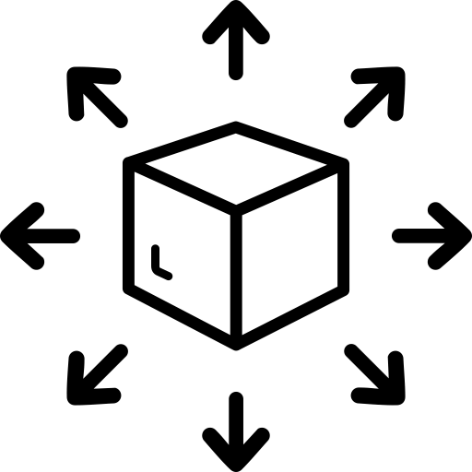
CONCLUSIONS AND NEXT STEPS
Consider allocating resources away from album art creation, as artwork style doesn’t seem to affect popularity on Spotify
Commission a study on album and/or song name to understand naming effect on Spotify popularity
If artwork context is crucial, consider other means of distribution outside of Spotify as users don’t seem engaged with it

Slide 9

Thank you
Sabina Bains
Email: Sabinabains3@gmail.com
LinkedIn: https://www.linkedin.com/in/sabina-bains-a58645a6/

