Slide 1
Predicting track success on spotify using album artwork
SABINA BAINS
October 2022

Slide 2
BUSINESS objective
XX is an upcoming record label preparing to upload artists’ music to Spotify
x
X

Slide 3
Our solution
Pull track data from ”Fresh Finds” playlists on Spotify
Playlist consists of artists represented by lesser known labels
Analyze respective album artwork using Convolutional Neural Networks to train models
Determine if album art plays a role in track success, and if so, which album artwork is predicted to succeed on Spotify
Data source: https://www.kaggle.com/code/anayad/classifying-cyberbullying-tweets/data

Slide 4
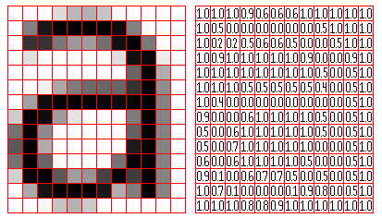
What is a convolutional neural network?

Slide 5
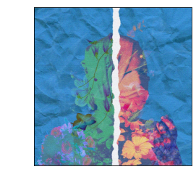
DATA exploration and processing
Album artwork example pulled from Spotify’s new artist playlist
Data used for prediction consists of 1,000 tracks on Spotify’s “Fresh Finds” playlists, which highlights artists on independent labels
Album art, and popularity metric (need to describe this) are pulled from the Spotify API
Album artwork is condensed into numbers to be read into a model.
Data source: https://www.kaggle.com/code/anayad/classifying-cyberbullying-tweets/data

Slide 6
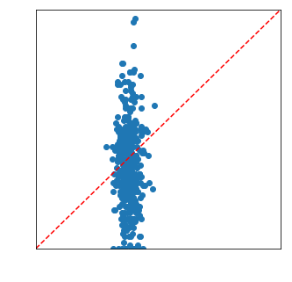
Evaluation of Final model
Scatterplot of True vs. Predicted Values
Our model was within a 5 point threshold of predicting popularity only 25% of the time.
Data source: https://www.kaggle.com/code/anayad/classifying-cyberbullying-tweets/data

Slide 7

Recommendations / next steps
Consider not spending time and money towards creation of album art
x
x

Slide 8
Thank you
Sabina Bains
Email: Sabinabains3@gmail.com
LinkedIn:
https://www.linkedin.com/in/sabina-bains-a58645a6/

