Slide 1
Predicting SONG POPULARITY on spotify using album artwork FOR VISION RECORDS
SABINA BAINS
OCTOBER 2022

Slide 2
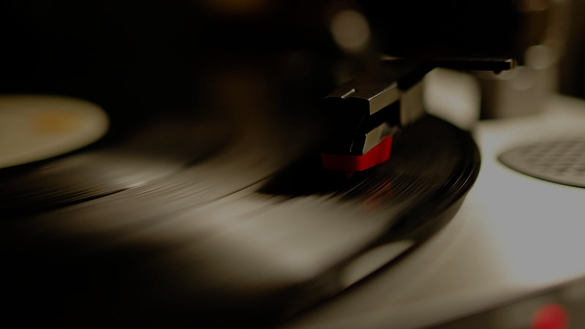
I try to explain that to my kids - the experience of going to a record store, flipping through racks and finding that album cover that intrigues you - but my kids don't want to know about it. They download the one song on the album they like, and pay their 99 cents.
-Jon Bon Jovi

Slide 3
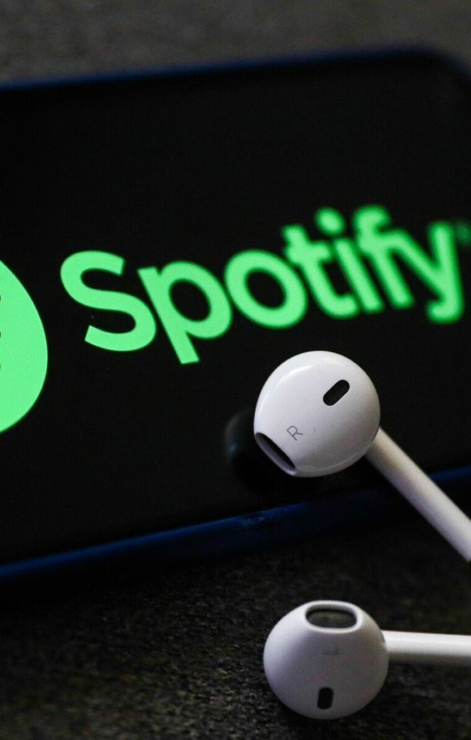
BUSINESS OBJECTIVE
New record label Vision preparing to upload artists’ music to Spotify
Efficiently allocate resources regarding album artwork creation
Understand album artwork styles that resonate with Spotify subscribers

Slide 4
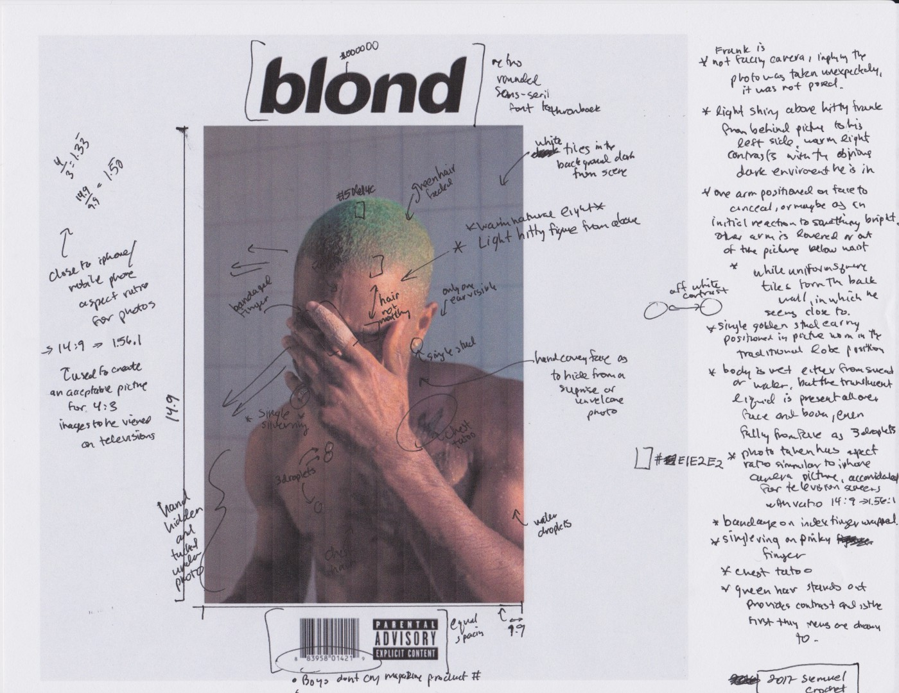
OUR SOLUTION
Analyze songs from ”Fresh Finds” playlists on Spotify
Playlist highlights artists on independent labels
Use album artwork and popularity index of each track
Determine if album art plays a role in track success, and if so which artwork style

Slide 5
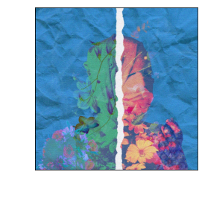
DATA UNDERSTANDING
Popularity index is a calculation between 0-100, with 100 as most popular
Calculated by total number of plays, and play recency
Album artwork reformatted to be “viewed” by algorithm to predict popularity
An image is 3 matrices of pixel values.
Each pixel is represented as the height and width of a matrix
Each matrix represents the Red, Green, Blue values
Album artwork example from Spotify

Slide 6
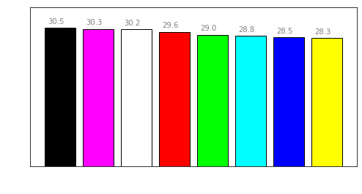
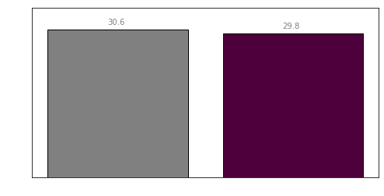
COLOR OF ALBUM ARTWORK DOES NOT INDICATE SIGNIFICANT DIFFERENCES IN POPULARITY
Artwork with black as a dominant color have a slightly higher index than other colors on average
Black-and-white images have a slightly higher average index than colored images
Data source: https://developer.spotify.com/

Slide 7
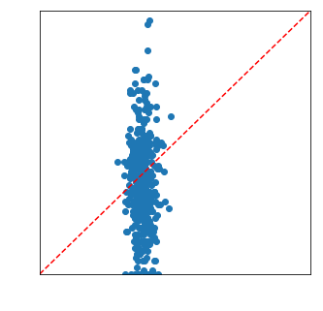
FINAL MODEL SUGGESTS ALBUM ARTWORK DOES NOT PLAY A SIGNIFICANT ROLE IN SPOTIFY POPULARITY
Scatterplot of True vs. Predicted Values
Model did not find any relationship between album artwork and Spotify popularity
Model was within a 5-point threshold of predicting popularity only 25% of the time.
The model generated an R-squared value of 0
album artwork explains the popularity index about as efficiently as averaging the popularity index would
Data source: https://developer.spotify.com/

Slide 8


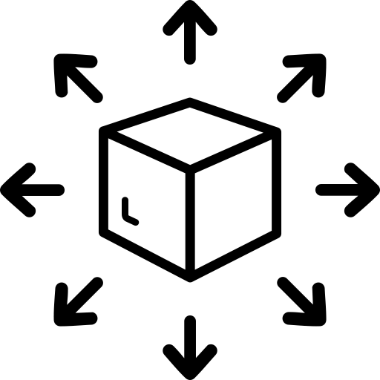
CONCLUSIONS AND NEXT STEPS
Consider reallocating resources away from album art creation, as artwork style doesn’t seem to affect popularity
Commission a study on album and/or song name to understand naming effect on Spotify popularity
If artwork context is crucial, consider other means of distribution outside of Spotify as users don’t seem engaged with it

Slide 9

Thank you
Sabina Bains
Email: Sabinabains3@gmail.com
LinkedIn: https://www.linkedin.com/in/sabina-bains-a58645a6/

