Slide 1
Predicting track success on spotify using album artwork
SABINA BAINS
October 2022

Slide 2
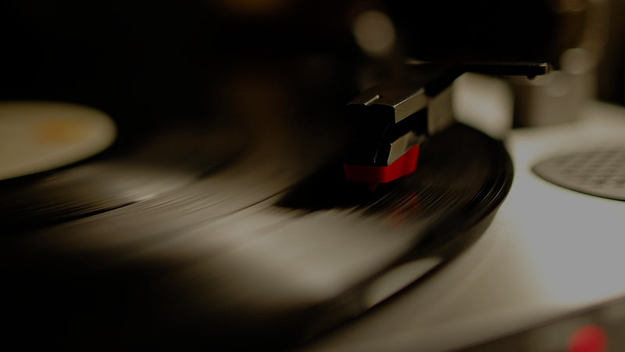
I try to explain that to my kids - the experience of going to a record store, flipping through racks and finding that album cover that intrigues you - but my kids don't want to know about it. They download the one song on the album they like, and pay their 99 cents.
-Jon Bon Jovi

Slide 3
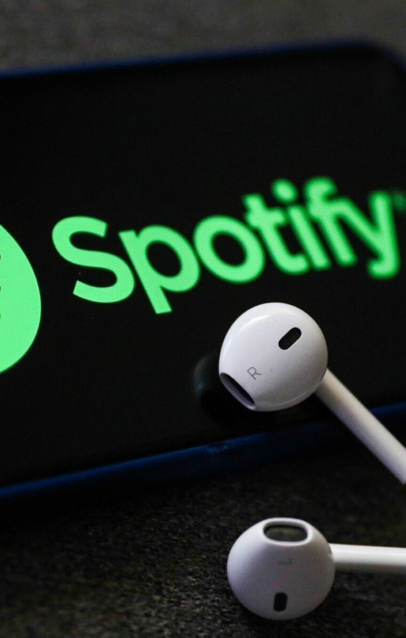
Business Objective
VISION is an upcoming record label preparing to upload artists’ music to Spotify
In preparation of album releases, VISION would like help allocating its resources
The label wants to understand importance of album artwork, and which artwork is most likely to entice Spotify subscribers to explore the full album

Slide 4
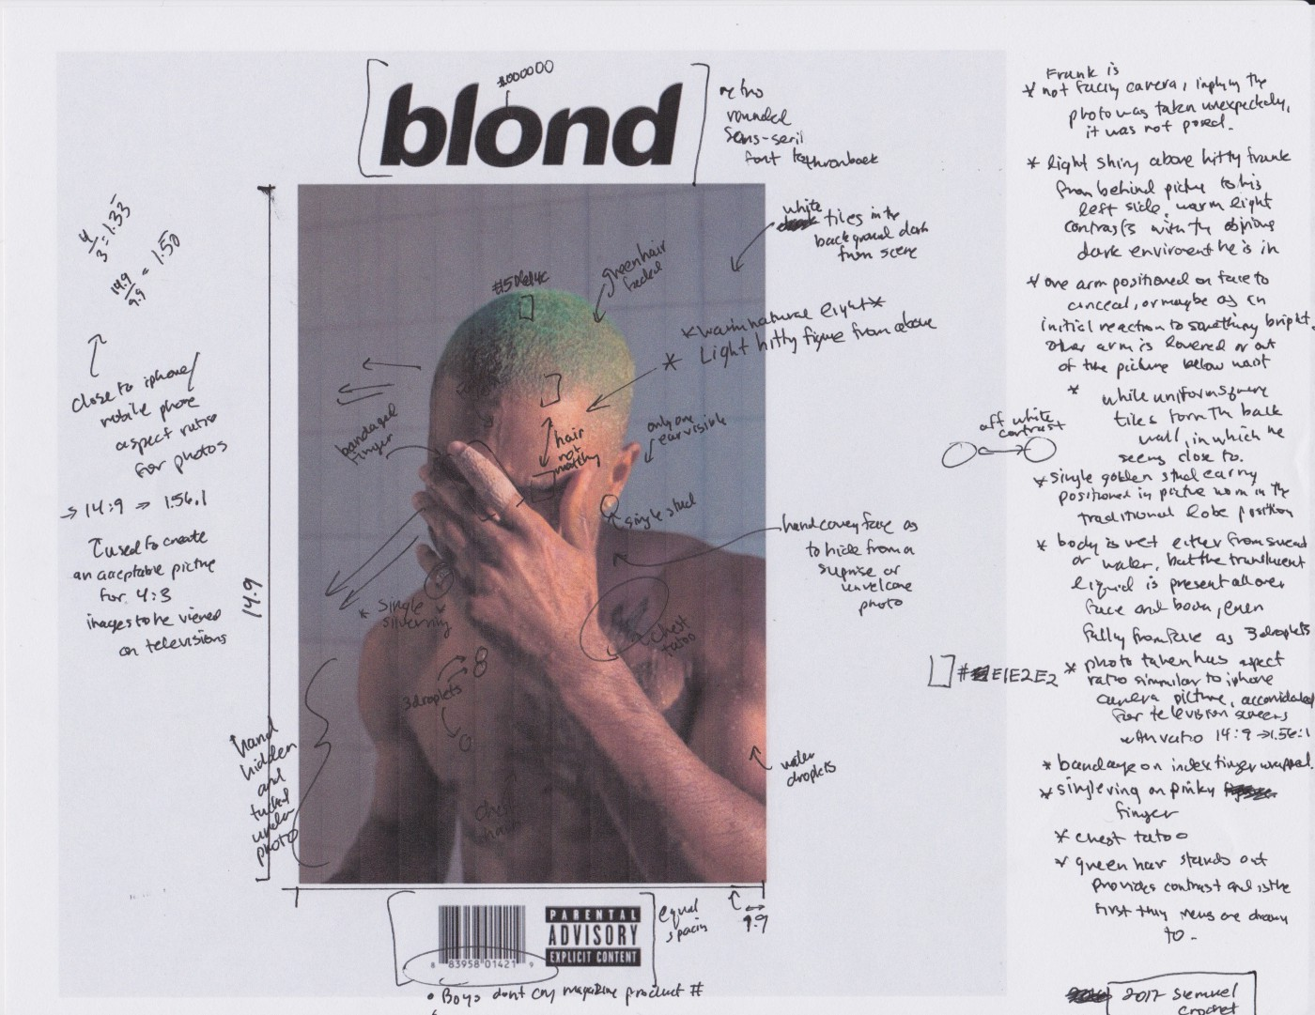
Our solution
# kernel size - tuple, must be odd integer, determines the size of the kernel.
# padding - padding: "valid" means no padding. "same" results in padding with zeros evenly to the left/right or up/down of the input.
# When padding="same" and strides=1, the output has the same size as the input.
# strides: An integer or tuple/list of 2 integers, specifying the strides of the convolution along the height and width.
# Can be a single integer to specify the same value for all spatial dimensions.
Pull track data from ”Fresh Finds” playlists on Spotify
Playlist consists of artists represented by lesser known labels
Analyze respective album artwork using Convolutional Neural Networks to train models
Determine if album art plays a role in track success, and if so, which album artwork is predicted to succeed on Spotify
### 50 is thenumber article - https://www.loudlab.org/blog/spotify-popularity-leverage-algorithm/
# cover art "importance" - https://d4musicmarketing.com/free-cover-art-for-music/
# importance of album artwork - https://www.themicmagazine.co.uk/post/seeing-what-you-hear-the-importance-of-album-artwork

Slide 5
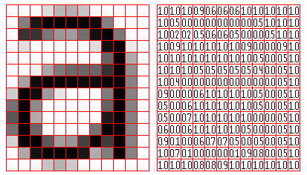
What is a convolutional neural network?
Algorithm with the ability to “see” images.

Slide 6
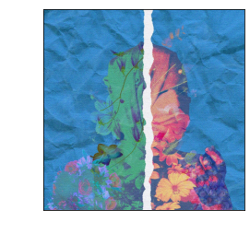
Data Understanding
Album artwork example from Spotify
Data used for prediction consists of XX tracks on Spotify’s “Fresh Finds” playlists
Playlist highlights artists on independent labels
Artwork from track and popularity index are pulled
Popularity index is a calculation between 0-100, with 100 as most popular
Popularity calculated by total number of plays, and play recency
Album artwork reformatted to be “read” by computer
An image is 3 matrices of pixel values.
Each pixel represents a number
Data source: https://www.kaggle.com/code/anayad/classifying-cyberbullying-tweets/data

Slide 7
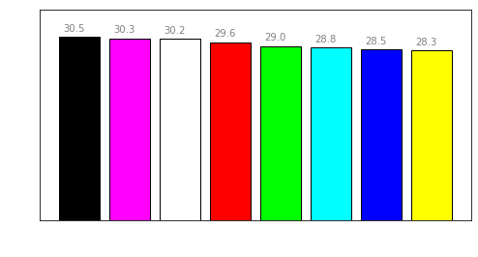
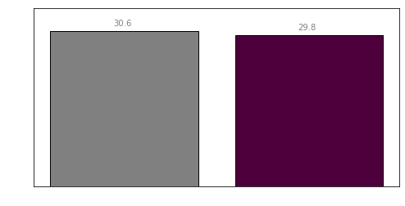
Preliminary Color Analysis
Initial analysis on color does not show significant difference in popularity
Black and White images have a slightly higher index than colored images
Album Art with black as its dominant color have a slightly higher index than other colors on average
Data source: https://www.kaggle.com/code/anayad/classifying-cyberbullying-tweets/data

Slide 8
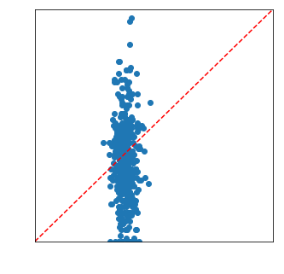
Evaluation of Model
Scatterplot of True vs. Predicted Values
Model did not find any relationship between album artwork and Spotify popularity
Our model was within a 5 point threshold of predicting popularity only 25% of the time.
The model generated an R-squared value of 0, meaning album artwork explains the popularity index about as efficiently as simply averaging the popularity index does
Data source: https://www.kaggle.com/code/anayad/classifying-cyberbullying-tweets/data

Slide 9
Next Steps
Consider reallocating resources away from album art creation
1
Commission a study on album / track name to understand effect on Spotify popularity
2
If artwork is crucial for album, consider other means of distribution outside of Spotify, as users don’t seem engaged with it
3

Slide 10

Thank you
Sabina Bains
Email: Sabinabains3@gmail.com
LinkedIn: https://www.linkedin.com/in/sabina-bains-a58645a6/

