Slide 1
Predicting track success on spotify by album artwork
SABINA BAINS
October 2022

Slide 2
BUSINESS objective
X
X
X

Slide 3
Our solution
Utilize existing tracks on Spotify to train
X
X
Data source: https://www.kaggle.com/code/anayad/classifying-cyberbullying-tweets/data

Slide 4
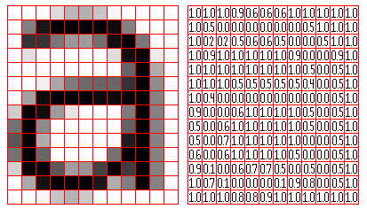
What is a convolutional neural network?

Slide 5
DATA exploration and processing
Frequency Distribution Of Top Words Used in Cyberbullying Tweets
Data used for prediction consists of 1,000 tracks on Spotify’s “Fresh Finds” playlists, which highlights new independent artists
Album art, and popularity metric (need to describe this) are pulled from the Spotify API
Album artwork is condensed into numbers to be inputted into a model.
Put album example here with axes to show pixels.
Data source: https://www.kaggle.com/code/anayad/classifying-cyberbullying-tweets/data

Slide 6
Evaluation of Final model
Matrix of True and Predicted Values
Our model was within a 10 point threshold of predicting popularity 68% of the time
The model was vastly more efficient when taking genre into consideration
Put scatterplot here of true vs. predicted.
Data source: https://www.kaggle.com/code/anayad/classifying-cyberbullying-tweets/data

Slide 7

Recommendations / next steps
Consider allocating resources towards creation of album art
x
x

Slide 8
Thank you
Sabina Bains
Email: Sabinabains3@gmail.com
LinkedIn:
https://www.linkedin.com/in/sabina-bains-a58645a6/

