Slide 1

Predicting CLASSROOM SUCCESS FOR Jump Start ORG.
SABINA BAINS
MARCH 2022

Slide 2

BUSINESS objective
Jump Start aims to help high school students in need find success in the classroom
The organization needs help allocating tutors to students who need them most

Slide 3
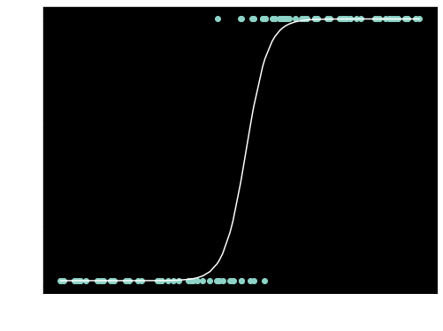
Our solution
Use a classification model to predict students that are at a higher risk of failing
Prioritize tutoring resources to these students the model has predicted
What is Classification?
A model that predicts two outcomes based on existing information
For our model, this would be either passing or failing a course
Which data?
Data source: https://www.kaggle.com/impapan/student-performance-data-set

Slide 4
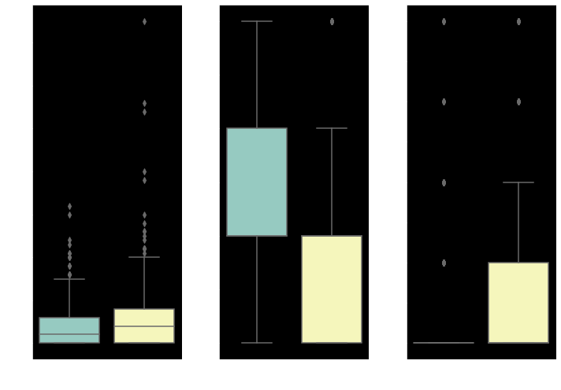
DATA and modeling
Data used for prediction is from 1044 students from multiple high schools in Portugal
Information on parent involvement and careers
Student extracurricular activities and time spent
Data source: https://www.kaggle.com/impapan/student-performance-data-set

Slide 5
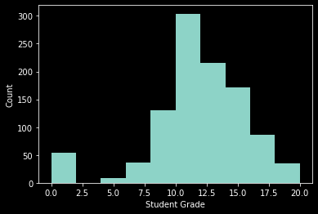
Modeling
Distribution of Grades
Grades are recoded to a binary outcome based on whether students pass or fail their courses (scoring less than 12 is considered failing)
Our model
students with more absences are 45.0% more likely to fail
students with more hours spent going out are 31.8% more likely to fail
students with who do not have a desire for higher education are 28.6% more likely to fail
Data source: https://www.kaggle.com/impapan/student-performance-data-set

Slide 6
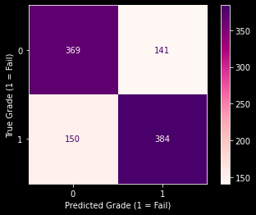
Evaluation
Matrix of True and Predicted Grades
Overall, our model correctly predicted students who passed and those who failed 72.1% of the time.
Out of all the students who did fail, our model correctly predicted 71.9% of them
While the model is much more accurate than just predicting through random chance, there is room for improvement
Data source: https://www.kaggle.com/impapan/student-performance-data-set

Slide 7


RECOMMENDATIONS
Look at the strongest attributes
x
x

Slide 8
Next steps
Work with school districts to distribute surveys prior to the school year with effective attributes
Run new data through model to predict which students are at risk of failing and assign tutors
Continue to gather data to further improve survey and predictions

Slide 9
Thank you
Sabina Bains
Email: SabinaBains3@Gmail.com
LinkedIn:
https://www.linkedin.com/in/sabina-bains-a58645a6/

