Slide 1
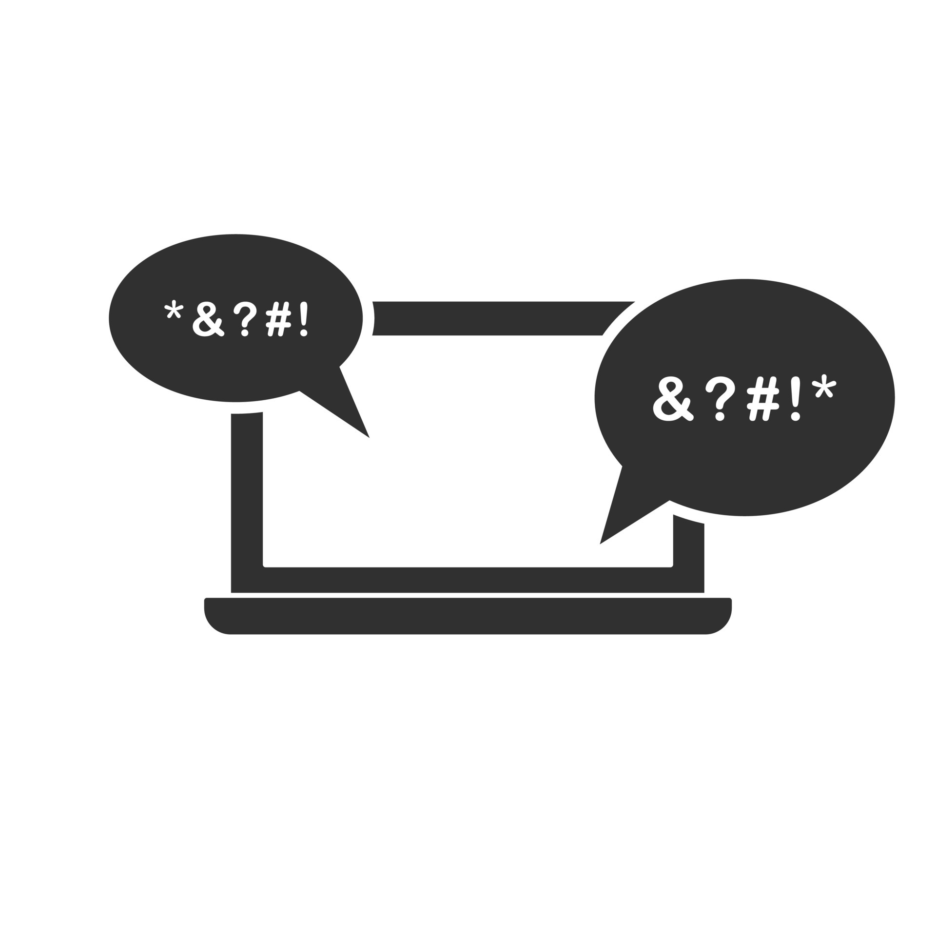
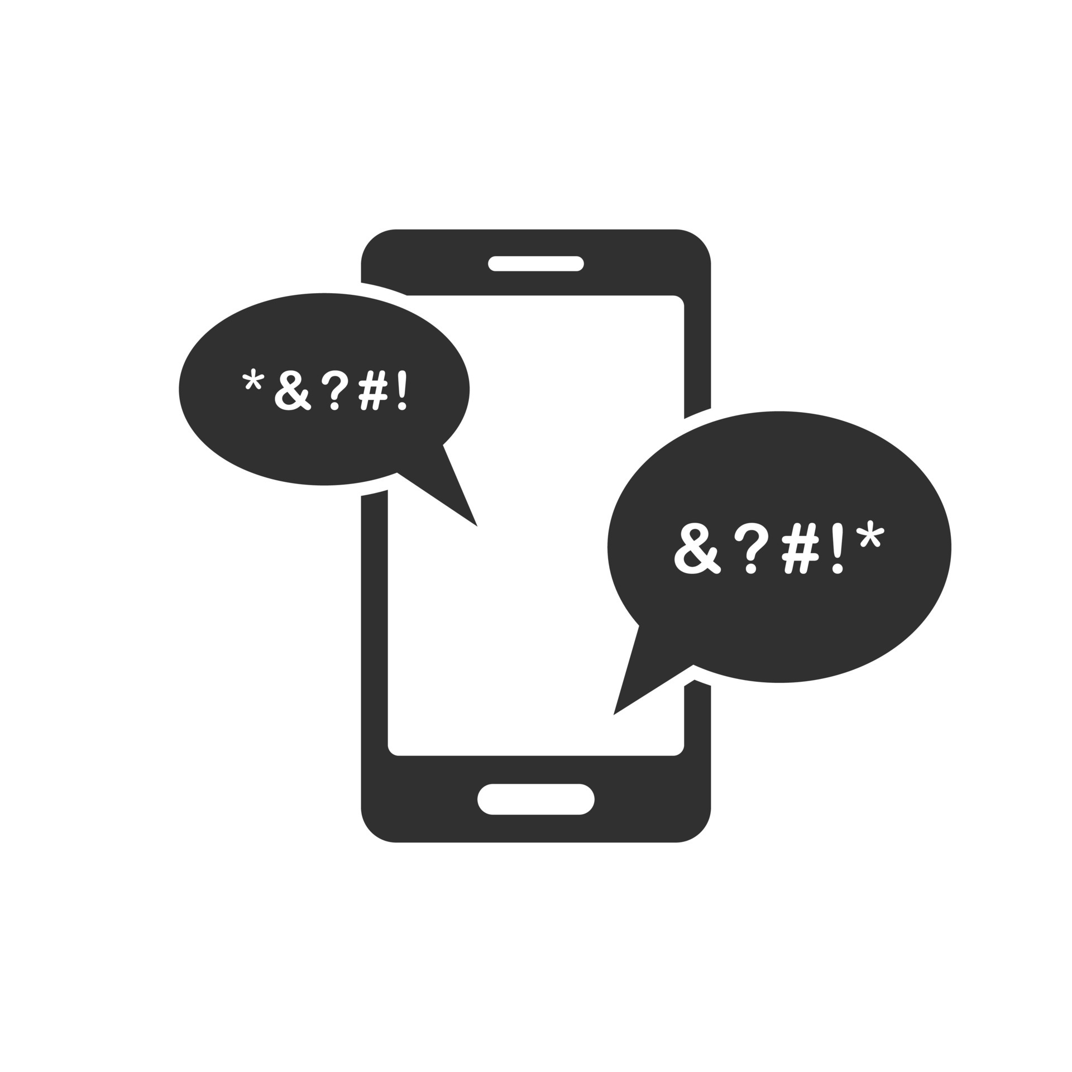
FLAGGING CYBERBULLYING on twitter for Kind inc.
SABINA BAINS
July 2022

Slide 2
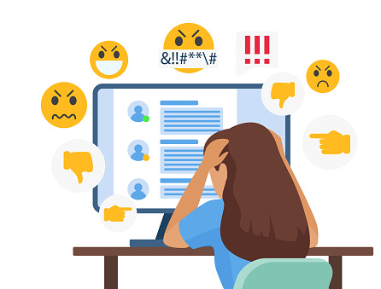
BUSINESS objective
With the possibility of Twitter removing it’s moderating practices, many fear incidents of hate speech and misinformation will skyrocket
Kind Inc. would like to create a browser extension with the ability to flag potentially harmful tweets
Kind Inc. needs our help creating an algorithm that will accurately flag instances of cyberbullying in tweets

Slide 3
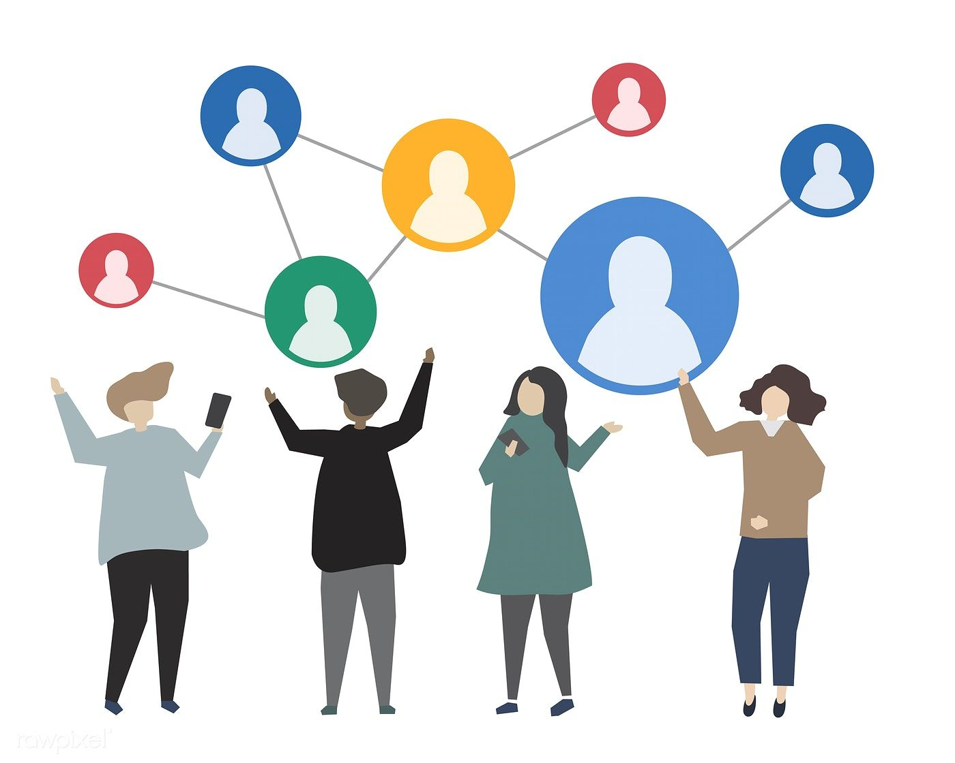
Our solution
Use a supervised learning approach
Utilizing real tweets that have already been manually flagged by type of cyberbullying
Alter the data due to Natural Language Processing , which gives computers the ability to understand text and spoken words in much the same way human beings can.
Train dataset using Neural Networks, algorithm inspired by the biological neural networks that constitute the human brain
Data source: https://www.kaggle.com/code/anayad/classifying-cyberbullying-tweets/data

Slide 4
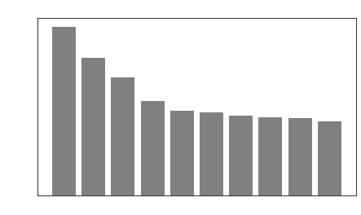
DATA exploration and processing
Data used for prediction consists of 47K tweets labeled according to the class of cyberbullying:
Age
Ethnicity
Gender
Religion
Other type of cyberbullying
Not cyberbullying
Because this analysis requires Natural Language Processing, we must standardize the words in each tweet
For example, bully and bullying will becoming “bully”
xx
Frequency Distribution
Data source: https://www.kaggle.com/code/anayad/classifying-cyberbullying-tweets/data

Slide 5
DIFFERENCES BY CYBERBULLYING TYPE
xxx
Data source: https://www.kaggle.com/code/anayad/classifying-cyberbullying-tweets/data

Slide 6
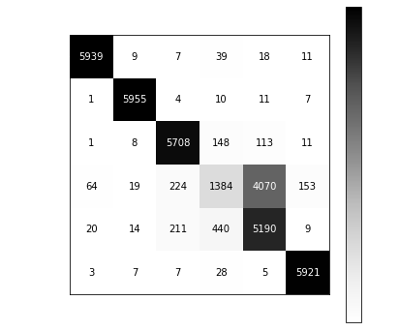
Evaluation of model
Matrix of True and Predicted Values
Overall, our model predicted the correct label 82% of the time
While our different classifications of bullying performed well, the model had a difficult time classifying ”other” types of cyberbullying with non-bullying
This model correctly predicted non-bullying tweets 31% of the time, most were incorrectly predicted as “other”
Data source: https://www.kaggle.com/code/anayad/classifying-cyberbullying-tweets/data

Slide 7
Recommendations / next steps
Work with school districts to distribute surveys prior to the school year with these attributes
Add feature to flag fake news
Cyberbullying not related to age, race, gender, religion is hard to identify, and often time

Slide 8
Thank you
Sabina Bains
Email: Sabinabains3@gmail.com
LinkedIn:
https://www.linkedin.com/in/sabina-bains-a58645a6/

