Slide 1
Introduction to Kubernetes
Kubernetes

Slide 2
Course Objectives
In this module, you will learn:
What and Why of Kubernetes
Architecture Components
Kubernetes deployment options
Setting up Minikube

Slide 3
What & Why of Kubernetes?
Introduction to Kubernetes

Slide 4
What is Kubernetes?
Kubernetes is an open-source container orchestration system
Typical use case involves a containerized application running on a cluster of machines
Extremely popular and active open-source project
Originally developed by Google to run Google’s data centres
Designed to operate at Google scale
Proven and tested running Google’s applications
Donated to the Cloud Native Computing Foundation in 2015

Slide 5
Managed Kubernetes Service
Kubernetes has wide support from cloud vendors including:
Google Kubernetes Engine (GKE)
AWS Elastic Kubernetes Service (EKS)
Microsoft Azure Container Service (AKS)
Red Hat OpenShift
Managed Kubernetes services typically provide:
Automated cluster creation and maintenance
Clusters implemented as a collection of VMs
Very simple creation using a web console or command line

Slide 6
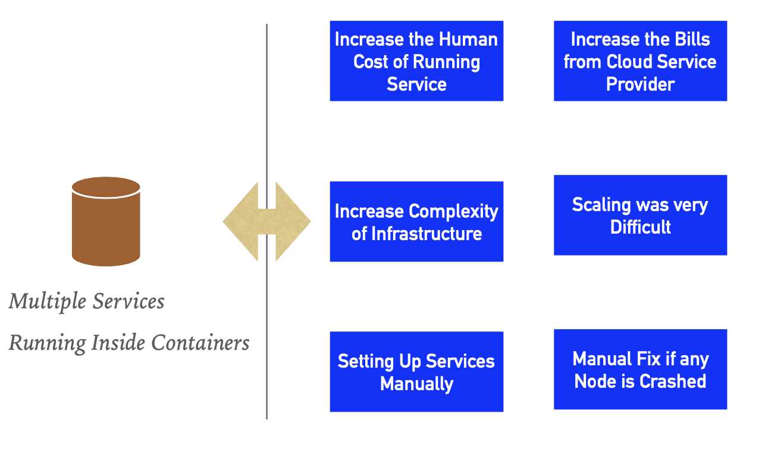
Challenges without Orchestration

Slide 7
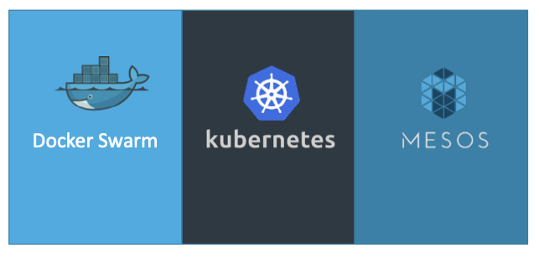
Orchestration Technologies

Slide 8
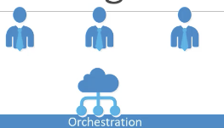
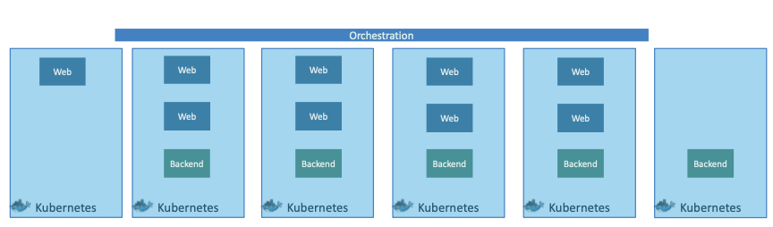
Kubernetes Advantage
Automated Scheduling
Healing Capabilities
Rolling Upgrades & Rollback
Horizontal Scaling
Run Anywhere

Slide 9
Architecture
Introduction to Kubernetes

Slide 10
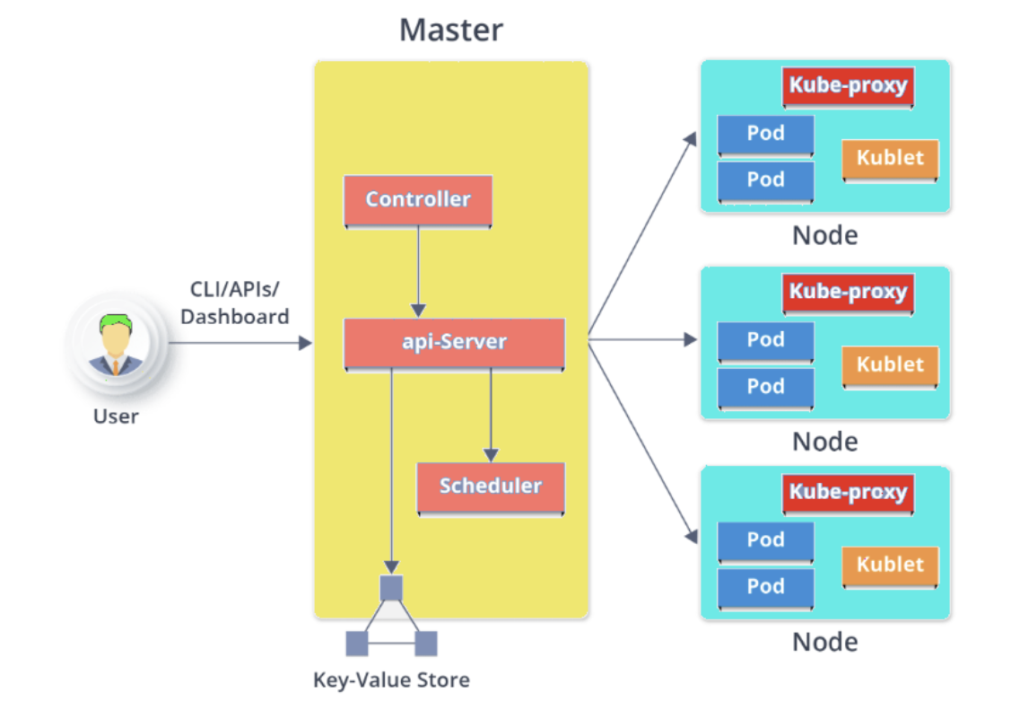
Architecture Components

Slide 11
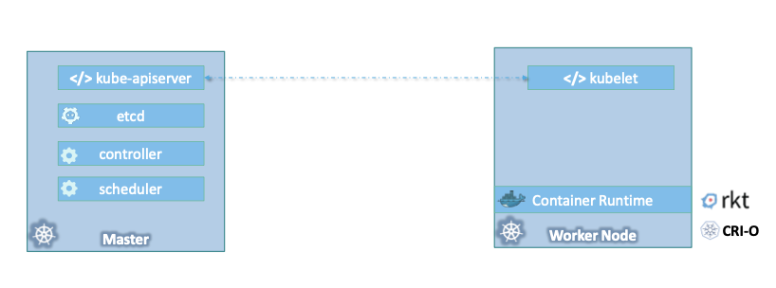
Master vs. Worker Node

Slide 12
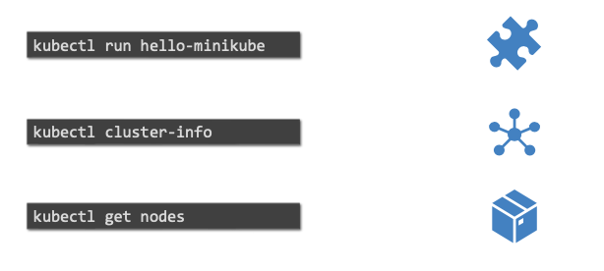
kubectl

Slide 13
Worker Node
Worker Node : It’s a physical server or you can say a VM which runs the applications using Pods.
Worker nodes contain all the necessary services to manage the networking between the containers, communicate with the master node, and assign resources to the scheduled containers.

Slide 14
Worker Node - Kubelet
Kubelet : It is an agent which communicates with the Master node and executes on worker nodes.
Kubelet gets the PodSpec configuration of a Pod from the API server and ensures that the described containers are up and running and are healthy.
It talks to the Docker daemon using the API over the Docker socket to manipulate containers lifecycle
It then reports back to the API Server the status of changes regarding those pods.
The Kubelet ships with built-in support for cAdvisor, which collects, aggregates, processes and exports metrics (such as CPU, memory, file and network usage) about running containers on a given node.
It role is to Retrieve container metrics from cAdvisor, aggregate and expose them through the Kubelet Summary API
The kubelet doesn't manage containers which were not created by Kubernetes.

Slide 15
Worker Node - Pods
Pods : Is a group of one or more containers with shared storage/network, and a specification for how to run the containers.
The smallest and simplest unit in the Kubernetes object model that you create or deploy.
Pods run on nodes and run together as a logical unit.
Single Pod can Run on Multiple Machines and Single Machine can Run Multiple Pods.
Each pod has a unique IP address assigned to it.
If a pod is running multiple containers, then the containers can communicate with each other using localhost. When they have to communicate outside the Pod, they expose a port.

Slide 16
Worker Node – Kube-Proxy
Kube-Proxy : Kube-proxy runs on each node to deal with individual host sub-netting and ensure that the services are available to external parties.
Kube-proxy acts as a network proxy and a load balancer for a service on a single worker node.
It is the network proxy which runs on each worker node and listens to the API server for each Service endpoint creation/ deletion.

Slide 17
Master Node
Kubernetes follow the Master - Slave(Worker) Node Architecture.
Master Node : Responsible for the management of Kubernetes cluster. It is mainly the entry point for all administrative tasks.
More than One Master Nodes be the there in Kubernetes Cluster.
In Multi Master Node System, Single Master node will be commanding Node for own workers and other Masters too.

Slide 18
Master Node – API Server, etcd
API Server : API server is the entry point for all the REST commands used to control the cluster.
Main Master Node uses etcd to manage the Workers and Other Master Nodes.
Stores the state of the cluster in the distributed key-value store.
Can be a part of Kubernetes Master or can be configured externally
It is mainly used for shared configuration and Service Discovery

Slide 19
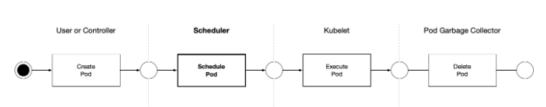
Master Node – Scheduler
Scheduler : Schedules the work in the form of Pods and Services
The Kubernetes Scheduler is a core component of Kubernetes: After a user or a controller creates a Pod, the Kubernetes Scheduler, monitoring the Object Store for unassigned Pods, will assign the Pod to a Node.
Then, the Kubelet, monitoring the Object Store for assigned Pods, will execute the Pod.

Slide 20
Master Node - Controller
Controller : Regulates the Kubernetes cluster which manages the different non-terminating control loops.
Controller watches the desired state of the objects it manages and watches their current state through the API server.
If the current state of the objects it manages does not meet the desired state, then the control loop takes corrective steps to make sure that the current state is the same as the desired state.
Performs lifecycle functions such as namespace creation, event garbage collection, node garbage collection, etc.

Slide 21
Setting up Kubernetes
Setting up Kubernetes

Slide 22
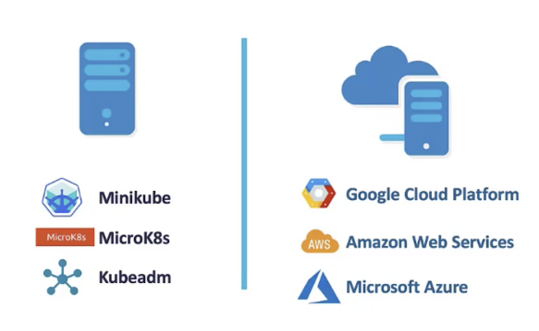
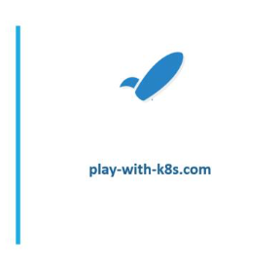
Setup Kuberetes

Slide 23
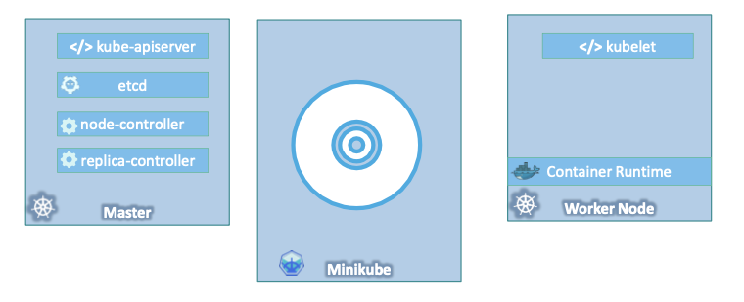
Minikube

Slide 24
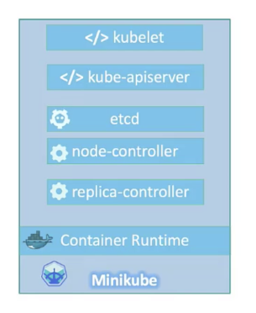
Minikube

Slide 25

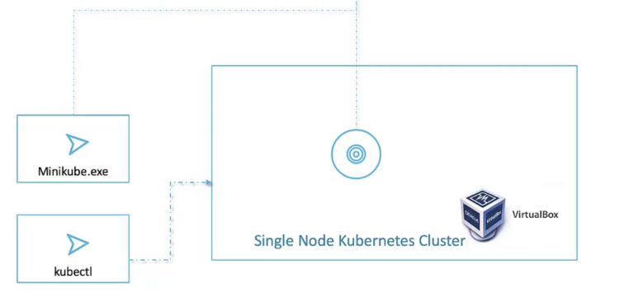
Minikube

Slide 26
Minikube - I
Minikube is a free, open-source tool for running a Kubernetes cluster locally
Runs on Linux, Mac, and Windows
Useful for proof of concept, development, and testing
Minikube is installed on the classroom VMs
Execute the following command to start a Minikube cluster:
Be sure to stop the Minikube cluster when it is no longer needed
It takes up resources and will cause other programs to run slower
$ minikube start
$ minikube stop //next start will begin where you left off
$ minikube delete –all //next start will be totally clean

Slide 27
Minikube - II
To get the Minikube pod status across all namespaces, execute:
Once all the Minikube services are running, we can prove that it works
Execute the following commands to run a standard hello world example:
$ kubectl get pods -A
$ kubectl create deployment hello-minikube \
--image=k8s.gcr.io/echoserver:1.4
$ kubectl expose deployment hello-minikube \
--type=NodePort --port=8080
$ kubectl get services hello-minikube
$ minikube service hello-minikube
$ minikube delete --all

