Slide 1
Running Applications
Kubernetes

Slide 2
Course Objectives
In this module, you will learn:
Pods
Replica-sets
Deployments
Services

Slide 3
Pods
Running Applications

Slide 4
Pods
Pods are the smallest unit of deployment
Usually pods represent a single container
But there are certain use cases where we may need one pod to have more than one containers.

Slide 5
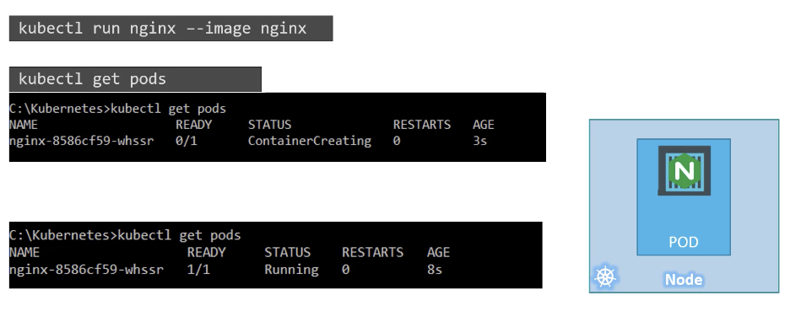
Create Pods using kubectl

Slide 6
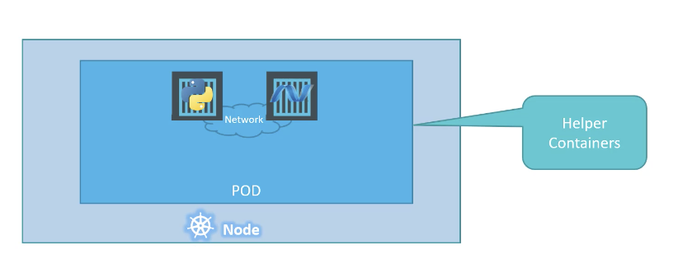
Multi-Container PODs

Slide 7
Creating Pods with YAML
Running Applications

Slide 8

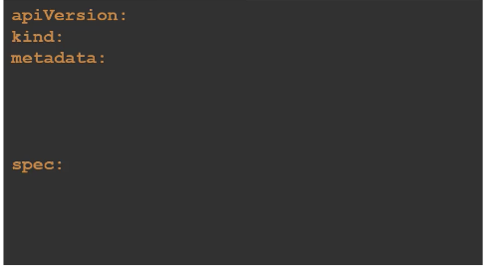
YAML in Kubernetes - Structure

Slide 9
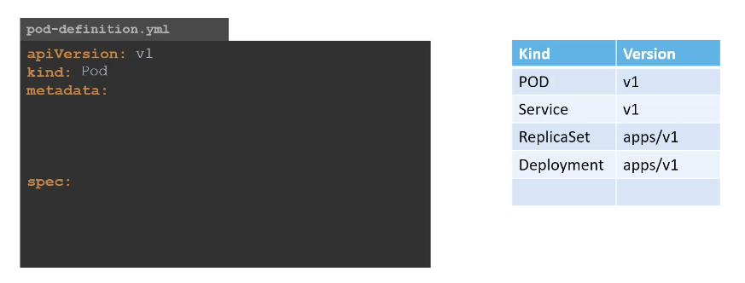
YAML in Kubernetes

Slide 10
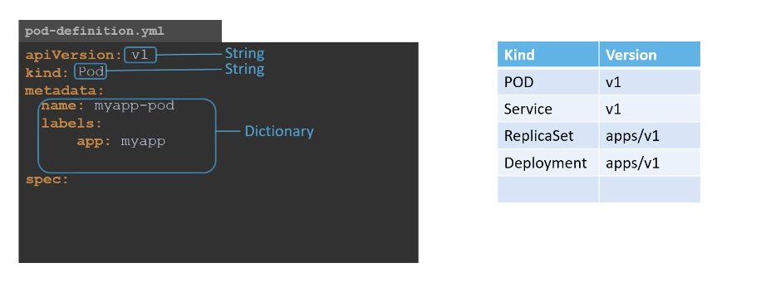
YAML in Kubernetes

Slide 11
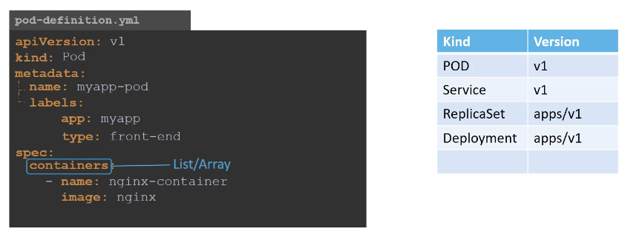
YAML in Kubernetes

Slide 12
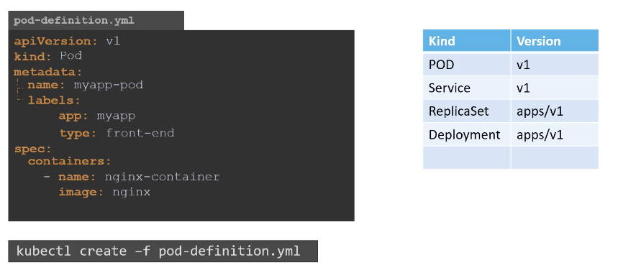
YAML in Kubernetes

Slide 13
Replica Set
Running Applications

Slide 14
Kubernetes Terms
Replication controllers are used to create multiple instances of a pod
Guarantee pods are healthy and the right number exist
It replaces any pod that fails
cluster
master
node
node
node
kubectl
API Server
kubelet
kubelet
kubelet
Pod
etcd
X
Pod
Pod
Pod

Slide 15
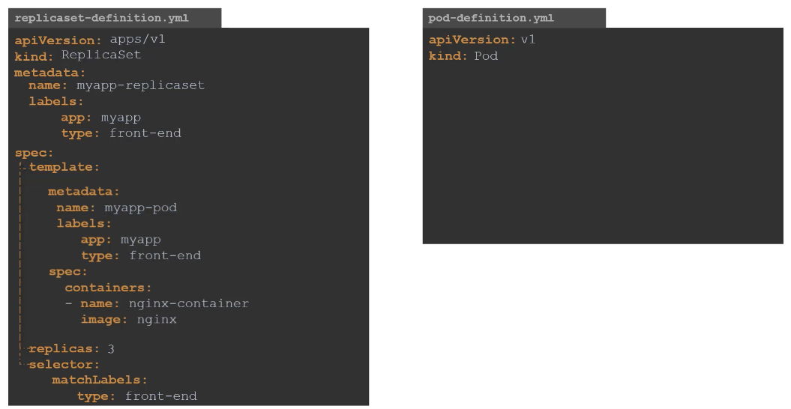




Slide 16
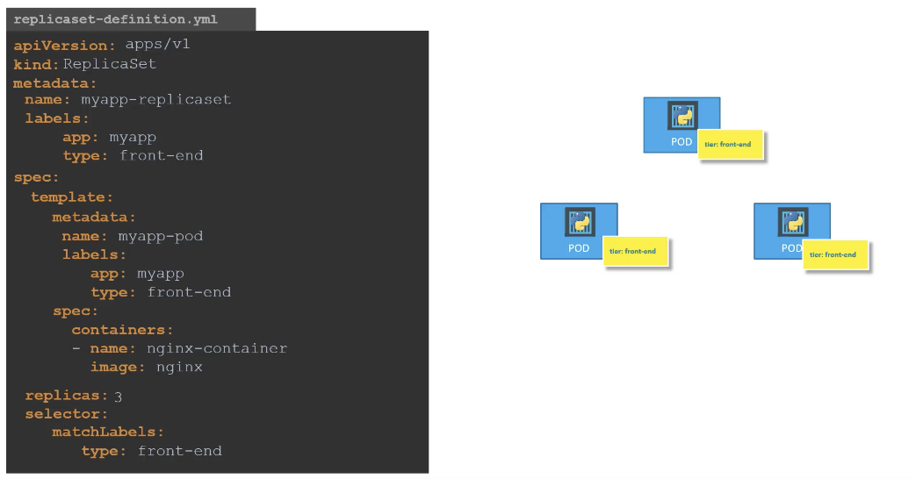
Labels & Selectors

Slide 17
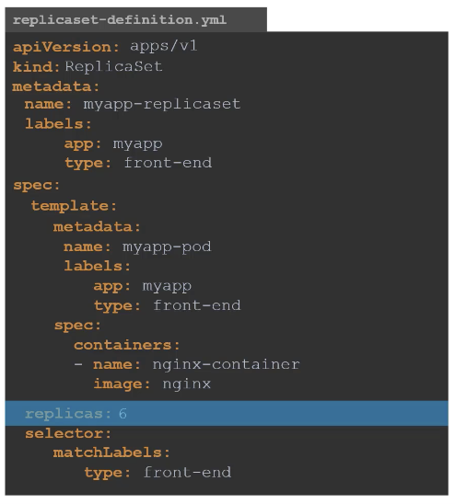


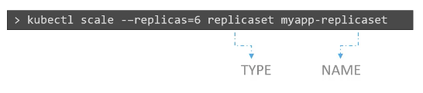
Scaling in Replica Set

Slide 18
Commands

Slide 19
Deployments
Running Applications

Slide 20
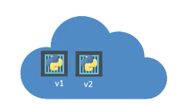
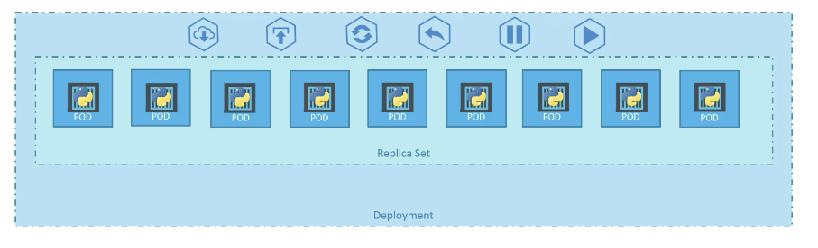
Understanding Deployments

Slide 21
Kubernetes Deployments
Deployments are configurations that define service resources
Use kubectl to send config files to the master
Can also send individual commands using kubectl, i.e.
kubectl create deployment hello-server --image=gcr.io/myproject/events:1.0
The master then decides how to deploy the pods
cluster
master
node
node
node
kubectl
API Server
kubelet
kubelet
kubelet
etcd
Pod
Pod
Pod

Slide 22
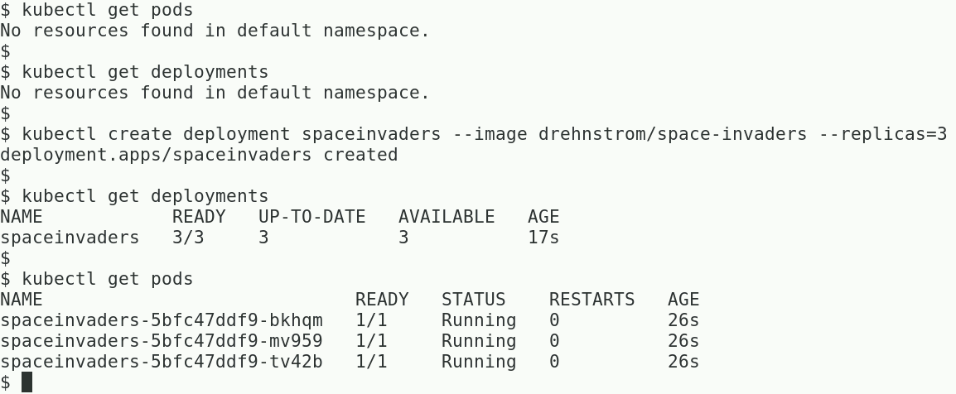
kubectl create deployment
Deployments support declarative management of applications
For the following, Minikube should be running

Slide 23
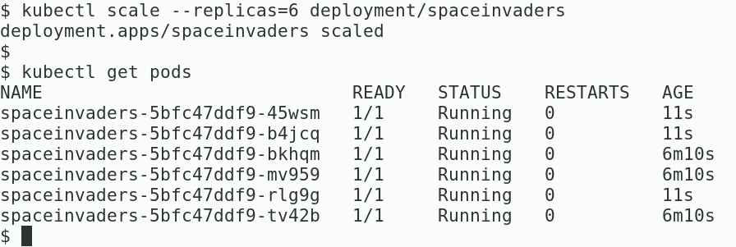
Use kubectl scale to Add Instances

Slide 24
Deployments Combine Pods with Replica Sets
apiVersion: apps/v1beta1 kind: Deployment metadata: name: devops-deployment labels: <Some code omitted to save space> spec: replicas: 3 selector: <Some code omitted to save space> template: <Some code omitted to save space>
spec: containers: - name: devops-demo image: drehnstrom/devops-demo:latest ports: - containerPort: 8080
Kind of resource: Deployment
We want 3 replicas of the pod
This spec defines the pod. The same as the Pod configuration.

Slide 25
Can Control the Resources Your Pods require and are allowed to consume
apiVersion: apps/v1
kind: Deployment
***CODE OMITTED FOR SPACE ***
spec:
containers:
- name: devops-demo
image: drehnstrom/devops-demo:latest
ports:
- containerPort: 8080
resources:
requests:
memory: "256Mi"
cpu: "0.1"
limits:
memory: "512Mi"
cpu: "0.5"
The minimum amount of resources required for each pod
The maximum amount of resources a pod is allowed to consume

Slide 26
Creating a Deployment from a Configuration File
Deploy a service based on a configuration file
Show the running pods
Show all the deployments
Show details of a deployment
kubectl apply -f kubernetes-config.yaml
kubectl get pods
kubectl get deployments
kubectl describe deployments devops-deployment

Slide 27
Creating an Autoscaler
To dynamically scale up and down, create an autoscaler
Specify min and max number of pods and some metric to monitor
kubectl autoscale deployment devops-deployment --min=5 --max=10 --cpu-percent=60

Slide 28
Adding the Autoscaler to Configuration
apiVersion: autoscaling/v1
kind: HorizontalPodAutoscaler
metadata:
name: devops-autoscaler
spec:
scaleTargetRef:
apiVersion: apps/v1beta1
kind: Deployment
name: devops-deployment
minReplicas: 3
maxReplicas: 10
metrics:
- type: Resource
resource:
name: cpu
targetAverageUtilization: 60

Slide 29
Deleting Deployments and Resources
Use the delete command to destroy anything previously created
Specifying a configuration file will delete everything created from it
Can also delete resources individually when created at the command line
kubectl delete -f kubernetes-config.yaml
kubectl delete hpa devops-autoscaler
kubectl delete services devops-loadbalancer

Slide 30
Deployments – Updates & Rollback
Running Applications

Slide 31
Rolling Updates
Cloud services typically have multiple instances behind a load balancer
Multiple replicas of a pod in a Kubernetes cluster
Rolling deployments update instances incrementally
One at a time, 10% at a time, etc.
Allows services to be updated with no downtime
Supported by managed instance groups
Supported by Kubernetes using the apply command
Simply change the container image and re-apply the configuration
Can also roll back the update

Slide 32
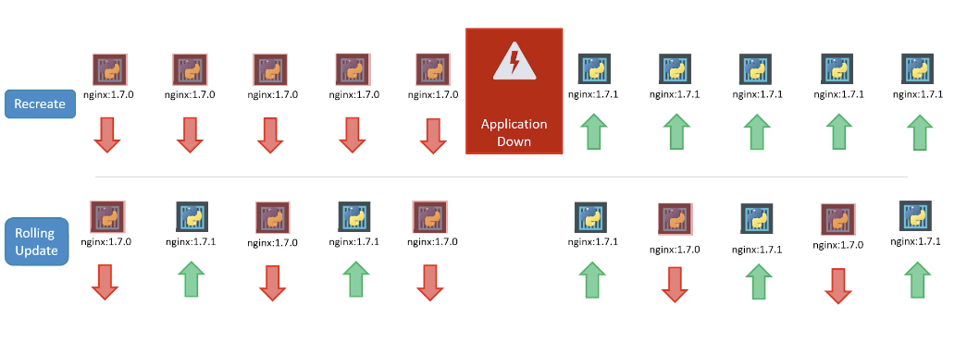
Deployment Strategy

Slide 33
Rolling Update with Kubernetes
Initially a deployment creates a single ReplicaSet
Deployment
ReplicaSet - version 1
Pod
Pod
Pod
Service

Slide 34
Rolling Update with Kubernetes (continued)
When a container update is applied
A new ReplicaSet is created in the same deployment
Deployment
ReplicaSet - version 1
ReplicaSet - version 2
Pod
Pod
Pod
Pod
Service

Slide 35
Rolling Update with Kubernetes (continued)
A pod in the old ReplicaSet is deleted
Deployment
ReplicaSet - version 1
ReplicaSet - version 2
Pod
Pod
Pod
Service

Slide 36
Rolling Update with Kubernetes (continued)
This is repeated
Deployment
ReplicaSet - version 1
ReplicaSet - version 2
Pod
Pod
Pod
Pod
Service

Slide 37
Rolling Update with Kubernetes (continued)
This is repeated
Deployment
ReplicaSet - version 1
ReplicaSet - version 2
Pod
Pod
Pod
Service

Slide 38
Rolling Update with Kubernetes (continued)
Until all pods have been updated
Deployment
ReplicaSet - version 1
ReplicaSet - version 2
Pod
Pod
Pod
Service

Slide 39
Blue/Green Deployment
Allows new revisions to be deployed with less risk and no downtime
There are two copies of the production environment
Blue environment is taking requests
Green environment is idle
When deploying a new version:
Update new version to green environment leaving the blue environment in place
Test the green environment
When testing is complete, move the workload to the green environment
Green is now blue; can turn the old environment off
Blue/green deployments also make rolling back to old versions easy

Slide 40
Blue/Green Deployments in Kubernetes
Service routes all traffic to one version
Deployment
Deployment
ReplicaSet - version 1 “blue”
ReplicaSet - version 2 “Green”
Pod
Pod
Pod
Pod
Pod
Pod
Service

Slide 41
Blue/Green Deployments in Kubernetes (continued)
Can switch the version quickly
Deployment
Deployment
ReplicaSet - version 1 “blue”
ReplicaSet - version 2 “Green”
Pod
Pod
Pod
Pod
Pod
Pod
Service

Slide 42
Canary Releases
A new version of a service is put into production alongside old versions
A small subset of select traffic is routed to the canary release
Canary releases help developers know how a new version will perform
Canary releases are easy to pull back if they fail their testing
Deployment
Deployment
ReplicaSet - version 1
ReplicaSet - ”canary”
Pod
Pod
Pod
Pod
Pod
90% of traffic
10% of traffic
Service

Slide 43
Canary Release in Kubernetes
apiVersion: v1
kind: Service
metadata:
name: devops-loadbalancer
labels:
app: devops
tier: frontend
spec:
type: LoadBalancer
ports:
- port: 80
targetPort: 8080
selector:
app: devops
tier: frontend
Services use selectors to determine what pods to route traffic to.
Create a new deployment with a new container, but use the same labels as the current deployment.
If the current deployment has 3 replicas and the new deployment has 1, then the new deployment gets about 25% of the traffic.
More advanced control possible with an Ingress controller or a service mesh (Istio)
Outside the scope of this discussion

Slide 44
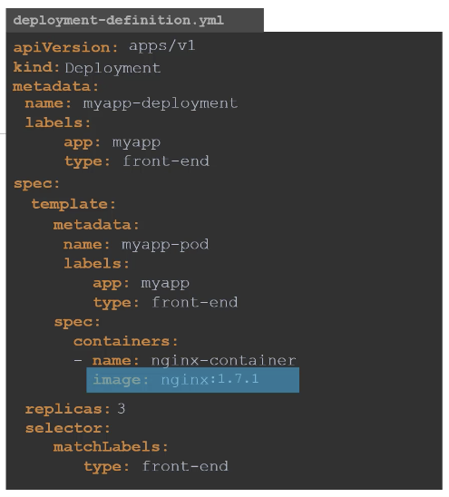


Kubectl apply

Slide 45
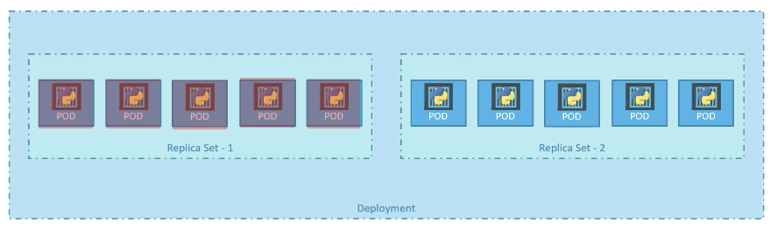
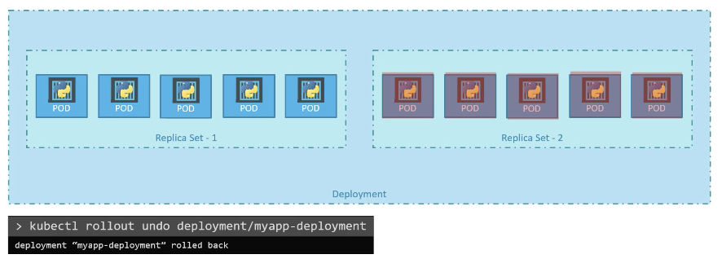
Rollback

Slide 46
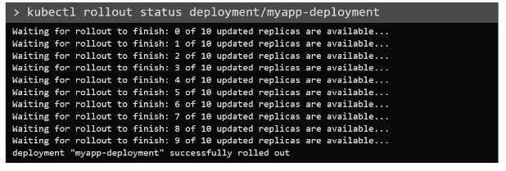
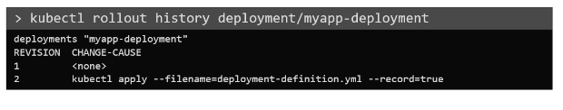
Rollout Command

Slide 47
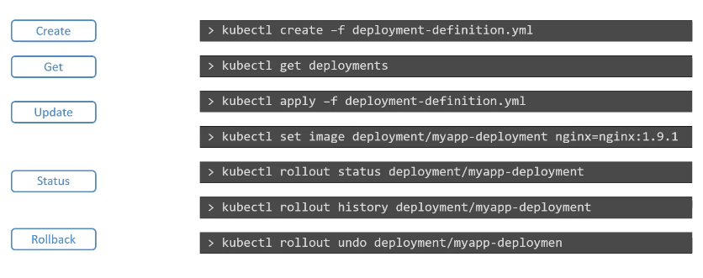
Commands

Slide 48
Services
Running Applications

Slide 49
Types of Services
ClusterIP | The default service type. Has only an internal IP address that is only accessible by other services running inside the cluster.
LoadBalancer | A service that provides an external IP address. In Google Cloud, this is implemented as a TCP load balancer. In AWS, this is implemented as an Elastic Load balancer. Not all Kubernetes deployments would support this type of service. Can be expensive if you have lots of services, which means lots of load balancers.
NodePort | Assigns a port between 30000 and 32767 to nodes in your cluster. When a node is accessed at that port, it routes to your service.

Slide 50
Types of Services (continued)
A single application can have multiple services
cluster
master
node
node
node
API Server
Frontend service
Frontend Deployment
etcd
Pod
Pod
Pod
Backend service
Backend Deployment
Pod
Pod

Slide 51
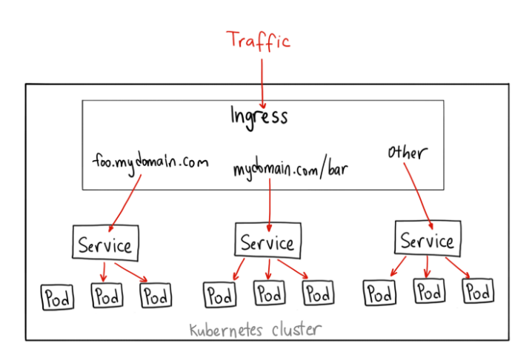
Ingress
Ingress is NOT a type of service.
Instead, it sits in front of multiple services and act as a “smart router” or entrypoint into your cluster.
The default GKE ingress controller will spin up a HTTP(S) Load Balancer for you.
This will let you do both path based and subdomain based routing to backend services.
For example, you can send everything on foo.yourdomain.com to the foo service, and everything under the yourdomain.com/bar/ path to the bar service.

Slide 52
Ingress
When would you use this?
Ingress is the most useful if you want to expose multiple services under the same IP address, and these services all use the same L7 protocol (typically HTTP).
You only pay for one load balancer if you are using the native GCP integration, and because Ingress is “smart” you can get a lot of features out of the box (like SSL, Auth, Routing, etc)

Slide 53
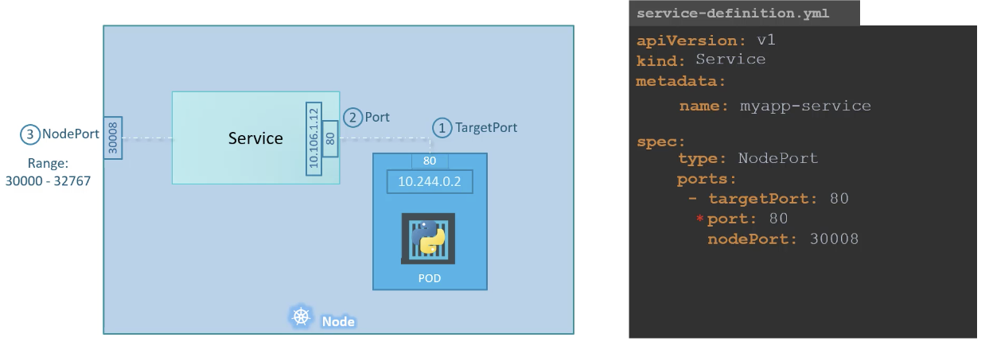
Service - NodePort

Slide 54
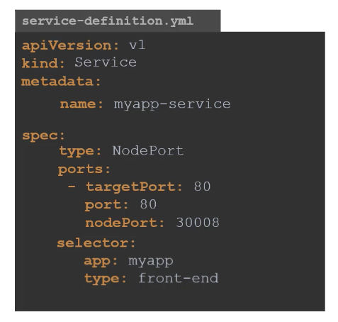

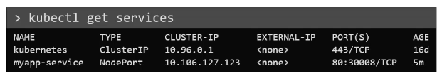
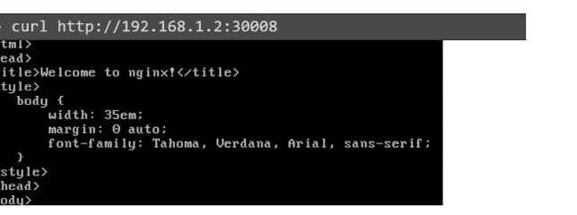
Service - NodePort

Slide 55
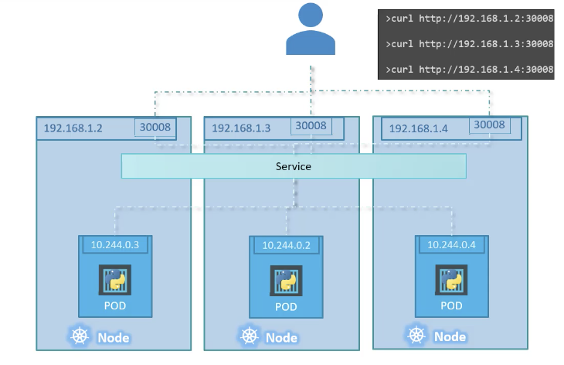
Service - NodePort

Slide 56
Adding the Load Balancer to Configuration
apiVersion: v1
kind: Service
metadata:
name: devops-loadbalancer
labels:
app: devops
tier: frontend
spec:
type: LoadBalancer
ports:
- port: 80
targetPort: 8080
selector:
app: devops
tier: frontend

Slide 57
Accessing a Deployment with a Load Balancer
Need a load balancer to route requests to the pods
To get the load balancers public IP address, use the following command:
kubectl expose deployment devops-deployment --port=80 --target-port=8080 --type=LoadBalancer
kubectl get services

Slide 58
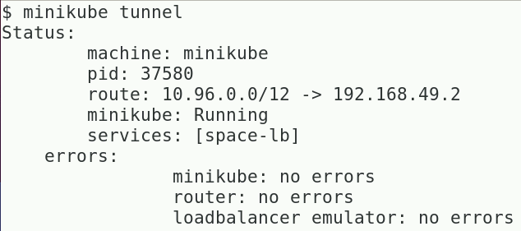
Running a Load Balancer on Minikube—I
To obtain an external IP address, the load balancer must be running on a platform that knows how to generate one, such as GCP and AWS
Minikube does not know how generate an IP address
Open a new terminal and execute the following command to create a route from the host to the deployment:

Slide 59
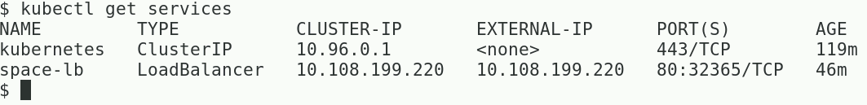
Running a Load Balancer on Minikube—II
Once the Minikube tunnel is running, go back to the original termial and execute the following command
The load balancer should now have an external IP address
Open a browser and point it to the external IP address of the load balancer service
What do you see?

