Slide 1
Advanced Concepts
Kubernetes

Slide 2
Course Objectives
In this module, you will learn:
Commands & Arguments
Environment variables
Config Maps & Secrets
Health Checks
Jobs/ Cron Jobs
Application Logs
Daemon Sets / Stateful Sets

Slide 3
Commands & Arguments
Advanced Concepts
Notes:
Hello and welcome to this lecture in this lecture.
We will now look at Command and Arguments in a Kubernetes POD.

Slide 4
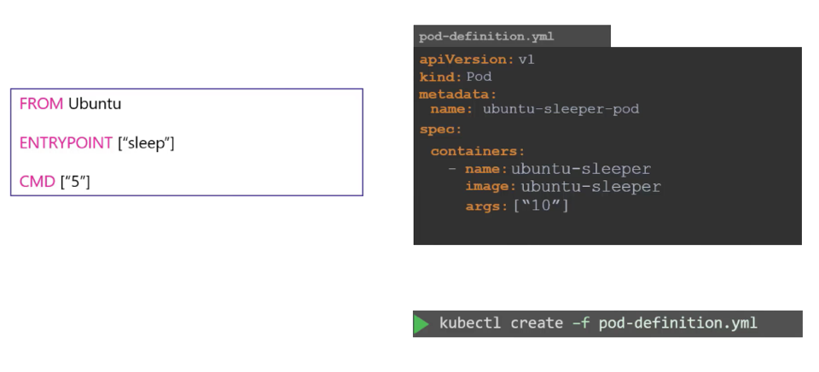
Dockerfile vs Pod YAML
Notes:
Let us try to relate that to the docker file we created earlier.
The Dockerfile has an Entrypoint as well as a CMD instruction specified.
The entrypoint is the command that is run at startup, and the CMD is the default parameter passed to the command.
With the args option in the pod definition file we override the CMD instruction in the Dockerfile.
But what if you need to override the entrypoint?
Say from sleep to a hypothetical sleep2.0 command?

Slide 5
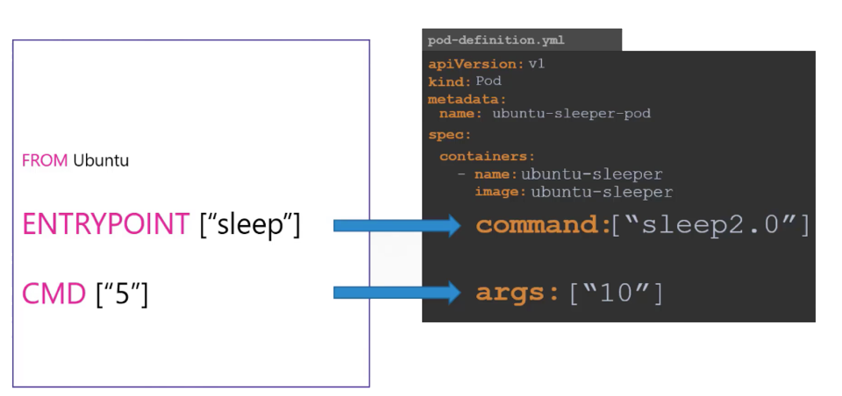
Dockerfile vs Pod YAML
Notes:
so to summarize there are two fields that correspond to two instruction in the docker file.
The command field overrides the entry point instruction and the args field overrides the command instruction in the docker file.
Remember it is not the command field that overrides the CMD instruction in the docker file.
Well that's it about commands and arguments in Kubernetes

Slide 6
Environment variables in Applications
Advanced Concepts
Notes:
Hello In this lecture we will see how to set an environment variable in Kubernetes.

Slide 7
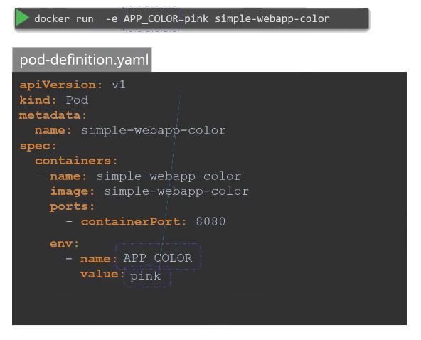
ENV variables in Kubernetes
Notes:
Given a pod definition file which uses the same image as the dockor command, we ran in the last lecture.
To set an environment variable, use the ENV property.
ENV is an array. So every item under the env property starts with a dash, indicating an item in the array.
Each item has a name and a value property.
The name is the name of the environment variable made available with the container and the value is
its value.
What we just saw was a direct way of specifying the environment variables using a plain key value pair
format.

Slide 8
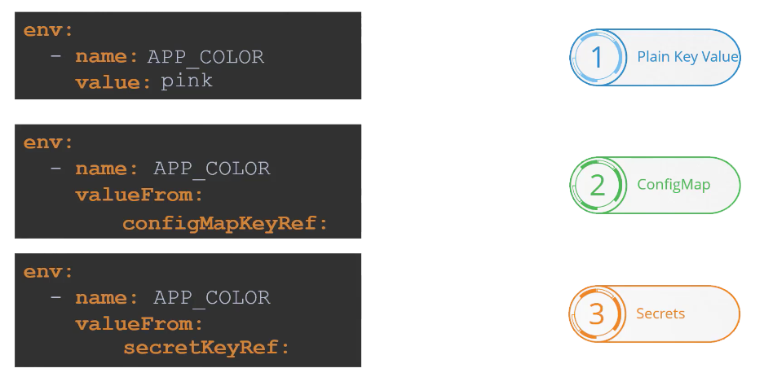
ENV Value Types
Notes:
However there are other ways of setting the environment variables such as using config maps and secrets.
The difference in this case is that instead of specifying value, we say valueFrom. And then a specification
of configMap or secret.
We will discuss about configMaps and secretKeys in the upcoming lectures.
That's it for this lecture and I will see you in the next.

Slide 9
Configuring Config Maps
Advanced Concepts
Notes:
In this lecture we discuss how to work with configuration data in Kubernetes.
In the previous lecture we saw how to define environment variables in it pod definition file.

Slide 10
ConfigMap
In programming, we use env files or separate configuration files to store settings, configurations, or variables that are required to execute the program.
In Kubernetes, we can use ConfigMaps to achieve the same functionality.
A ConfigMap is a Kubernetes API object that can be used to store data as key-value pairs. Kubernetes pods can use the created ConfigMaps as a:
Configuration file
Environment variable
Command-line argument

Slide 11
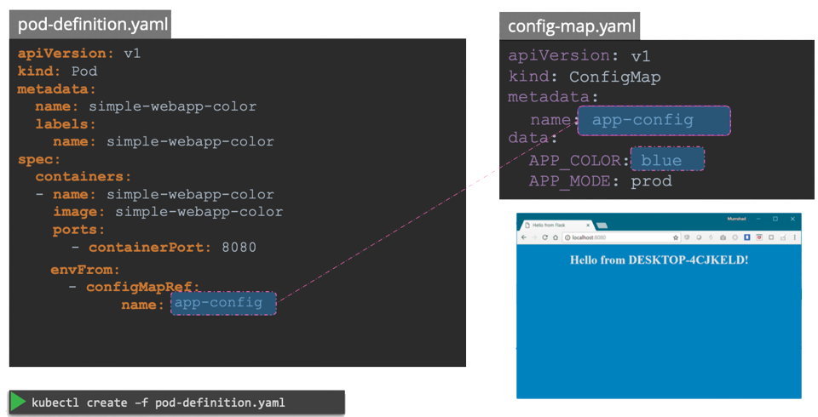
ConfigMap in Pods
Notes:
Now that we have the config map created let us proceed with step 2 configuring it with a pod
Here I have a simple pod definition file that runs my simple web application to inject an environment variable add a new property to the container called envFrom.
The envFrom property is a list, so we can pass as many environment variables as required.
Each item in the list corresponds to a configMap item.
Specify the name of the configmap we created earlier.
This is how we inject a specific configmap from the ones we created before.
Creating the pod definition file now creates a web application with a blue background

Slide 12
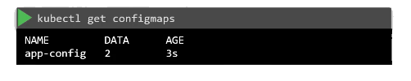
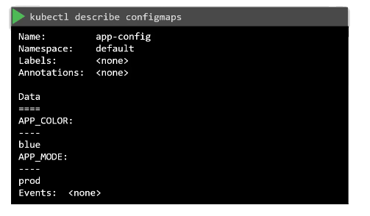
View ConfigMaps
Notes:
To view the configmaps, run the kubectl get configmaps command.
This lists the newly created configmap named app-config.
The describe configmaps command List the configuration data as well under the data section

Slide 13
Configuring Secrets
Advanced Concepts
Notes:
Hello and welcome to this lecture on secrets in Kubernetes.

Slide 14
Kubernetes Secrets
A secret is an object that contains a small amount of sensitive data
Such as a password, a token, or a key
Putting this information in a secret is safer and more flexible than putting it verbatim in a pod definition or in a Docker image
A secret is only sent to a node if a pod on that node requires it
Not written to disk—stored in a tmpfs on the nodes
Deleted once the pod that depends on it is deleted
One pod does not have access to the secrets of another pod
Secrets are encrypted at the storage layer in etcd

Slide 15
Creating Kubernetes Secrets
apiVersion: v1
kind: Secret
metadata:
name: mysecret
type: Opaque
data:
username: YWRtaW4=
password: MWYyZDFlMmU2N2Rm
Not encrypted, base64 encoded
To get the secret
$ kubectl get secret mysecret -o yaml

Slide 16
Health Checkers
Application Lifecycle Management

Slide 17
Health Checkers
There are two types of Kubernetes health checks: Liveness and Readiness probes
If a Liveness probe fails, the pod is deleted and re-created
If a Readiness probe fails, requests are not sent to the pod until it is back up and running
But it is not removed and recreated

Slide 18
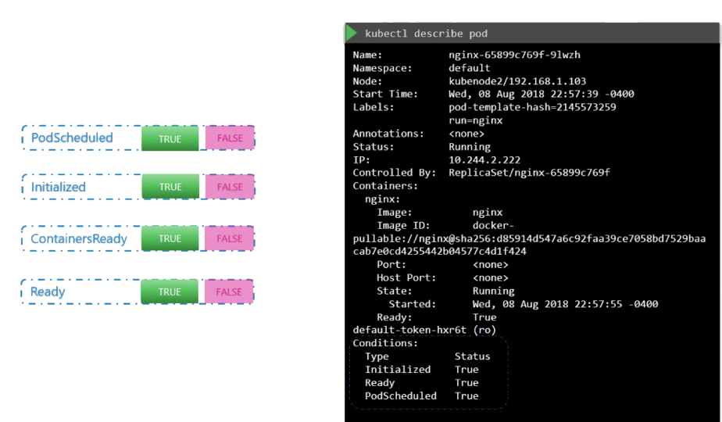
POD Conditions
Notes:
To see the state of POD conditions,
Run the kubectl describe pod command and look for the conditions section.

Slide 19
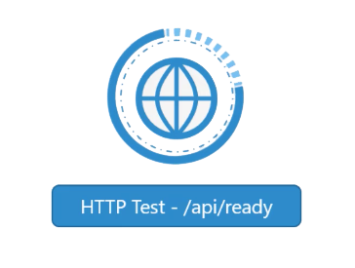
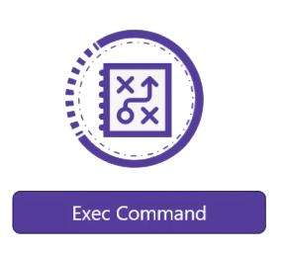
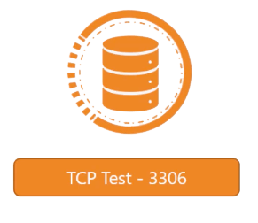
Readiness/ Liveness Probes
Notes:
You can set up different kinds of tests or probes which is the appropriate term in case of a web application.
It could be even the API server is up and running.
So you could run it a HTTP test to see if the API server response.
-----------
In case of a database, you may test to see if a particular TCP socket is listening
---------
or you may simply execute a command within the container to run a custom script that will exit successfully if the application is ready.

Slide 20
Liveness and Readiness Probe Configuration
apiVersion: apps/v1
kind: Deployment
*** CODE OMITTED ***
spec:
containers:
*** CODE OMITTED ***
readinessProbe:
httpGet:
path: /health
port: 8080
initialDelaySeconds: 30
periodSeconds: 30
livenessProbe:
httpGet:
path: /health
port: 8080
initialDelaySeconds: 15
periodSeconds: 15
Added to the Containers section of the Deployment

Slide 21
Jobs/ Cron Jobs
Application Lifecycle Management
Notes:
Hello and welcome to this lecture. In this lecture we will look at Jobs in Kubernetes.
There are different types of workloads that a container can serve.

Slide 22
Job
A Kubernetes Job is a workload controller that represents a finite task.
Jobs differ from other controller objects in that Jobs manage the task as it runs to completion, rather than managing an ongoing desired state (such as the total number of running Pods).
When a specified number of pods reach completion, the Job is said to have successfully completed.

Slide 23
Job – Use cases
The best use case for Kubernetes jobs are,
Batch processing: Let’s say you want to run a batch task once a day or during a specific schedule. It could be something like reading files from storage or a database and feed them to a service to process the files.
Operations/ad-hoc tasks: Let’s say you want to run a script/code which runs a database cleanup activity or to even backup a kubernetes cluster itself.

Slide 24
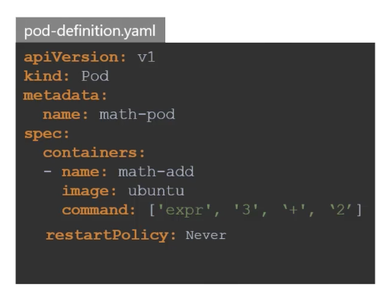
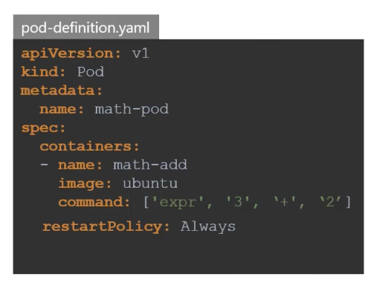
Restart Policy – Never vs Always
Notes:
This behavior is defined by the property restart policy set on the pod which is by default set to always.
And that is why the pod always recreates the container when it exits.
--------
You can override this behavior by setting this property to never or on failure.
That way kubernetes does not restart the container once the job is finished.
Now that works just fine.
We have new use cases for batch processing.
We have large data sets that require multiple PODs to process the data in parallel.
We want to make sure that all PODs perform the task assigned to them successfully and then exit.
So we need a manager that can create as many PODs as we want to get work done and ensure that work
gets done successfully.

Slide 25
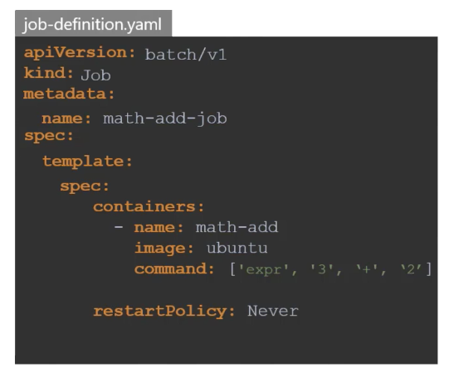





Create, View & Delete
Notes:
Once done, create the job using the kubectl create command.
Once created, use the Kube control get jobs command to see the newly created job.
We now see that the job was created and was completed successfully.
To see the pods created from the kubectl get pods command.
We see that it is in a completed state with zero restarts indicating that kubernetes did not try to
restart the pod.
Perfect.
But what about the output of the Job.
In our case we just had the addition performed on the command line inside the container.
So the output should be in the pod's standard output.
The standard output of a container can be seen using the logs command as we've seen in the previous
lecture.
So we run the kubectl logs command with the name of the pod to see the output.
Finally to delete the job from the kubectl delete job command.
Deleting the job will also result in deleting the pods that were created by the job.

Slide 26
Multiple Job Pods and Parallelism
When a job is deployed you can make it run on multiple pods with parallelism.
For example, in a job if you want to run 6 pods and run 2 pods in parallel, you need to add the following two parameters to your job manifest.
completions: 3
parallelism: 3
The job will run 2 pods in parallel for 3 times to achieve 6 completions.
Here is the manifest file with those parameters.

Slide 27
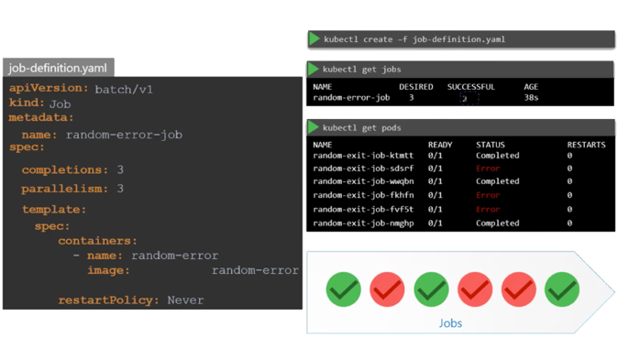
Multiple Job Pods and Parallelism
Notes:
So it's intelligent enough to create one pod at a time until we get a total of three complete pods
Well that's it for this lecture.
Head over to the coding quiz and have fun playing around with Jobs.
I will see you in the next lecture.

Slide 28
Cron Jobs
Application Lifecycle Management
Notes:
Hello and welcome to this lecture
In this lecture, we will look at CronJobs in Kubernetes.
A CronJob is a job, that can be scheduled just like Cron tab in Linux. If you're familiar with it.
Say for example you have a Job that generates a report and sends an email.

Slide 29
Crobjob
What if you want to run a batch job on specific schedules, for example, every 2 hours. You can create a Kubernetes cronjob with a cron expression.
The job will automatically kick in as per the schedule you mention in the job.
A CronJob is basically a Kubernetes Job with time-based scheduling and some specific parameters to handle failure.

Slide 30
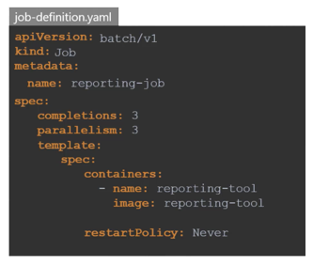
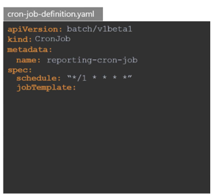
CronJob
Notes:
You can create the job using the Kube control create command, but it runs instantly.
Instead you could create a Cronjob to schedule and run it periodically.
To create a Cronjob, we start with a blank template.
The apiVersion as of today is batch/v1beta1.
The kind is CronJob with a capital C and J.
I will name it reporting-cron-job under spec you specify a schedule.
The schedule option takes a cron like format string where you can specify the time when the job is to be run.
Then you have the job template, which is the actual job that should be run.
Move all of the conten from the spec section of the job definition under this.

Slide 31
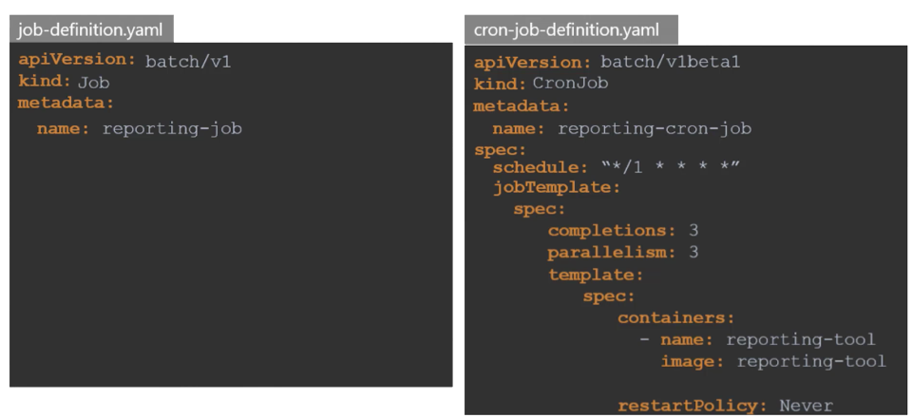
CronJob
Notes:
Notice that the CronJob definition now gets a little complex.
So you must be extra careful.
There are now 3 spec sections one for the cron-job, one for the job and one for the pod.

Slide 32
Managing Application Logs
Monitoring & Logging
Notes:
Hello and welcome to this lecture. In this lecture
we will talk about various Logging mechanisms in kubernetes.

Slide 33
Application Logs
Application logs are the logs from the applications that run on Kubernetes.
The data stored in these logs consists of the information that your applications output as they run.
Typically, this data is written to stdout inside the container where the application runs.

Slide 34
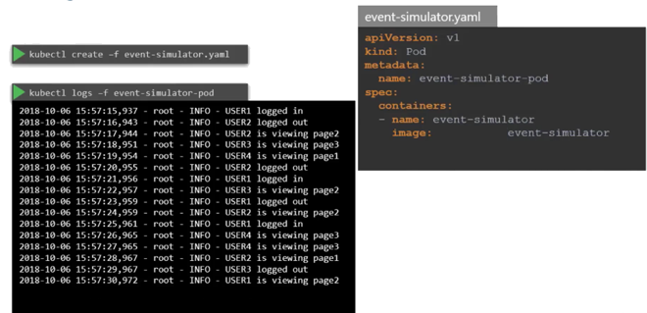
Viewing Application Logs
There are two main ways to interact with application log data.
The first is to run a command like
kubectl logs pod-name
where “pod-name” is the name of the pod that hosts the application whose logs you want to access.
Notes:
Now back to Kubernetes.
We create a pod with the same docker image using the pod definition file.
Once it’s the pod is running, we can view the logs using the kubectl logs command with the pod name.
Use the –f option to stream the logs live just like the docker command.
Now these logs are specific to the container running inside the pod.
As we learned before, Kubernetes PODs can have multiple docker containers in them.

Slide 35
Storing & Analyzing Application Logs
Suppose you want to store logs persistently and analyze them systematically.
In that case, you’re better served by using an external logging tool like IBM Log Analysis with LogDNA to collect and interpret the logs.
The easiest way to go about this is to run a so-called sidecar container, which runs alongside the application, collects its logs, and makes them available to an external logging tool.
Notes:
Now back to Kubernetes.
We create a pod with the same docker image using the pod definition file.
Once it’s the pod is running, we can view the logs using the kubectl logs command with the pod name.
Use the –f option to stream the logs live just like the docker command.
Now these logs are specific to the container running inside the pod.
As we learned before, Kubernetes PODs can have multiple docker containers in them.

Slide 36
Daemon Sets & Stateful Sets
Monitoring & Logging
Notes:
Hello and welcome to this lecture. In this lecture
we will talk about various Logging mechanisms in kubernetes.

Slide 37
DaemonSet - When Your Pods Must Be Everywhere
A DaemonSet is a controller that ensures that the pod runs on all the nodes of the cluster.
If a node is added/removed from a cluster, DaemonSet automatically adds/deletes the pod.
Some typical use cases of a DaemonSet is to run cluster level applications like:
Monitoring Services
Logs Collection Daemon
Cluster services like kube-proxy
Security solutions like antivirus, intrusion detection, and image scanning

Slide 38
StatefulSet - When Your Pods Are Unique
A StatefulSet is a controller that helps you deploy and scale groups of Kubernetes pods.
When using Kubernetes, most of the time you don’t care how your pods are scheduled, but sometimes you care that pods are deployed in order, that they have a persistent storage volume, or that they have a unique, stable network identifier across restarts and reschedules.
In those cases, StatefulSets can help you accomplish your objective.
To scale stateful systems, you need a StatefulSet.

Slide 39
StatefulSet - When Your Pods Are Unique
Each pod created by the StatefulSet has an ordinal value (0 through # replicas - 1) and a stable network ID (which is statefulsetname-ordinal) assigned to it.
You can also create a VolumeClaimTemplate in the manifest file that will create a persistent volume for each pod.
When pods are deployed by a StatefulSet, they will go in order from 0 to the final pod and require that each pod is Running and Ready before creating the next pod.

Slide 40
StatefulSet - When to use?
Some examples of reasons you’d use a StatefulSet include:
A Redis pod that has access to a volume, but you want it to maintain access to the same volume even if it is redeployed or restarted
A Cassandra cluster and have each node maintain access to its data
A webapp that needs to communicate with its replicas using known predefined network identifier

