Slide 1
Managing Storage
Kubernetes

Slide 2
Course Objectives
In this module, you will learn:
Volumes
Persistent Volumes
Persistent Volume Claims

Slide 3
Volumes, PV & PVC
Managing Storage
Notes:
Hello and welcome to this lecture on labels and selectors.

Slide 4
Kubernetes Volumes solves below problems
On-disk files in a container are ephemeral and they are lost when a container crashes. when a container crashes, the kubelet restarts the container but with a clean state.
A second problem occurs when sharing files between containers running together in a Pod.

Slide 5
Introduction to Volumes
A Kubernetes volume is essentially a directory accessible to all containers running in a pod.
In contrast to the container-local filesystem, the data in volumes is preserved across container restarts.
When a pod ceases to exist, the volume is destroyed.

Slide 6
Volumes Types
The medium backing a volume and its contents are determined by the volume type:
node-local types such as emptyDir or hostPath
file-sharing types such as nfs
cloud provider-specific types like awsElasticBlockStore, azureDisk, or gcePersistentDisk
distributed file system types, for example glusterfs or cephfs
special-purpose types like secret, gitRepo

Slide 7
emptyDir
An emptyDir volume is first created when a Pod is assigned to a node, and exists as long as that Pod is running on that node.
As the name says, the emptyDir volume is initially empty. All containers in the Pod can read and write the same files in the emptyDir volume, though that volume can be mounted at the same or different paths in each container.
When a Pod is removed from a node for any reason, the data in the emptyDir is deleted permanently.
Note: A container crashing does not remove a Pod from a node. The data in an emptyDir volume is safe across container crashes.
Some uses for an emptyDir are:
scratch space, such as for a disk-based merge sort
checkpointing a long computation for recovery from crashes

Slide 8
Kubernetes Volumes vs Persistent Volumes
A Kubernetes volume exists only while the containing pod exists.
Once the pod is deleted, the associated volume is also deleted.
Kubernetes volumes are useful for storing temporary data that does not need to exist outside of the pod’s lifecycle.
Persistent volumes remain available outside of the pod lifecycle.
This means that the volume will remain even after the pod is deleted.
It is available to claim by another pod if required, and the data is retained.

Slide 9
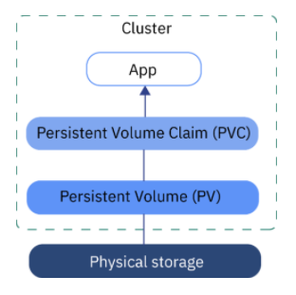
PV & PVC

Slide 10
Persistent Volumes
PVs are defined by a PersistentVolume API object, which represents a piece of existing networked storage in the cluster that has been provisioned by an administrator.
It is a resource in the cluster just like a node is a cluster resource.
PVs are volume plug-ins like Volumes, but have a lifecycle independent of any individual pod that uses the PV.
PV objects capture the details of the implementation of the storage, be that NFS, iSCSI, or a cloud-provider-specific storage system.

Slide 11
Persistent Volume Claims
PVCs are defined by a PersistentVolumeClaim API object, which represents a request for storage by a developer.
It is similar to a pod in that pods consume node resources and PVCs consume PV resources.
For example, pods can request specific levels of resources (e.g., CPU and memory), while PVCs can request specific storage capacity and access modes (e.g, they can be mounted once read/write or many times read-only).

Slide 12
Lifecycle of a Volume and Claim
PVs are resources in the cluster.
PVCs are requests for those resources and also act as claim checks to the resource.
The interaction between PVs and PVCs have the following lifecycle.
Stage 1 - Provisioning
A cluster administrator creates some number of PVs.
They carry the details of the real storage that is available for use by cluster users.
They exist in the API and are available for consumption.

Slide 13
Lifecycle of a Volume and Claim
Stage 2 - Binding
A user creates a PersistentVolumeClaim with a specific amount of storage requested and with certain access modes.
A control loop in the master watches for new PVCs, finds a matching PV (if possible), and binds them together.
The user will always get at least what they asked for, but the volume may be in excess of what was requested. To minimize the excess, Container Platform binds to the smallest PV that matches all other criteria.
Claims remain unbound indefinitely if a matching volume does not exist.
Claims are bound as matching volumes become available.
For example, a cluster provisioned with many 50Gi volumes would not match a PVC requesting 100Gi. The PVC can be bound when a 100Gi PV is added to the cluster.

Slide 14
Lifecycle of a Volume and Claim
Stage 3 - Using
Pods use claims as volumes.
The cluster inspects the claim to find the bound volume and mounts that volume for a pod.
For those volumes that support multiple access modes, the user specifies which mode is desired when using their claim as a volume in a pod.
Once a user has a claim and that claim is bound, the bound PV belongs to the user for as long as they need it.
Users schedule pods and access their claimed PVs by including a PVC in their pod’s volumes block.

Slide 15
Lifecycle of a Volume and Claim
Stage 4 - Releasing
When a user is done with a volume, they can delete the PVC object from the API which allows reclamation of the resource.
The volume is considered "released" when the claim is deleted, but it is not yet available for another claim.
The previous claimant’s data remains on the volume which must be handled according to policy.

Slide 16
Lifecycle of a Volume and Claim
Stage 5 - Reclaiming
The reclaim policy of a PersistentVolume tells the cluster what to do with the volume after it is released.
Currently, volumes can either be Retain or Recycle.
Retain allows for manual reclamation of the resource.
For those volume plug-ins that support it, recycling performs a basic scrub on the volume (e.g., rm -rf /<volume>/*) and makes it available again for a new claim.

Slide 17
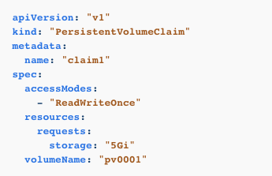
Requesting Storage
You can request storage by creating PersistentVolumeClaim objects in your projects:

Slide 18
Volume & Claim Binding
A PersistentVolume is a specific resource.
A PersistentVolumeClaim is a request for a resource with specific attributes, such as storage size.
In between the two is a process that matches a claim to an available volume and binds them together.
This allows the claim to be used as a volume in a pod.
Ex: OpenShift Enterprise finds the volume backing the claim and mounts it into the pod.

Slide 19
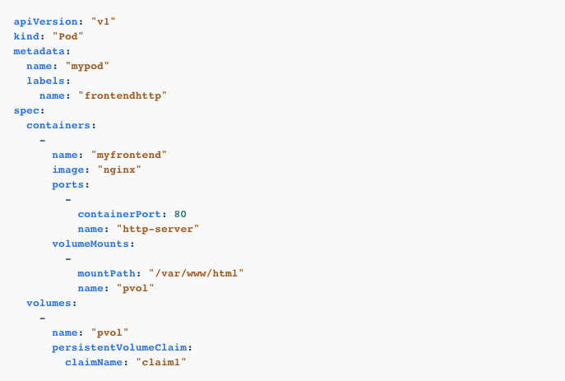
Claims as Volumes in Pods
A PersistentVolumeClaim is used by a pod as a volume.
Ex: OpenShift Enterprise finds the claim with the given name in the same namespace as the pod, then uses the claim to find the corresponding volume to mount.

Slide 20
Volumes
Managing Storage
Notes:
Hello and welcome to this lecture

Slide 21
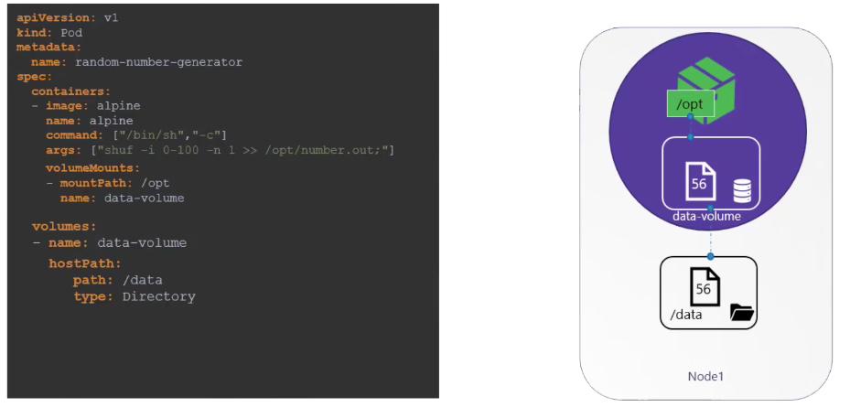
Volumes & Mounts
Notes:
We use the volumeMounts field in each container to mount the data-volume to the directory /opt
within the container.
The random number will now be written to /opt mount inside the container, which happens to be on
the data-volume which is in fact /data directory on the host.

Slide 22
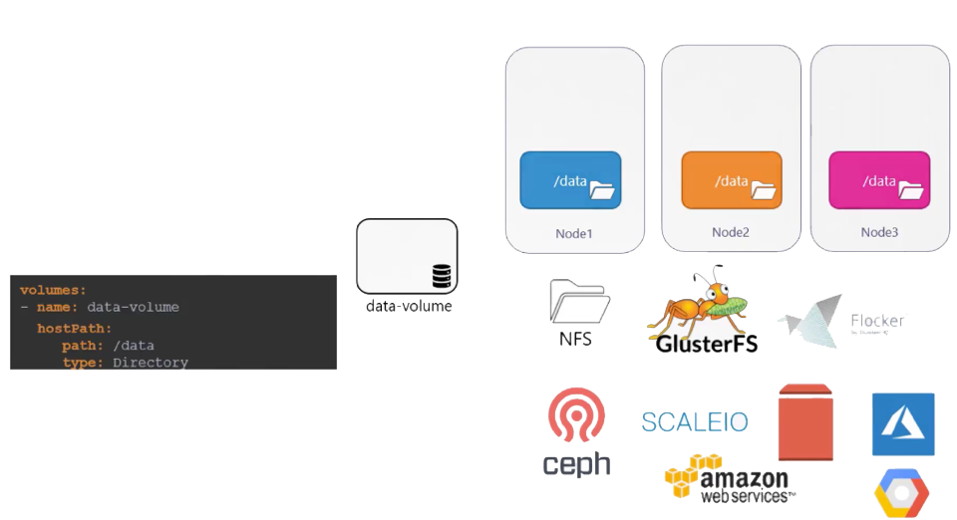
Volume Storage Options
Notes:
Kubernetes supports several types of standard storage solutions such as NFS, glusterFS,
Flocker, FibreChannel, CephFS, ScaleIO or public cloud solutions like AWS,
EBS, Azure Disk or File or Google’s Persistent Disk.

Slide 23
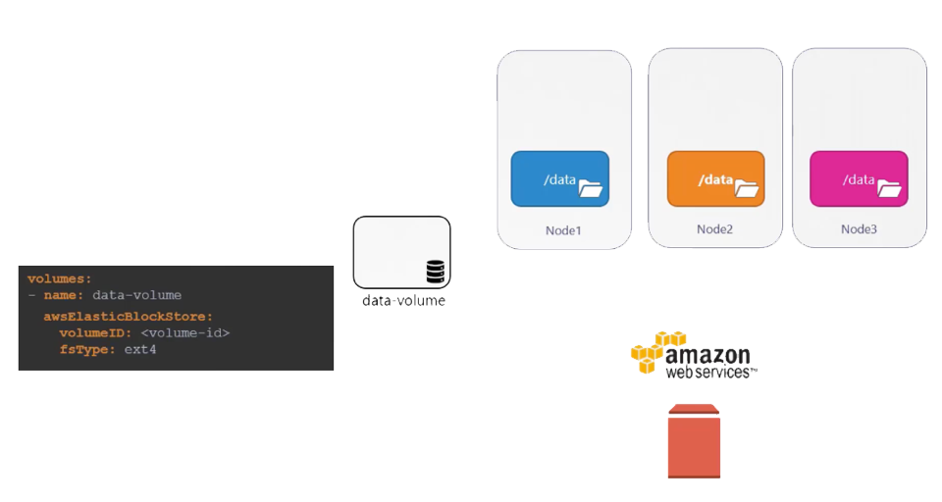
Volume Storage Options
Notes:
For example, to configure an AWS Elastic Block Store volume as the storage option for the volume, we replace hostPath field of the volume with the awsElasticBlockStore field along with the volumeID
and filesystem type.
The Volume storage will now be on AWS EBS.
Well, that’s it about Volumes in Kubernetes. We will now head over to discuss Persistent Volumes
next.

Slide 24
Persistent Volumes
Managing Storage
Notes:
Hello and welcome to this lecture on persistent volumes.

Slide 25
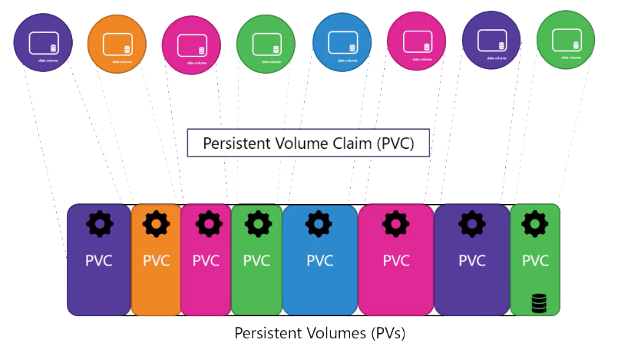
Pods using Persistent Volumes
Notes:
That is where persistent volumes can help us.
A persistent volume is a cluster wide pool of storage volumes configured by an administrator to be used
by users deploying applications on the Cluster.
The users can now select storage from this pool using persistent volume claims

Slide 26
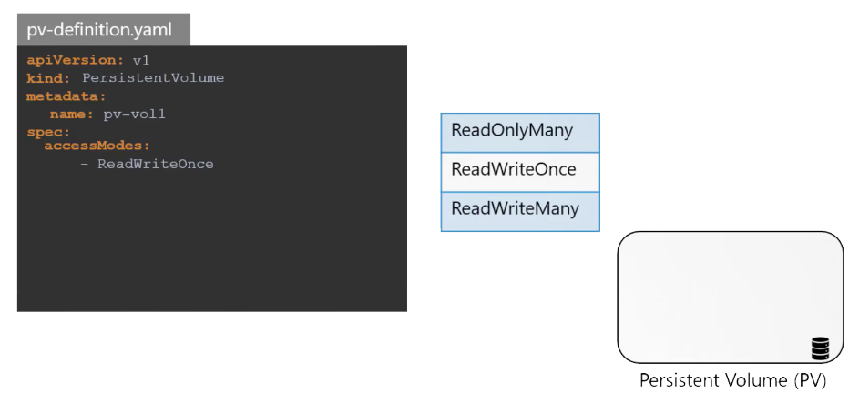
Creating a Persistent Volume
Notes:
let us now create a persistent volume.
We start with the base template and update the API version
set the kind to persistent volume and name it pv-vol1
Under the specs section -- specify the access modes
Access mode defines how a volume should be mounted on the hosts whether in a read only mode or read write mode etc.
The supported values are read only many/ read write ones or read write many

Slide 27
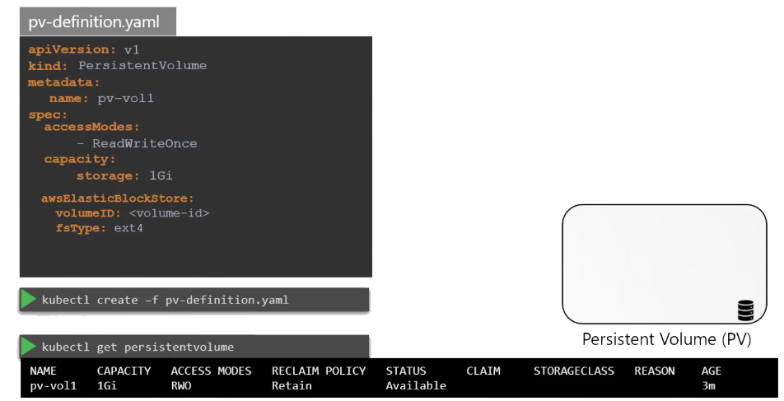
Persistent Volume Capacity
Notes:
Next is the capacity
Specify the amount of storage to be reserved for this persistent volume which is set to 1 GB here.
Next comes the volume type.
We will start with the host path option that uses storage from the nodes local directory.
Remember this option is not to be used in a production environment.
To create the volume run kubectrl Create command and to list the created volume - Run the kubectrl get persistent volume command
replace the host Path option with one of the supported storage solutions as we saw in the previous lecture like AWS elastic blocks store etc
well that's it on persistent volumes.
In this lecture in the next lecture we will look at how we use persistent volume claims to claim the
volume configured with persistent volumes.

Slide 28
Persistent Volume Claims
Managing Storage
Notes:
Hello and welcome to this lecture on Persistent Volumes in Kubernetes.
In the previous lecture, we created a persistent volume.

Slide 29
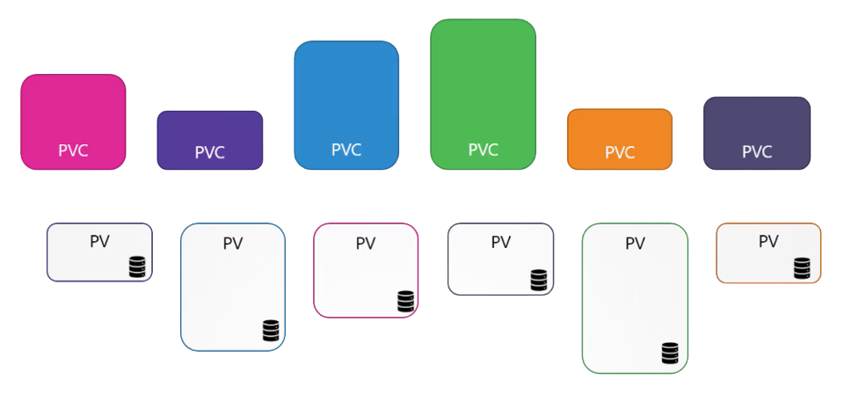
Making Storage available to a node using PVC
Notes:
Now we will create a Persistent Volume Claim to make the storage available to a node.
Persistent Volumes and Persistent Volume Claims are two separate objects in the Kubernetes namespace.
An Administrator creates a set of Persistent Volumes and a user creates Persistent Volume Claims to
use to storage.

Slide 30
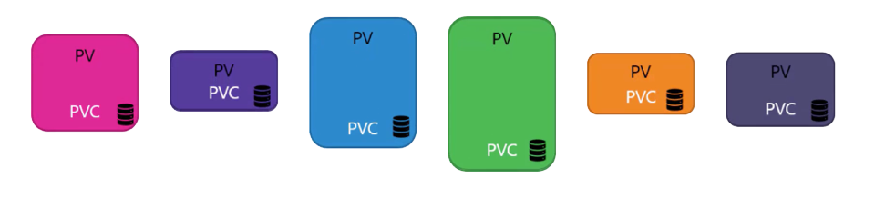
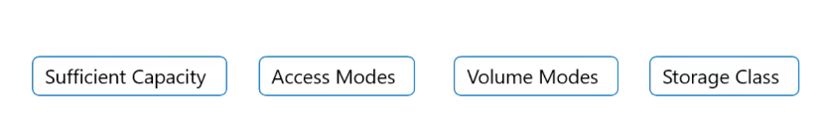
Mapping PV to PVC
Notes:
Once the Persistent Volume Claims are created, Kubernetes binds the Persistent Volumes to Claims based
on the request and properties set on the volume.
Every Persistent Volume Claims is bound to single Persistent volume
During the binding process, Kubernetes tries to find a persistent volume that has sufficient
capacity as requested by the claim
And any other request properties such as access modes/ volume modes/ storage class etc.

Slide 31
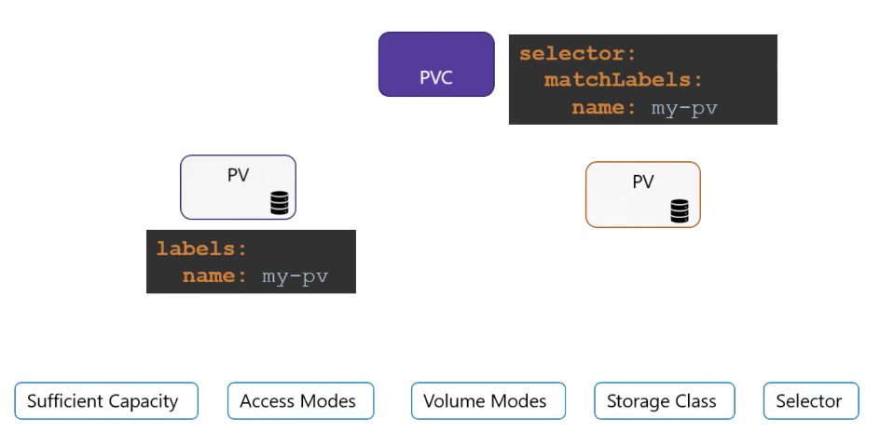
Using labels & Selectors to use specific Volume
Notes:
However if there are multiple possible matches for a single claim and you would like
to specifically use a particular volume you could still use labels and selectors to bind to the right
volumes.

Slide 32
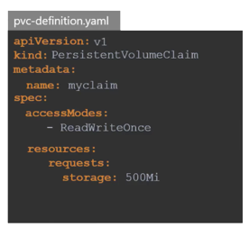


Creating Persistent Volume Claim
Notes:
let us now create a persistent volume claim.
We start with a blank template said the API version to V1 and kind to persistent volume claim.
We will name it myclaim.
Under specification set the accessModes to ReadWriteOnce.
And set resources to request a storage of 500 mega bytes.
--------
Create the claim using kubectl create command.
--------
To view the created claim run the kubectl get persistentvolumeclaim command.
We see the claim in a pending state.

Slide 33
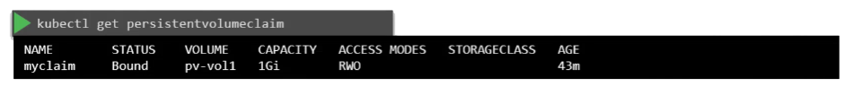
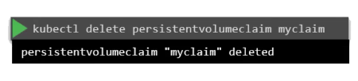
Commands
Notes:
when we run to get volumes command again, we see the claim is bound to the persistent volume we created
perfect.

