Slide 1
Networking Fundamentals
Kubernetes

Slide 2
Course Objectives
In this module, you will learn:
Networking at the Pod level
Networking at the Cluster level

Slide 3
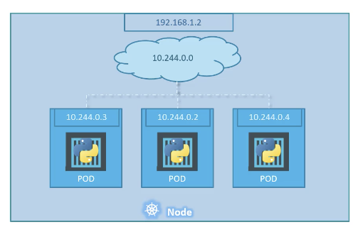
Pods with IP Addresses
IP address are assigned to a Pod
Containers in the same pod communicate using localhost

Slide 4
Internet-to-Service Networking
We need to be able to access our deployments from outside the cluster:
When setting up external access, there are two techniques you need to use — egress and ingress.
These are policies that you can set up with either whitelisting or blacklisting to control traffic into and out of your network.

Slide 5
Internet-to-Service Networking
Egress:
Egress is a process that routes traffic from your node to an outside connection.
It is often accomplished via an Internet gateway attached to your virtual private cloud (VPC).
This gateway uses network address translation (NAT) to map IPs between your users and the machine your node is hosted on.
It cannot, however, map to the individual pods on your node.
For this step, Kubernetes uses IP tables and cluster-IPs to finalize communications.
Ingress:
Ingress is an opposite process to egress and involves communications from external clients to your Kubernetes services.
It operates as a set of rules defining what connections are allowed and which are blocked from communicating with your services.

Slide 6
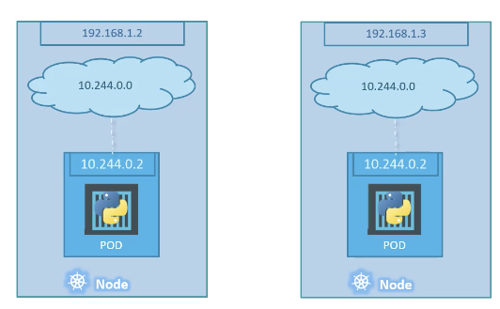
Cluster Networking

Slide 7
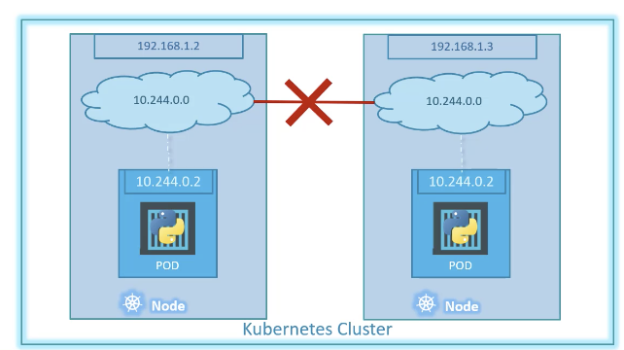
Cluster Networking
All containers/PODs can communicate to one another without NAT
All nodes can communicate with all containers and vice versa without NAT
Notes:
How does NAT work? A. Basically, NAT allows a single device, such as a router, to act as an agent between the Internet (or public network) and a local network (or private network), which means that only a single unique IP address is required to represent an entire group of computers to anything outside their network

Slide 8
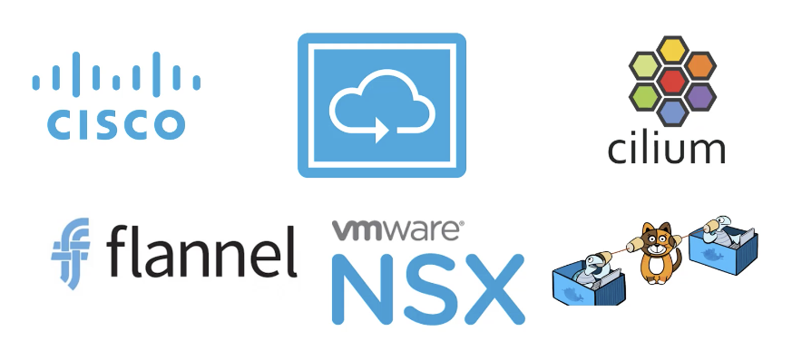
Networking Tools

Slide 9
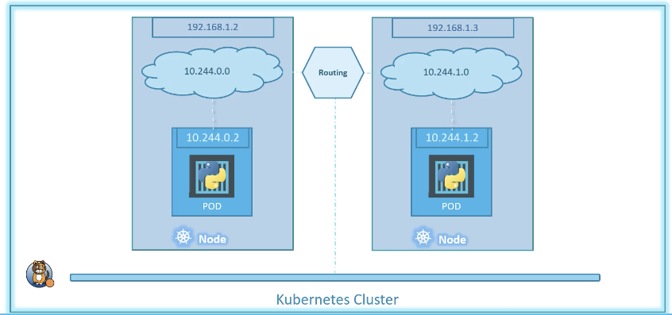
Cluster Networking

