Slide 1


Slide 2
About Me
I am a Java Developer proficient in full stack development.
Recent graduate from Georgia Institute of Technology with a bachelor’s Computer Engineer.

Slide 3
Description
InterviewYou is a web application that helps jobseekers in the CS field practice for interviews by offering exposure to current interview questions.
Through a chatbot component jobseekers can pick a topic and receive questions pertaining to that topic. They can then answer those questions and see whether their answers match.
The application maintains a variety of current questions and gives users visual data on their performance.

Slide 4
Environment
Java8, Spring MVC, Spring Boot, Spring Data JPA, JWT Security, MySQL
Angular, HTML 5, CSS, SCSS Bootstrap, JavaScript, TypeScript

Slide 5
Technologies used:
Used Spring boot alongside Maven automation tool to quick start and bootstrap the project with some of the identified module dependency, thereby simplifying the build process with very little need for any complex configuration.
Applied Spring MVC design pattern to logically separate the different layers of the application, from the business logic to presentation logic of the system.
Used Spring Core Annotations for Dependency Injection Spring DI and Spring MVC for REST APIs and Spring Boot.

Slide 6
Technologies used:
Implemented entity classes to automatically create tables for the integrated MySQL database functionality of the application.
Use RequestMappings to ensure correct users had access to their expected functionalities.
Developed and coded using Spring Bean and Spring REST API.
Used jUnit framework to unit test individual classes within the application

Slide 7
Technologies used:
Used Spring Boot Devtools to improve the development efficiency.
Interact with third party Restful Web API to fetch Question resources in JSON format so users can view up-to-date topics Extensively used Spring IOC, AOP, configured Application Context files and performed database object mapping using annotations.
Used Java 8 Lambda Expression in service classes to provide a clear and concise way to iterate, filter and extract data from collections.
Used JWT with Spring Security in multi-tiered client web applications for User authentication to use one login feature.

Slide 8
Technologies used:
Used HTML 5 to develop the user interface.
Heavily utilized Bootstrap and custom SCSS to make the user interface as smooth and aesthetically pleasing as possible.
Used Angular 10 to develop the client-side web application.
Deployed JavaScript and TypeScript within Angular to control program logic, access control and user interface
Used jQuery for HTML manipulation
Included Payment API Gateway with Stripe
Uploaded the project on GITHUB.

Slide 9
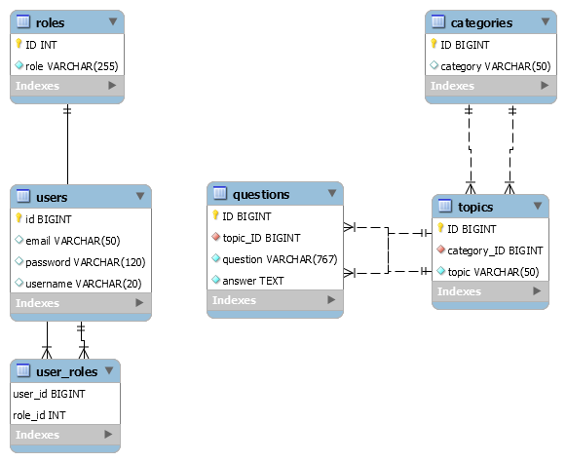
Database
One to Many
Many to One
Many to One
One to Many
One to Many

Slide 10
Onto the Website

