Slide 1
Gaussian Processes
Bayesian Modeling with Distributions over Functions
Max Kieff, Mengyue Huang, Alan Wu, Yaohao Zhang, Andrew Zhao

Slide 2
The Shortcomings of Regression
How can we do Bayesian inference when we are unsure of the functional form?
Ordinary regression assumes the response is linear in the features.
BAYESIAN LINEAR REGRESSION
yᵢ = β₀ + β₁xᵢ + εᵢ, εᵢ ∼ 𝑵(0, σ²), β ∼ p(β)
WHERE THIS FALLS SHORT
Functional form chosen in advance
Must commit to linear, quadratic, cubic, etc before seeing the data.
Misspecification risk
If the truth isn’t in the chosen class, fit and inference degrade.
Limited flexibility
A finite coefficient vector may not capture complex nonlinear structure.
Uncertainty on the wrong object
We get uncertainty on β, but our real unknown is the function itself.

Slide 3
Why Gaussian Processes?
What if we want a prior over functions, not parameters?
Parametric approach
Assume a fixed form, e.g.
y = β₀ + β₁x + β₂x² + ε
Choose degree / basis upfront
Model misspecification if wrong
Hard to express “smooth but unknown”
Gaussian Process approach
Place a prior directly on f:
y = f(x) + ε where f ∼ GP(m, k)
Nonparametric: no fixed basis
Encodes smoothness via kernel
Gives structured uncertainty while remaining very flexible

Slide 4
What Is a Gaussian Process?
DEFINITION
A stochastic process {f(x) : x ∈ 𝒳} is a Gaussian process if, for every finite collection of inputs x₁, …, xₙ ∈ 𝒳, the vector (f(x₁), …, f(xₙ)) has a multivariate normal distribution. The multivariate normal is governed by a mean function m(x) and a covariance matrix that comes from the kernel function k(x, x’).
f ∼ 𝒢𝒫 ( m(·), k(·, ·) )
At any finite set of inputs
(f(x₁), …, f(xₙ)) ∼ 𝒩(m, K)
with (m)ᵢ = m(xᵢ) and (K)ᵢⱼ = k(xᵢ, xⱼ).
Two ingredients
m(x) = 𝔼[f(x)] — prior average behavior
k(x, x′) = Cov(f(x), f(x′))
encodes smoothness & scale
The conceptual shift: from a prior on coefficients to a prior on functions.

Slide 5
The RBF (Squared Exponential) Kernel
The kernel determines how strongly two function values are related under the prior.
k(x, x′) = α² exp (− ‖x − x′‖² / 2ℓ²)
α² — amplitude
k(x, x) = α² — marginal variance
Typical vertical size of function fluctuations.
ℓ — lengthscale
ℓ — rate of correlation decay
How far the influence of one point reaches.
IF x AND x′ ARE CLOSE
k(x, x′) ≈ α² — strong correlation
Nearby inputs → similar function values.
HOW IT SHAPES THE PRIOR
low k
high k
IF x AND x′ ARE FAR APART
k(x, x′) ≈ 0 — nearly independent
Distant inputs provide little info about each other.
x₁
x₂
x₃

Slide 6
Bayesian GP Regression
PRIOR ON THE FUNCTION
f ∼ 𝒢𝒫(m, k_{θ})
θ = (α, ℓ) are the kernel hyperparameters.
LIKELIHOOD
yᵢ | f(xᵢ), σ² ∼ 𝒩(f(xᵢ), σ²)
Gaussian noise: y = f(x) + ε, with ε ∼ 𝒩(0, σ²).
HYPERPRIORS
α ∼ p(α), ℓ ∼ p(ℓ), σ² ∼ p(σ²)
Fully Bayesian: priors on the kernel params and noise.
Hierarchical: α, ℓ, σ² → f → y
POSTERIOR PREDICTIVE AT A NEW INPUT · f(x*) | y ∼ 𝒩(μ*, v*)
POSTERIOR MEAN
μ* = m(x*) + k*ᵀ(K_{θ} + σ²I)⁻¹(y − m)
estimated function value at x*
POSTERIOR VARIANCE
v* = k(x*, x*) − k*ᵀ(K_{θ} + σ²I)⁻¹k*
principled uncertainty — shrinks near data

Slide 7
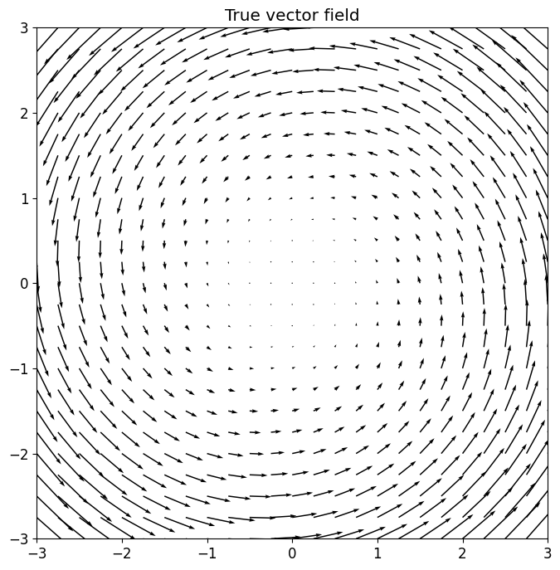
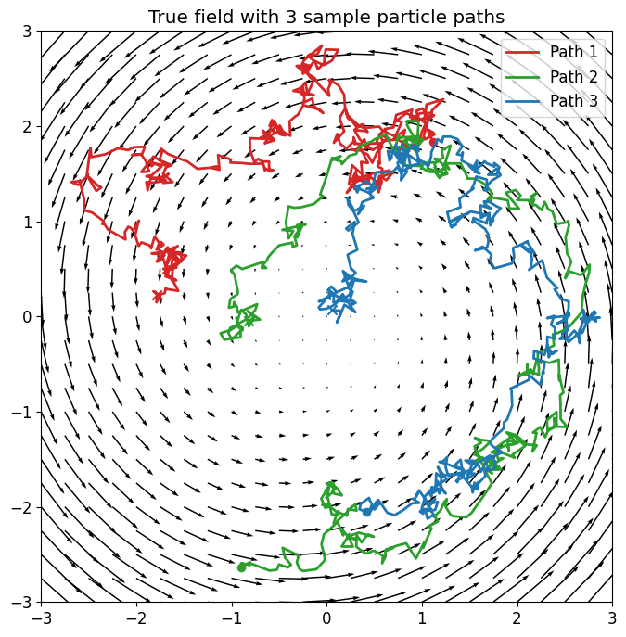
Toy Example: Recovering a Hidden Drift Field
Particles in ℝ² do a random walk (Gaussian noise) and are driven by unknown vector field F. We only observe the particle trajectories; we want to recover F.

Slide 8
Toy Example: Recovering a Hidden Drift Field
Particles in ℝ² do a random walk (Gaussian noise) and are driven by unknown vector field F. We only observe the particle trajectories; we want to recover F.
Xₜ₊₁ = Xₜ + F(Xₜ) Δt + σ√Δt εₜ εₜ ∼ 𝑵(0, I₂)
Xₜ : current particle position • F(Xₜ)Δt : deterministic drift from the hidden field over time Δt
σ√Δt εₜ : random perturbation over time Δt • σ > 0 : sets the noise magnitude
STEP 1 — Finite-difference velocity
Yₜ := (Xₜ₊₁ − Xₜ) / Δt
Rearranging the update yields Yₜ = F(Xₜ) + (σ/√Δt) εₜ.
STEP 2 — A regression problem emerges
Yᵢ = F(xᵢ) + ηᵢ
Each displacement is a noisy local clue about F. A GP prior on F stitches them together.

Slide 9
Fitting the GP to the Toy Example
The unknown object is the hidden vector field F; σ is treated as known.
THE DATA · Pairs (xᵢ, Yᵢ) with xᵢ, Yᵢ ∈ ℝ² — a position and its noisy local velocity Yᵢ = (Xₜ₊₁ − Xₜ) / Δt.
Each short displacement is a noisy clue about F at the current location.
LIKELIHOOD
Yᵢ | F(xᵢ), σ² ∼ 𝒩 (F(xᵢ), (σ²/Δt) I₂)
Velocity centered on the true field; noise inflated by 1/Δt.
GP PRIOR ON THE FIELD
F₁ ∼ 𝒢𝒫(0, k_{θ}), F₂ ∼ 𝒢𝒫(0, k_{θ})
Two independent components, zero mean, shared RBF kernel θ = (α, ℓ).
Base assumption is m(x)=0 everywhere (purely random walk)
HYPERPRIORS
α ∼ Half-Normal(2.5), ℓ ∼ Half-Normal(2)
Weakly informative:
ℓ : for a 6x6 observation window, allows for some local variation
α : forces are same order of magnitude as particle stdv (0.5)
POSTERIOR TARGET
p(F₁, F₂, α, ℓ | Y₁, …, Yₙ)
Update the prior over smooth vector fields using the observed local velocities.
IMPLEMENTATION · Full Bayesian fit with PyMC (GP priors + MCMC)

Slide 10
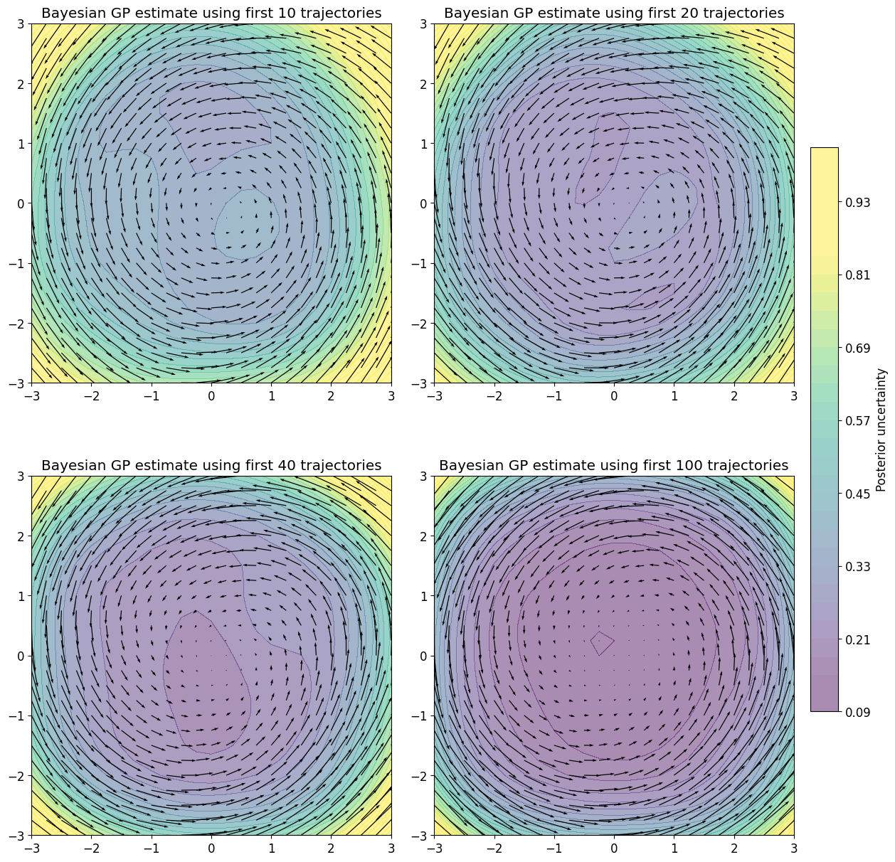
How the Posterior Sharpens with More Data
10 trajectories
Posterior is still diffuse.
Main directional signal detected, estimate of “center” is off.
20 trajectories
Data are now strong enough to distinguish signal from noise in most of the interior.
Posterior mean field is becoming stable.
40 trajectories
Significant uncertainty remains around edges, reflecting lack of data.
Global structure has converged.
100 trajectories
Posterior has concentrated strongly around the true field.
Posterior uncertainty reduced by an order of magnitude on majority of domain.

Slide 11
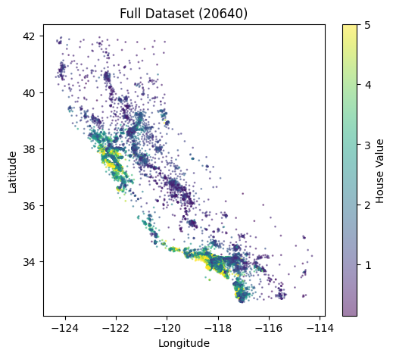
Case Study: California Housing Dataset
Dataset Overview
Based on the 1990 U.S. Census. Each row is a "block group" (600–3,000 people); target is median house value.
Column | Type | Description
MedInc | Float | Median income in the block group
HouseAge | Float | Median house age in the block group
AveRooms | Float | Average number of rooms per household
AveBedrms | Float | Average number of bedrooms per household
Population | Float | Total block group population
AveOccup | Float | Average number of household members
Latitude | Float | Spatial input (X₂): block group latitude
Longitude | Float | Spatial input (X₁): block group longitude
MedHouseVal | Float | Target: median house value (×$100,000)
Full Dataset (N=20640)
Spatial inputs highlighted in blue; target variable highlighted in tan.
Notes:
left: original data with 20640 records, right: sampled 300 cases w/ replacement for both train and test
kriging: its primary advantage over traditional machine learning methods is its probabilistic nature: it outputs not only a continuous prediction curve but also a quantifiable measure of uncertainty (confidence intervals), making it highly robust for sparse or noisy spatial data.

Slide 12
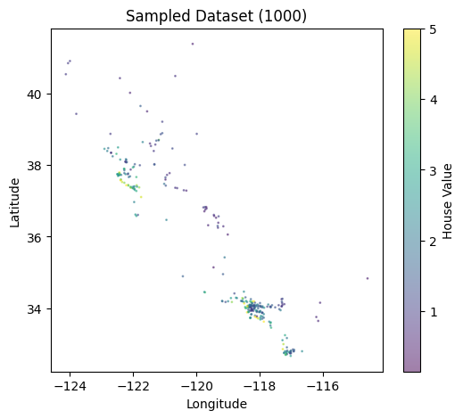
Standardization & Feature Selection
Standardization: We standardized the input features using z-scoring, important for Gaussian Process models since kernels measures distances between inputs.
Feature Selection: We have eight features available but used only longitude and latitude.
Inductive Bias: What scale should relate longitude, latitude, house, age, and median income? Using the RBF kernel for all of these implies they are comparable to one another in a meaningful way, which they are not.
Curse of Dimensionality: 8-dimensional data is sparse and would require a more flexible kernel.
Computation: Costs scale O(n³) with the number of features, and the posterior geometry becomes complex, requiring longer chains.
Training Dataset (N=300)

Slide 13
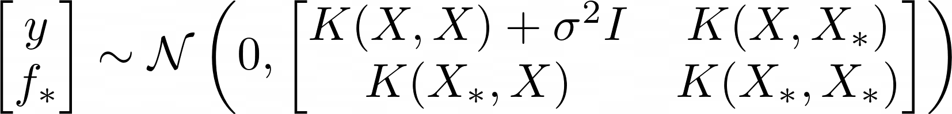
Specifying the Model
PRIOR ON THE FUNCTION
f ∼ 𝒢𝒫(0, k_{θ})
Zero-mean GP with RBF (squared exponential) kernel.
LIKELIHOOD
yᵢ | f(xᵢ), σ² ∼ 𝒩(f(xᵢ), σ²)
Gaussian noise: y = f(x) + ε, with ε ∼ 𝒩(0, σ²).
HYPERPRIORS
α ∼ LogNormal(0, 0.5)
⍴ ∼ LogNormal(0, 0.5)
σ ∼ LogNormal(−1, 0.5)
Weakly informative priors on positive (α, ℓ, σ).
Hierarchical: α, ℓ, σ → f → y
Joint Distribution
Prior & Observations
POSTERIOR PREDICTIVE AT A NEW INPUT · f(x*) | y ∼ 𝒩(μ*, v*)
POSTERIOR MEAN
μ* = k*ᵀ(K_{θ} + σ²I)⁻¹ y
POSTERIOR VARIANCE
v* = k(x*, x*) − k*ᵀ(K_{θ} + σ²I)⁻¹k*

Slide 14
Stan Code
MODEL BLOCK
model {
matrix[N_train, N_train] K;
matrix[N_train, N_train] L_K;
// Weakly informative priors for positive
// GP hyperparameters
alpha ~ lognormal(0, 0.5);
rho ~ lognormal(0, 0.5);
sigma ~ lognormal(-1, 0.5);
// Use robust gp_exp_quad_cov to avoid
// 0 * Inf gradient NaNs
K = gp_exp_quad_cov(X_train, alpha, rho);
for (i in 1:N_train) {
K[i, i] = K[i, i] + square(sigma) + jitter;
}
L_K = cholesky_decompose(K);
y_train ~ multi_normal_cholesky(
rep_vector(0, N_train), L_K);
}
GENERATED QUANTITIES BLOCK
generated quantities {
// Variable definitions redacted for brevity
// Rebuild K using the built-in function
K = gp_exp_quad_cov(X_train, alpha, rho);
for (i in 1:N_train) {
K[i, i] = K[i, i] + square(sigma) + jitter;
}
// Cross and test covariance
K_s = gp_exp_quad_cov(X_train, X_test, alpha, rho);
K_ss = gp_exp_quad_cov(X_test, alpha, rho);
for (i in 1:N_test) {
K_ss[i, i] = K_ss[i, i] + jitter;
}
// Posterior predictive mean and covariance
alpha_vec = mdivide_left_spd(K, y_train);
f_test_mean = K_s' * alpha_vec;
K_pred = K_ss - K_s' * mdivide_left_spd(K, K_s);
// Add observation noise + jitter to stabilize
for (i in 1:N_test) {
K_pred[i, i] = K_pred[i, i] + square(sigma) + jitter;
}
// Draw posterior predictive samples
y_test_rep = multi_normal_rng(f_test_mean, K_pred);
}

Slide 15
Numeric Tricks for GP Stability
Ensuring Numerical Stability in GP Models
01. Safe Boundaries & Priors
Applied <lower=1e-6> constraints and Log-normal priors to prevent parameters from collapsing to zero.
02. Diagonal Jitter
Added (1e-5) to the covariance matrix to guarantee positive-definite.
03. Optimized Built-in Functions
Utilized gp_exp_quad_cov to avoid 0 * Inf gradient crashes during HMC warmup exploration.
04. Cholesky & SPD Solvers
Avoided direct matrix inversions with robust Cholesky decompositions and mdivide_left_spd solvers.
Notes:
"To ensure robust Gaussian Process inference and prevent numerical instability while HMC prior exploration— such as non-positive definite matrices or NaN gradients—this model implements a suite of best-practice stability techniques. Key strategies include injecting a small diagonal jitter into the covariance matrix, utilizing Stan's optimized built-in gp_exp_quad_cov function for safe analytical gradients, and employing Cholesky decomposition paired with SPD linear solvers (mdivide_left_spd) rather than direct matrix inversion. Furthermore, strict parameter lower bounds (1e-6) and log-normal priors are applied to safely guide the HMC sampler away from degenerate edge cases."

Slide 16
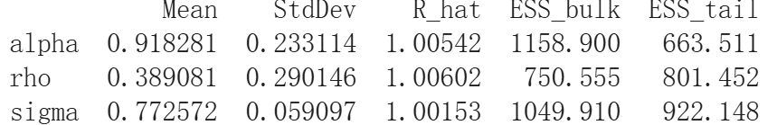
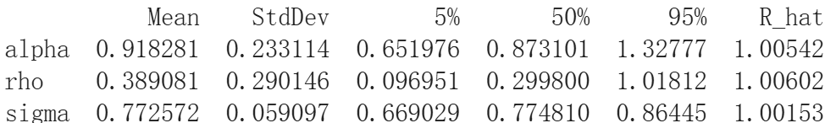
Diagnostics
Summary Statistics (alpha, rho, sigma)
Quantile & Convergence Metrics
Gaussian Processes

Slide 17
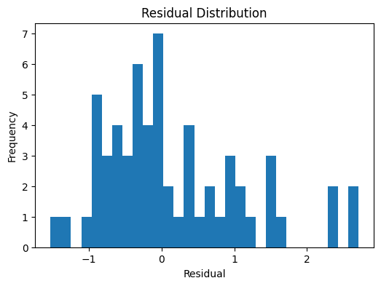
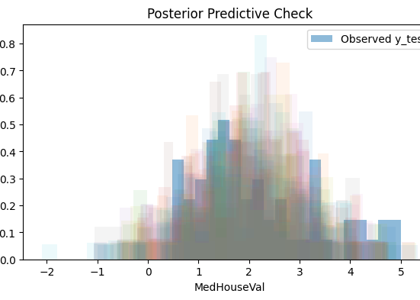
Diagnostics
Residual Distribution
Posterior Predictive Check
Gaussian Processes
Notes:
The residuals are generally centered around zero, indicating that the model is approximately unbiased on average. However, the distribution exhibits a noticeable right tail, suggesting that the model tends to underestimate higher housing prices.
This pattern is consistent with the observed vs. predicted plot, where extreme values are shrunk toward the mean. This behavior reflects the limitations of the model, which relies only on spatial features and cannot fully capture all sources of variability in housing prices.
—-------------------------------
The predictive distributions broadly align with the observed data in the central region, indicating that the model captures the overall structure of the housing price distribution.
However, discrepancies are evident in the tails, particularly for higher values. The model tends to underestimate extreme housing prices, producing smoother distributions with less mass in the upper range.
This suggests that while the Gaussian Process captures large-scale spatial trends, it lacks the flexibility to model sharp variations and extreme values. This limitation is expected given that only spatial features (latitude and longitude) are used in the model.

Slide 18
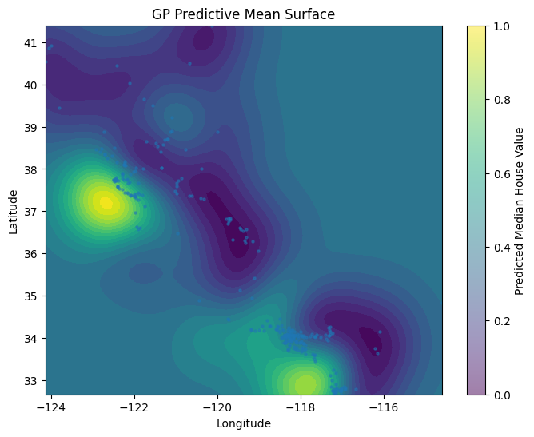
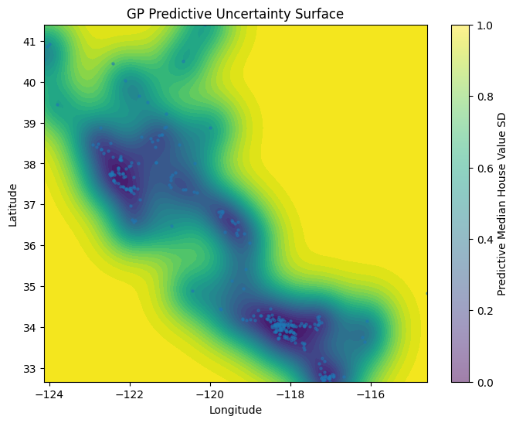
Reconstructed GP: Posterior Heatmap
Mean Predictive Surface
Predictive Uncertainty Surface
Gaussian Processes
Notes:
The GP predictive mean surface reveals a smooth, non-linear spatial structure in housing prices across California. High-value regions are concentrated around major urban areas, such as the Bay Area and Southern California, indicating strong spatial dependence.
The smooth transitions between regions reflect the properties of the RBF kernel, which enforces local continuity in the latent function.
—------------------------
The predictive uncertainty surface shows that uncertainty is lowest in regions with dense observations and increases in areas with sparse or no data. This reflects the Bayesian nature of the Gaussian Process, which naturally quantifies uncertainty based on data availability.
In particular, boundary regions and areas far from observed locations exhibit significantly higher uncertainty, indicating that predictions in these regions should be interpreted with caution.

Slide 19
Areas for Improving the Model
Oversmoothing from the RBF kernel
The squared-exponential (RBF) kernel assumes a very smooth latent function modulated only by ρ, washing out sharp local changes and underestimating extreme prices.
k(x, x′) = α² exp( − ‖x − x′‖² / 2ρ² )
Composite spatial + demographic kernels
Split x = (s, z) with s = (Lat, Lon) and combine two kernels — capturing smooth coordinates alongside nonlinear demographic features.
k(x, x′) = k_{spatial} (s, s′) + k_{demographic} (z, z′)
A richer kernel with more features
Augment the input with all predictors (Lat, Lon, MedInc, HouseAge, AveRooms, AveBedrms, Pop, AveOccup) and use an Auto-Relevance Detector (ARD) kernel with dimension-specific length scales ρⱼ.
k(x, x′) = α² exp( −½ Σⱼ (xⱼ − x′ⱼ)² / ρⱼ² )
Inclusion of linear structure
Combine a linear mean with GP so large-scale linear effects (e.g., median income) are modeled directly, while the GP captures nonlinear structure.
yᵢ = β₀ + xᵢᵀβ + f(xᵢ) + εᵢ

Slide 20
Augmenting the Model with Income
k(x, x′) = k_{spatial}(s, s′) + k_{income}(z, z′)
An additive income kernel helps eliminate omitted variable bias
Geography-only model
With income variable added
Location
Location
Housing Price
Housing Price
Income
Income
Income affects housing prices and varies geographically. By only modeling Location → Housing Price, we force our spatial kernel to implicitly capture the location-income covariance as well.
By introducing the income variable, the spatial kernel no longer attempts to explain the indirect effect of
Location → Income → Housing Price.

Slide 21
Inside the Augmented Model
Spatial kernel
k_{spatial}(s, s′) = α_{loc}² exp(− ‖s − s′‖² / 2ρ_{loc}²)
α_{loc} controls the size of the spatial variation
ρ_{loc} is the spatial lengthscale
Nearby locations are more strongly correlated
Income kernel
k_{income}(z, z′) = α_{inc}² zz′
A linear kernel — the income effect is linear, but its slope is uncertain and learned from the data.
α_{inc} controls the strength of the income signal
Full covariance structure
K = K_{loc} + K_{inc} + σ² I
y_{train} ∼ N(0, K)
Price variation = smooth spatial effect + linear income effect + residual noise.
Equivalent latent-function decomposition
f(s, z) = f_{loc}(s) + f_{inc}(z)
f_{loc} ∼ 𝒢𝒫(0, k_{spatial}), f_{inc} ∼ 𝒢𝒫(0, k_{income})
The total GP is additive — one component for space, one for income.

Slide 22
Relationship with the Mean Function
From Bayesian linear effect to linear kernel
Suppose we had instead modeled the income contribution as a mean function with normal β hyperprior:
m(z) = β z, β ∼ N(0, α_{inc}²)
For two incomes z and z′, what is the induced covariance?
Cov(βz, βz′) = zz′𝔼[β²] = zz′ Var(β )= α_{inc}² zz′
The equivalence, in plain terms
If the data are centered, a linear mean function with a Gaussian prior on the coefficient is mathematically equivalent — after marginalizing over the coefficient — to a zero-mean GP with a linear kernel.
So the linear income kernel is the GP representation of Bayesian linear regression on income.
Why this matters
Splitting the kernel additively lets us separate two kinds of structure:
Nonlinear smooth spatial dependence (RBF on location)
Linear dependence on income (Bayesian linear effect)
This reduces the risk that the spatial kernel incorrectly absorbs income-driven covariance

Slide 23
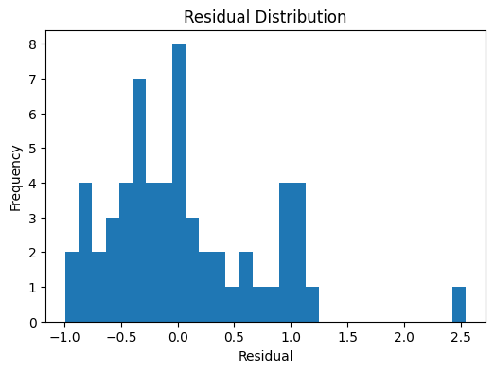
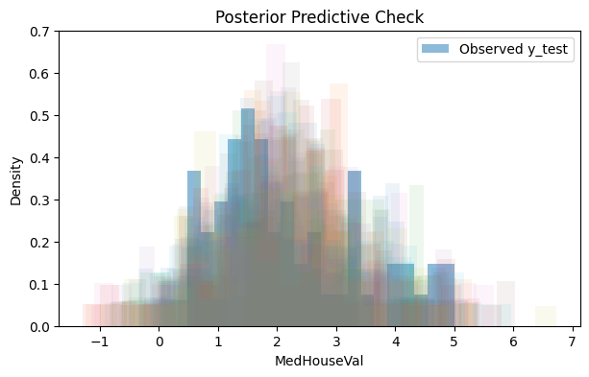
Diagnostics — Augmented Model
Residual Distribution
Posterior Predictive Check

Slide 24
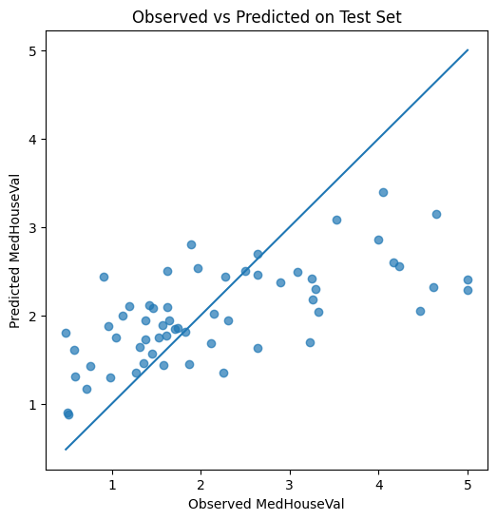
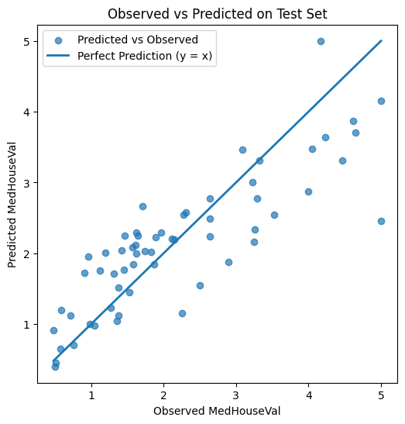
Out-of-Sample Performance
Spatial-only model
Spatial + Income model
Predictions vs. actuals on held-out test set
Predictions vs. actuals on held-out test set

Slide 25
Thank You
Questions?

