Slide 1
EclipseLink JPA:
Queries and Object Building
Advanced
Gordon Yorke

Slide 2
Topics
Execution
  EclipseLink query execution
    Query To SQL translation
Cursored Streams
Query Redirection
Custom Calls
  StoredProcedure calls
InmemoryQuerying / Conforming
  Conforming limitations
  InMemoryQueryIndirectionPolicy
Query Options
  CacheUsage

Slide 3
Insert basic query slide from basic queries

Slide 4
EclipseLink Query Execution
EclipseLink
JDBC
Queries
Not Cache Queryable
Cache
DatabaseMechanism
Cache Hit
ObjectBuilder
Result

Slide 5
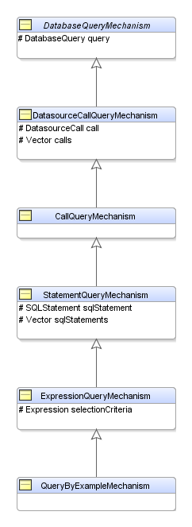
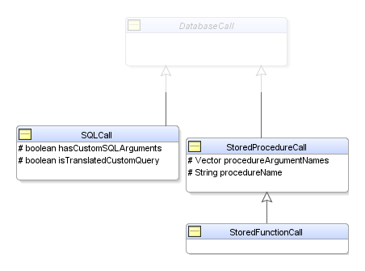
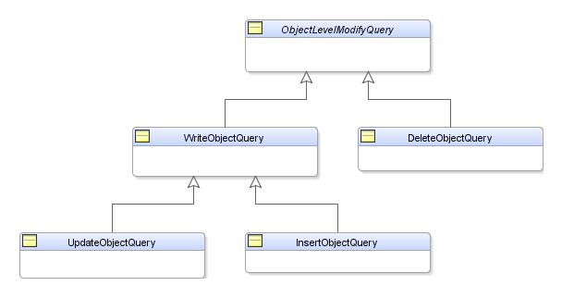
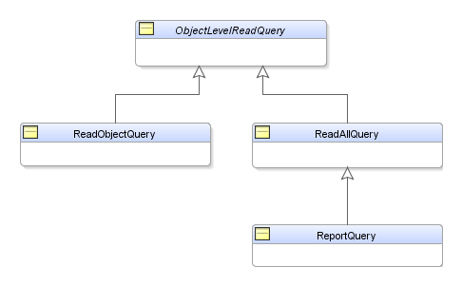
Query Translation

Slide 6
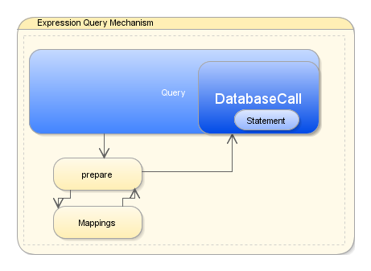
Translation steps

Slide 7
Cursored Streams / Scrollable Cursors
ReadAllQuery.useCursoredStream()/ReadAllQuery.useScrollableCursors()
Usefull for large result sets
Alternate to setFirstResults()/setMaxResult()
Holds connections for life of Cursor
Results can be ‘conformed’

Slide 8
Custom Calls

Slide 9
Redirectors
Allow total interception of executing query
org.eclipse.persistence.queries.QueryRedirector
Provided implementations
  MethodBasedQueryRedirector
Implementor can
  redirect query to other datasource
  Augment results
  Augment query

Slide 10
In memory Querying
In memory Querying
  Queries can be resolved against the cache only
  Large number of expressions supported
  InMemoryQueryIndirectionPolicy
    Configurable behaviour for lazy relationship join
      Trigger Indirection
      Throw Exception <default>
      Return conformed
      Return unconformed

Slide 11
Conforming
Conforming used with UnitOfWork
Query results are compared to UnitOfWork/Persistence Context
Alleviates requirement to flush UnitOfWork/Persistence Context
Uses in memory querying functionality
Powerful when carefully crafted
Incompatible query features
  Ordering
  setFirstResult/setMaxRows
  Multiple Entity selections
    (SELECT e, a FROM Employee e, Address a …)
  Pessimistic Locking
  Untriggered relationships
    Default InMemoryIndirectionPolicy is : ‘Return Conformed’

Slide 12
Cache Usage
Used on ObjectLevelReadQueries (ie. ReadObjectQuery)
Modes:
  DoNotCheckCache
  CheckCacheByExactPrimaryKey
    If query contains only PK check cache.
  CheckCacheByPrimaryKey
    If query contains at least PK check cache
  CheckCacheThenDatabase
    In memory query and if not found check database
  CheckCacheOnly
    In Memory Querying, no database
  ConformResultsInUnitOfWork
    Conforming against transactional cache.

Slide 13
Query Settings Misc
dontMaintainCache()
  Similar to JPA 2.0 Cache Retrieve/Store Mode Bypass
  Cache will not be checked and will not be updated with results or modifications.
‘Cascade’ settings
  {CascadePrivateParts, NoCascading …}
  Used mostly for refreshing
    Controls depth of refresh
  some native modification queries (DeleteObjectQuery).
Query Timeout
Container Policies
  Can control collection type of results

Slide 14
Settings cont..
ReadOnly
  Returns results from Shared Cache through Persistence Context without clonning
  Performance.
Use exclusive connection
  When Isolated Client session is configured to have Exclusive connection a query can be forced to use that connection

