Slide 1
Welcome to EclipseLink Summit 2010
Doug Clarke
Project co-lead

Slide 2
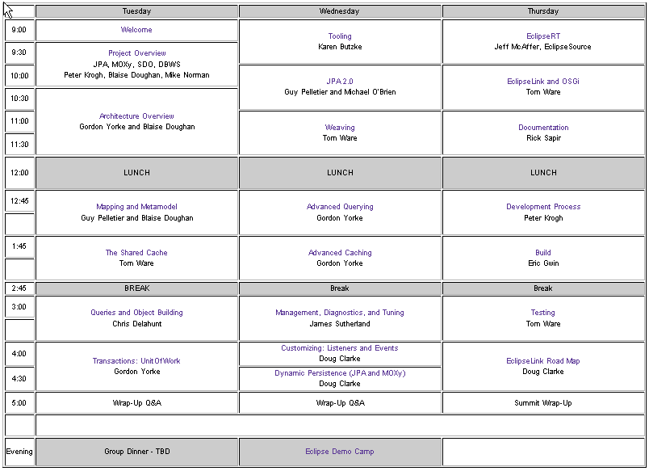
The Schedule: http://wiki.eclipse.org/EclipseLink/Development/Summit

Slide 3
Logistics
The Facilities and Security
Meals, Snacks, Drinks
Internet Access
  Daily user-name and password will be provided

Slide 4
Goals and Format
Each Session has leads
  Presentation: 20-40 minutes
  Discussion: Until 55 minute mark
  Collect Open issues and action Items
    May address later in Summit or defer to weekly meetings
Getting the most out of the Summit
  Pay attention
  Make notes during presentation
  Participate in discussion
  Follow-up if more details are needed
Feedback is greatly appreciated

Slide 5


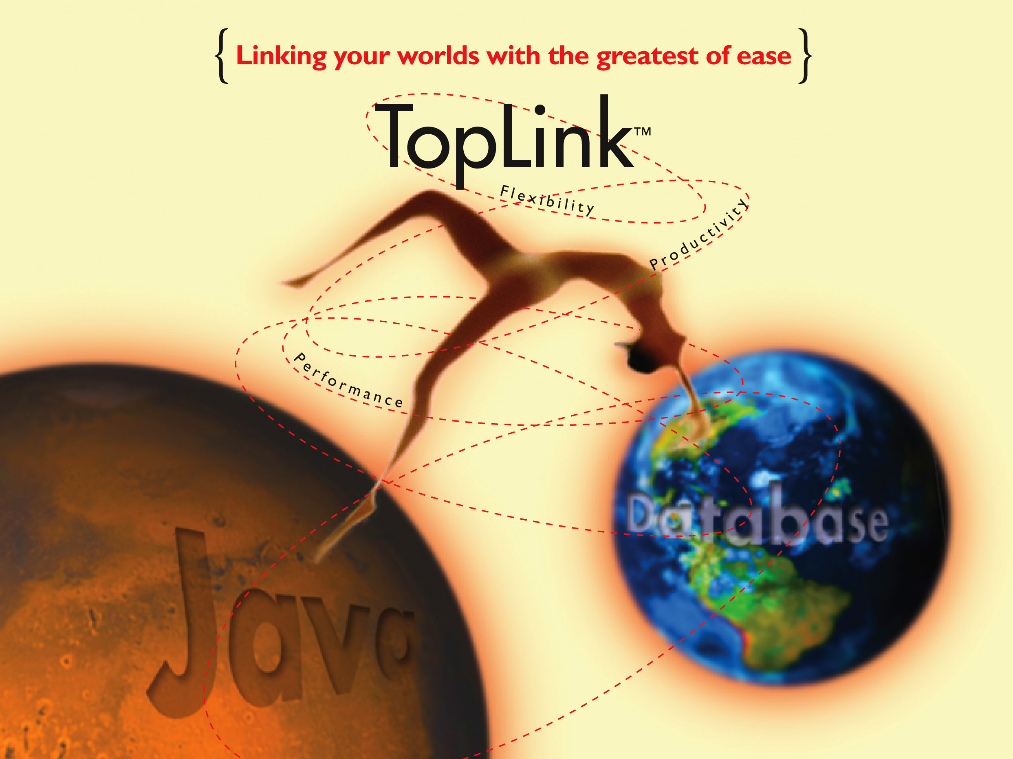
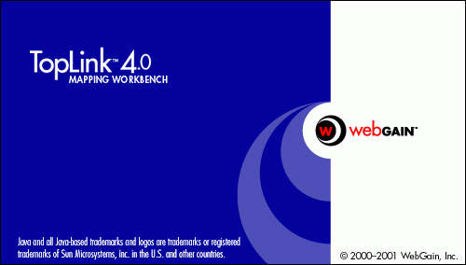
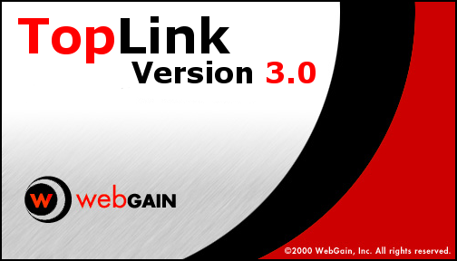
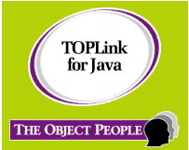
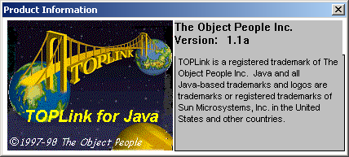
History of EclipseLink
1996
2010

Slide 6
The Oracle People
Project Leadership
  Doug Clarke – Director of Product Management
  Peter Krogh – Development Manager
Technical Leaders
  James Sutherland – Performance
  Gordon Yorke – Foundation, JPA
  Tom Ware – Foundation, OSGi, Build
  Blaise Doughan – MOXy, SDO
  Mike Norman – DBWS
  Mike Keith – JPA Specification and general guidance
  Shaun Smith – Ecosystem Development
Oracle Managers
  Peter Krogh – Foundation, JPA
  David Twelves – MOXy, SDO, DBWS, Build
  Huyen Nguyen – QA

Slide 7
More People
EclipseLink Committers
  Oracle
  SAP
Build Engineer: Eric Gwin
Documentation: Rick Sapir
Eclipse Dali: Karen Butzke
Oracle QA
Oracle Sustaining Engineering
EclipseSource: Jeff McAffer

Slide 8
Eclipse RT
EclipseLink part of the RT top-level project
Represented by Doug Clarke on the PMC
PMC Responsible for guiding its projects
  Review approval: release, graduation
  Committer elections approval
  CQ approvals
  Tutorials and demos at conferences showing RT technologies working together
  Define distributions of RT for annual releases
Resources
  https://dev.eclipse.org/mailman/listinfo/rt-pmc
  http://wiki.eclipse.org/RT

Slide 9
Project Resources
Bug Database (bugzilla)
  https://bugs.eclipse.org/bugs/
  Tracks all bugs and enhancement requests
  All transactions should be associated with a bug
  Classification: RT
  Product: EclipseLink
  Bug queries
    http://wiki.eclipse.org/EclipseLink/Bugs
    http://wiki.eclipse.org/EclipseLink/Development/Bugs
IP Log: Tracks all contributions and 3rd party dependencies
  http://wiki.eclipse.org/EclipseLink/IPLog

Slide 10
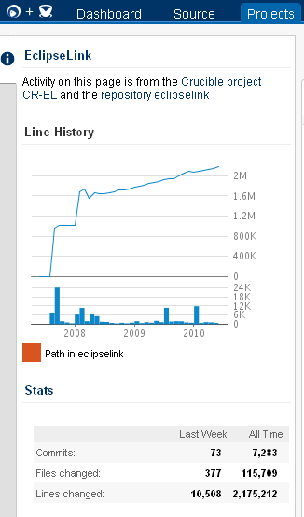
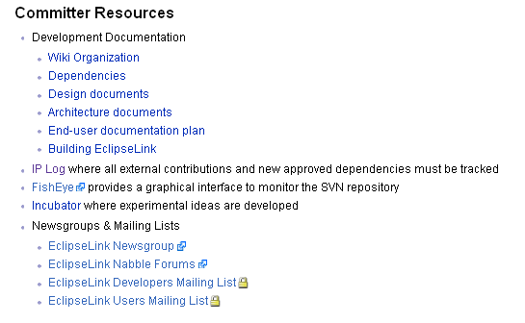
EclispeLink FishEye

Slide 11





EclipseLink: Distributions
Eclipse.org
  www.eclipse.org/eclipselink/downloads
  http://download.eclipse.org/rt/eclipselink/updates
  Maven
Oracle
  TopLink 11g
  WebLogic Server 10.3
GlassFish v3
  Replaces TopLink Essentials
  JPA 2.0 Reference Implementation
Spring Source
  Spring Framework
  Spring OSGi Bundle Repository
TMaxSoft JEUS
JOnAS Application Server 5.1

Slide 12





EclipseLink Developer Tool Support
EclipseLink is a Runtime Project but supported by IDEs
Eclipse IDE
  EclipseLink support included by Web Tools Platform's Dali Project
  EclipseLink included in Eclipse 3.5 (Galileo) – Java EE
    Enhanced Dali support for use of EclipseLink features
  Oracle Enterprise Pack for Eclipse (OEPE)
  MyEclipse
JDeveloper 11g
  JPA, Native ORM, OXM, and EIS mapping
NetBeans
Standalone Workbench
  Native ORM, OXM, EIS

Slide 13
Release History
Initial Source Contribution: August 27th, 2007
EclipseLink 1.0 – July 9th, 2008
  1.0.1 – September 9th, 2008
  1.0.2 – October 29th, 2008
EclipseLink 1.1 – March 12th, 2009
  1.1.1- May 15th, 2009
  1.1.2 – Galileo – June 24th, 2009
  1.1.3 – Planned for October 30th, 2009
EclipseLink 1.2: September 30th, 2009
EclipseLink 2.0: November 24th, 2009
  Governed by JavaEE 6 and JPA 2.0 specification
  Patch Sets: 2.0.1, 2.0.2, …
EclipseLink 2.1 Helios: June 23, 2010

Slide 14
Summit Challenge
Exchange of Technical information
Get to know other members of the community
Reflect on where we have been and where we want to go
Challenge things you don’t understand

