Slide 1

Architectural Overview
Gordon Yorke

Slide 2
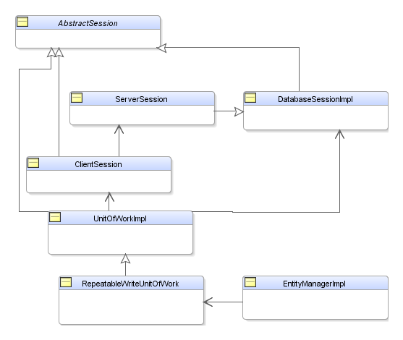
Session Structure

Slide 3
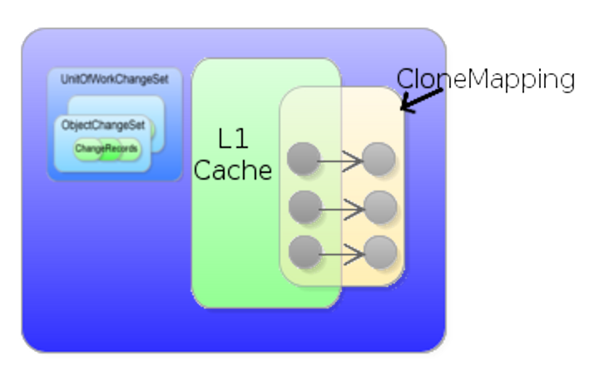
UnitOfWork Structure

Slide 4
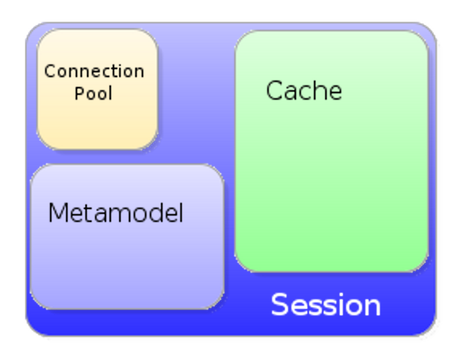
Session Structure

Slide 5
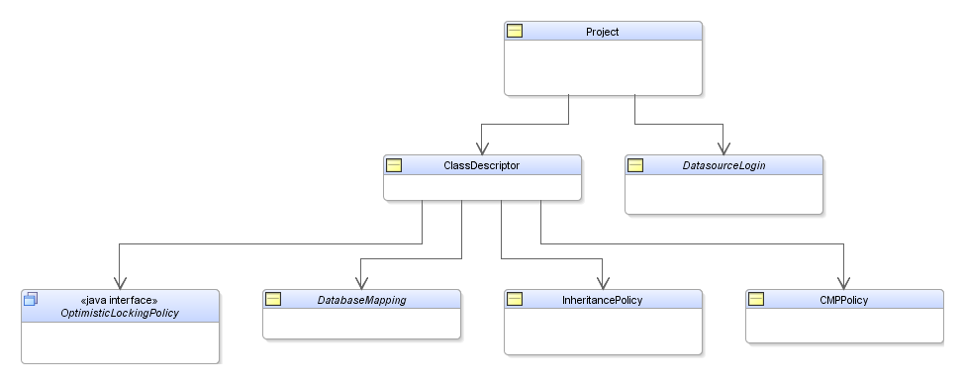
Metamodel

Slide 6
Login
Database connection properties
Database platform
JDBC Connectors
JNDI Connectors
Custom Connectors
Returns JDBC Connections encapsulated within Accessor

Slide 7
Database Mappings

